Slide 1
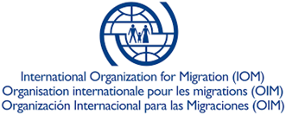
Sindh Drought Needs Assessment
Presentation on Findings of Assessment (Draft)
January 18, 2019
Islamabad

Slide 2
Objectives and Methodology of Assessment
Objectives
The assessment was conducted by Natural Disasters Consortium (NDC) with the following specific objectives:
To assess the impact of the drought on agriculture (crop cultivation, production, water availability and livestock), livelihoods and food security, access to water and sanitation and hygiene practices of the households and communities.
To provide recommendations to the Government of Sindh, NDC partners, and other decision/policy makers to prioritize actions (short, medium and long term) in relevant sectors and geographic areas to address immediate needs, build back better and increase future resilience to drought.
Methodology
Assessment was conducted in 69 sampled drought notified revenue villages (Dehs) of the eight districts, namely, Tharparkar, Umerkot, Sanghar, Thatta, Badin, Jamshoro, Dadu and Kambar Shahdadkot.
Assessment was carried out in October 2018, and used a multi-sector household level questionnaire and Focus Group Discussion (FGD) tools.
Total 1,229 households were interviewed in 69 Dehs of 53 Union Councils, located in 24 sub-districts (Talukas/Tehsils) of the 8 districts.
Of 1,229 surveyed households, 92% were interviewed in desert/arid areas, and 12% were headed by women.

Slide 3
Agriculture (Crops and Livestock Sectors)

Slide 4
Land Ownership, Crop Cultivation and Production
On average, the surveyed households own 3.1 acres of land whereas cultivate 2.8 acres only.
Water availability is reported very low by the surveyed households. 98% in Umerkot, 93% in Tharparkar and 82% in Sanghar reported water either not available or very less available compared to 2017.
Compared to 2016-17 seasons, cultivation area (measured in acres) for wheat reduced by 17% in 2017-18, rice by 70%, cotton by 16%, cluster beans by 30%, millet by 38% and pulses by 45%.
Compared with the 2016-17 agricultural season, overall crop production (measured in maunds) for wheat reduced by 23%, sorghum by 33%, rice by 35%, cotton by 18%, cluster beans, millet and sesame each by 83% and pulses by 95%.
Own production of cereals for household consumption was only sufficient for about 2.8 months (lowest 2.3 months in Tharparkar).
Notes:
The three major problems faced by farming households as they reported are:
lack of water for crop cultivation (94%), lack of access to high yielding variety seeds (69%) and lack of access to fertilizer (48%).
The farming households reported the need for:
irrigation water (66%), quality seeds (77%), fertilizer (38%), repair/rehabilitation of water sources for agriculture, new irrigation system (39%), agricultural services (19%), agricultural tools (10%) and agricultural credit (20%) to enhance crop production.

Slide 5
Livestock/Poultry Ownership
Notes:
6.5 million livestock population in Tharparkar only.
32% of the surveyed households currently own cattle, 12% own buffaloes, 69% own goats, 12% own sheep, 9% own camels, 21% own donkeys and 11% of surveyed households own poultry.

Slide 6
Livestock/Poultry Deaths and Sale
Notes:
Of the surveyed households who own livestock, 25% reported deaths of cattle during the past six months, 54% reported deaths of goats, deaths of sheep by 45%, deaths of buffaloes by 21%, deaths of camels by 20%, donkeys by 18%, whereas 57% reported deaths of poultry.
Overall, 40% of the surveyed households that keep livestock sold one or more cattle during the past six months, 31% sold one or more buffaloes, 65% sold goats, 55% sold sheep, 13% sold camels, and 7% sold donkeys and 29% sold poultry.
The main reasons for deaths of livestock reported by surveyed households are lack of fodder, livestock diseases and lack of water.
The main problems reported by livestock holders are lack of fodder for animals reported by 96% of surveyed livestock holders, 89% reported lack of drinking water, 83% reported livestock diseases and 53% reported lack of shelter for animals.
The top four items/supports required by livestock owners (in order of importance) are: straw/green fodder (reported by 93% livestock holders), drinking water (by 83%), vaccines/medicines (by 67%) and concentrated feed (by 35%).

Slide 7
Livelihood/Income Sources, Food Consumption and Food Security

Slide 8
Household Main Sources of Livelihood Currently
11% reduction in average monthly income compared to six months ago

Slide 9
Food Consumption, Coping Strategies and Access to Markets
67% households spend more than 65% (‘high’ and ‘very high’) of total HHs expenditure on acquiring food
41% households each have ‘poor’ and ‘borderline’ whereas 18% have ‘acceptable’ food consumption
83% households used at least one livelihood-based coping strategy to meet their food needs during past 30 days
55% of the households travel for more than 10 km to access markets to buy food and non-food items

Slide 10
Food Insecurity based on Food Insecurity Experience Scale (FIES)
FIES is used to compute SDG 2-Zero Hunger indicator 2.1.2: Prevalence of Moderate and Severe Food Insecurity among Population.
Overall, 71% of surveyed households are moderately or severely food insecure, whereas 32% are severely food insecure.

Slide 11
Migration, Health and Nutrition and Access to Water and Sanitation

Slide 12
Migration

Slide 13
Health and Nutrition
Main Problems faced by households in accessing health facilities/providers are:
Long distance to health facility/providers
High cost of health services
Limited availability of transport
Limited availability of health staff, medicines and medical equipment at health facilities

Slide 14
Access to Water and Sanitation
Overall, only 72% of the surveyed households currently have access to improved water sources, while 28% forced to rely on unimproved sources of drinking water.
64 % of those surveyed in Thatta, 44% in Tharparkar and 42% in Sanghar relying on unimproved sources of water.
Overall 38 % of surveyed households indicated that the drinking water available is insufficient for their household needs, with 61%, 58% and 43% of households from Tharparkar, Sanghar and Thatta respectively reporting as such.
One Way Time Taken to Travel to Water Source
Households Reporting Water Treatment Measures at Household Level
Surveyed population overwhelmingly (82%) has no access to a household toilet and therefore practice open defecation; 96% in Thatta, 94% in Kambar Shahdadkot, 88% in Dadu, 86% in Badin , 81% in Umerkot and 75% in Tharparkar

Slide 15
Balochistan Drought Assessment
With same objectives as in Sindh, NDC is also conducting assessment in 14 districts of Balochistan, namely, Pishin, Killa Abdullah, Loralai, Kachhi (Bolan), Dera Bugti, Jhal Magsi, Nushki, Chagai, Kharan, Washuk, Awaran, Panjgur, Kech (Turbat) and Gwadar districts.
First phase of assessment in 10 districts has already completed, whereas it will be completed in 4 districts (Nushki, Kharan, Awaran and Jhal Magsi ) by January 20.
Around 5,150 households were interviewed in 14 districts.
Preliminary findings of the Balochistan Assessment will be ready in first week of February.

Slide 16
Preliminary Observations from Baluchistan Drought Assessment
Agriculture | Livestock | Water availability for agriculture | Major Livelihood Sources | Food security | Health | Nutrition | Access to drinking water | Migration
No/very little crop production in most of the districts mainly due to lack of rain / irrigation water, dry land, low seed quality, lack of fertilizer. Crops badly affected due to lack of rain/irrigation water | Reports of livestock deaths and distress sale due to drought, water and fodder unavailability and livestock diseases Goats, sheep, camels are the main livestock, Main disease is Limpushk (which happens due to dust) | Water shortage is extreme Water table has gone down and water is not accessible mostly No rain since 2016 | Major livelihood sources are sale of livestock, sale of orchards, and non-agriculture labor (daily wage laborers). Other common sources include traders and wood cutting & sale | Food security situation in general is very poor Difficult to obtain adequate amounts of food Slaughtering of own animals for household consumption in some areas | Health facilities are very far away Health facilities lack facilities and services Hepatitis, skin diseases, flu, and TB are common Weakness among children and PLW | High malnutrition among under 5 children | In general it is difficult to access water throughout the districts Water sources are very far away Turn system for families who access water from Karez and tube wells due to limited availability of water | Migration occurred throughout the province including seasonal and due to drought. People who can afford have moved to major cities such as Quetta or Loralai

Slide 17
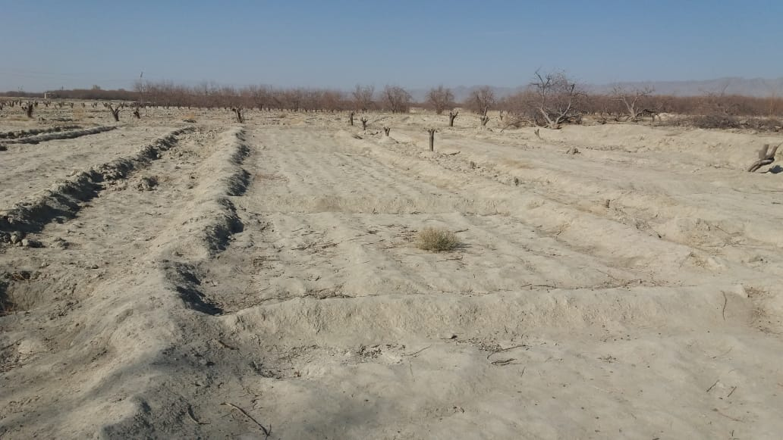
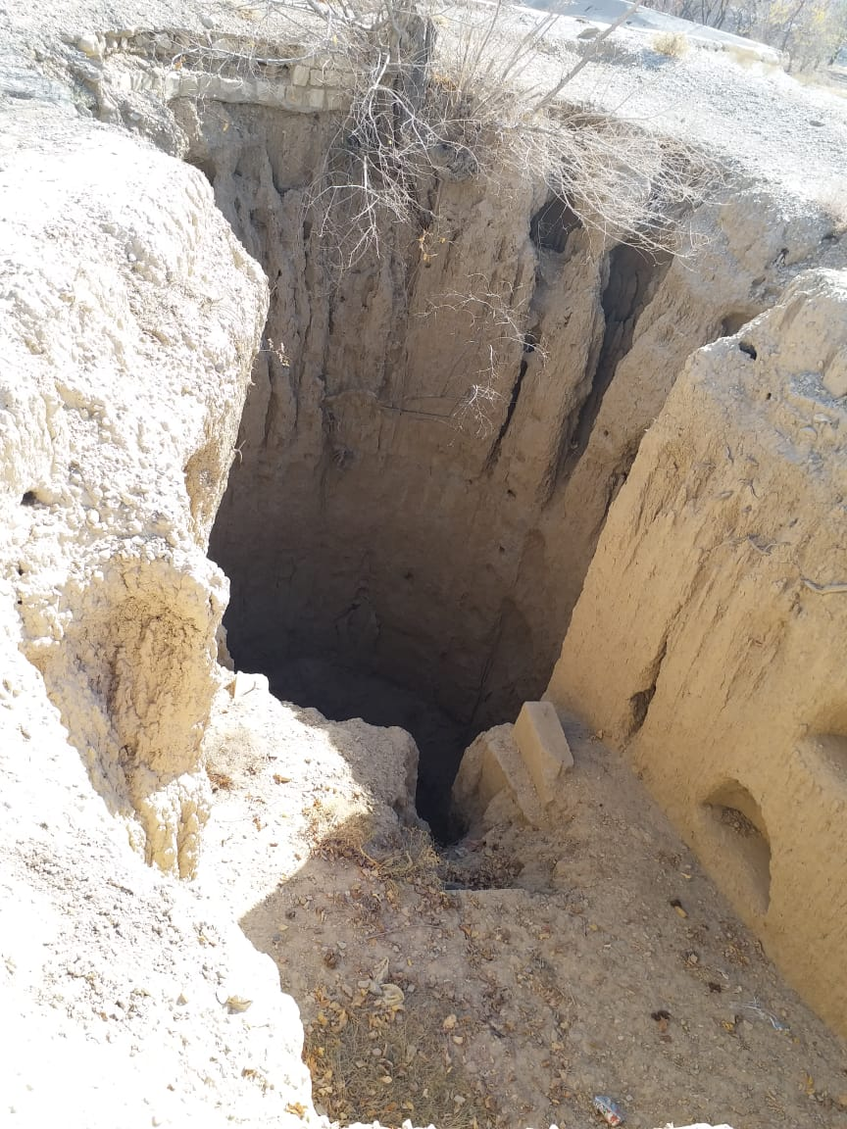
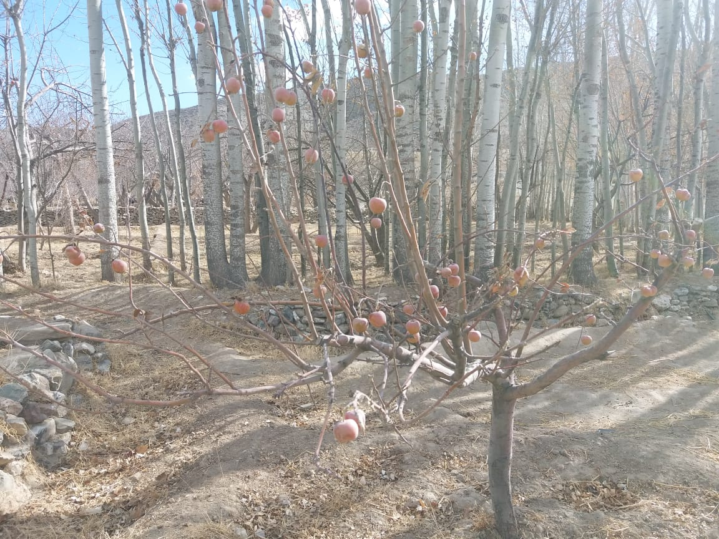
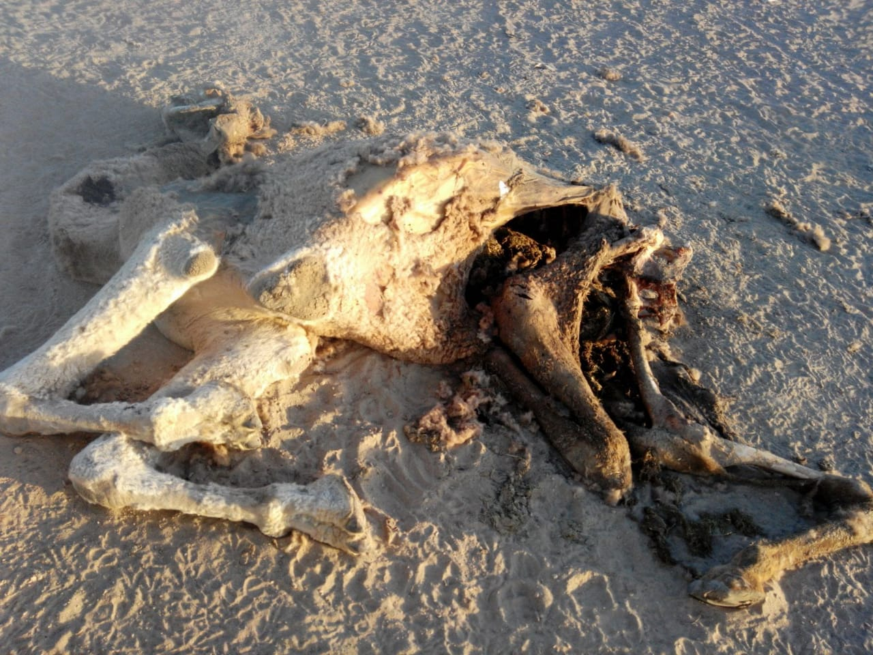
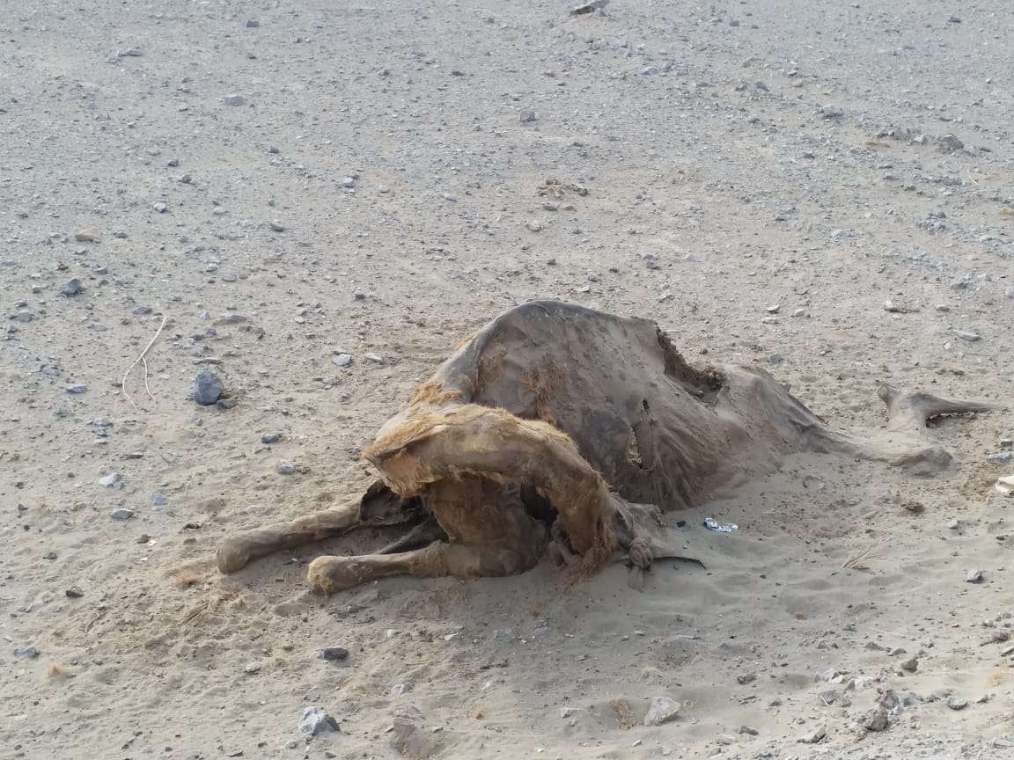
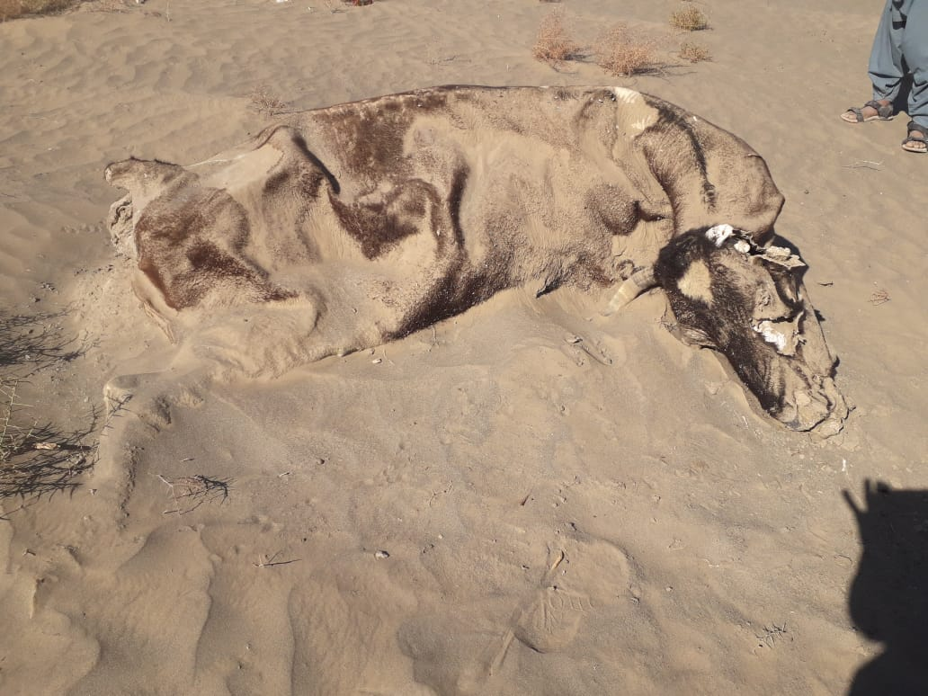
Balochistan Drought Assessment-Pictures from the Field

Slide 18
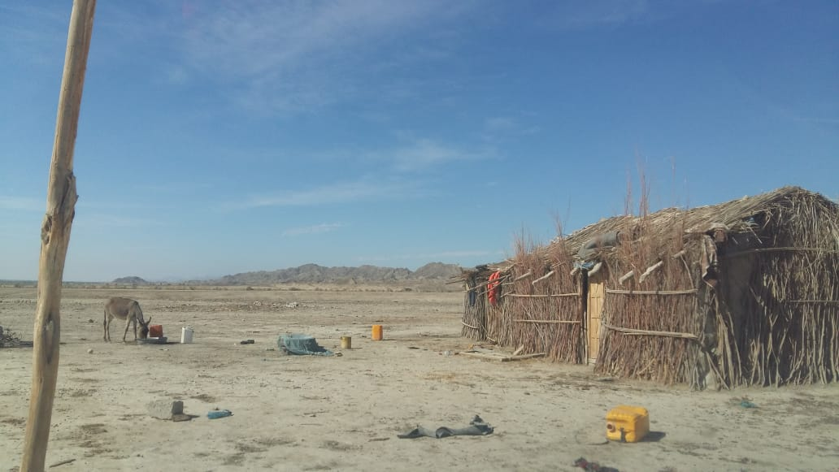
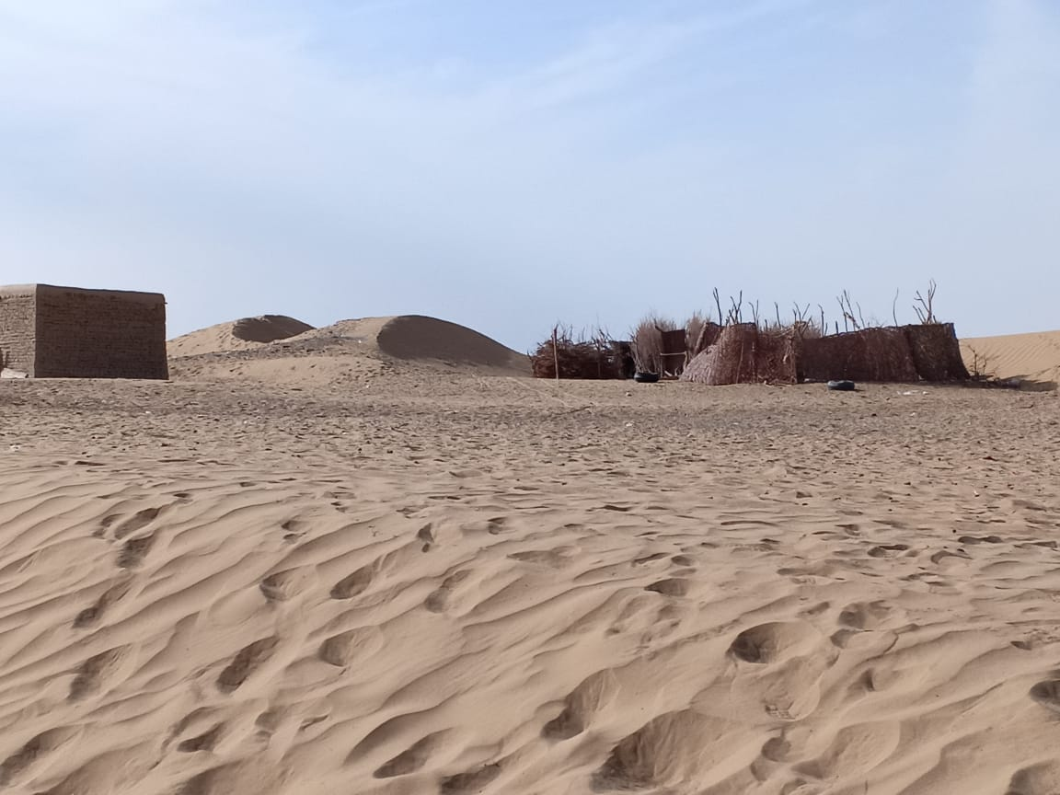
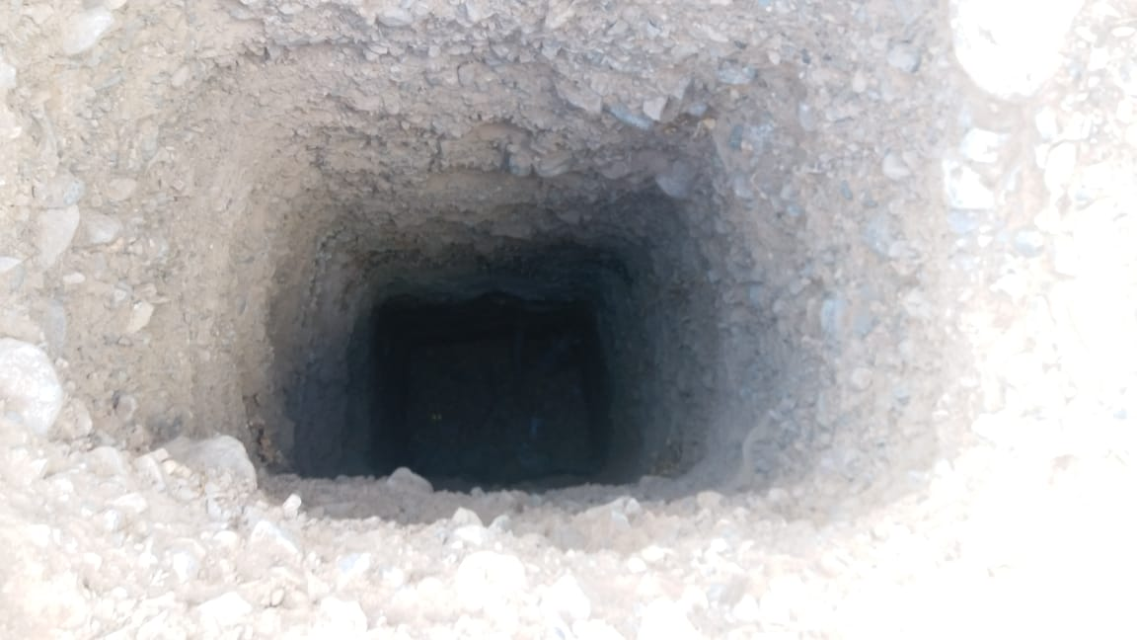
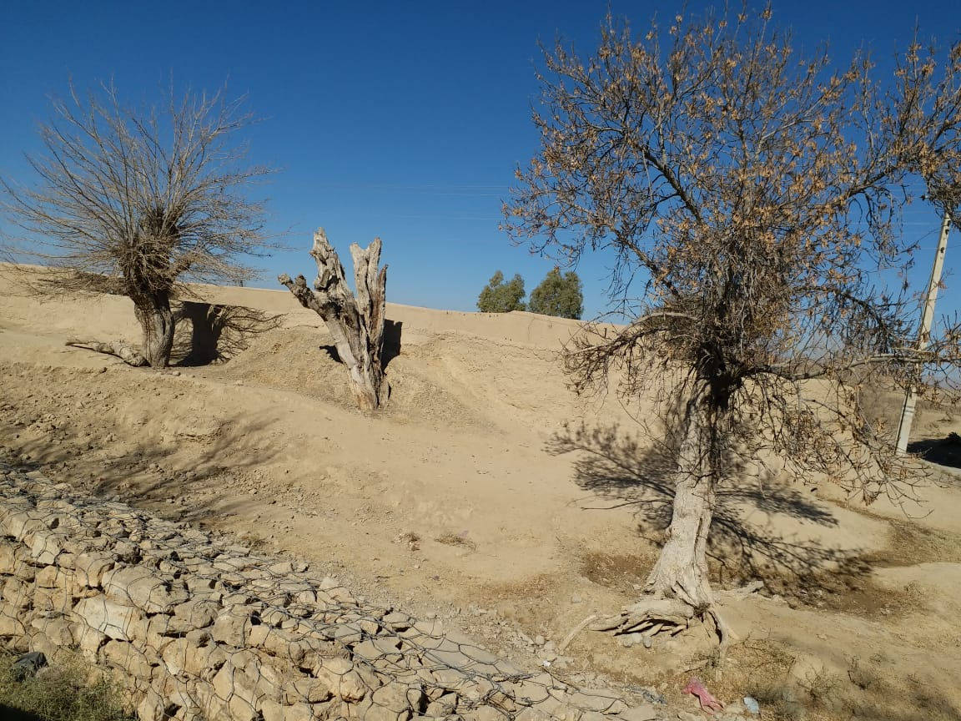
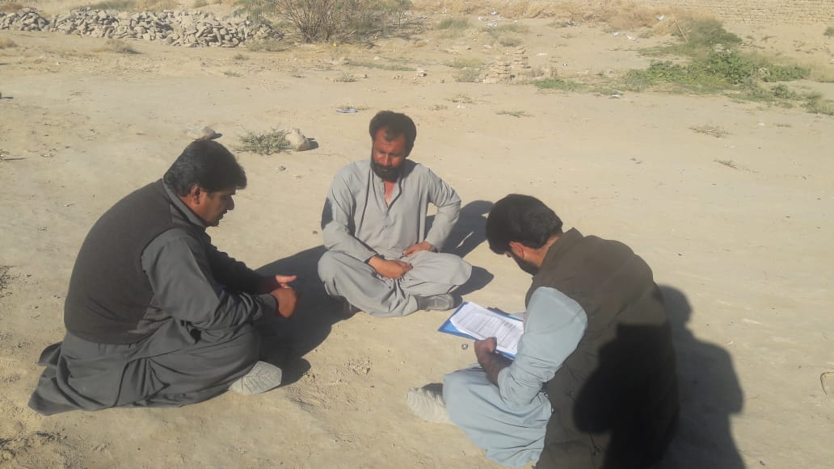
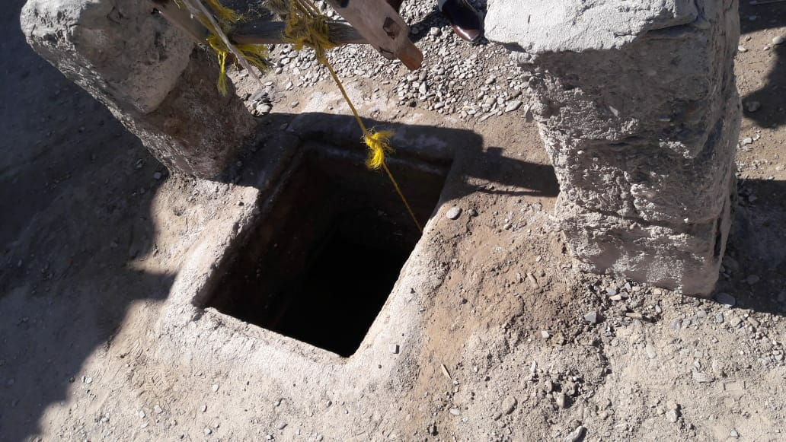
Balochistan Drought Assessment-Pictures from the Field

Slide 19
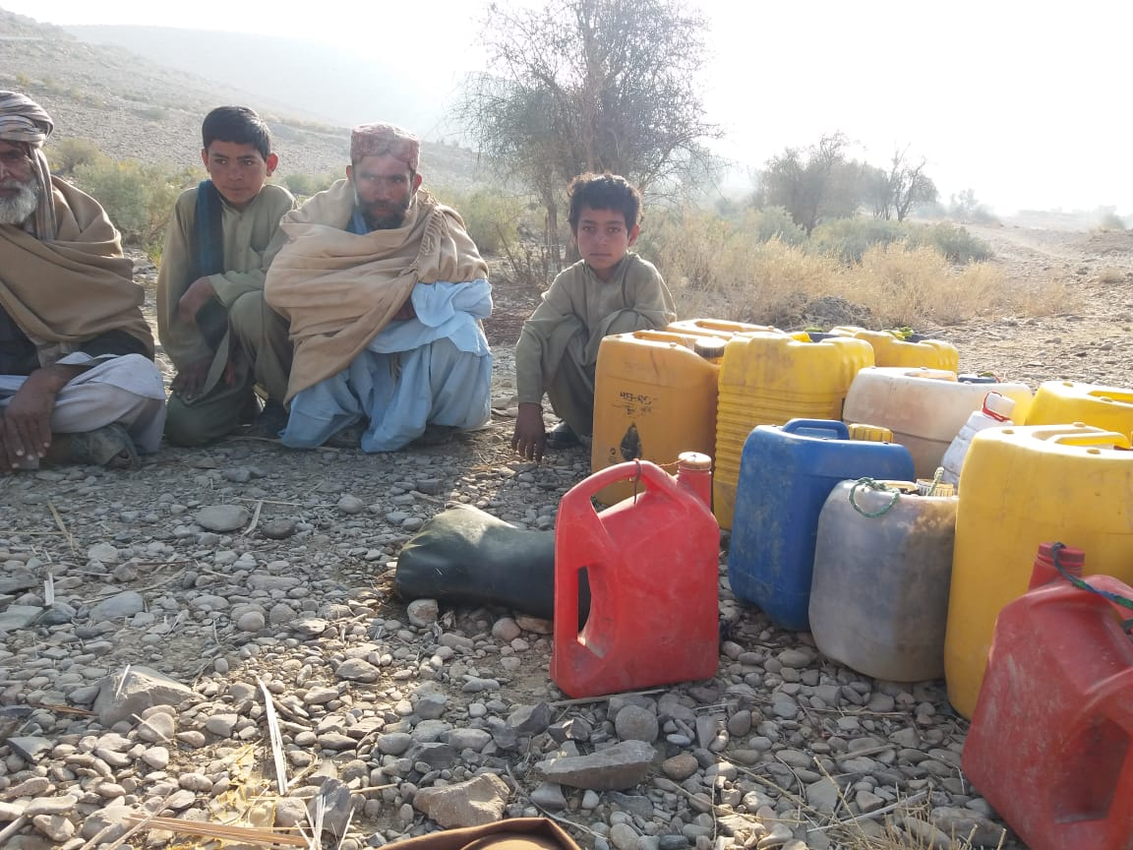
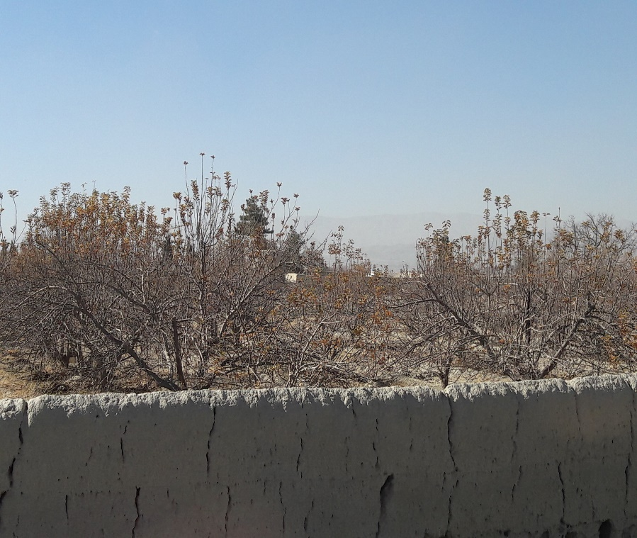
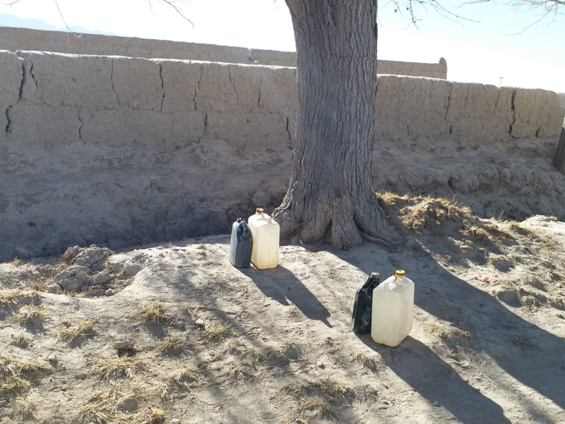
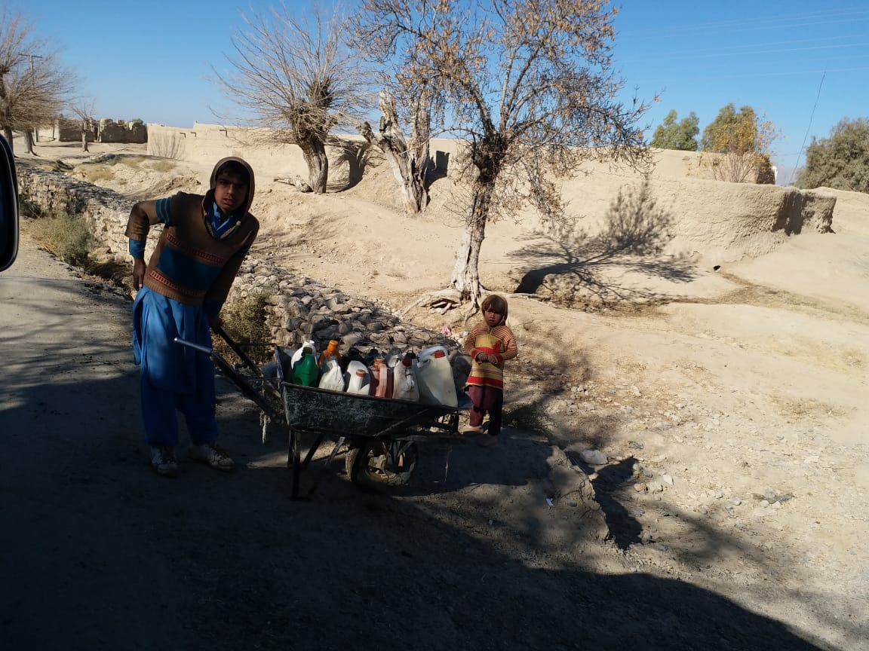
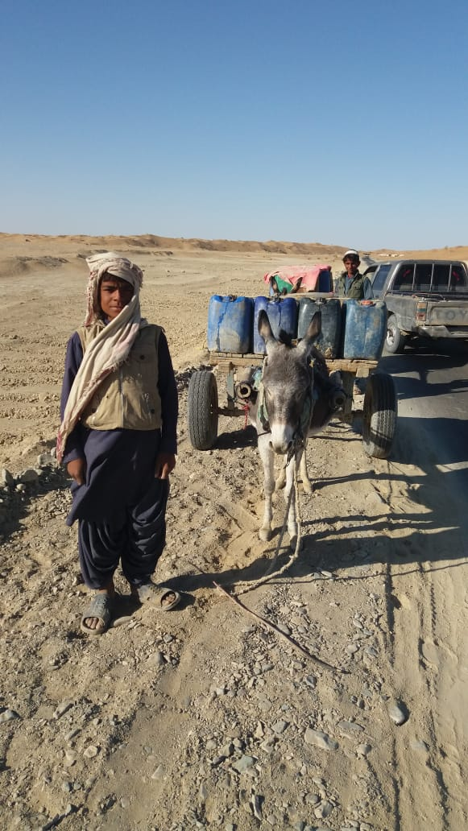
Balochistan Drought Assessment-Pictures from the Field

