Slide 2
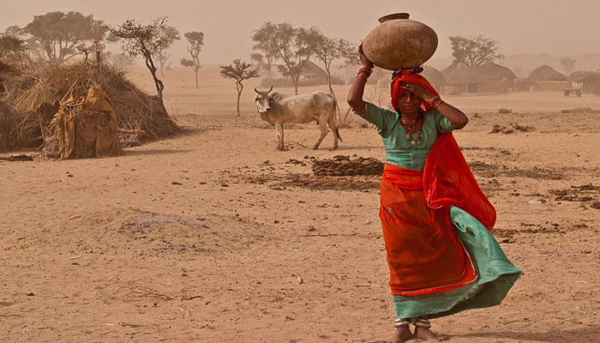
The Drought Situation in Sindh & Balochistan

Slide 3
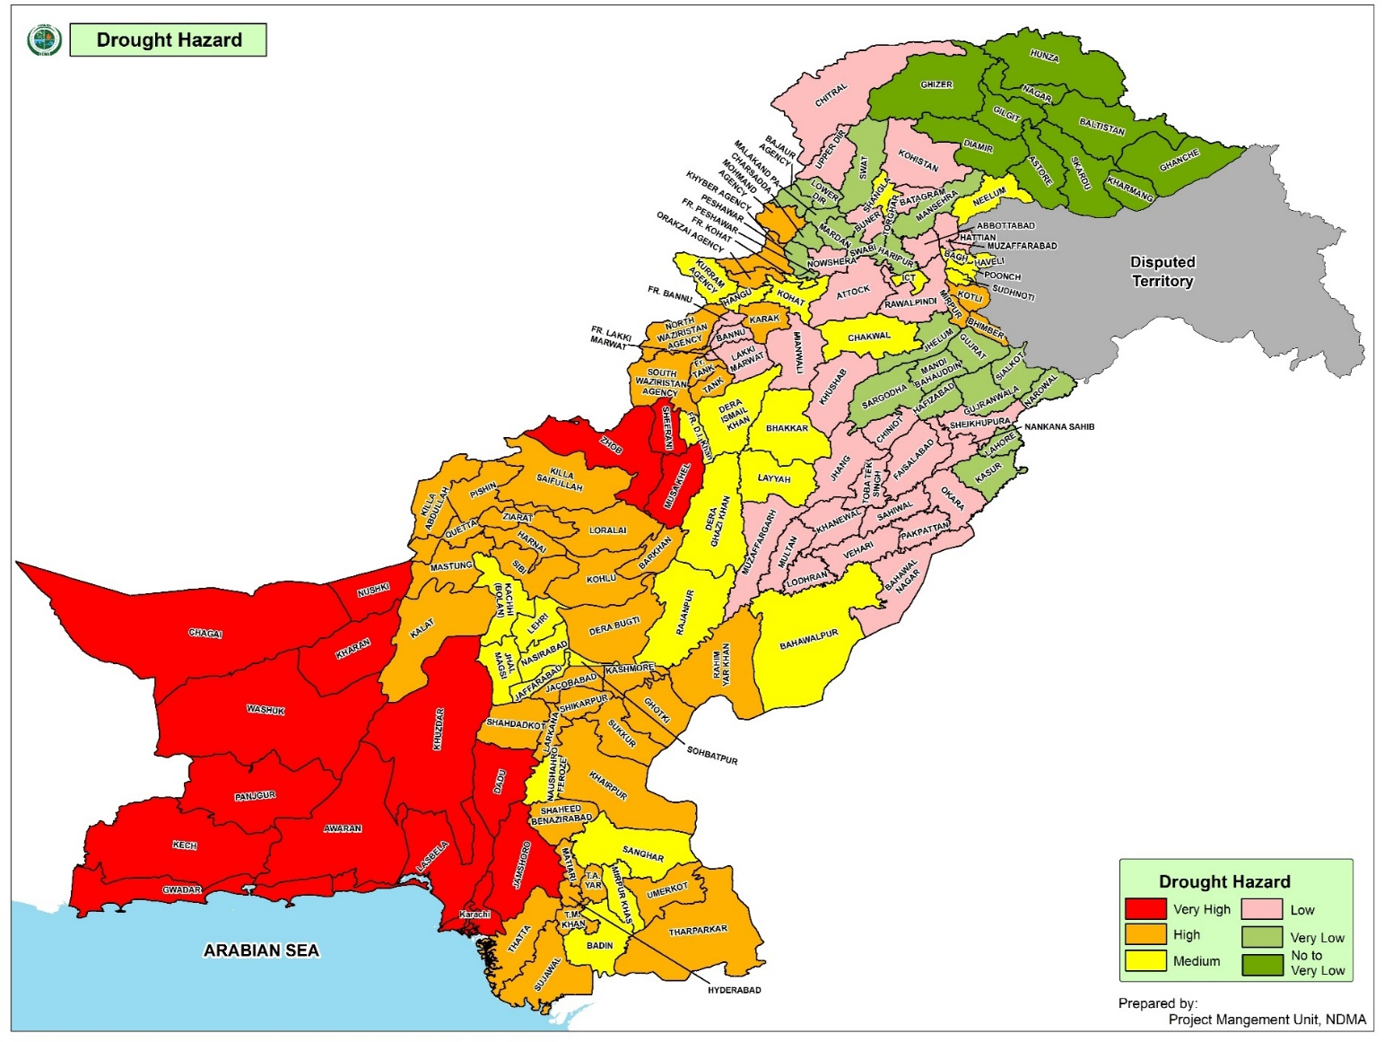
Background
Both Climatologically and topographically large areas of Pakistan is vulnerable to adverse effects of droughts
Koh-e-Suleiman Range
Kirthar Range
Balochistan’s Arid Zones
Coastal Areas, Balochistan’s Arid Zones, Eastern Sindh, Koh-e-Suleiman & Kirthar Ranges and South Punjab are vulnerable to drought
South Punjab
Costal Areas
Eastern Sindh

Slide 4
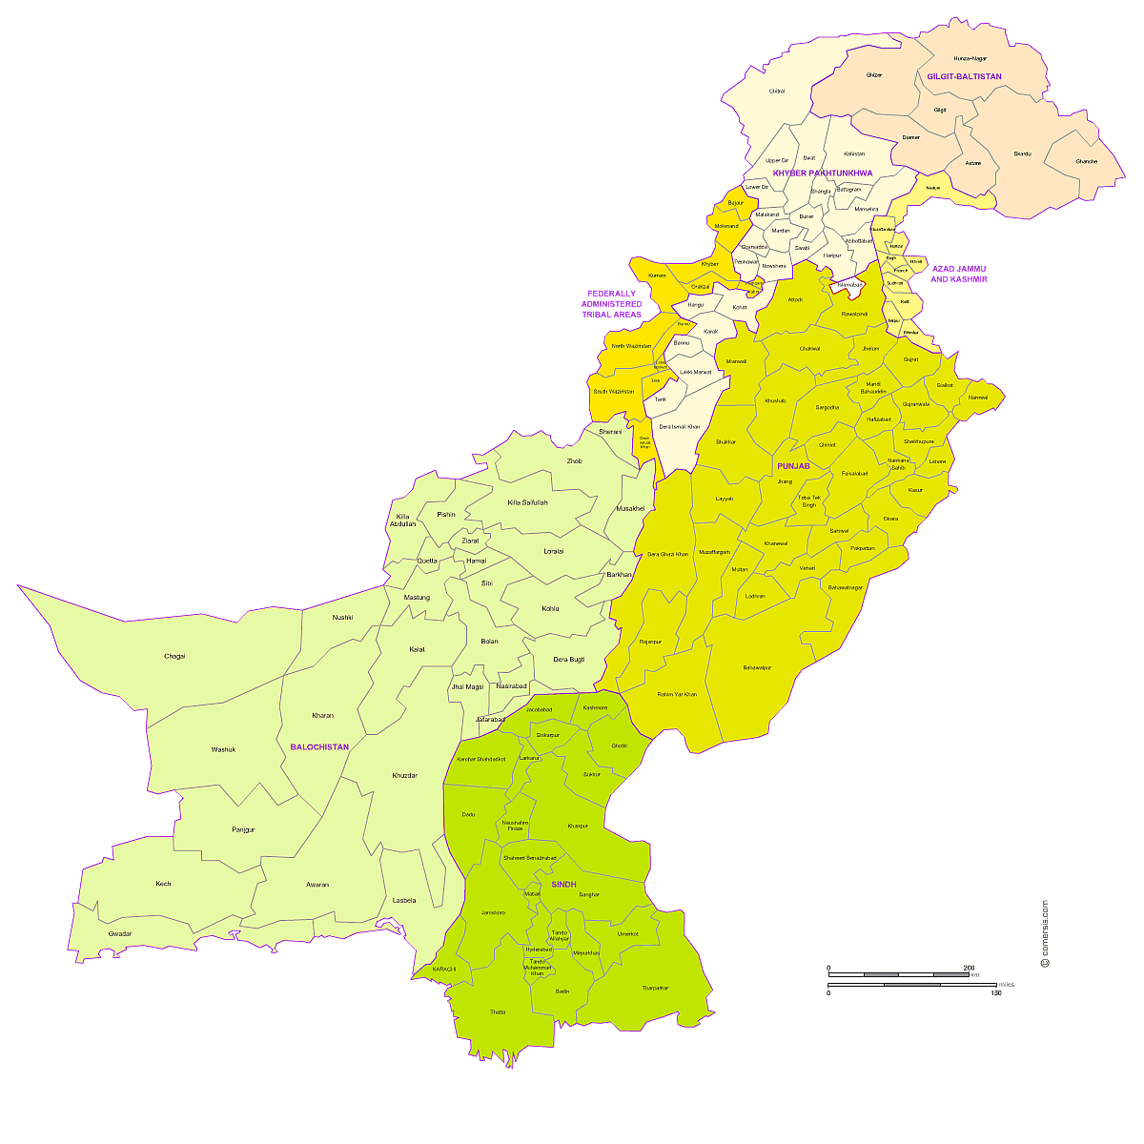
Background
1999 – 2001 Pakistan Drought Impact
58
Districts Impacted
3
Million People Affected
2.5
Million Livestock Perished
$1.2
Billion Losses

Slide 5
Current Situation
Due to Global Warming and Climate Change, Frequency of Droughts is likely to increase
Based on Rainfall data, Pakistan Meteorological Department (PMD) issued 3x Drought Alerts / Warnings
PMD predicted and recorded Below Normal Rainfall during June – November 2018 in most areas of Pakistan

Slide 6
Current Situation
ALERT | AREAS AFFECTED | DROUGHT CONDITIONS
1st Alert 6 June 18 | Barani Areas & South Punjab, lower areas of KP Southwest Balochistan and Southeast Sindh | Moderate to Severe
2nd Alert 6 Sept 18 | Sindh: Tharparkar, Mityari, Hyderabad, Jacobabad, Dadu, Karachi, Kambar, Shahdadkot, Umerkot, Sanghar, Sajawal, Shaheed Benazirabad, Jamshoro and Khairpur Balochistan: Jiwani, Pasni, Gwadar, Ormara, Dalbandin Panjgur, Nokkundi, Quetta and Turbat | Moderate to Severe
3rd Alert 7 Dec 18 | Awaran, Bolan, Chaghi, Gwadar, Kech, Kharan, Noshki, Mastung, Panjgur, Quetta and Washuk | Moderate to Severe

Slide 7
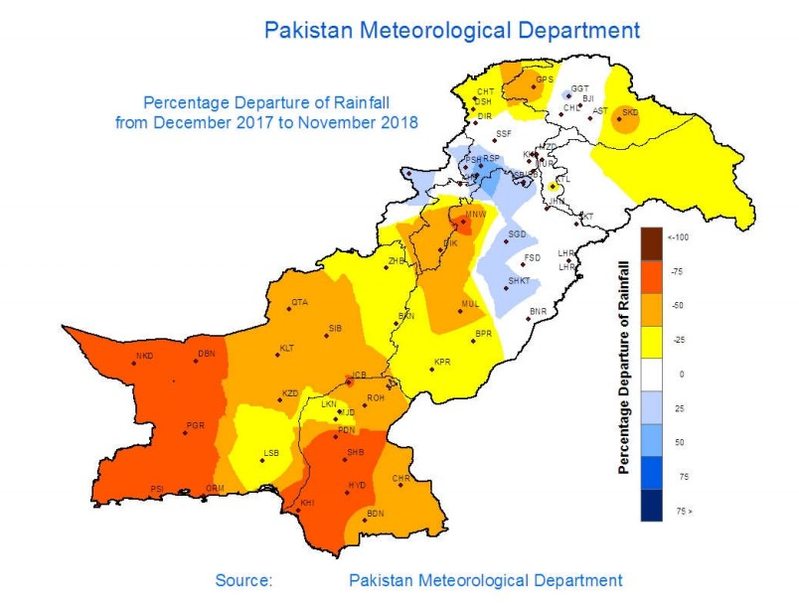
Drought Condition of Pakistan 2018
Max length of dry spell (Rainfall < 1.00 mm) from 1st May 2018 to 30th November 2018
-75% Rain

Slide 8
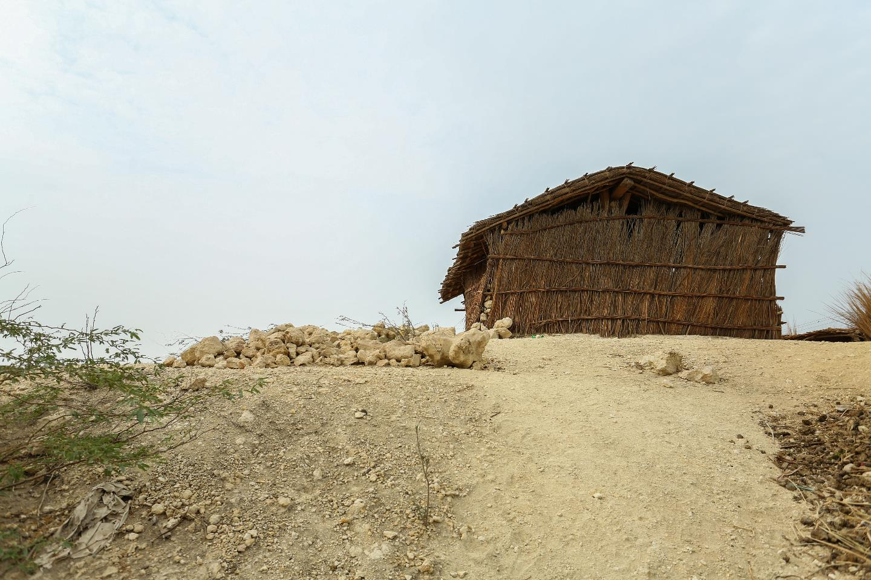
Drought Situation in Sindh
Drought Situation in Sindh

Slide 9
Sindh Drought Affected Districts
Govt of Sindh declared 8x Districts
(Tharparkar, Umerkot, Dadu, Thatta,
Sanghar, Qamber, Jamshoro & Badin) as “Calamity Affected” Districts

Slide 10
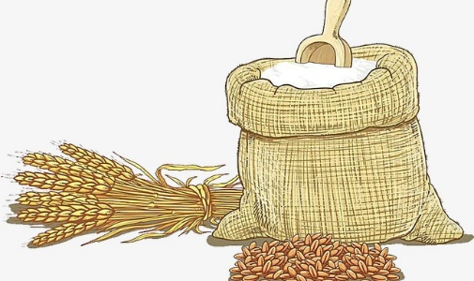
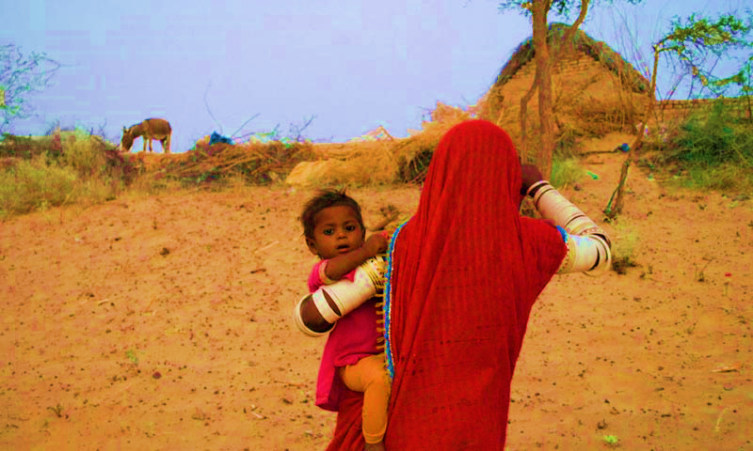
Response by PDMA Sindh
On the directions of CM Sindh, 50kg Wheat Bags were distributed among Affected Households in 2x Phases
Livestock have been vaccinated
Special Ration Bags have been distributed amongst PLWs

Slide 11
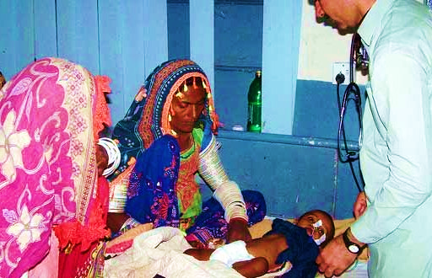
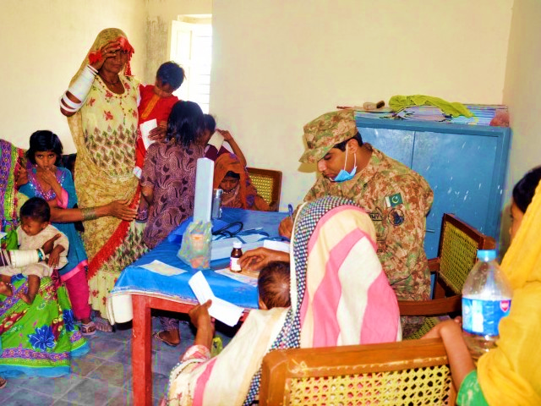
Response by PDMA Sindh
403 Doctors & 467 LHWs have been Posted to District Tharparkar
95,377 Patients have been
Treated in District Tharparkar

Slide 12
Actions by PDMA Sindh
NDC’s Drought Assessment was completed in December 2018 and report is being finalised

Slide 13
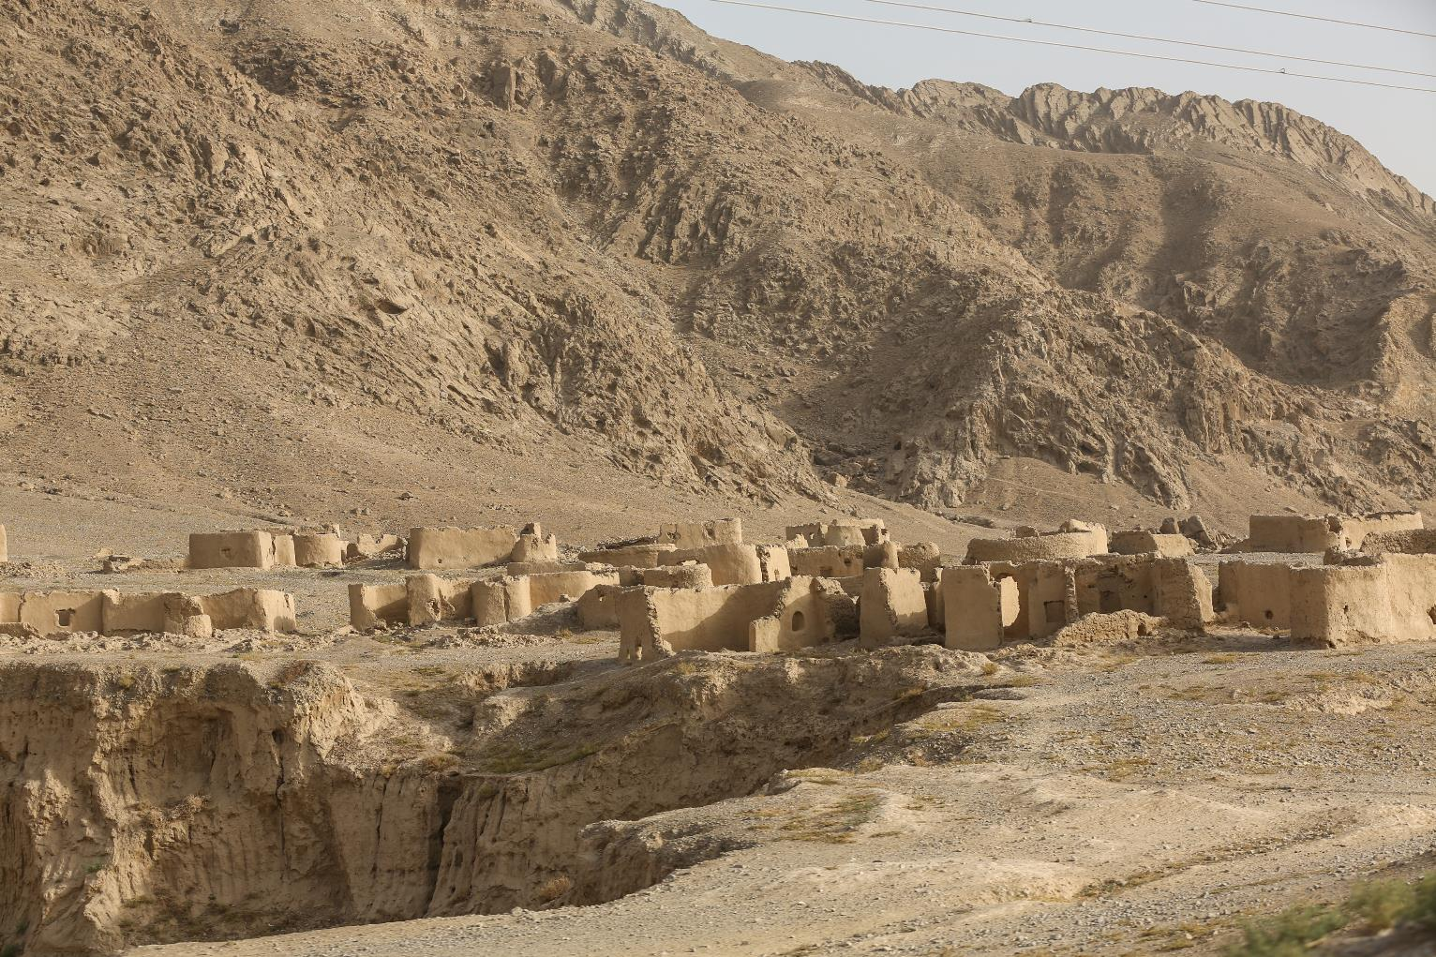
Drought Situation in Balochistan

Slide 14
Balochistan Drought Affected Districts
In 18x Districts of Balochistan
(Pishin, Killa Abdullah, Noshki, Chaghi, Kharan, Washuk, Panjgur,
Kech, Jhal Magsi, Awaran, Zhob,
Jaffarabad, Barkhan, Quetta, Killa Saifullah, Kohlu, Naseerabad & Kachhi)

Slide 15
Actions by PDMA Balochistan
1
On the approval of CM, PDMA Balochistan provided Food / Non-Food Items to affectees during December 2018
NDC has been tasked to conduct Rapid Drought Need Assessment in 14x Most Affected Districts on 22nd December 2018
NDC, Survey Teams have completed assessment in 10x Districts
Survey in remaining 4x Districts is in progress

Slide 16
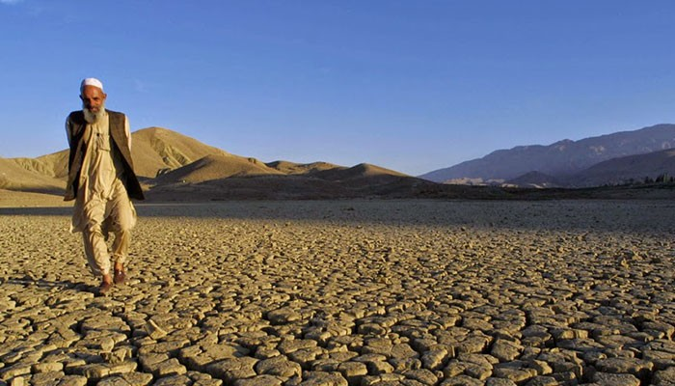
Support Provided by NDMA for Drought Affected Districts in Sindh & Balochistan

Slide 17
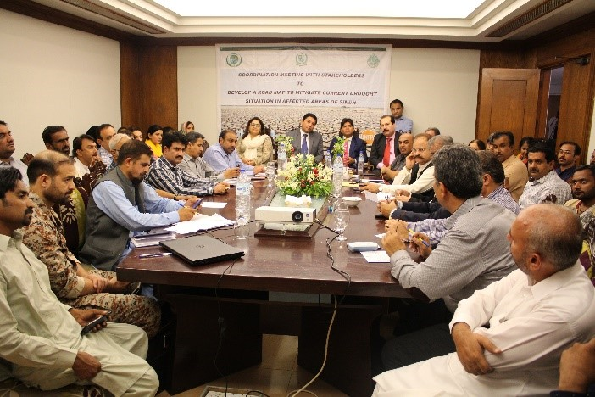
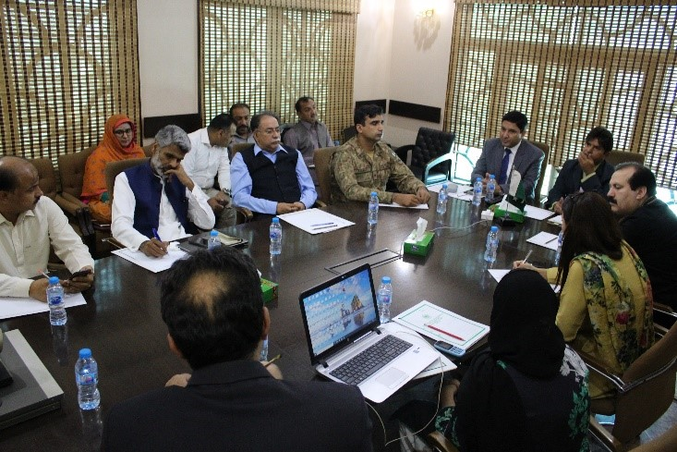
Actions Taken by NDMA
31st October 2018
Drought Meeting with Government Officials, Pak Army and Sindh Rangers
at PDMA Sindh
30th October 2018
Drought Seminar in Karachi with All Stakeholders

Slide 18
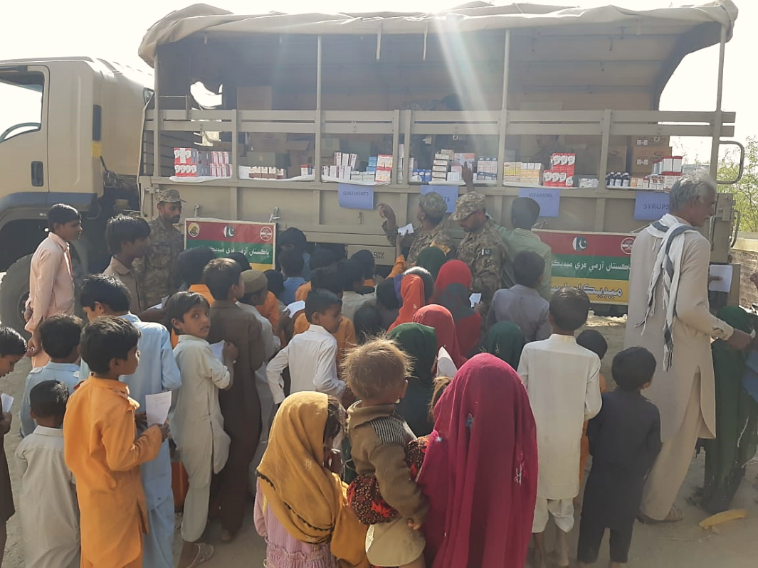
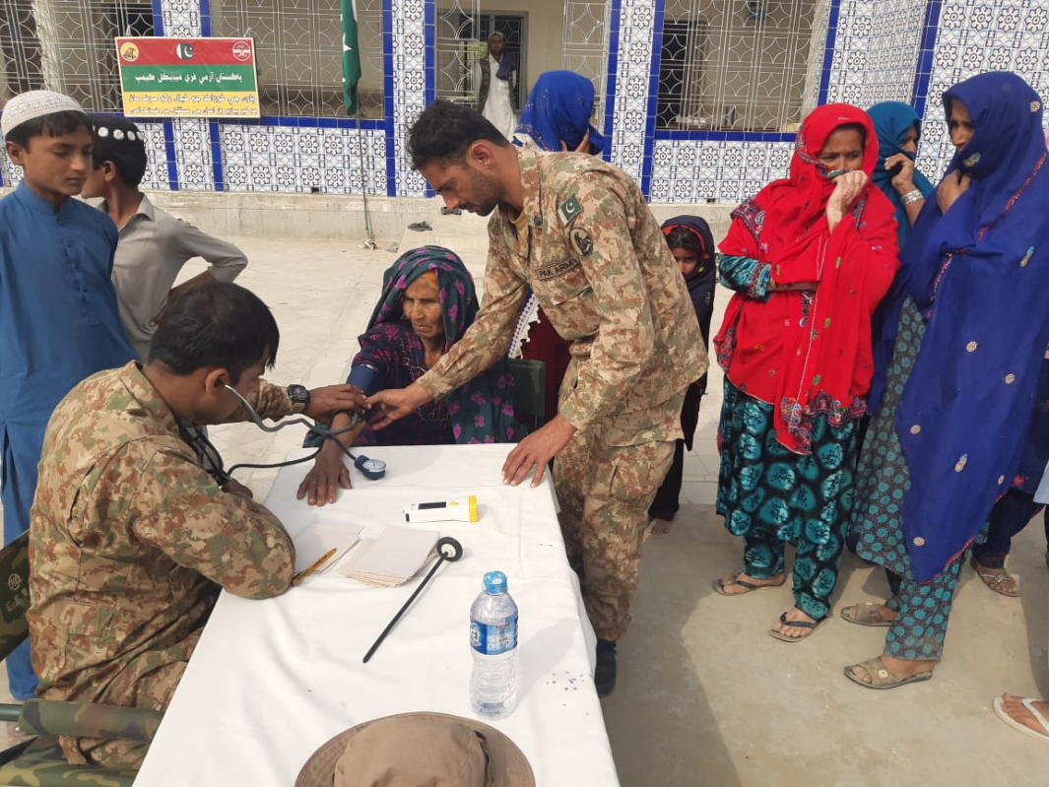
Actions Taken by NDMA
Pak Army has supported in delivery of emergency health services through establishment of Free Medical Camps in affected areas

Slide 19
Actions Taken by NDMA
NDMA in coordination with NADRA, provided data of ‘Head of Families’ to PDMA Sindh
R&R Directorate (Ops Wing) of NDMA has been declared as “Drought Secretariat” for effective coordination of efforts
NDMA on request from PDMAs has submitted Summary for Prime Minister’s approval for Provision of Food Items

Slide 20
s
Actions Taken by NDMA
NDMA is monitoring the drought and sharing Situation Reports with President Secretariat & other relevant stakeholders
NDMA has also approached United Nations Agencies to augment the Government’s efforts in the ongoing response in Sindh & Balochistan

Slide 21
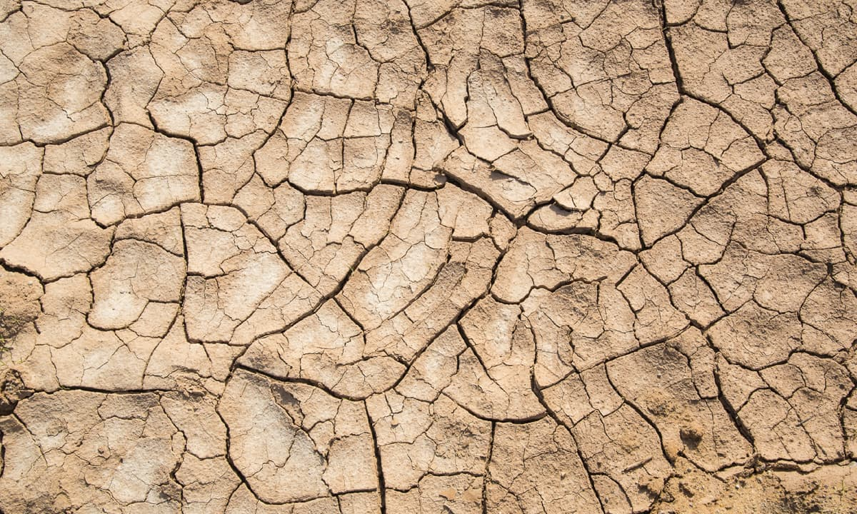
National Consultative Workshop to Develop National Drought Mitigation Plan for Affected Districts of Pakistan
18th January 2019

Slide 22
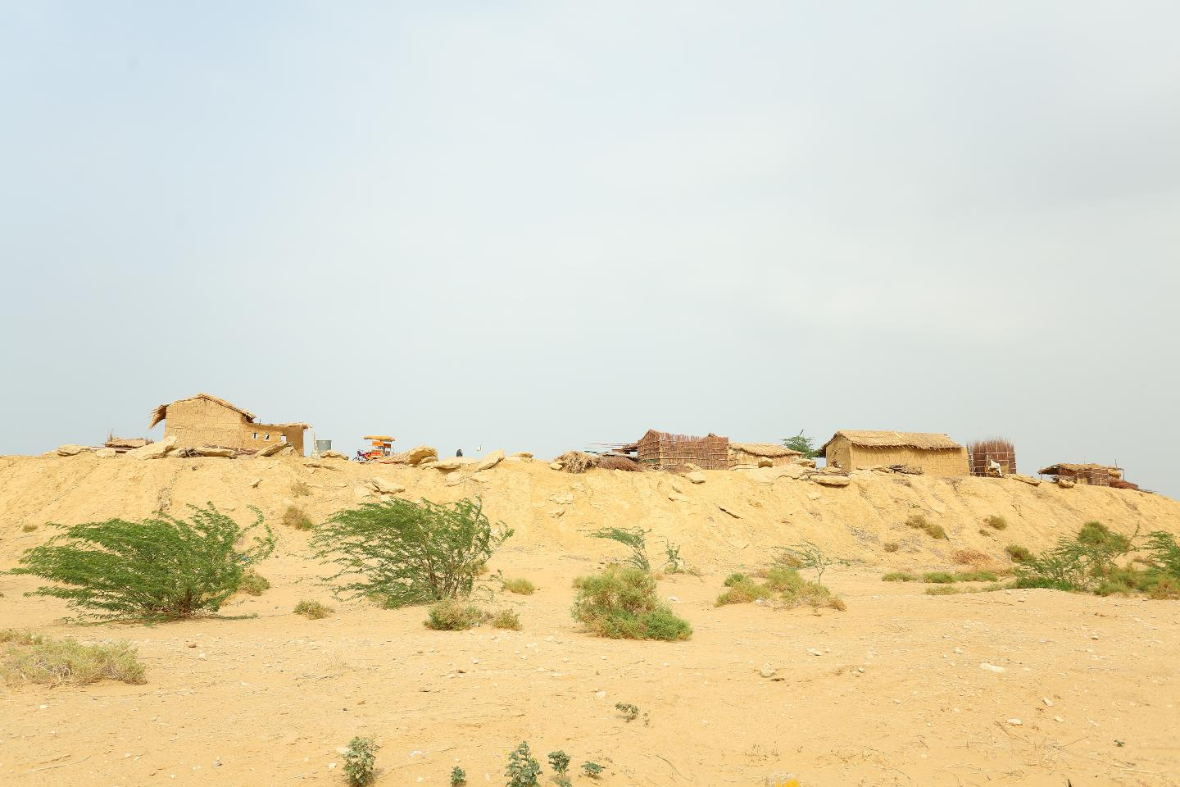
National Consultative Workshop
Aim
To analyse the Drought Situation in Pakistan, especially in Sindh & Balochistan and to Formulate a Comprehensive National Strategy

Slide 23
Objectives
Analyse & Assess Drought Situation (Severity / Extent) and response measures taken so far by PDMAs
Identify Gaps in Response in Health & Nutrition, Food Security / Agriculture, WASH, Livelihood and Education / Awareness
Devise all inclusive and well-coordinated immediate Response Plan
Formulate Comprehensive National Strategy based on short, mid and long term sector-wise mitigation measures
Work out possible Support from UN Agencies / Humanitarian Actors

Slide 24
Expected Outcomes
Develop a coordinated and comprehensive drought strategy with the support of PDMAs, UN Agencies, NGOs / INGOs, Donors and other charitable organisations which is vital to effectively manage the situation
A detailed gap analysis may be carried out by all relevant Provincial Departments/ Organisation/ Agencies and humanitarian actors to ascertain any gaps which need to filled
Devising a short, mid & long term action and mitigation strategy

Slide 25
Expected Outcomes
Exploring the opportunity for implementation of Cash based interventions
In follow-up to ICA, NDMA and WFP will be conducting ICA-Plus to help in mitigating the adverse effects of drought
Relevant stakeholders to provide all possible support for all sectors

Slide 26
THANK YOU

