Slide 1
DROUGHT MITIGATION AND ADAPTATIONS IN AGRICULTURE

Slide 2
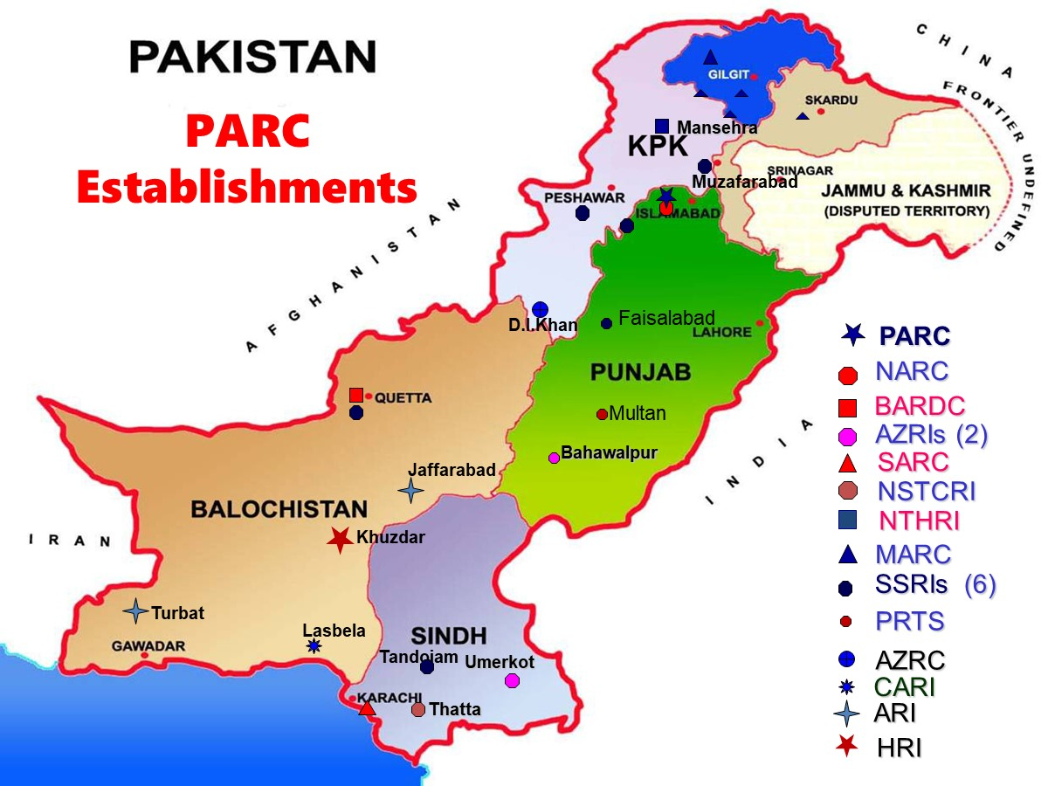

Slide 3
Adaptation and Mitigation Measures
PARC has successfully tested and introduced a number of varieties of different crops/grasses/plants, which are of short duration, consume less water and are resistant to water/heat stress.
PARC and other organizations like PCRWR have developed and demonstrated drought/desertification control technologies in the Cholistan, Ummrkot, D I Khan, Quetta and other areas:
Grassland development
Rainwater harvesting
Range management
Arid horticulture
Livestock production
Afforestation
Saline agriculture
Agriculture with good quality rain water stored in the ponds

Slide 4
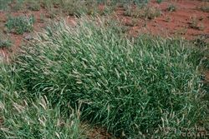
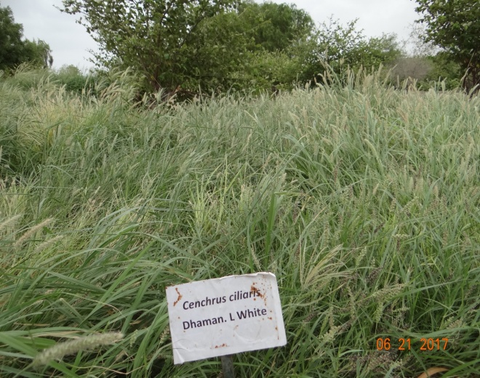
Grasses for Livestock
Wado Dhaman: Can be used as direct feed/grazing and also mix with any other hay. It can give 5-6 cuttings per year.
Water Requirement: Two irrigations, optimum rainfall about 200 to 250 mm/ year. This withstand up to 3500 TDS water on sandy soils
Acho Dhaman (Cenchrus ciliaris)
Can be used as direct feed/graizng and also mix with any other hay. It can give 6-7 cuttings per year.
Water Requirement: Two irrigations, optimum rainfall about 150 to 225 mm/ year. This withstand up to 3500 TDS water on sandy soils

Slide 5
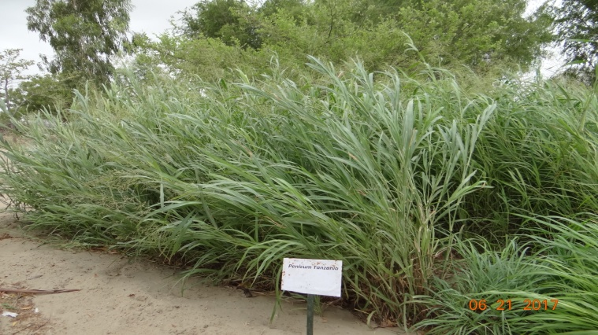
Adaptation and Mitigation Measures
Panicum Tanzania: Can be used as direct feed/grazing and also mix with any other hay. It can give 8- cuttings per year.
Water Requirement: 3-5 irrigations, optimum rainfall about 150 to 250 mm/ year. High sat tolerant
Panicum maximum: Can be used as direct feed/graizng and also mix with any other hay. It can give 4-5 cuttings per year.
Water Requirement: 3-4 irrigations, optimum rainfall about 200 to 225 mm/ year.

Slide 6
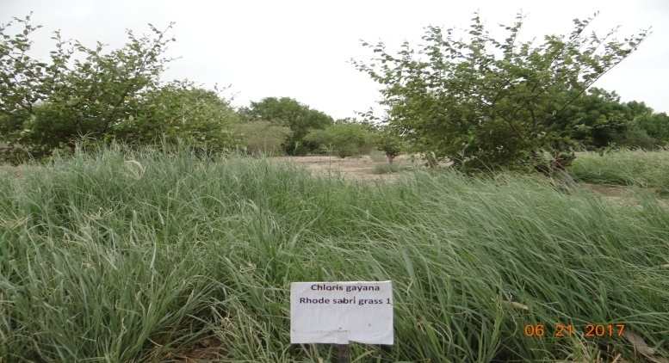
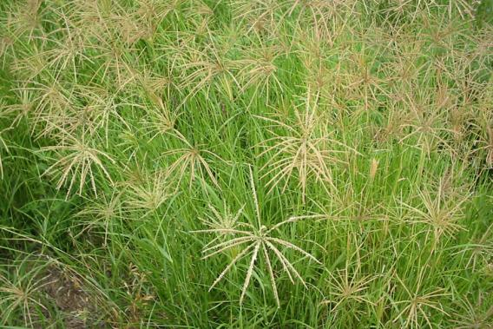
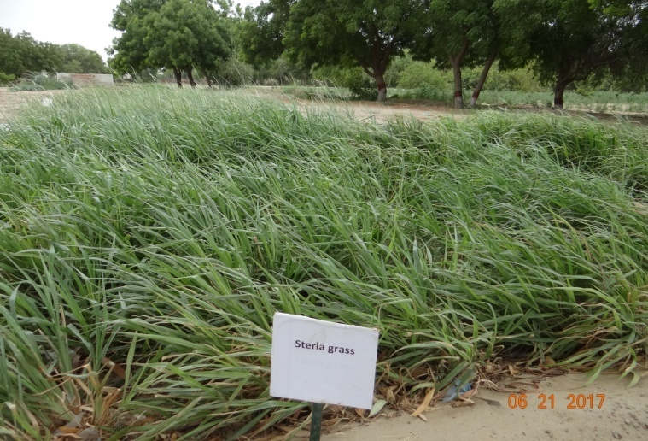
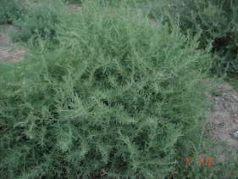
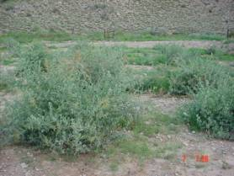
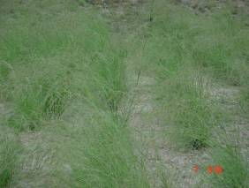
Grasses for Livestock
Rhode grass (Sabri)
Rhode grass Kambro
Steria grass
Atriplex canescens
Atriplex lentiformis

Slide 7
Development of Low-delta, Heat and Drought Resistant and Salt Tolerant Crop Varieties
Kharif crops: Millet (08), Sorghum, Mungbean (08), Guar, Castor, Cluster bean (42), Sesame (08), Moth (02)
Rabi crops: Barley, Rape, Mustard, lucerne, cowpea, horsegram, sunhemp, Lentil (Shir-AZ-96), chickpea, mashbean, safflower, seasum and cereals
Forage: Legume (Kuhak-96) in Quetta
Fruits: Pomegranate, Fig, Olive in Balochistan, Dhaki date palm in DI Khan, Ber, Guava, Date-palm, Fig, Pomegranate and falsa at Umerkot and Bahawalpur

Slide 8
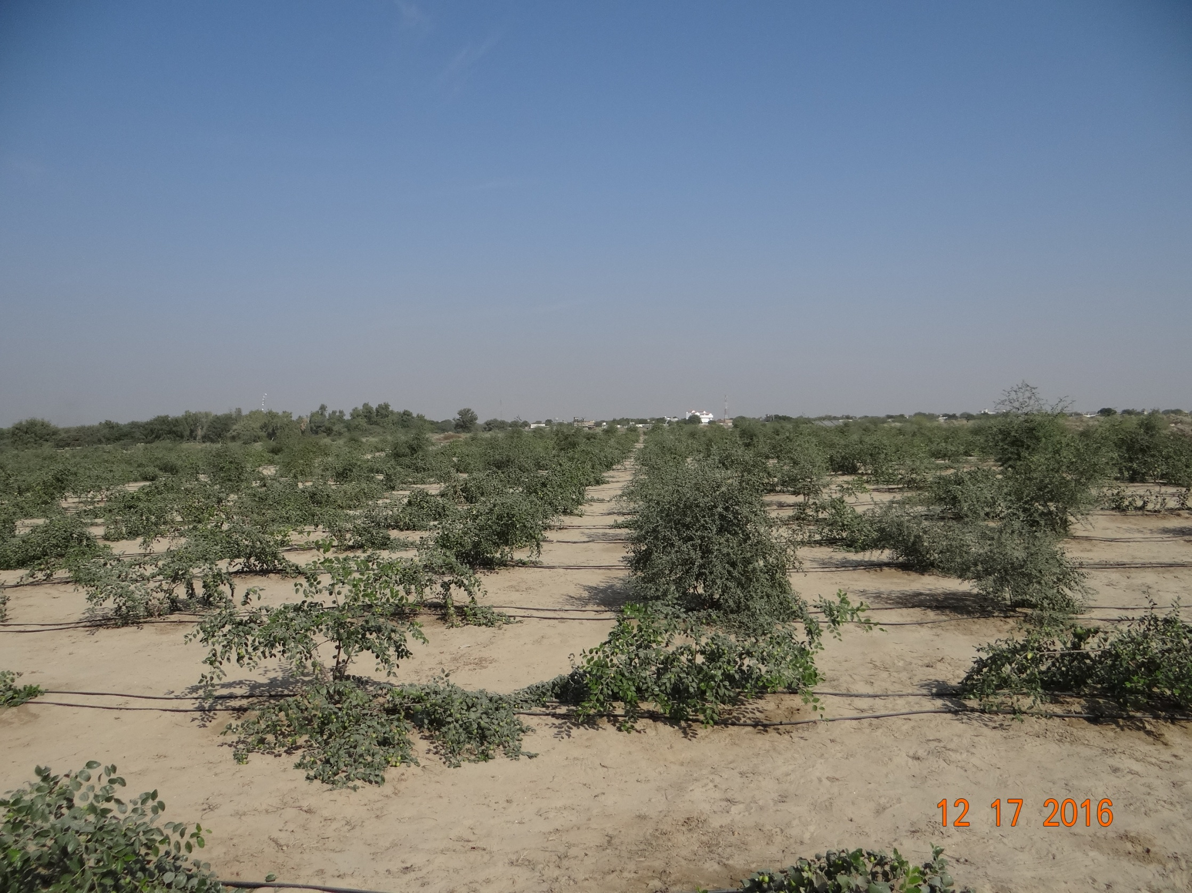
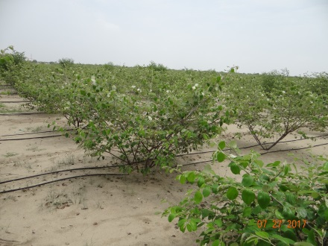
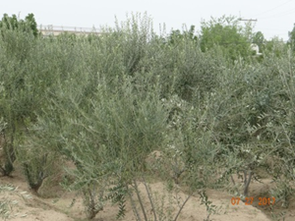
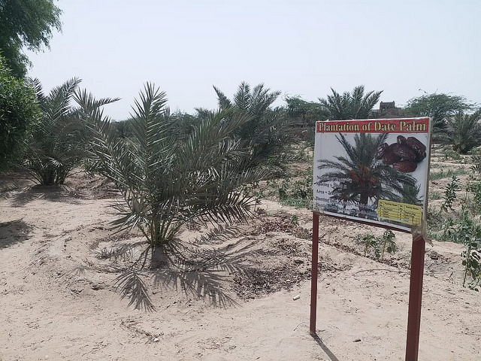
Arid horticulture Plants
Fruit plans like Moringa, Grafted Ber, Date palm, Olive, Falsa, Chiku and Lemon are tested and found best to grow in Thar Dessert with 3000-3500 TDS saline water

Slide 9
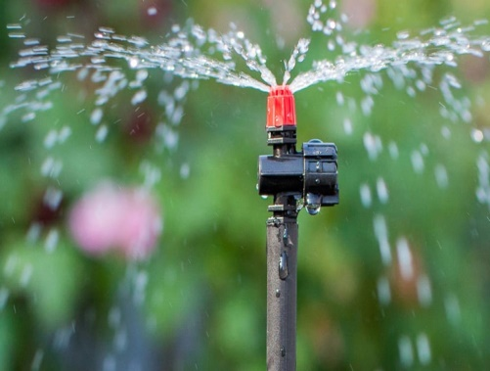
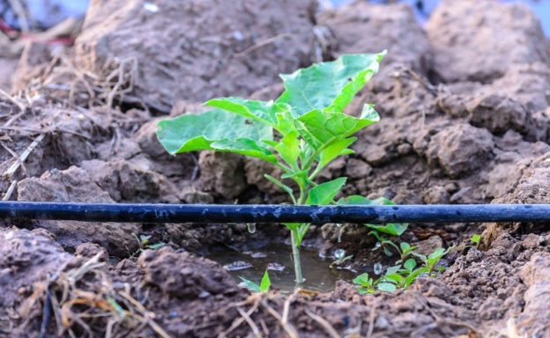
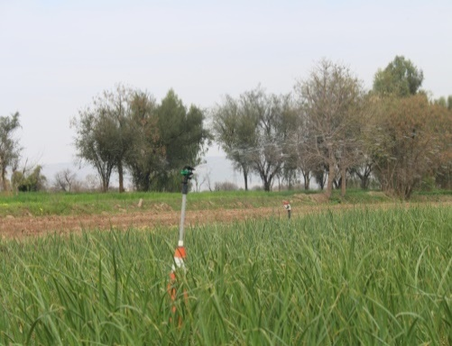
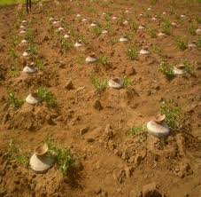
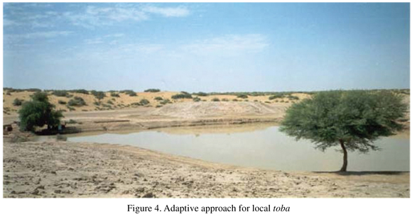
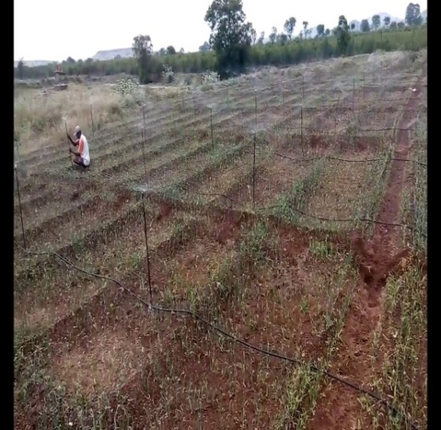
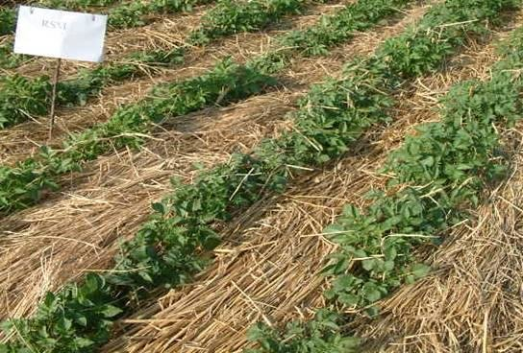
Soil and Water Conservation and Management
Drip, mini and micro sprinkler irrigation
Pitcher irrigation
Rainwater harvesting and efficient utilization
Soil moisture conservation through mulching and zero tillage

Slide 10
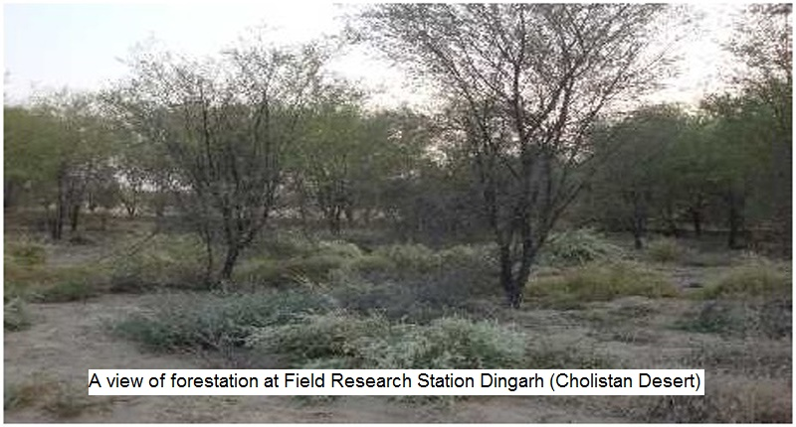
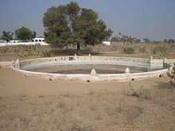
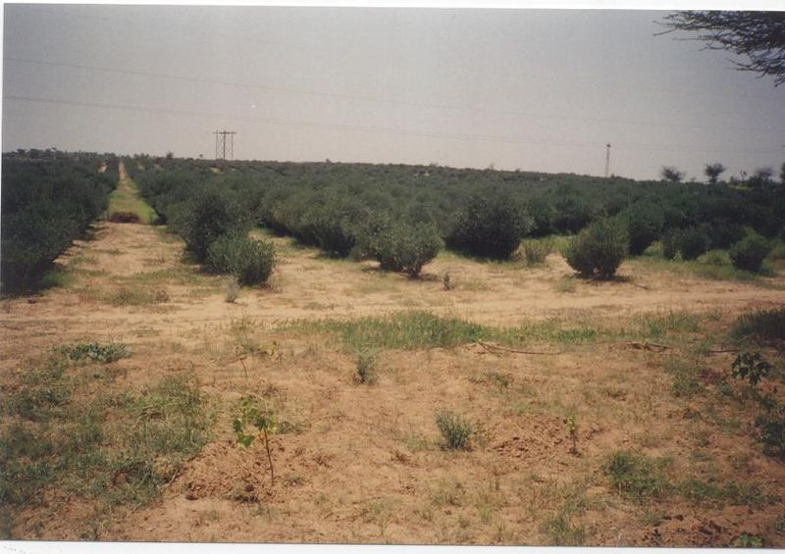
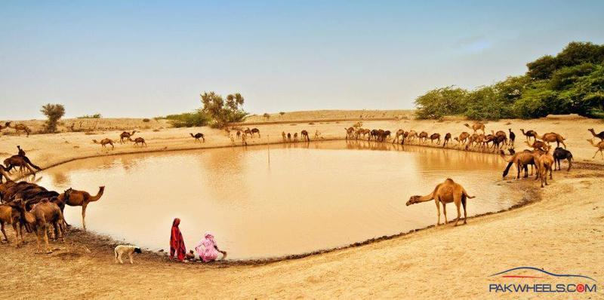
Soil and Water Conservation and Management
Construction of water ponds and storage tanks for stockwater use
Development and promotion of shelterbelt technology in desert areas to control wind erosion
Introduction of skimming wells and dugwells in areas with shallow thickness of fresh groundwater
Greening desert with plantations of jojoba at Fatehpur, Shekhawati, India

Slide 11
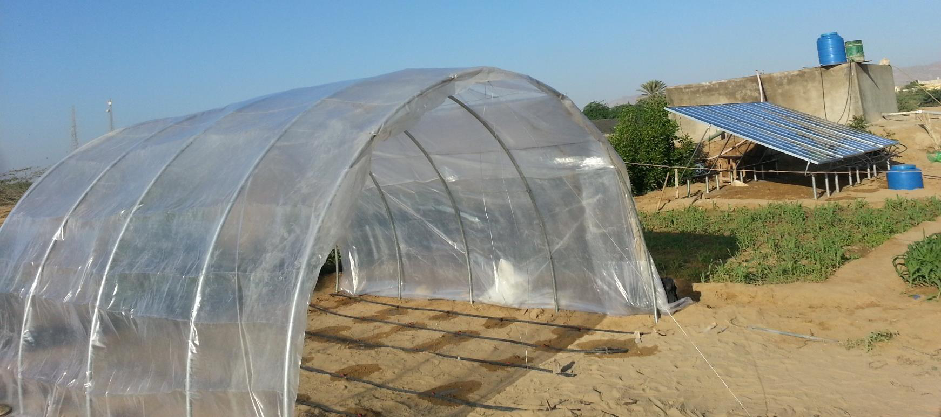
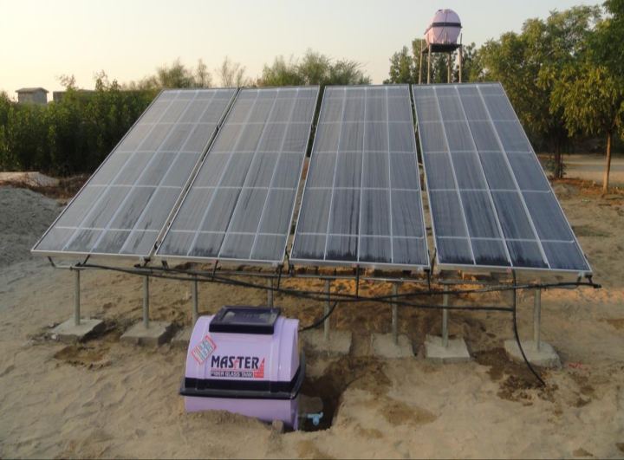
Desalination of Brackish Water
PARC introduced this technology of house-hold scale solar desalination units in Tharparkar and Bahawalpur. .
It can clean up to 20,000 ppm of brackish water in drinkable limit less than 500 ppm and desalinate about 25 litters in 8 hours of sunshine.
The desalinated water can be used solely or in conjunction with brackish water to grow high-value fruits/vegetables crops in pots/kitchen gardening to secure food deficiency and improve livelihoods at household level.

Slide 12
Bio-saline Agriculture/Agro-forestry
PARC has done some pioneer work on introduction of energy crops/plants in marginal conditions
Four species of indigenous cultivars of energy plants (Pongamia, Jojoba, Castor, Jatropha) were tested in DI Khan, Bahawalpur, Umerkot and Karachi
Adoption of these crops in drought prone areas can improve farmers’ livelihoods and resilience against drought
Recently, PARC-AZRI Umerkot has demonstrated cultivation of arid horticulture (dates, grafted ber, Guava) using brackish water coupled with drip irrigation

Slide 13
Energy and Medicinal Plants
Energy Plants Four species of indigenous energy plants (Pongamia, Jojoba, Castor, Jatropha were tested in DI Khan, Bahawalpur, Umerkot and Karachi and found successful in marginal conditions
Medicinal plants: Fifty-five exotic species of medicinal plants have been raised at Quetta some of indigenous aromatic/medicinal herb plants include German Chamomile, Lavender, Rosemary, Mint, Thyme, Marjoram, Oregano, Basil, Dill, Sage, Funnel, Ispaghol, and Tarragon.

Slide 14
Recommendations
To designate some agency/institution for carrying out drought management with clear role and responsibilities which presently completely lacks.
Our focus has been responsive whereas proactive drought management approach is cheaper and effective
Improvement of linkages between research and line agriculture, irrigation and NGOs for upscaling and outscaling tested innovations
Awareness raising of line departments, NGOs and communities for household adoption of tested technologies
Provision of tested intervention through development projects on subsidy

Slide 15
Recommendations
Promote “low delta crops” and research on drought and pest resistant crops
More coordinated focus on drought reseach
Provision of solar desalination and RO plants , solar pumps, drip for drinking, kitchen gardening, tunnel farming and arid horticulture
Provision of seed of potential grasses/crops/fruit cultivars

Slide 16
Recommendations Short term Actions
Promote “low delta crops” and research on drought and pest resistant crops
Undertake development of drought resistant shrubs, fodder crops and grasses for pastures and oasis for livestock
Ensure sustainable harvesting of indigenous dry land tree species

Slide 17
Recommendations Short term Actions
Deployment of water filtration plants / water tankering
Construction of more water storage facilities as well as construct of additional small retention ponds throughout the watershed
Find technological breakthrough for irrigation systems, to raise vegetative cover in extremely difficult and harsh areas of arid zone
Livestock emergency extrication plan from the worst affected areas towards the traditional relief zones.
Encourage development of technological innovations for improved water efficiency for crops, including artificial groundwater recharge

Slide 18
Recommendations Medium term Interventions
Promote water harvesting at regional as well as household level
Parallel interventions should promote awareness and reinforce local emergency response coping capacities.
Mapping of vulnerable human population, mainly from the food security, nutrition, access to potable water perspective
Mapping of the vulnerable livestock from inadequate access to water, fodder and time required for extrication to the relief zones perspective

Slide 19
Recommendations Long Term Policy Initiative
Drought Mitigation Strategy (DMS) is essential for the drought prone areas which may address; i. Water ii. Food and agriculture iii. Health iv. Livestock and range management v. Climate change adaptation
Drought mitigation activities are by and large, managed on an ad hoc basis Contrary to well established flood control mitigation with adequate institutional arrangements
Designate agencies and stakeholders responsible for carrying out drought mitigation and response actions, and require regular review of, and progress reports on, their implementation.
The farmers should be trained in adoption of efficient water use technologies such as sprinkler and drip irrigation, rain water harvesting, water storages etc.

Slide 20
THANKS

