Slide 1
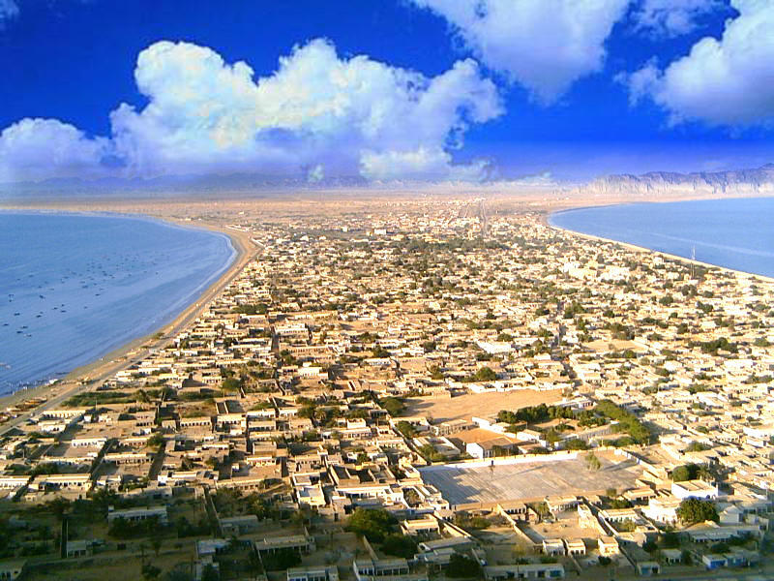


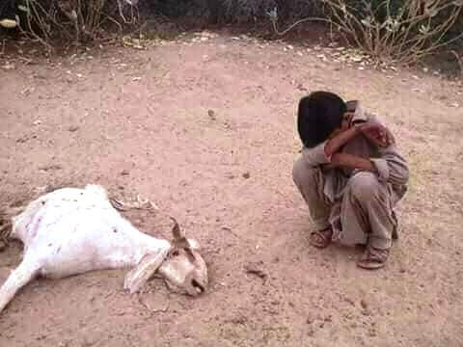
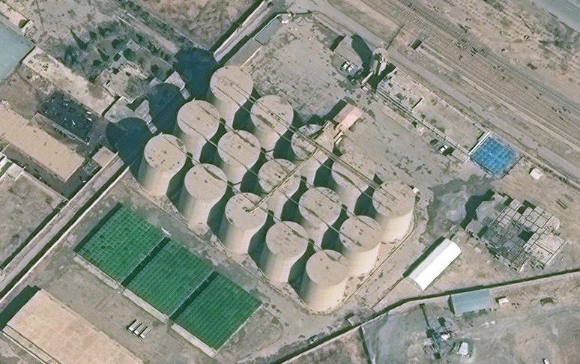
PDMA Balochistan
Provincial Disaster Management Authority

Slide 2
HISTORY OF DROUGHT
The longest Historical spell over 1945 to 1955 and 1997 to 2003 after 2011 there is the spell of one year.
The drought spell is continuing for the last 2 years whereas in Makran division it is since 4 years.
Due to scarcity rainfall there have been devastation for shortage of water effecting the population and the livestock/Agriculture.
Pdma Balochistan

Slide 3
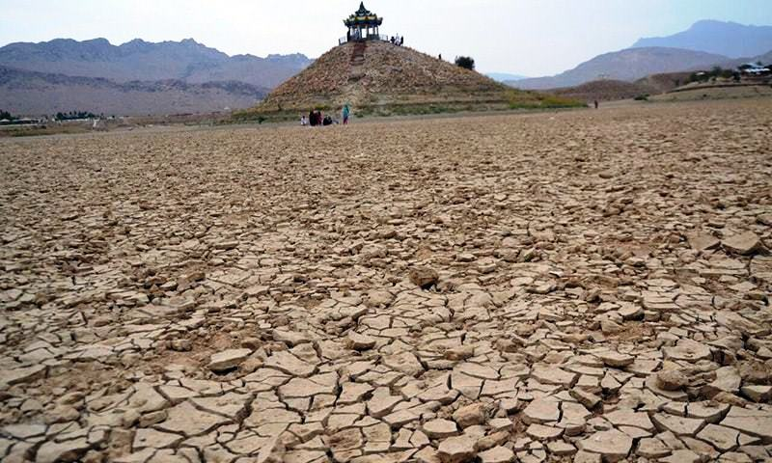
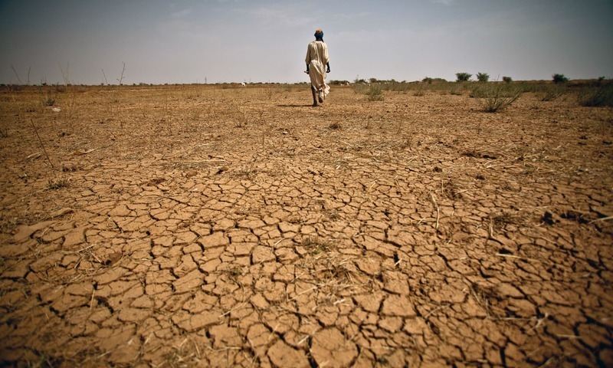
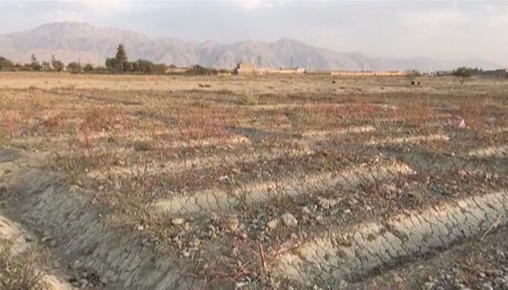
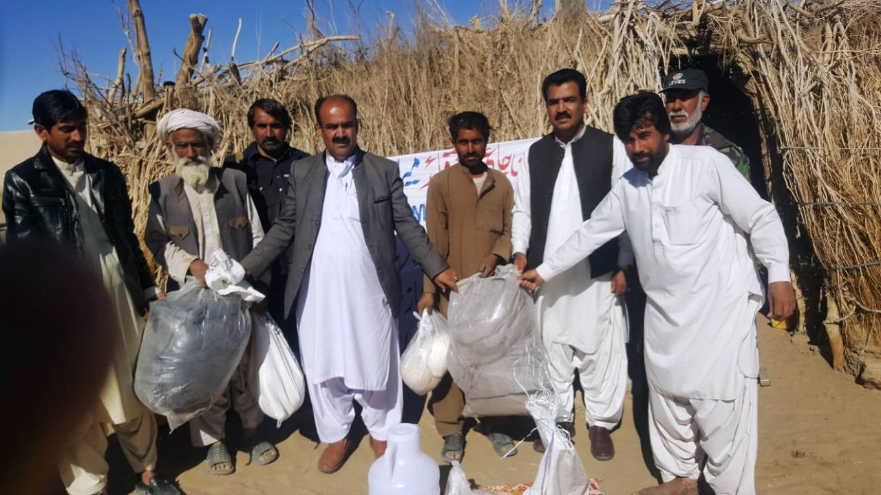
HISTORY OF DROUGHT
Pdma Balochistan

Slide 4
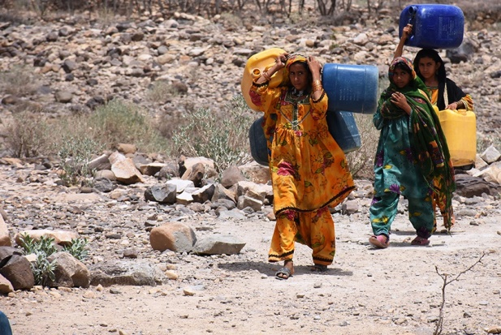
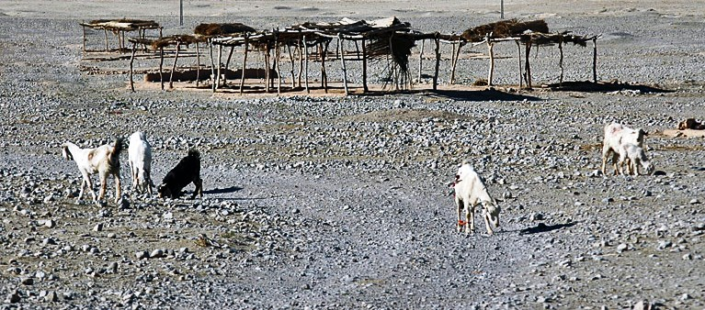
IMAGES OF DROUGHT
Pdma Balochistan

Slide 5
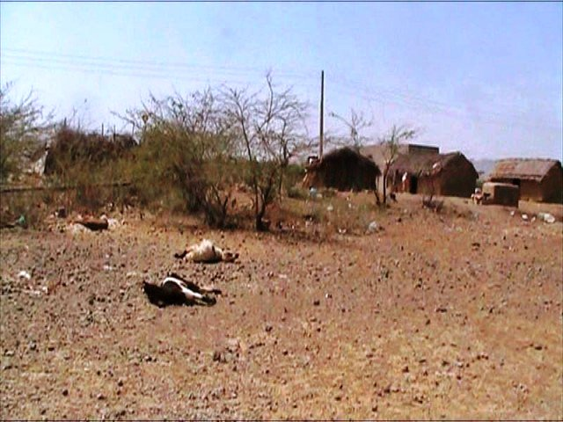
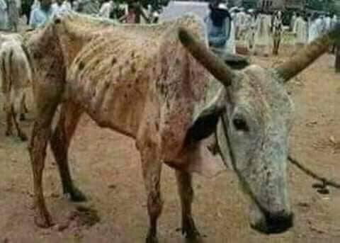
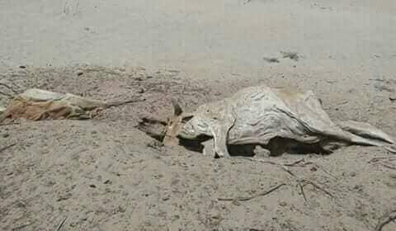
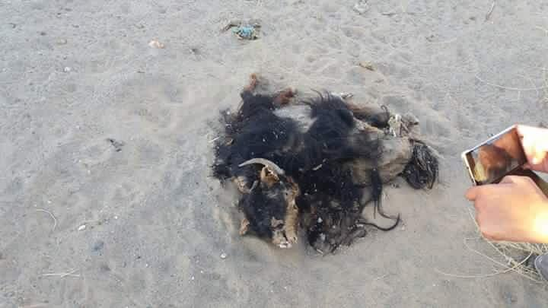
IMAGES OF DROUGHT
Pdma Balochistan

Slide 6
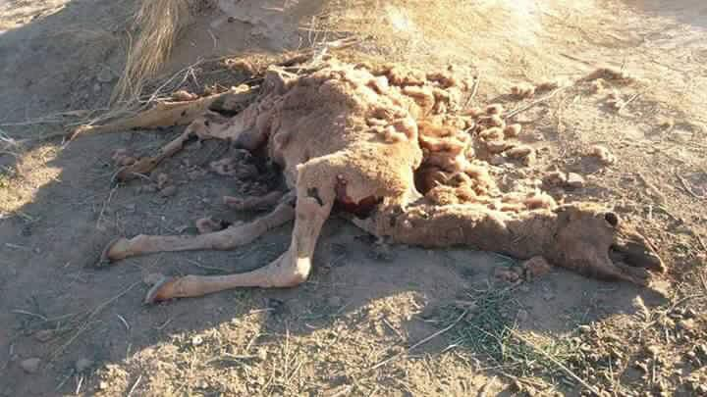
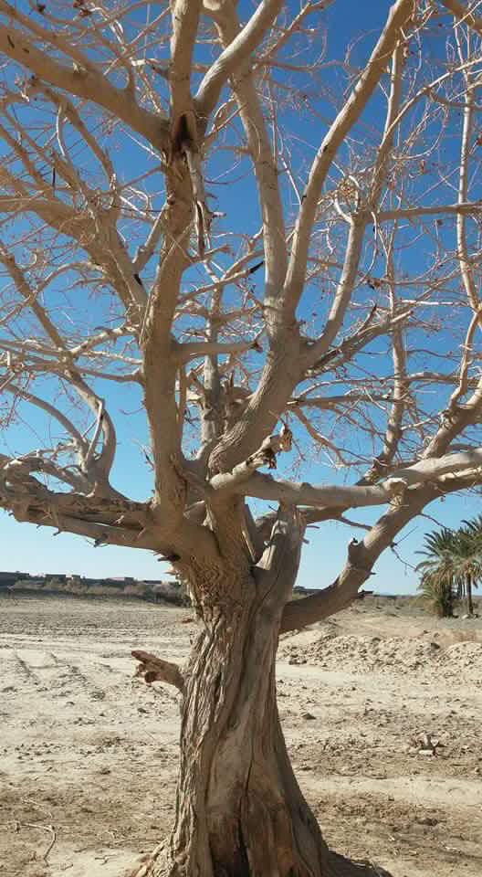
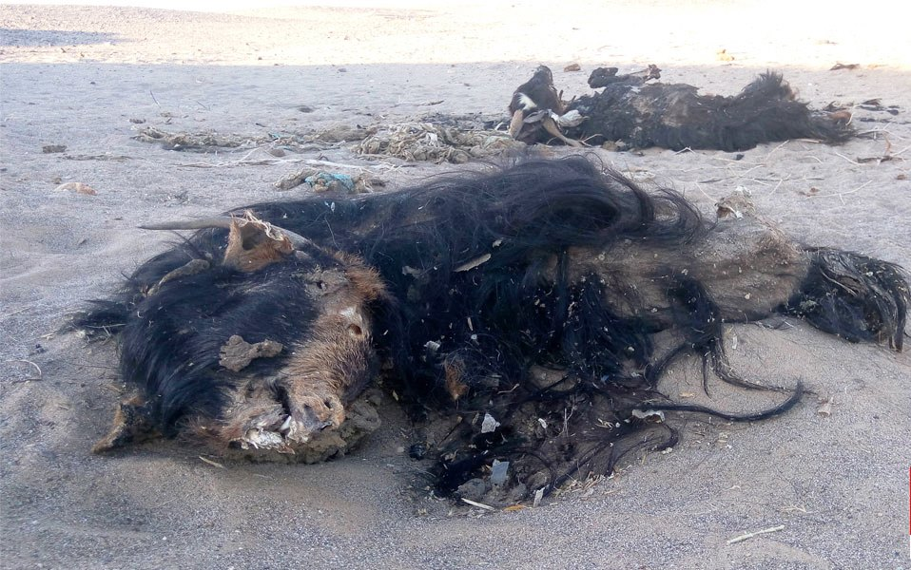
IMAGES OF DROUGHT
Pdma Balochistan

Slide 7

DETAIL OF EFFECTED DISTRICTS
PDMA BALOCHISTAN

Slide 8
Response/ initiatives
PDMA Balochistan took early response and provided support to 28,283 in shape of Food & NFIs affected families in 21 districts for 15 days.
Special Initiative :
12 water purification plants dispatched to 8 districts
03 Generators 50 KVA for hospitals to 3 districts
15 Generator 05 KVA for hospital to 4 districts
2 De-watering pump to Jaffarabad district
Special instruction issued through Chief Secretary to health department to established emergency medical camps in drought effected areas.
In collaboration with Muslim Hands an Eye camp was established at Sibi.
PDMA BALOCHISTAN

Slide 9
gaps/current need
Gap 242,975 families.
Food & Non Food items for 270,258 families for next 3 months needed.
Fodder for live stock 3,488,700 for next 3 months needed.
Pdma Balochistan

Slide 10
Way forward/ Recommendation
Urgent detail Assessment of the effected areas.
Data Analysis for Drought effected areas.
Fodder and vaccination for animals.
Life saving drugs for people of effected areas.
Necessary Relief items for effected areas.
Heavy water filtration plants for effected areas.
To start the livelihood program in drought affected areas
Pdma Balochistan

Slide 11


Pdma Balochistan

