Slide 1
Training on
Project Management in Humanitarian Context
Muhammad Sufyan
Grassroots Pakistan

Slide 2
Introduction
Notes:
Time : 5 min
Ask the participants to write their designation and projects they are involved in.

Slide 3
Key Findings of Learning Needs Assessment

Slide 7
Training Objectives
At the end of the training , participants will be able to
Explain the key terms and basics of project management
Describe the knowledge areas of project Management
Explore and use different tools & techniques of project management

Slide 8
Training Content
Overview and Background of Humanitarian Project Management
Project Identification and Planning - LFA
Project Monitoring and Evaluation
Project Monitoring and Evaluation Framework
Project Quality Management
Project Risk Management
Project Stakeholder and Integration Management

Slide 9
Code of Conduct
Respect the others’ opinions
Participate in Polls and Q & A
Click Raise your hands option if you want to ask question
Punctuality and time management
Advise facilitator if session is not working

Slide 10
Overview and background of project management
The most valuable and least used WORD in a project manager's vocabulary is "NO“
The most valuable and least used PHRASE in a project
manager's vocabulary is "I don't know"

Slide 11
What is a Project?
A project is a temporary endeavor undertaken to create a unique product, service, or result.
PMI PMBOK® Guide , Edition 5
Notes:
Temporary
Does not mean short, A project is Temporary but not necessarily the outcome. Has a start and an end
Unique
Environment changes, Team changes, organizational Directions change, Procedures change
Product : The end result of the processes, to be offered to the marketplace to satisfy a need or want, like Shelters,
Service: A function that supports production or distribution for community facilitation
Result: The combined output of a set of processes
The end is reached when the project’s objectives have been achieved or when the project is terminated because its objectives will not or cannot be met, or when the need for the project no longer exists. A project may also be terminated if the donor wishes to terminate the project.
Outcome of the project can be tangible like Constructing the Shelters for Disaster Affectees
Outcome of the project can be intangible like developing the capacity of Disaster Affectees on Health & Hygiene Education

Slide 12
What do you think
This definition is sufficient enough , if yes /no why
Notes:
Progressive Elaboration
•Requires resources
•Involves uncertainty

Slide 13
What is the difference between project and program

Slide 14
Program
A group of related projects, subprograms, and program activities managed in a coordinated way to obtain benefits not available from managing them individually.
Programs may include elements of related work outside the scope of the discrete projects in the program. A project may or may not be part of a program but a program will always have projects.

Slide 15
Portfolio
A portfolio refers to a collection of projects, programs, sub-portfolios, and operations managed as a group to achieve strategic objectives.
Although the projects or programs within the portfolio may not necessarily be interdependent or directly related, they are linked to the organization’s strategic plan by means of the organization’s portfolio.

Slide 16
DFID in Pakistan
Strategic Objective : To reduce poverty and help build a prosperous and stable country
Pakistan National Cash Transfers Program
Punjab Education Support Program
Stability and Support Program
Enterprise and Asset Growth Program
Provincial Health and Nutrition Program
Multi-year Humanitarian Program
Skill Development Program
Notes:
We work in Pakistan to reduce poverty and help build a prosperous and stable country.
DFID Stat
In Pakistan:
more than 60 million people in Pakistan live in extreme poverty
12 million children are out of school
1 in 11 children die before their fifth birthday
12,000 women die in childbirth every year
Entrenched poverty is denying opportunities to millions of people and undermining Pakistan’s long-term stability and prosperity.
Beating poverty and building a prosperous democratic Pakistan will help not only millions of poor Pakistanis, but it will also improve stability in Pakistan, the region and beyond.

Slide 17
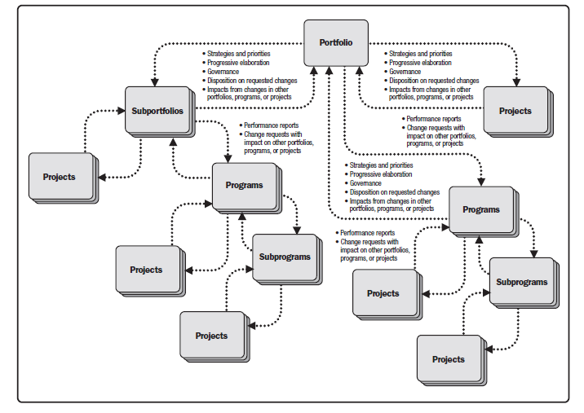
Notes:
As Figure illustrates, organizational strategies and priorities are linked and have relationships between
portfolios and programs, and between programs and individual projects. Organizational planning impacts
the projects by means of project prioritization based on risk, funding, and other considerations relevant to the
organization’s strategic plan. Organizational planning can direct the management of resources, and support for the
component projects on the basis of risk categories, specific lines of working , or general types of projects, such as
infrastructure and process improvement.

Slide 18
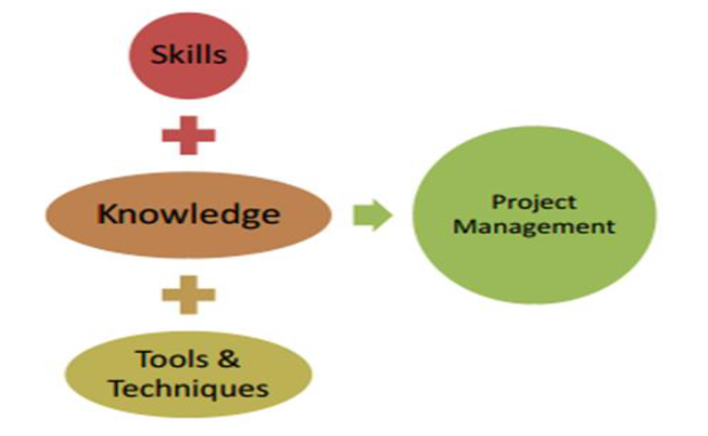
Project Management
Project management is the application of knowledge, skills, tools, and techniques to project activities to meet the project requirements and objective.
Notes:
Social need (e.g., a nongovernmental organization in a developing country authorizing a project to provide
potable water systems, latrines, and sanitation education to communities suffering from high rates of
infectious diseases);

Slide 19
Objectives of Humanitarian Action
The objectives of humanitarian action are to save lives, alleviate suffering and maintain human dignity during and in the aftermath of crises and natural disasters, as well as to prevent and strengthen preparedness for the occurrence of such situations.
(Good Humanitarian Donorship Initiative, 2003)

Slide 20
Characteristics of Humanitarian Action
Cause
Timescale and frequency
Area affected
State/national capacity to respond
Notes:
Cause: for example, armed conflict; rapid-onset natural disaster such as
an earthquake or flooding; slow-onset natural disaster such as drought;
health crisis such as Ebola (IFRC, n.d.).
2. Timescale and frequency: for example, protracted, recurrent, rapid or
slow onset (ALNAP, 2007).
3. Area affected: for example, urban, rural, mega (IFRC, 2010).
4. State/national capacity to respond: for example, if state capacity is
limited, international agencies may perform a substituting function, but
where state capacity is strong they may play a more collaborative role
(Ramalingam and Mitchell, 2014).

Slide 21
Project Cycle management

Slide 22
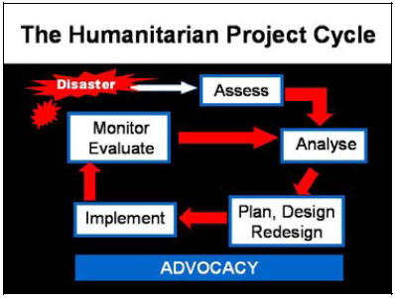
Plan

Slide 23
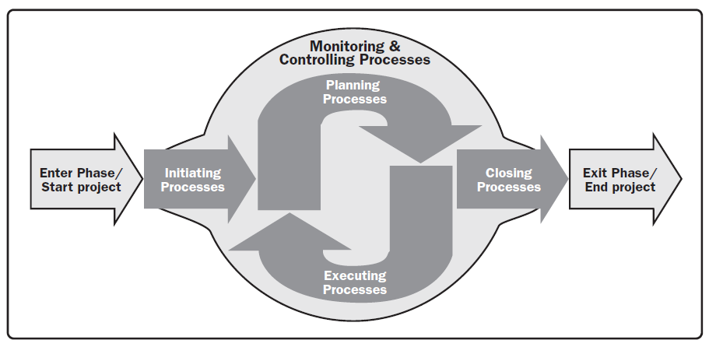

Slide 24
Why projects fail?
Notes:
Caruisal Activity
Four Chart in different of the training room will be displayed

Slide 25
Why projects fail?
Poor Scope Definition
Lack of Understanding
Lack of Leadership Consistency
Communications Failure
Unrealistic Targets
Lack of Direction
Lack of Commitment By Donor
Not Aligned With organizational Objectives
Started For Wrong Reasons
Lack of Availability of professional team
No Project Plan
Lack of Experience

Slide 26
How the beneficiary explained
How the consultant described it
What the beneficiary really needed

