Slide 1
Revising the Sphere Handbook:
What is new and how you can contribute?
Notes:
AOA and Good Morning to all ….thank you for joining all over the Pakistan today
My name is Muhammad Sufyan ……. I am honoured to be serving as Speaker for this webinar which is hosted by National Humanitarian Network Pakistan
This webinar is about the revision of Sphere handbook 2011 and how you can contribute
In this webinar You can ask questions about the process …….
It will also contribute to the consultation being organized by the community world Service Asia
Which is going to be held on June 01
Director of Sphere Project Christine will be there to lead the discussions
Important changes are under way as you probably know… terminologies are being updated to build greater consistency among chapters …Cross cutting Cash programming, urban response and environmental concerns based on the evidence to practices …….
Further input needed from the experience practitioners
Please continue introducing yourself as some of you already doing it…..
You can contribute in asking questions and responding to the polls
Please ask your question by typing it in the chat box below

Slide 2
Sphere Handbook Revision Consultation Phase, Draft 1
What’s new
Next Step
How to share you experience

Slide 3
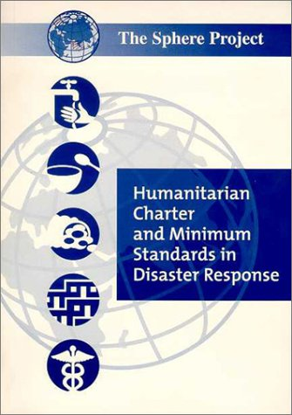
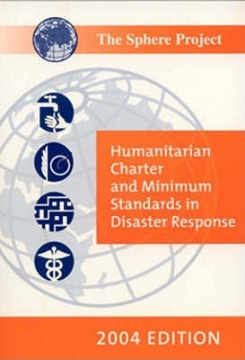
Time to revise?
2000 Version
2004 Version
2011 Version
Notes:
Standard needs to have certain life …. There are some standards which are static to some extent….
2011 …. revision of the humanitarian Charter and addition of the protection principles

Slide 4
Why?
Cash: shift in how assistance is provided: what mix of cash, in-kind and services?
Context : Urban and complex crisis
Accountability: renewed attention to accountability across the sector, better evidence ; integrated CHS fully into handbook
Users: Change in user profiles and people working in humanitarian field, including more local actors, “ non-humanitarians”, military, civil protection
Notes:
Big evolution in the use of cash … there is no clearly understanding how the handbook goes about it…
2011 saw the revision of the humanitarian Charter and addition of the protection principles
What’s new since 2011? Drivers in the sector:
Cash: shift in how assistance is provided: what mix of cash, in-kind and services?
Context : Urban and complex crisis
Accountability: renewed attention to accountability across the sector, better evidence ; integrated CHS fully into handbook
Users: Change in user profiles and people working in humanitarian field, including more local actors, “ non-humanitarians”, military, civil protection

Slide 6
Notes:
Poll : Which type of organizations do you work ?
CSO
NGO
I/NGO
UN
Other

Slide 7
Notes:
Poll : For what purpose do you use the sphere most?
To guide proposal writing
To guide Assessment
To guide M & E
Capacity Building
Advocacy
Research
Other

Slide 8
Three Big Changes
Chapter: Core Standards replaces with Core Humanitarian Standard
Focus on Accessibility . Simplification of language , shorter handbook, Clearer linkages with companions
New structure of the standard
Standard
Outcome Indicators
Key Actions
Key Indicators ….threshold
Guidance note
Notes:
Standards are not revised but the performance indicators, key actions, key indicators , guidance notes
CHS is not being changed but the consultations are open for performance indicators , monitoring questions and guidance note
Sink with Sphere Handbook
4 parts of the chapter
Intro paragraph
Overview of the each of the nine commitment
Description of each commitment
Reference document

Slide 9
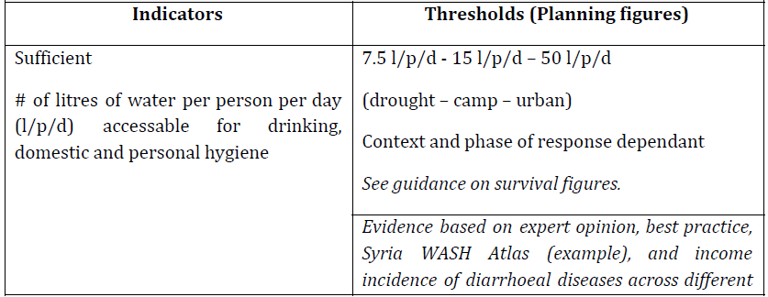

Slide 10
Notes:
Please read the introduction chapter

Slide 13
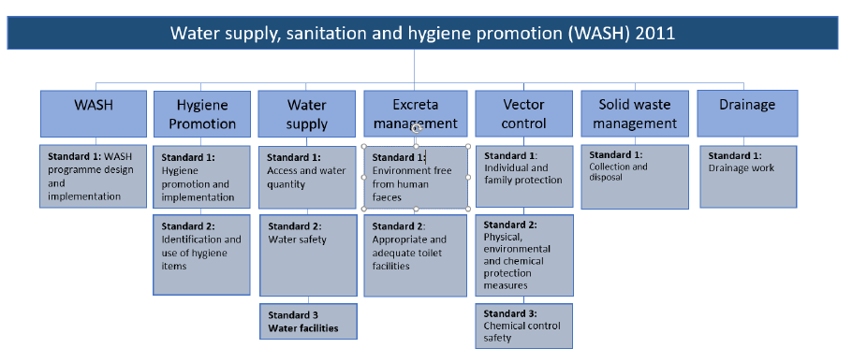
Notes:
Standard 4
There are 2 many key actions
From Infrastructure approach to behavior change approach
Waste management
Shifted to whole process of waste managerment

Slide 14
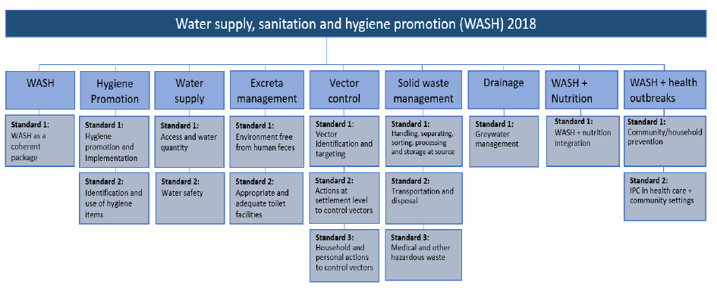

Slide 17
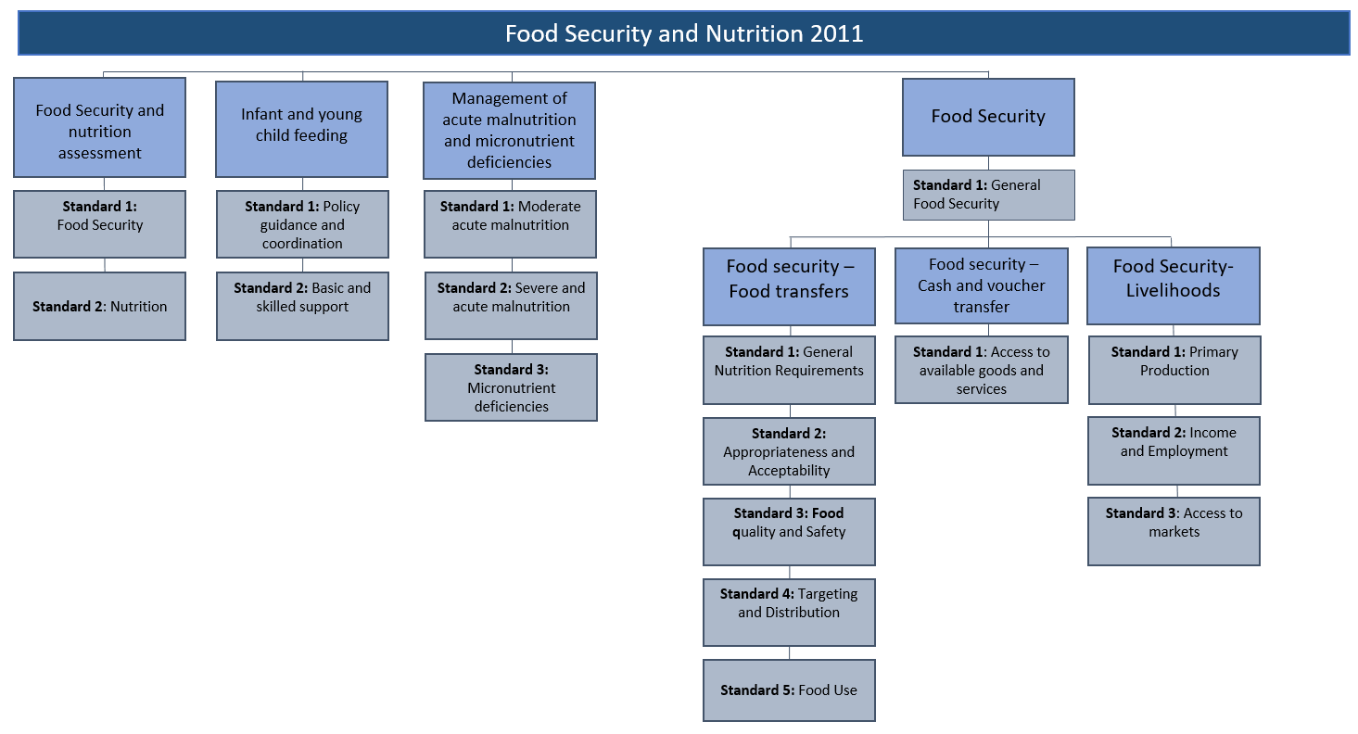

Slide 18
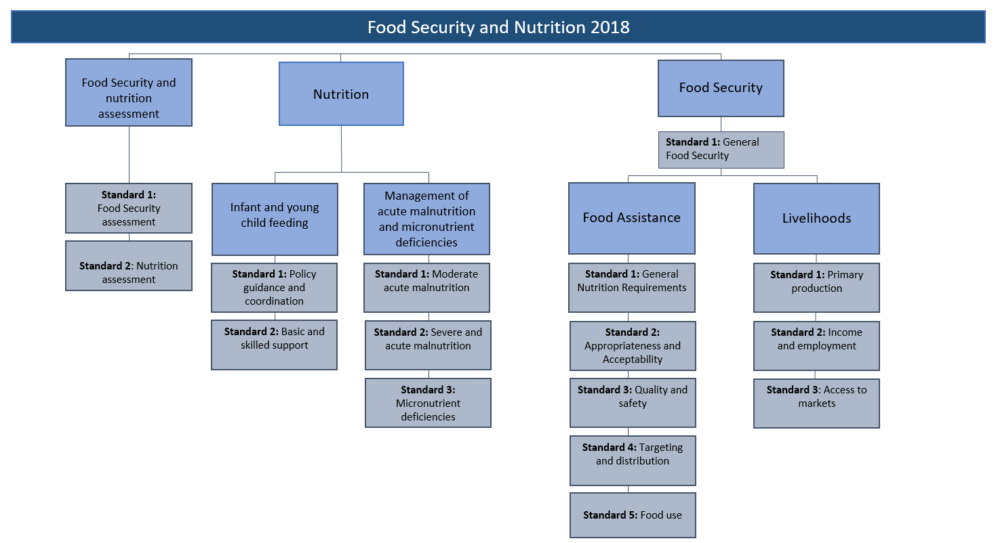

Slide 20
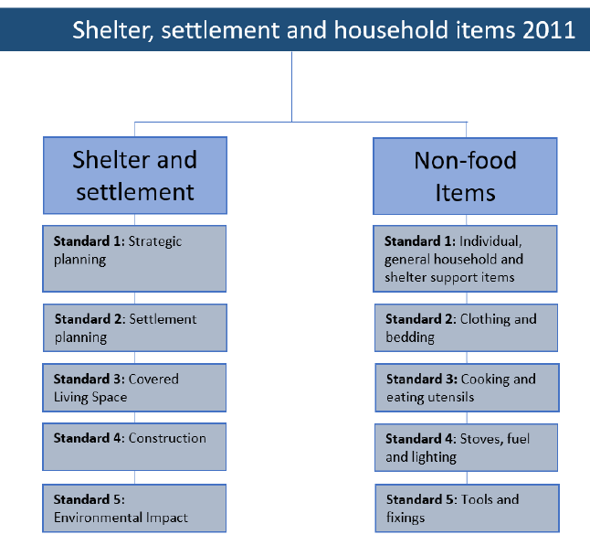

Slide 21
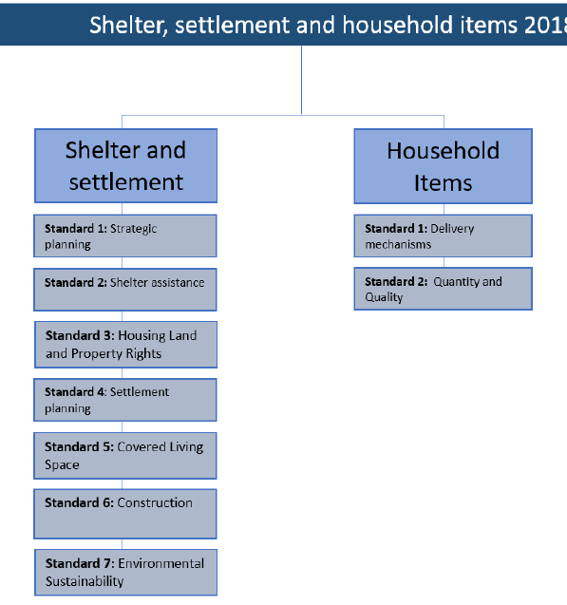

Slide 25
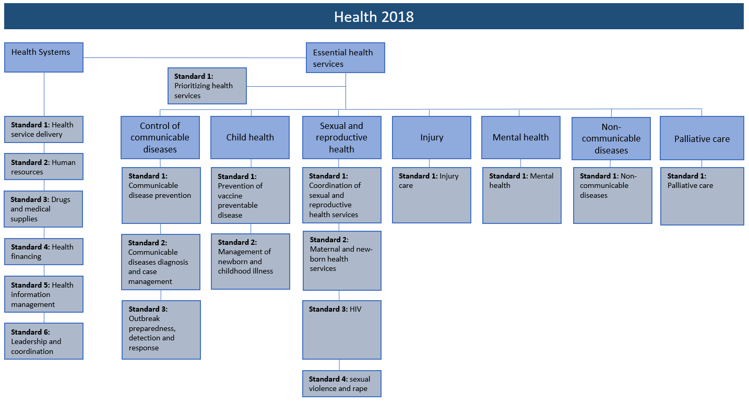

Slide 28
