Slide 1
Humanitarian 5Ws (WHO, WHAT, WHERE, for WHOM and WHEN)
PAKISTAN
Tools, Process and Responsibilities
Rashmi Rita
Office for the Coordination of Humanitarian Affairs (OCHA)

Slide 2
New 5W Process Highlights
One entry sheet for agencies
Agencies
No need to submit same information to multiple requests
Sector coordination/working groups
do not have to spent collecting
have more time to check information quality
focus on monitoring and reporting
Combined data and dashboards

Slide 3
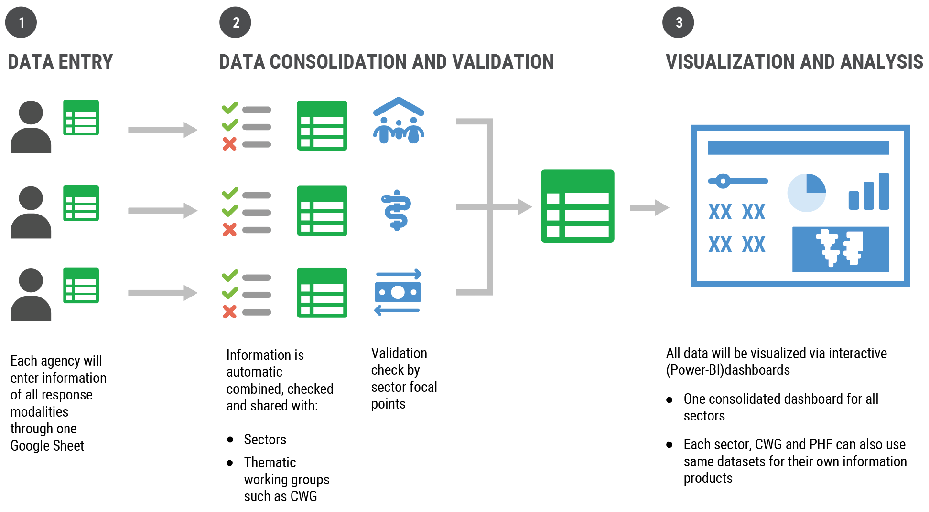
5W Process

Slide 4
Links
Register using this link - https://forms.gle/tSkww2yXQkvkujbo8
View link of live consolidated data after data entry. This will be validated by OCHA/Sectors before update to Dashboard. This is link is shared so agencies can – https://docs.google.com/spreadsheets/d/1mPTxVhCtW-NHgAFtcScu9ptTKj99Ykm6y5-ObjBQ_DA/edit#gid=0
Dashboard - https://response.reliefweb.int/pakistan/2022-monsoon-5w-dashboard

Slide 5
Next Steps…
Sectors
Nominate/Register Sector Focal Point (SFP) for 3W
Responsibility SFP
Register and access sector information
Ensure all partner agencies have submitted
Highlight any duplication or gaps to partner agencies
Conduct sector analysis as required
Check sector activities and indicators
Check submissions and follow-up with agencies if required – link with be available tomorrow

Slide 6
Next Steps…
Agencies
Nominate/Register Agency Focal Point (AFP) for 3W
Responsibility AFP
Register, access agency sheet
Ensure all information from agencies are entered/updated
When needed, address any data validation issues
Ensure data entry sheets are accessible/editable
Data entry

Slide 7
Actions and timeline
Second round data entry by agencies – 5 Sept to 7 Sept
First round data validation by sectors/agencies – 1 September 2022
Next Dashboard update – 8 September

Slide 8
Register or ask agencies to register to access entry tool :
https://forms.gle/oJKpzPVCkary5jkv6

