Slide 1
Webinar COVID19 Prevention, Response & Recovery

Slide 2
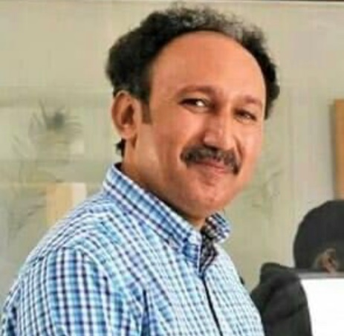
Mr. Ghulam Mustafa Zaor is a renowned development professional having more than a decade and half experience in the field of rural development. His expertise is Strategic Planning in community development sector, Project Management & networking with the public and private sector. Mr. Zaor is also a master trainer in the field of social mobilization, leadership, project management & strategic planning. He has developed manual and protocols for the social mobilization, organizational management, Urban and Rural WASH and climate smart programing. Mr. Ghulam Mustafa Zaor is equipped with the relevant knowledge on local governance issues, public policy, democracy and its challenges.

Slide 3
Background
On 12 January 2020, the WHO confirmed that a novel coronavirus was the cause of a respiratory illness in a cluster of people in Wuhan City, Hubei Province, China
The outbreak of the COVID-19 in most part of the world was unprecedented in its scale, severity, and complexity
In Pakistan, the first imported case of COVID-19 reported on Feb 25, 2020
The major entry of infection was through primary cases returned from different countries as pilgrims from Iran, Saudi Arabia, Pakistani nationals from Europe, England and USA

Slide 4
Preparedness Phase
Fist Case Reported in Pakistan
P TF formed by GoS
2 Cases
NAP- CoVID-19 by GoP
NCC formed by GoP
NCOC Established by GoP
5 Cases
134 Cases
1,865 Cases

Slide 5
Ground Realties
150 health facilities were assessed by in 24 districts
Only 30% of facilities received complete PPEs and IPC trainings up to the March 31, 2020.
Major items such as Tyvec suits and N95 respirator masks were available on only 50% secondary health facilities.
Face mask and disposable gloves were available on nearly 75% secondary health facilities.
Latex gloves and Hand sanitizer are available on nearly 40% secondary health facilities and less than one third of all isolation facilities
The data revealed that ventilators were available only in 9 districts & 12 Tertiary and Secondary care health facilities, while in remaining 15 districts even the District Headquarter Hospitals, ventilators were not available.

Slide 6
Sub-national level status of CoVID-19 cases
Provinces | Population in million | Total Tests Conducted (till 10th Aug) | Tests/ Million | Confirmed Cases | CoVID-19 cases/ million (till 10th Aug)
Punjab | 110 | 783,680 | 7,124 | 94,477 | 859
Sindh | 47.88 | 826,258 | 17,257 | 123,849 | 2,587
KP | 35.5 | 222,325 | 6,263 | 34,692 | 977
Balochistan | 12.34 | 64,361 | 5,216 | 11,906 | 965
Gilgit Baltistan | 4.05 | 16,795 | 4,147 | 2,334 | 576
ICT | 2 | 205,264 | 102,632 | 15,261 | 7,631
AJK | 1.25 | 28,901 | 23,121 | 2,141 | 1,713
Pakistan | 213.02 | 2,147,584 | 10,082 | 284,660 | 1,336

Slide 7
Testing Capacity and Utilization
S# | Province | Total Number of Laboratories | Testing Capacity | % capacity of utilization
1 | Punjab | 34 | 16,470 | 45%
2 | Sindh | 25 | 13,850 | 74%
3 | KP | 13 | 3,050 | 63%
4 | Balochistan | 5 | 2,220 | 18%
5 | Islamabad | 16 | 7,400 | 28%
6 | AJK | 3 | 376 | 88%
7 | GB | 3 | 360 | 13%
 | Pakistan | 99 | 43,726 | 47%

Slide 8
Trend of CoVID-19 cases

Slide 9
Global Trend of CoVID-19 cases

Slide 10
16 Essentials of CoVID-19 Response Strategy Developed by Government of Sindh
1. Expand capacity for communication and proactively manage media relations | 2. Bolster capacity of essential public health services to enable emergency response | 3. Clarify first-point-of-contact strategy for possible CoVID-19 cases, phone, online, physical | 4. Protect other potential first- contact health system entry points
5. Designate hospitals to receive CoVID-19 patients and prepare to mobilize surge acute and ICU capacity | 6. Organize and expand services close to home for CoVID-19 response | 7. Maintain continuity of essential services while freeing up capacity for CoVID-19 response | 8. Train, repurpose and mobilize health workforce according to priority services
9. Protect the physical health of frontline health workers | 10. Anticipate and address the mental health needs of the health workforce | 11. Review supply chains and stocks of essential medicines and health technologies | 12. Mobilize financial support and ease logistical and operational barriers
13. Assess and mitigate potential financial barriers to accessing care | 14. Assess and mitigate potential physical access barriers for vulnerable groups of people | 15. Optimize social protection to mitigate the impact of public health measures on household financial security | 16. Ensure clarity in roles, relationships and coordination mechanisms in health system governance and across government

Slide 11
Initiatives at National level
National Action Plan for CoVID-19 was developed and enabling environment was created for UN and CSOs to initiate CoVID-19 response
National Command and Operation Center- NCOC was established
Smart lockdown strategy agreed and introduced
Helpline and telehealth services initiated by the provincial governments and national government
PPEs support and testing kits were distributed through NDMA
Risk Communication package was designed, and campaigns launched at national level
Ehsaas Emergency Cash program introduced in the context of the economic hardship being experienced by the vulnerable due to the ongoing coronavirus crisis

Slide 12
HANDS Contribution
669 staff members of health facilities and isolation centers was trained in infection prevention and control
PPE Kits were provided at 404 health facilities and 38 isolation centers
181 handwashing stations installed at Health care facilities and communal places, 19,050 people daily accessed the communal handwashing stations
42 Electric Water Coolers & 16 Dispensers with Purifier, 48 Water storage Tanks with 350 Gallon capacity have been installed in Health/ Isolation Centers in Sindh
44 latrines/ public toilet facilities rehabilitated at health facilities
15,000 most vulnerable families were identified and provided support of food baskets for the period of one month
Family Planning services were continued in 3,000 villages through cadre of community-based health workers/ MARVI workers and SBAs

Slide 13
HANDS Contribution
675 Religious Leaders have been engaged in 11 districts of Sindh to reach population through Advocacy, Community Engagement and Interpersonal Communication Activities.
42,140 soaps and 690 bottles of hand sanitizers distributed in 339 & 69 Masjids respectively including 2569 liquid soaps in 100 masjids for Eid-ul- Azha preparedness.
1.33,687 people have been reached till date through dissemination of COVID-19 Awareness messages at Health Centers, Community Engagement, Advocacy and Interpersonal Communications.
Mass media campaign was launched through 8 FM Radio stations to reach 5 million population. Talk Shows with experts and key messages regarding COVID-19 Precautionary Measures were relayed

Slide 14
Area for improvements
Health is a devolved subject after 18th amendment, so, pandemic emergency was a high time to strengthen the provincial level institutions, but the political priorities were the major barrier in this regard
Border management was challenge to meet the provincial level priorities and actions
There is a dire need to develop localize Pandemic Response Plans (UCs/ City level, district, sub-national and national level)
Humanitarian sector partners including UN should improve the priory setting , decision making and to respond the critical needs in the context of economic impact of pandemic emergency
Data management and sharing at the UN and humanitarian sector partners level

Slide 15
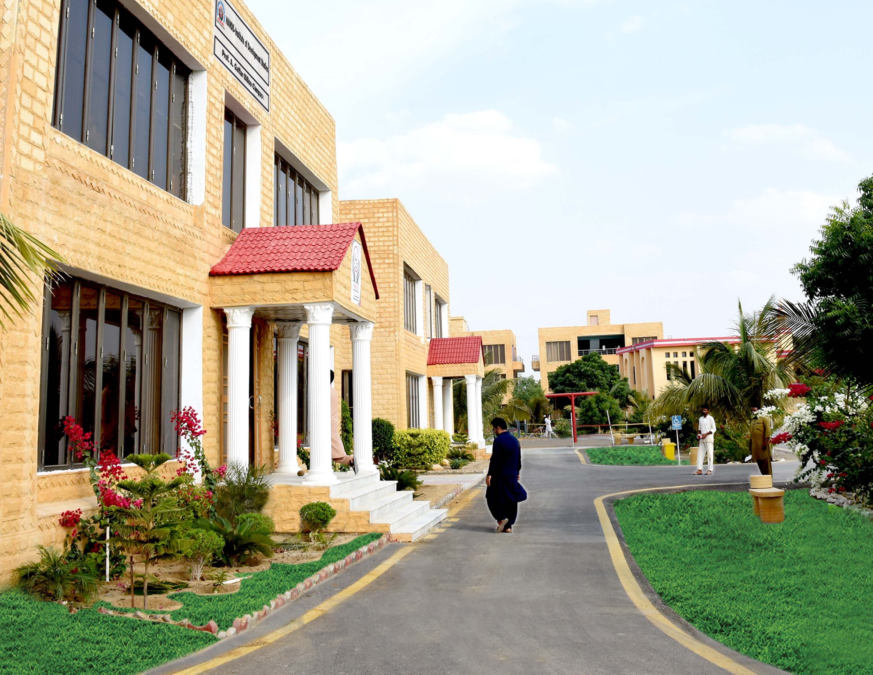
Thank You
www.hands.org.pk

