Slide 1
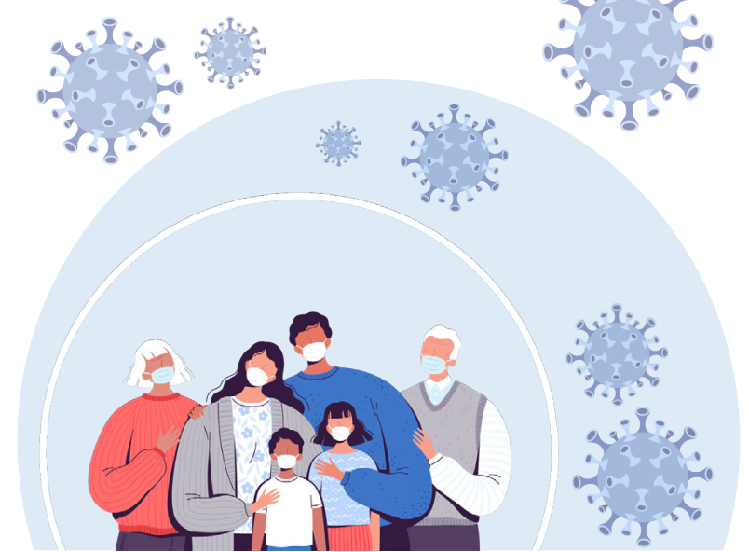
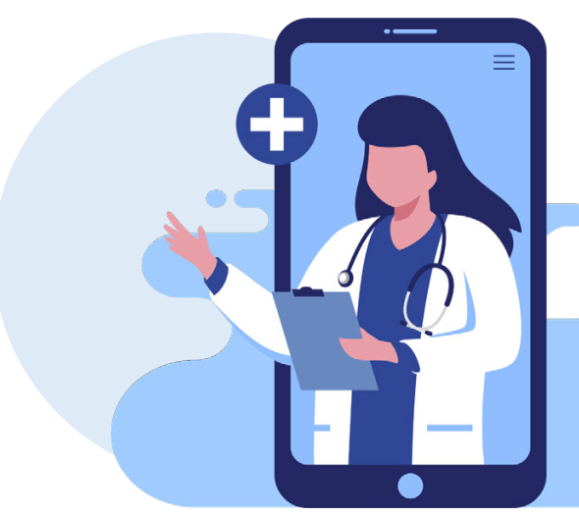
FAQs Covid Vaccination

Slide 2
https://vaccinateyourfamily.org/questions-about-vaccines/covid19faq/?gclid=CjwKCAjw8KmLBhB8EiwAQbqNoLgR9ai5q0Lhr8e6RVgq9vLV4w5GIAfaMM-oiqVxaQtoMfZ-p6jqiRoCTvUQAvD_BwE#heading0

Slide 3
COVID-19 vaccination is a safer way to build protection
COVID-19 and Vaccine Basics
COVID-19 and Vaccine Basics
Getting the virus that causes COVID-19 may offer some natural protection, known as an antibody or immune. But experts don’t know how long this protection lasts.
The risk of severe illness and death from COVID-19 far outweighs any benefits of natural immunity.
COVID-19 vaccination will help protect you by building immunity without the risk of severe illness.
Notes:
COVID-19 vaccination is a safer way to help build protection. Getting the virus that causes COVID-19 may offer some natural protection, known as immunity. But experts don’t know how long this protection lasts, and the risk of severe illness and death from COVID-19 far outweighs any benefits of natural immunity. COVID-19 vaccination will help protect you.

Slide 4
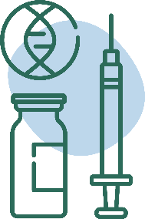
Key facts about COVID-19 vaccination
COVID-19 and Vaccine Basics
COVID-19 and Vaccine Basics
Getting vaccinated can help prevent getting sick with COVID-19
People who have already gotten sick with COVID-19 may still benefit from getting vaccinated
COVID-19 vaccines cannot give you COVID-19
COVID-19 vaccines will not cause you to test positive on COVID-19 viral tests*
https://www.cdc.gov/coronavirus/2019-ncov/vaccines/about-vaccines/vaccine-myths.html
*https://www.cdc.gov/coronavirus/2019-ncov/hcp/testing-overview.html
Notes:
It is easy to be confused by all the information that is circulating, some of which may be conflicting. CDC has facts to counteract common myths on this page, such as:
COVID-19 vaccines will not give you COVID-19
People who have gotten sick with COVID-19 may still benefit from getting vaccinated
Getting vaccinated can help prevent getting sick with COVID-19
COVID-19 vaccines will not cause you to test positive on COVID-19 viral tests*
Please visit: https://www.cdc.gov/coronavirus/2019-ncov/vaccines/about-vaccines/vaccine-myths.html to read more about these vaccine myths and the facts about COVID-19 vaccine from CDC.
NOTE: While COVID-19 vaccination will not cause a positive result on viral tests, there is a possibility that it could cause a positive result on a serologic (antibody) test.

Slide 5
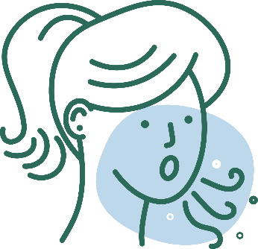
COVID-19 vaccination will help protect you from COVID-19
COVID-19 and Vaccine Basics
COVID-19 and Vaccine Basics
Getting a COVID-19 vaccine...
Will help create an immune response in your body against the virus
May help keep you from getting severely ill, even if you do get COVID-19
Notes:
COVID-19 vaccination will help keep you from getting COVID-19. Getting a COVID-19 vaccine will help create an immune response in your body against the virus without your having to experience illness. Based on what is known about vaccines for other diseases, experts believe that getting a COVID-19 vaccine may help keep you from getting seriously ill even if you do get COVID-19.

Slide 6
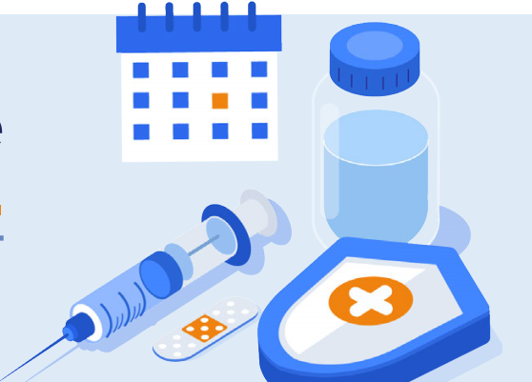
COVID-19 VACCINATION SAVES LIVES
Vaccination reduces the risks of infection, especially severe infection that leads to hospitalization
This will help keep our hospitals and healthcare facilities from being overwhelmed
Notes:
Sources:
https://www.cdc.gov/vaccines/hcp/conversations/understanding-vacc-work.html
https://www.cdc.gov/vaccines/vpd/vpd-vac-basics.html

Slide 7
What is a vaccine and how does it work?
Vaccines prevent diseases that can be dangerous, or even deadly. They work with your body’s natural defenses to safely develop protection from a disease.
A vaccine helps your immune system to produce antibodies, just like it would if you were exposed to the disease. After getting vaccinated, you have protection from that disease, without having to get the disease first.
This is what makes vaccines such powerful medicine. Unlike most medicines, which treat or cure diseases, vaccines prevent them.
Notes:
Sources:
https://www.cdc.gov/vaccines/hcp/conversations/understanding-vacc-work.html
https://www.cdc.gov/vaccines/vpd/vpd-vac-basics.html

Slide 8
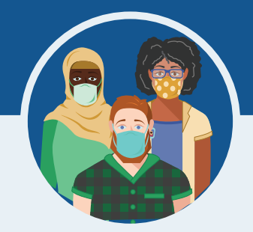
What are the benefits of getting a COVID-19 vaccine?
COVID-19 vaccination will help keep you from getting sick from COVID-19
All COVID-19 vaccines available have been shown to be very effective
The combination of getting vaccinated and following WHO recommendations to protect yourself and others will offer the best protection from COVID-19
The more people who get vaccinated, the faster we can get back to our normal lives
Notes:
We understand that some people may be concerned about getting vaccinated. While more COVID-19 vaccines are being developed as quickly as possible, routine processes and procedures remain in place to ensure the safety of any vaccine that is authorized or approved for use.
Safety is a top priority, and there are many reasons to get vaccinated.

Slide 9
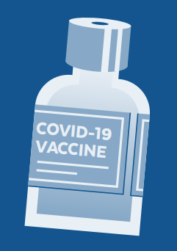
What vaccines are available?
All the COVID-19 vaccines are safe and highly effective against serious illness, hospitalization, and death
People should get both doses to be fully vaccinated in order to be effective.
Pakvac and Cansino has only 1 dose
Notes:
What does it mean now that the Pfizer COVID-19 vaccine has FDA approval?
On 8/23/21, the FDA approved the first COVID-19 vaccine. The vaccine has been known as the Pfizer COVID-19 Vaccine and will now be marketed as Comirnaty (koe-mir’-na-tee), for the prevention of COVID-19 in people 16 years of age and older.
Comirnaty is the same vaccine as the Pfizer vaccine.
The Pfizer vaccine is also still available under emergency use authorization (EUA) for people ages 12 through 15 and for a third dose for certain immunocompromised individuals.
Compared to an EUA, FDA approval of vaccines requires even more data on safety, manufacturing, and effectiveness over longer periods of time and includes real-world data.
The full approval by the FDA means that the Comirnaty vaccine now has the same level of approval as other vaccines routinely used in the U.S., such as vaccines for hepatitis, measles, chicken pox, and polio.
The Pfizer COVID-19 vaccine was the first vaccine to receive emergency authorization, which is why it is the first to have enough data to receive full approval. It does not mean anything about the safety and effectiveness of the Moderna or Johnson & Johnson vaccine.
What is an Emergency Use Authorization (EUA)?
The United States FDA has made the Pfizer, Moderna, and Janssen COVID-19 Vaccines available under an emergency mechanism called an EUA. The EUA is supported by a Secretary of Health and Human Services (HHS) declaration that a situation exists to justify the emergency use of pharmaceuticals during the COVID-19 pandemic.
FDA may issue an EUA when certain criteria are met, which includes that there are no adequate, approved, available alternatives. The FDA decision is also based on scientific evidence available showing that the product may be effective to prevent COVID-19 during the pandemic and that the known and potential benefits of the product outweigh the risks. All of these criteria must be met to allow for the product to be used during the COVID-19 pandemic.

Slide 10
How do we know if the vaccine is safe?
Vaccines go through more testing than any other pharmaceuticals:
Small groups of people receive the trial vaccine
The vaccine is given to specific groups of people (i.e by age, race, and physical health).
The vaccine is given tens of thousands of people and tested for effectiveness and safety.
Notes:
We understand the importance of being open and honest about the safety and development of the vaccine— especially for communities who have suffered consequences of medical mistreatment.
It’s important to know that vaccines go through more testing than any other pharmaceuticals. Before any vaccine is made available, it must go through rigorous development and testing. Manufacturing is critical — every dose must consistently be high quality. Additionally, there is extensive testing in clinical trials to prove safety.
Source: https://www.cdc.gov/coronavirus/2019-ncov/vaccines/safety.html

Slide 11
How do we know if the vaccine is safe?
The CDC’s Advisory Committee on Immunization Practices looks at the data to see if the vaccine is safe and works. They give advice to the U.S. Food and Drug Administration (FDA).
The FDA looks at the data and the advice from the Advisory Committee and decides whether to approve the vaccine.
The vaccine is only approved after all of these steps are done and various teams of reviewers are sure that it works and is safe.
Notes:
Safety is a top priority, and safety monitoring for the COVID-19 vaccines has been the most intense and comprehensive in U.S. history.
The pause of the J&J vaccine from 4/13/21-4/23/21 was an example of safety monitoring in action.
Out of an abundance of caution, on 4/13/21, the FDA and CDC paused use of the J&J COVID-19 vaccine because 6 people out of 7 million who had gotten the J&J vaccine developed a rare but serious type of blood clot about 2 weeks after getting the vaccine.
On 4/23, after further study and review, including two meetings of the CDC’s Advisory Committee on Immunization Practices, the FDA and CDC ended the pause and allowed immediate use of the J&J vaccine.
The FDA and CDC have confidence that this vaccine is safe and effective in preventing COVID-19, and that the vaccine’s known and potential benefits outweigh its known and potential risks in individuals 18 years of age and older.

Slide 12
How is it safe if it happened so fast?
The timeline was sped up but never cut corners on safety. Here is how:
We already had helpful information about coronaviruses, so we weren’t starting from scratch.
The governments invested a lot of money to support vaccine companies with their work.
A lot of people participated in clinical trials and we didn’t need to spend time finding volunteers.
Manufacturing happened at the same time as safety studies, so vaccines were ready to be distributed once they were approved.
Notes:
The COVID-19 vaccine was developed quickly but all of the same safety steps were followed for this vaccine that are used for all vaccines.
Vaccine companies moved quickly because:
We already had helpful information: The COVID-19 virus is a part of a coronavirus family that has been studied for a long time. Experts learned important information from other coronavirus outbreaks that helped them to develop the COVID-19 vaccine, so we weren’t starting from scratch.
Governments funded vaccine research: The United States and other governments invested a lot of money to support vaccine companies with their work. Working together with other countries also helped researchers move quickly.
Tens of thousands of people participated in vaccine studies: Studies of the vaccine (called Clinical Trials) were conducted to prove the vaccine is safe and effective. Tens of thousands of people signed up for the studies, so companies did not need to spend a lot of time finding volunteers.
Manufacturing happened at the same time as the safety studies: Vaccine companies started making the vaccine at the same time as studies were happening in hopes that it would be proven safe and effective. This meant vaccines were ready to be distributed once they were approved

Slide 14
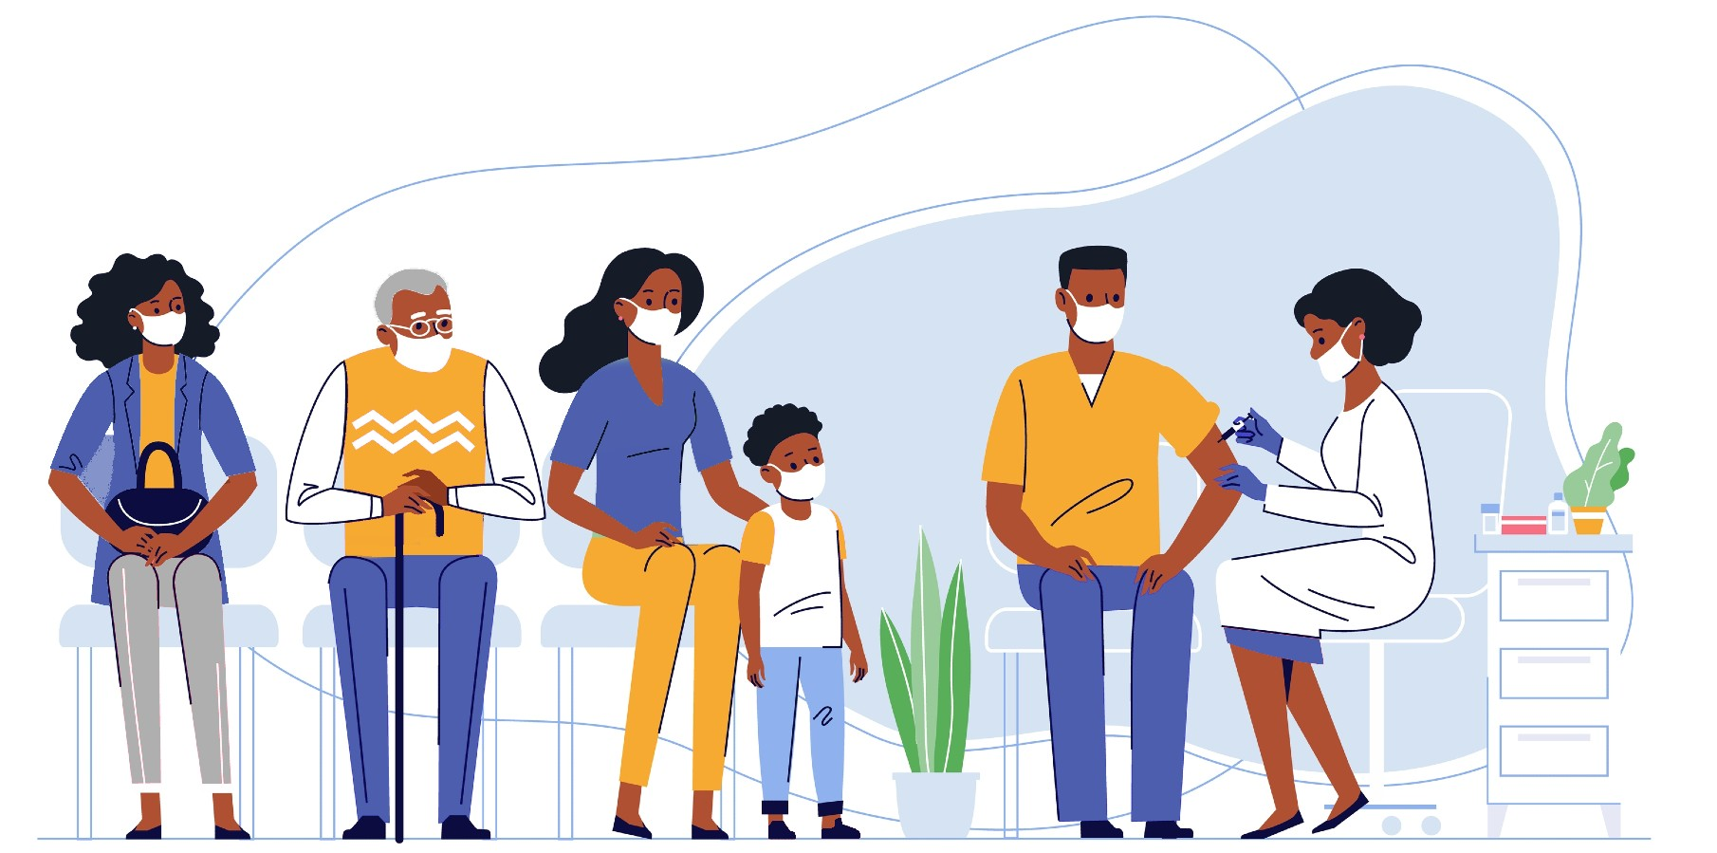
Who may get COVID-19 vaccines?
Everyone 12 years of age and older – including those who are pregnant and recently pregnant/breastfeeding – is recommended to get a COVID-19 vaccination.
Get a COVID-19 vaccine as soon as you can to protect from yourself and your loved ones from COVID.

Slide 15
Can I get COVID-19 from the COVID-19 vaccines?
No. The vaccines do not contain the live virus that causes COVID-19. This means that you can’t catch COVID-19 from the vaccine.

Slide 16
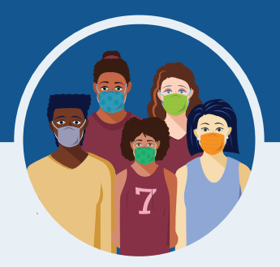
Do the COVID-19 vaccines have any side effects?
Serious side effects from vaccines, including the COVID-19 vaccine, are rare.
It is possible that some people may have side effects, which are normal signs that your body is building protection.
These side effects may affect your ability to do daily activities, but they should go away in a few days.
The most common side effects are minor and include:
Tiredness
Headache
Pain at the injection site
Muscle and/or joint pain
Chills
Nausea and/or vomiting
Fever
Notes:
Serious side effects from vaccines, including the COVID-19 vaccine, are rare. In the Pfizer, Moderna, and Janssen clinical trials, serious side effects happened at the same frequency as they do in the general population (among less than 1.0% of participants who received the vaccine). There were no notable differences in serious adverse events by age, race, ethnicity, or medical conditions. The side effects in adolescents 12-15 years old were consistent with those reported in clinical trial participants 16 years of age and older.
If you got the J&J COVID-19 vaccine and develop any of the symptoms below within 3 weeks after vaccination, get medical care right away:
Severe headache or blurred vision
Shortness of breath
Gut pain that does not go away
Chest pain
Leg swelling
Easy bruising or tiny blood spots under the skin
In the Moderna vaccine trial, examples of serious side effects included two people with facial swelling, one person with difficult-to-control nausea and vomiting, and one report of Bell’s palsy. In the Pfizer vaccine trial, examples included a shoulder injury at the vaccination site and swollen lymph nodes in the armpit opposite the vaccination arm. In the Janssen vaccine trial, examples included four people with seizures and six people with deep vein thrombosis. We don’t know if these serious side effects are related to the vaccine or not.
Some instances of severe allergic reactions have been reported outside of clinical trials. See slide 19 for more information about allergic reactions.
Minor side effects are more common after the second dose of Moderna and Pfizer than the first.
https://www.fda.gov/emergency-preparedness-and-response/mcm-legal-regulatory-and-policy-framework/pfizer-biontech-covid-19-vaccine-frequently-asked-questions
https://www.fda.gov/emergency-preparedness-and-response/mcm-legal-regulatory-and-policy-framework/moderna-covid-19-vaccine-frequently-asked-questions
https://www.fda.gov/emergency-preparedness-and-response/mcm-legal-regulatory-and-policy-framework/janssen-covid-19-vaccine-frequently-asked-questions
https://www.fda.gov/media/146305/download

Slide 17
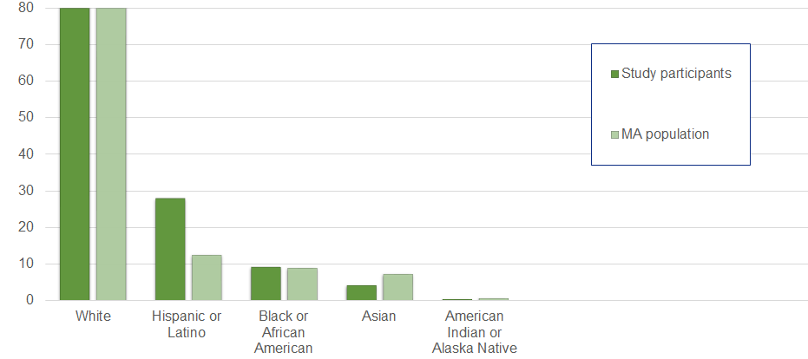
Who was the Pfizer vaccine tested on?
The safety of the Pfizer vaccine was evaluated in 43,448 people 16 years of age and older in two clinical studies conducted in the United States, Europe, Turkey, South Africa, and South America.
Notes:
Overall, 50.6% of participants in the Pfizer safety trials were male and 49.4% were female, 83.1% were White, 9.1% were Black or African American, 28.0% were Hispanic or Latino, 4.3% were Asian, and 0.5% were American Indian or Alaska Native. The safety of the Pfizer vaccine in younger adolescents was studied in 2,260 adolescents ages 12-15 in the U.S.
https://www.fda.gov/media/144413/download

Slide 18
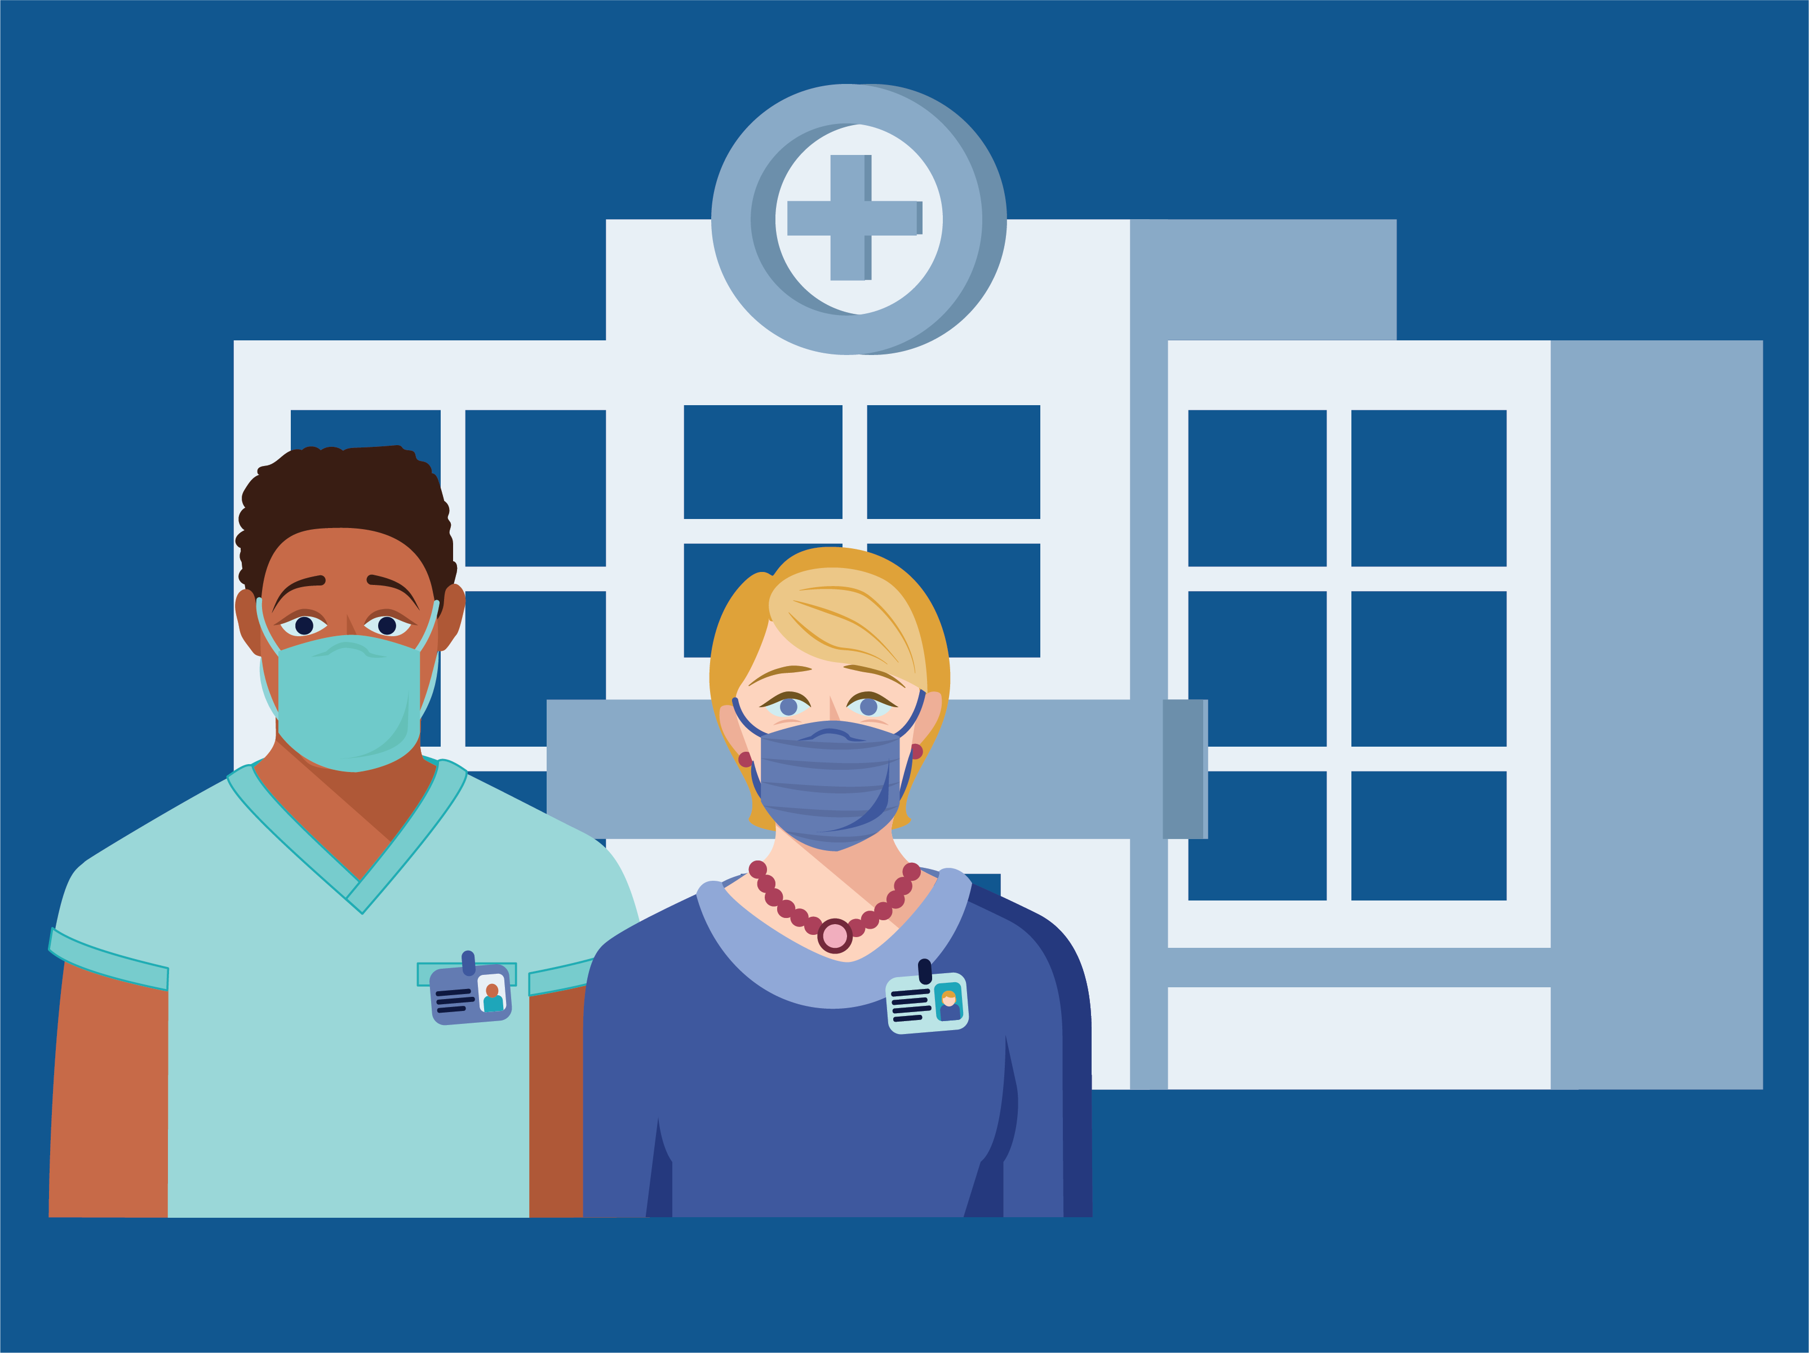
Should someone with allergies get the COVID-19 vaccine?
You should not get the COVID-19 vaccines if you have a history of severe allergic reaction (also called “anaphylaxis”) to any ingredient in the vaccine.
The vaccines do not contain eggs, gelatin, preservatives, or latex.
If you have a history of a severe allergic reaction to something else that’s not in the vaccine (like peanut butter), discuss with your health care provider before receiving the vaccine.
Notes:
Although there is a small chance that the COVID-19 vaccines could cause a severe allergic reaction, this would usually happen within a few minutes to one hour after getting the vaccine.
Signs of a severe allergic reaction can include:
• Difficulty breathing
• Swelling of your face and throat
• A fast heartbeat
• A bad rash all over your body
• Dizziness and weakness
If you have a history of allergic reactions, your vaccination provider may ask you to stay longer at the place where you received your vaccine for monitoring afterwards.
CDC looked at data reported to the federal Vaccine Adverse Event Reporting (VAERS) system from mid-December to mid-January, and there were rare reports of severe allergic reaction after COVID-19 vaccination, which happened at similar rates to what is seen with other commonly used vaccines like the flu.

Slide 19
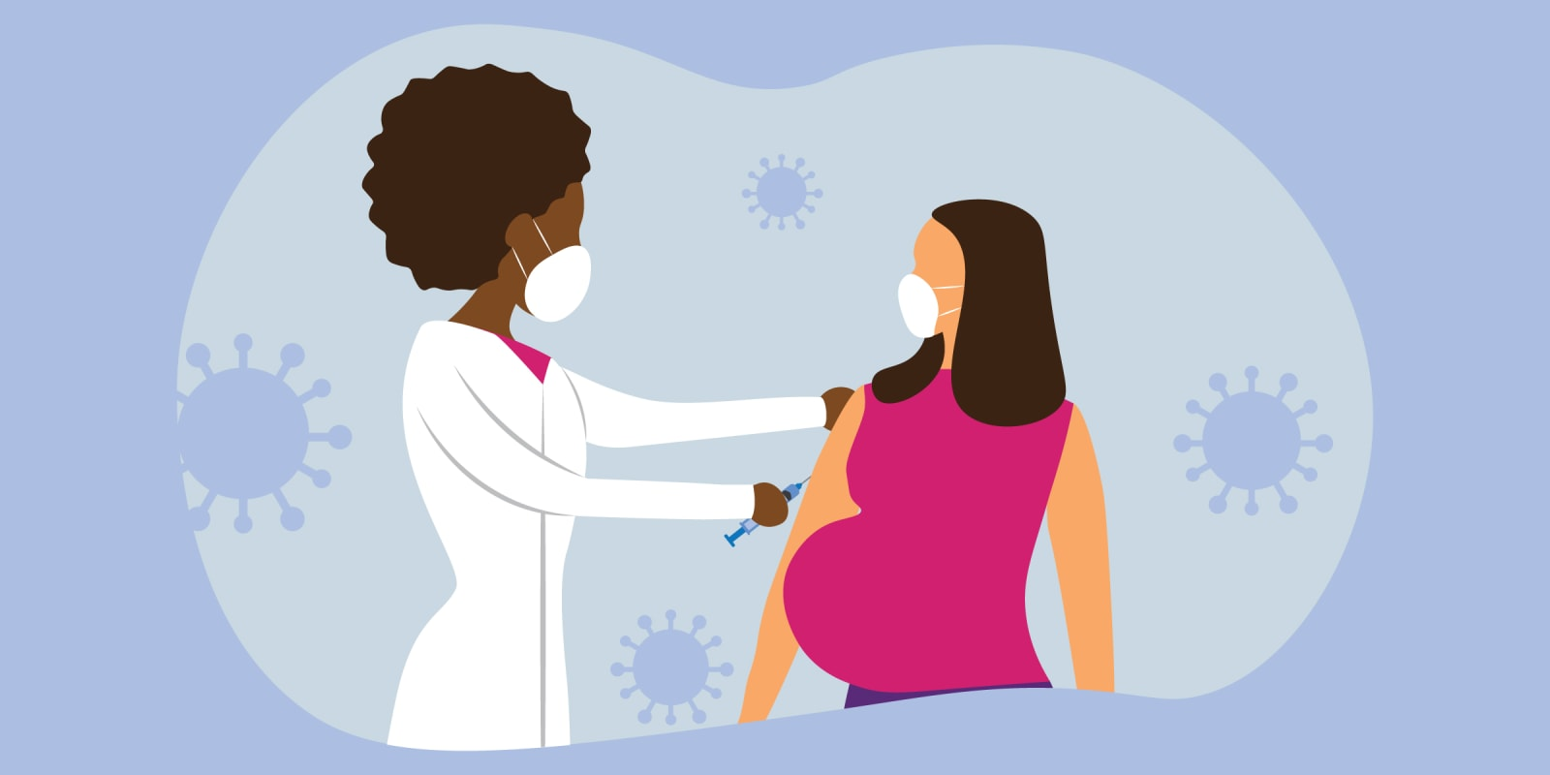
I would like to have a baby one day. Is it safe for me to get a COVID-19 vaccine?
Yes!
CDC recommends COVID-19 vaccination for people who are trying to become pregnant now or who might become pregnant in the future.
There is no evidence that antibodies made following COVID-19 vaccination or that vaccine ingredients will cause any problems.
There is no evidence that fertility problems in women or men are a side effect of any vaccine.
Notes:
COVID-19 vaccines are being studied carefully now and will continue to be studied for many years, similar to other vaccines.
Here’s why it’s safe:
The COVID-19 vaccine, like other vaccines, works by teaching our bodies to develop antibodies that fight against the virus that causes COVID-19, to prevent future illness.
There is no evidence right now that antibodies formed from COVID-19 vaccination will cause any problems with pregnancy, including the development of the placenta.
In fact, there is no evidence that fertility problems are a side effect of ANY vaccine.

Slide 20
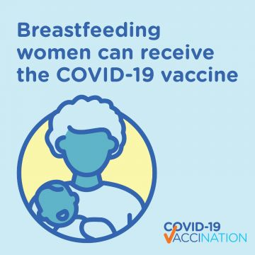
Can someone who is pregnant or breastfeeding get a COVID-19 vaccine?
Yes!
The CDC and American College of Obstetricians and Gynecologists recommend COVID-19 vaccination for pregnant and breastfeeding individuals.
The benefits of receiving a COVID-19 vaccine outweigh any known or possible risks of vaccination during pregnancy.
Getting sick with COVID-19 during pregnancy increases the risk of severe illness and preterm birth.
Getting vaccinated is a personal choice for people who are pregnant or breastfeeding. If you have questions, talk with your healthcare provider.

Slide 21
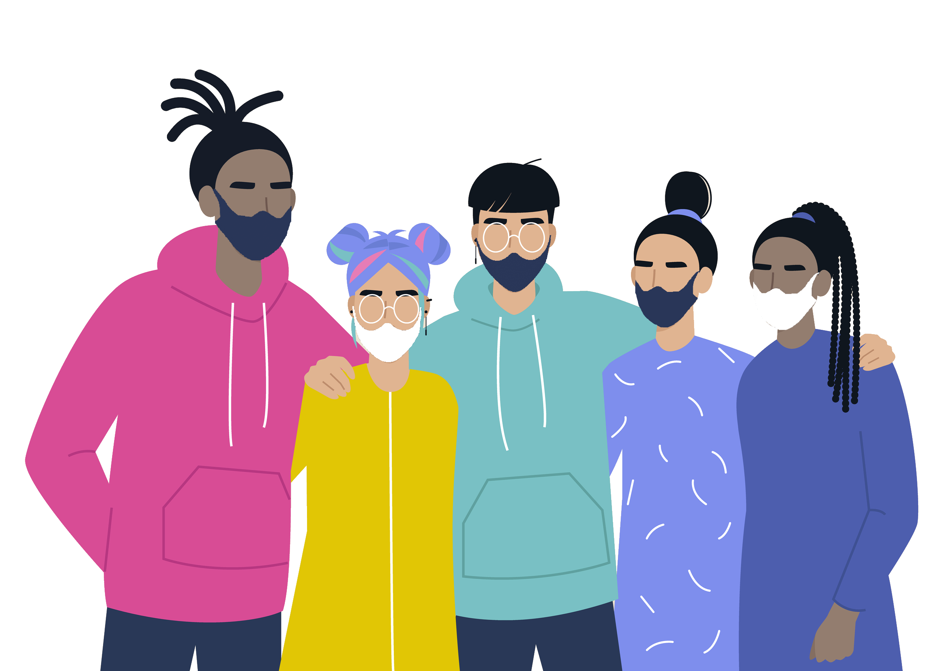
Are the COVID-19 vaccines safe for children?
The Pfizer vaccine is authorized for people ages 12 and older and has full approval for people ages 16 and older.
The Moderna and Johnson & Johnson vaccines are authorized for people ages 18 and older.
Younger children and adolescents should not get the COVID-19 vaccine right now.

Slide 22
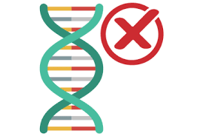
Will a COVID-19 vaccine change my DNA?
No. COVID-19 vaccines do not change or interact with your DNA in any way.
Vaccines teach our immune system how to fight against a specific virus.
In order to do its job, the COVID-19 vaccine doesn’t need to go inside the nucleus of the cell, which is where our DNA is kept. This means the vaccine never interacts with our DNA in any way and has no way to change it.
Notes:
No. COVID-19 vaccines do not change or interact with your DNA in any way.
Vaccines teach our immune system how to fight against a specific virus. They work with the body’s natural defenses to safely develop immunity to disease. In order to do its job, the COVID-19 vaccine doesn’t need to go inside the nucleus of the cell, which is where our DNA is kept. This means the vaccine never interacts with our DNA in any way and has no way to change it.
At the end of the process, our bodies have learned how to protect against future infection. That immune response and making antibodies is what protects us from getting infected if the real virus enters our bodies. (source: https://www.cdc.gov/coronavirus/2019-ncov/vaccines/facts.html)

Slide 23
Will the vaccines work against COVID-19 variants?
It is normal for viruses to change as they spread, and for new variants to appear.
So far, studies suggest that the vaccines provide protection from the known variants (like the Delta variant).
Even when a vaccinated person gets infected with COVID-19, they are very protected against severe disease and death.
Notes:
The CDC is monitoring virus changes in the United States, including changes with the Delta variant.
Scientists are working to learn more about how easily each variant spreads, whether they could cause more severe illness, and whether the vaccines we already have will protect people against specific COVID-19 variants.

Slide 24
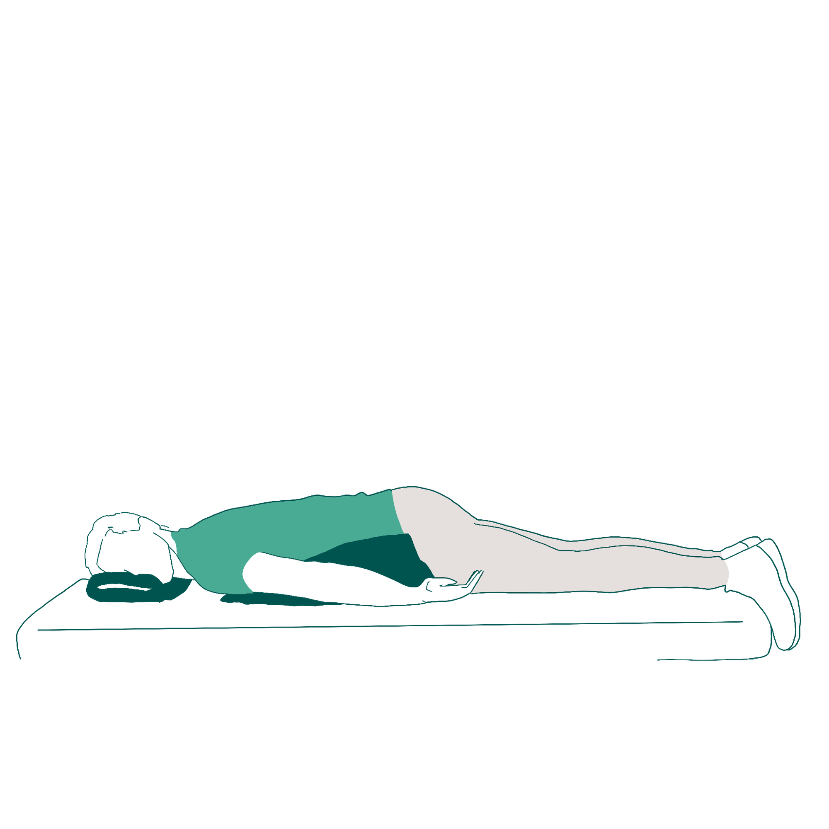
Should I get vaccinated if already had a COVID-19 infection?
Yes. You should be vaccinated, even if you’ve already had a COVID-19 infection
If you were treated for COVID-19 symptoms with monoclonal antibodies or convalescent plasma, you should wait 90 days before getting a COVID-19 vaccine. Talk to your doctor if you are unsure what treatments you received or if you have more questions about getting a COVID-19 vaccine
Why do I Need a COVID-19 Vaccine if I Already Had COVID?
Even if you have already recovered from COVID-19, it is possible—although rare—that you could be infected with the virus that causes COVID-19 again. Data shows that protection from “natural” COVID infection starts to lessen after 90 days.
Notes:
The following individuals are now eligible for a booster dose of Pfizer 6 months after their second shot:
People 65 years and older
Residents of long term care settings
People aged 18–64 years with underlying medical conditions as defined by the CDC: https://www.cdc.gov/coronavirus/2019-ncov/need-extra-precautions/people-with-medical-conditions.html
People aged 18-64 years who are at increased risk for COVID-19 exposure and transmission because of their occupational or institutional setting
You need to get the same brand of vaccine for the booster.
You are still considered fully vaccinated if you do not receive a booster shot.
The side effects following the booster are similar to those after the second dose.
You can get a COVID-19 vaccine and other vaccinations like a flu or shingles vaccine at the same time or close together.
For answers to more commonly asked questions about boosters, visit: https://www.mass.gov/info-details/covid-19-booster-frequently-asked-questions

Slide 25
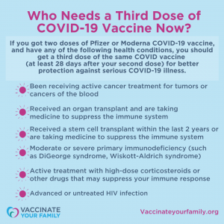
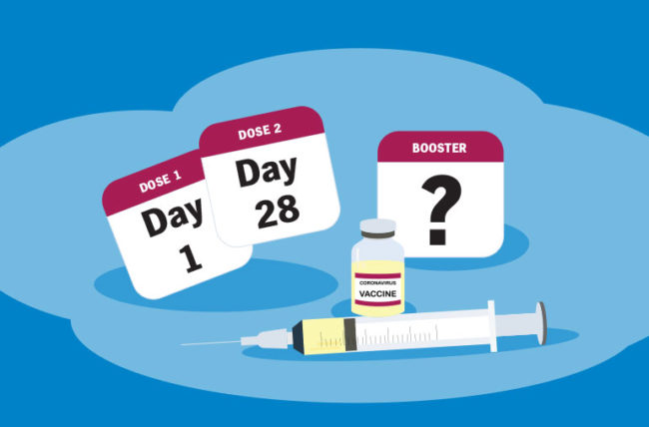
Will I need a booster shot?
COVID-19 vaccines work well to prevent severe illness, hospitalization, and death.
Right now, a booster is available for certain groups of people who received vaccine 6 months ago.
On September 24th, the CDC accepted the recommendations from its advisory committee (ACIP) on COVID booster doses
If you got the Moderna or Johnson & Johnson COVID vaccine, you are NOT recommended to get a booster shot at this time
Notes:
The following individuals are now eligible for a booster dose of Pfizer 6 months after their second shot:
People 65 years and older
Residents of long term care settings
People aged 18–64 years with underlying medical conditions as defined by the CDC: https://www.cdc.gov/coronavirus/2019-ncov/need-extra-precautions/people-with-medical-conditions.html
People aged 18-64 years who are at increased risk for COVID-19 exposure and transmission because of their occupational or institutional setting
You need to get the same brand of vaccine for the booster.
You are still considered fully vaccinated if you do not receive a booster shot.
The side effects following the booster are similar to those after the second dose.
You can get a COVID-19 vaccine and other vaccinations like a flu or shingles vaccine at the same time or close together.
For answers to more commonly asked questions about boosters, visit: https://www.mass.gov/info-details/covid-19-booster-frequently-asked-questions

Slide 26
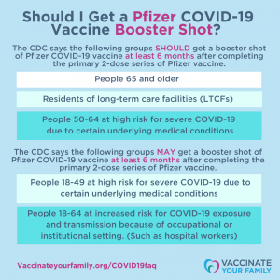
Will I need a booster shot?
The CDC says the following groups of people SHOULD get a booster dose of the Pfizer COVID vaccine at least 6 months after completing the primary 2 dose-series of vaccine:
People 65 years and older
Residents of long-term care facilities
People 50-64 years at high risk for severe COVID-19 due to certain underlying medical conditions
People 18-49 years with certain underlying medical conditions
People 18-64 years who are at increased risk for COVID-19 because of where they work (e.g., front line essential workers, healthcare workers, etc.) or where they live
Notes:
The following individuals are now eligible for a booster dose of Pfizer 6 months after their second shot:
People 65 years and older
Residents of long term care settings
People aged 18–64 years with underlying medical conditions as defined by the CDC: https://www.cdc.gov/coronavirus/2019-ncov/need-extra-precautions/people-with-medical-conditions.html
People aged 18-64 years who are at increased risk for COVID-19 exposure and transmission because of their occupational or institutional setting
You need to get the same brand of vaccine for the booster.
You are still considered fully vaccinated if you do not receive a booster shot.
The side effects following the booster are similar to those after the second dose.
You can get a COVID-19 vaccine and other vaccinations like a flu or shingles vaccine at the same time or close together.
For answers to more commonly asked questions about boosters, visit: https://www.mass.gov/info-details/covid-19-booster-frequently-asked-questions

Slide 28
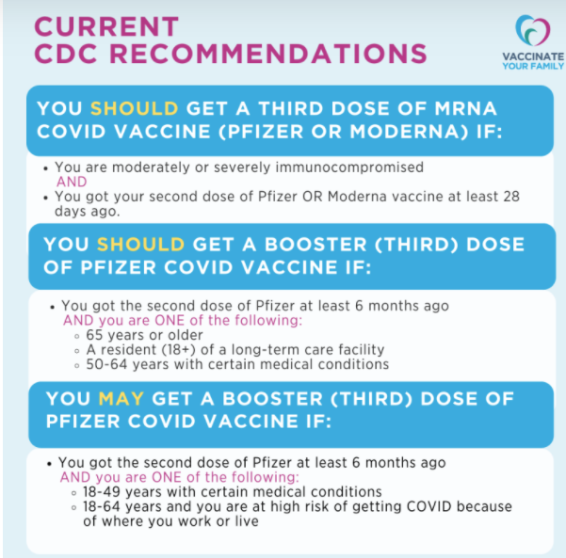
Do I Need a Third Dose of mRNA Vaccine (Pfizer or Moderna) OR a Pfizer Booster Dose?
At this time, there are 2 different recommendations from the CDC:
People who are moderately or severely immunocompromised AND who got vaccinated with a mRNA vaccine (Moderna or Pfizer), should get a third dose of the same COVID vaccine at least 28 days after the second dose.
Certain people who got the Pfizer vaccine (at least 6 months ago) AND are considered to be at high risk of getting a COVID-19 infection or getting serious COVID illness should (or can) get a booster dose of Pfizer vaccine.
At this time, people who got the Moderna or Johnson & Johnson vaccine are NOT recommended to get a booster dose. Stay tuned for more coming soon.
All COVID vaccines (Pfizer, Moderna and Johnson & J0hnson) continue to provide very good protection against severe COVID illness, hospitalization, and death, even during our current surge of the Delta variant.
Notes:
The following individuals are now eligible for a booster dose of Pfizer 6 months after their second shot:
People 65 years and older
Residents of long term care settings
People aged 18–64 years with underlying medical conditions as defined by the CDC: https://www.cdc.gov/coronavirus/2019-ncov/need-extra-precautions/people-with-medical-conditions.html
People aged 18-64 years who are at increased risk for COVID-19 exposure and transmission because of their occupational or institutional setting
You need to get the same brand of vaccine for the booster.
You are still considered fully vaccinated if you do not receive a booster shot.
The side effects following the booster are similar to those after the second dose.
You can get a COVID-19 vaccine and other vaccinations like a flu or shingles vaccine at the same time or close together.
For answers to more commonly asked questions about boosters, visit: https://www.mass.gov/info-details/covid-19-booster-frequently-asked-questions

Slide 29
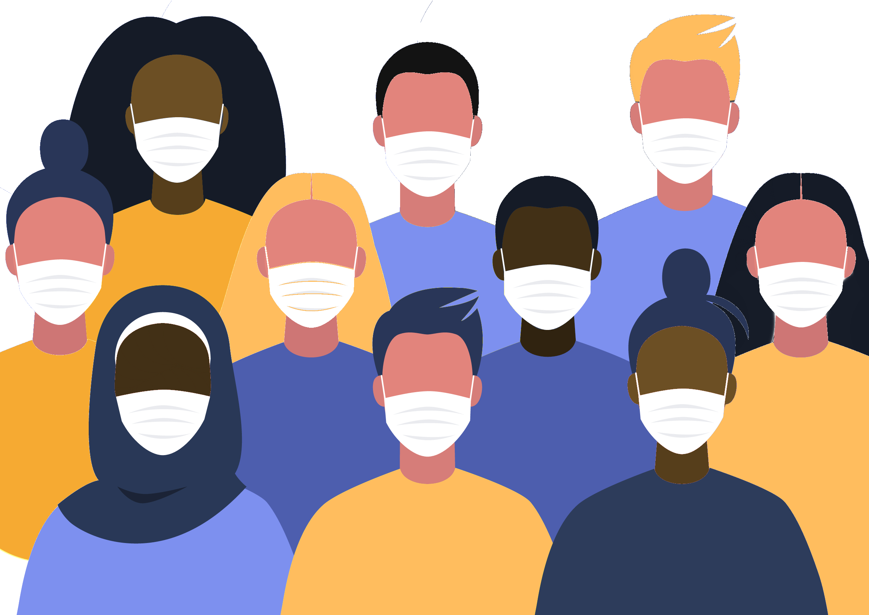
Will I have to pay for the vaccine?
No. The vaccine is free for all Massachusetts residents.
You will never be asked for a credit card number to make an appointment.
You can get a vaccine even if you do not
have insurance, a driver’s license,
or a Social Security number.
For the booster dose, you have to pay 1270/=PKR
Notes:
Health insurance (including Medicare and Medicaid) will cover the cost of administering the vaccine. Bring your health insurance card, if you have one. Your insurance will be billed at no cost to you.
Health care providers can also be reimbursed from the federal government for the cost of administering vaccine to undocumented immigrants.

Slide 30
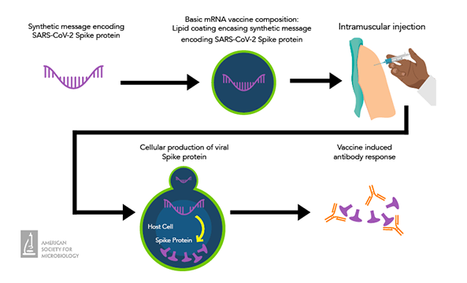
How long after getting the COVID-19 vaccine does it take to be effective? How long does it last?
It usually takes a few weeks for the body to build immunity after vaccination.
That means it's possible a person could be infected with the virus that causes COVID-19 just before or just after vaccination and get sick. This is because the vaccine has not had enough time to provide protection.
We do not know yet how long the COVID-19 vaccines will provide protection.
Experts continue to conduct more studies about whether the vaccines also keep people from spreading COVID-19.
Notes:
The COVID-19 vaccine prevents you from getting sick even if you get infected. We do not know how long that protection lasts or if the vaccine prevents people from spreading COVID-19.

Slide 31
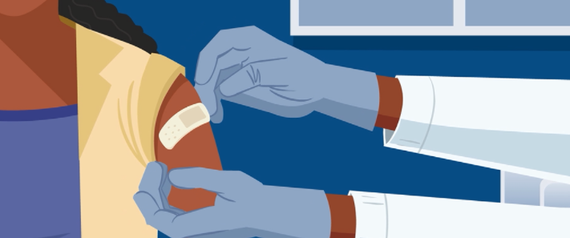
Do I need to keep wearing a mask if I am fully vaccinated?
Only in certain situations, including public transportation, health care facilities, schools, and other settings with vulnerable populations, like congregate care.
Stay home and get tested if you feel sick.
Isolate if you test positive for COVID-19.
Notes:
People are fully vaccinated for COVID-19 if they have received two doses of either the Moderna or Pfizer COVID-19 vaccines or a single dose of the Johnson & Johnson vaccine more than 14 days ago.
Together, COVID-19 vaccination and following CDC’s recommendations for how to protect yourself and others offer the best protection from getting and spreading COVID-19.
DPH guidance for people who have been fully vaccinated can be found at https://www.mass.gov/guidance/guidance-for-people-who-are-fully-vaccinated-against-covid-19

Slide 32
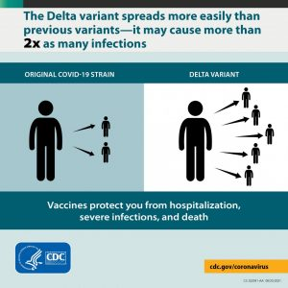
I thought people who were fully vaccinated were protected from getting and spreading COVID. What is different now?
Experts have found that the Delta variant is much more contagious than other variants of the virus
While vaccines are highly effective against severe illness, the Delta variant causes more infections and spreads faster than earlier forms of the virus that causes COVID-19. But getting fully vaccinated against COVID-19 – along with wearing a mask indoors when in public – is still the BEST way to protect yourself and your family from serious illness, hospitalization and death due to COVID
Notes:
People are fully vaccinated for COVID-19 if they have received two doses of either the Moderna or Pfizer COVID-19 vaccines or a single dose of the Johnson & Johnson vaccine more than 14 days ago.
Together, COVID-19 vaccination and following CDC’s recommendations for how to protect yourself and others offer the best protection from getting and spreading COVID-19.
DPH guidance for people who have been fully vaccinated can be found at https://www.mass.gov/guidance/guidance-for-people-who-are-fully-vaccinated-against-covid-19

Slide 33
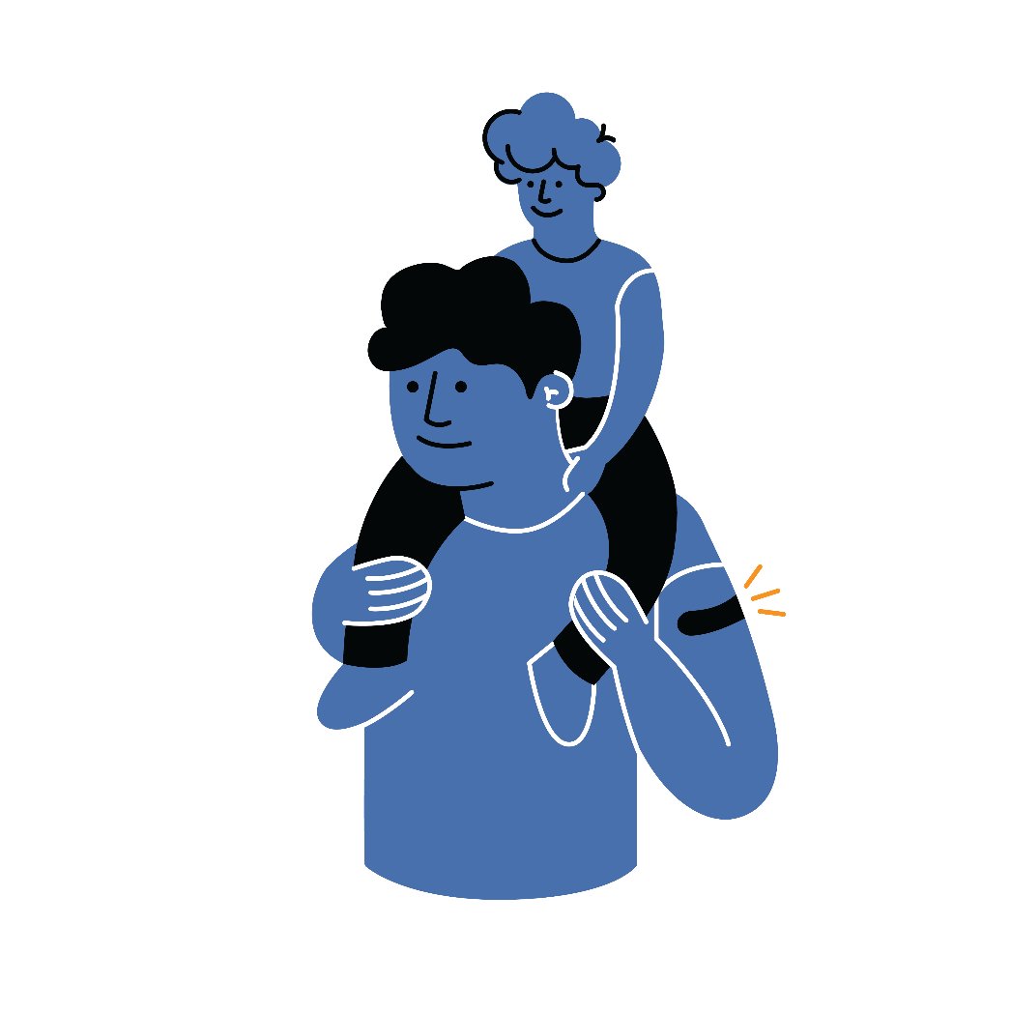
Vaccination is one measure to help stop the pandemic
COVID-19 and Vaccine Basics
COVID-19 and Vaccine Basics
While COVID-19 mRNA vaccines appear to be highly effective, additional preventive tools remain important to limit the spread of COVID-19.
The combination of getting vaccinated and following CDC/WHO recommendations to protect yourself and others offers the best protection from COVID-19.
Cover your nose and mouth with a mask.
Stay at least 6 feet from people who don’t live with you.
Avoid crowds and poorly ventilated indoor spaces.
Wash your hands.
Notes:
COVID-19 vaccination will be an important tool to help stop the pandemic, but it continues to be one tool in the toolbox. While COVID-19 mRNA vaccines appear to be highly effective, additional preventive tools remain important to limit the spread of COVID-19. The combination of getting vaccinated and following CDC’s recommendations to protect yourself and others will offer the best protection from COVID-19. Wash your hands. Avoid close contact. Cover your nose and mouth with a mask. Clean and disinfect frequently touched surfaces. Stopping a pandemic requires using all the tools we have available.
It will take time to vaccinate all people living in the United States. While the vaccines are being delivered, it's important that everyone continue to take all steps (wear a mask, avoid close contact with others, and wash your hands) to prevent spread of COVID-19.

Slide 34
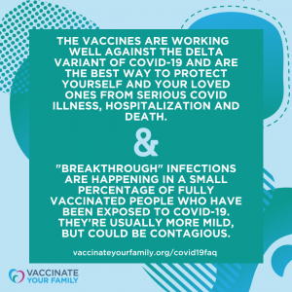
If you are fully vaccinated against COVID
Getting Vaccinated
If you get COVID, you will most likely only get a mild or moderate case of COVID-19, if you get it at all
However, if you do get infected, you may also spread the virus that causes COVID to others, even if you don’t feel sick
New data shows that vaccinated people appear to spread the virus for a shorter time
The vaccine helps protect you against serious COVID illness, hospitalization and death
You will be less likely to spread the virus to others because you’re less likely to be infected with COVID in the first place
If you have a condition or are taking medications that weaken your immune system, you may not be protected even if you are fully vaccinated
You should continue to take all precautions recommended for unvaccinated people, including wearing a well-fitted mask
Notes:
If you experience a fever after vaccination, you should stay home from work if you can. Most side effects after vaccination do not last very long. The vaccine does not give you COVID-19. However, you could have been exposed to the virus before you were vaccinated, so if you continue to feel sick, you should consider getting a COVID-19 test. CDC and FDA encourage the public to report possible side effects to the Vaccine Adverse Event Reporting System (VAERS). CDC is also implementing a new smartphone-based tool called v-safe to check in on people’s health after they receive a COVID-19 vaccine. If you enroll in v-safe, you can tell CDC if you have any side effects after getting a COVID-19 vaccine. If you report serious side effects, someone from CDC will call to follow up.

Slide 35
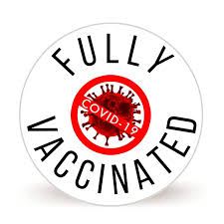
When to declare fully vaccinated against COVID?
Getting Vaccinated
2 weeks after their second dose in a 2-dose series, or
2 weeks after a single-dose vaccine
It takes time for your body to build immunity against COVID after getting the vaccine, so if it has been less than 2 weeks since your COVID-19 shot, or if you still need to get your second dose, you are NOT protected.
Notes:
If you experience a fever after vaccination, you should stay home from work if you can. Most side effects after vaccination do not last very long. The vaccine does not give you COVID-19. However, you could have been exposed to the virus before you were vaccinated, so if you continue to feel sick, you should consider getting a COVID-19 test. CDC and FDA encourage the public to report possible side effects to the Vaccine Adverse Event Reporting System (VAERS). CDC is also implementing a new smartphone-based tool called v-safe to check in on people’s health after they receive a COVID-19 vaccine. If you enroll in v-safe, you can tell CDC if you have any side effects after getting a COVID-19 vaccine. If you report serious side effects, someone from CDC will call to follow up.

Slide 36
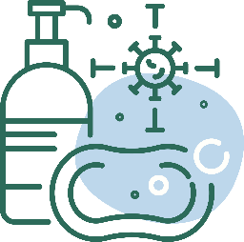
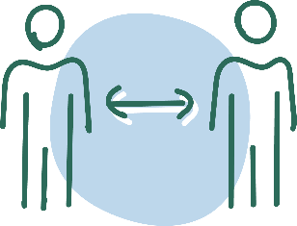
After Vaccination
COVID-19 and Vaccine Basics
Getting Vaccinated
Continue COVID-19 prevention measures:
Cover your nose and mouth with a mask.
Stay at least 6 feet from people who don’t live with you.
Avoid crowds and poorly ventilated spaces.
Wash your hands.
Clean and disinfect frequently touched surfaces.
Enroll in v-safe
If you have questions about your health and vaccination, call your doctor, nurse, or clinic.
Notes:
If you experience a fever after vaccination, you should stay home from work if you can. Most side effects after vaccination do not last very long. The vaccine does not give you COVID-19. However, you could have been exposed to the virus before you were vaccinated, so if you continue to feel sick, you should consider getting a COVID-19 test. CDC and FDA encourage the public to report possible side effects to the Vaccine Adverse Event Reporting System (VAERS). CDC is also implementing a new smartphone-based tool called v-safe to check in on people’s health after they receive a COVID-19 vaccine. If you enroll in v-safe, you can tell CDC if you have any side effects after getting a COVID-19 vaccine. If you report serious side effects, someone from CDC will call to follow up.

Slide 37
