Slide 1
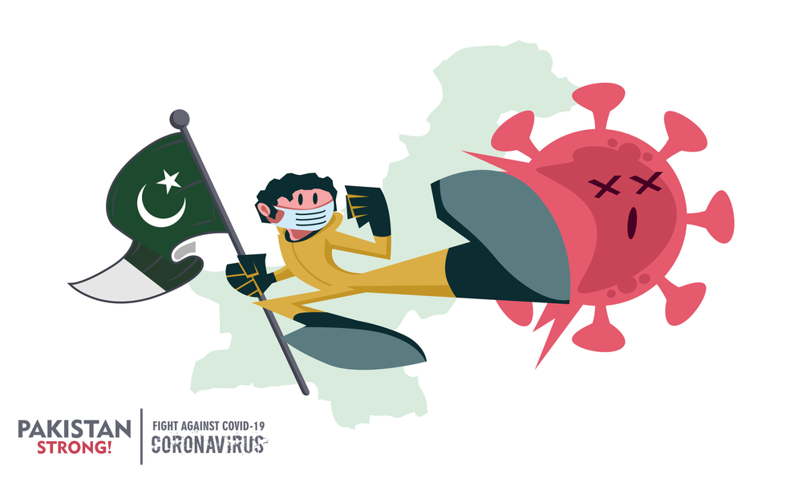
Things to Know About COVID – 19 Vaccine

Slide 2
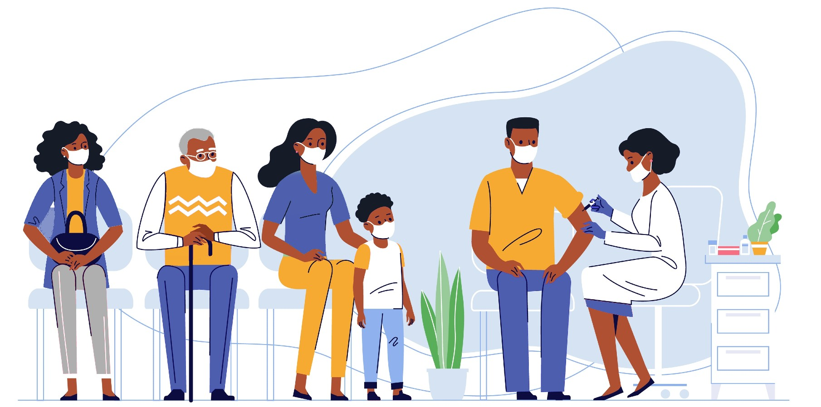
Objective
To provide basic level information related to COVID-19 disease and vaccination

Slide 3
Outlines
COVID update
Vaccination update
Vaccine types

Slide 4
Speaker: Dr. Mumtaz Ali Khan
Serving as Senior Scientific Officer in Field Epidemiology and Disease Surveillance Division of the National Institute of Health (NIH) Islamabad.
He is also Coordinator/Faculty member of FELTP Pakistan
National Focal Person for Infection Prevention & Control and
Project Coordinator Global Health Security Agenda (GHSA).
Holds multiple degrees in the field of Medical Science i.e. MD (AFG), MS in Public Health and Hospital Administration (PAK), MS in Community Health and Nutrition (PAK), MS in Public Health, MS in Field Epidemiology.
Done Fellowship in “Field Epidemiology from (CDC-USA) and Post Graduate Trainings from China, Japan, Malaysia, WHO Geneva.
Has almost 20 years of experience in the field of clinical Pediatrics and Public Health.
Working as Field Epidemiologist and Training coordinator at Field Epidemiology & Disease Surveillance Division, NIH Islamabad for last 10 years.

Slide 5
Speaker: Dr. Mumtaz Ali Khan
He is having vast experience of outbreak investigation and response.
Has represented Pakistan in more than 32 international conferences/meetings and presented 28 research papers in international conferences.
Has played a pro-active role in COVID-19 response.
Has been actively involved in making National Action Plan for COVID-19, remained focal person for COVID Response at NIH
performed as Team Lead for Rapid Response Trainings and Simulation Exercises at all Airports and Ground crossings and Setting Quarantine Center at Taftan in Feb 2020.
Keeping in View his extra ordinary services during the COVID-19 Pandemic, he has been granted appreciation certificates and shields and was also nominated for National Award during 2020.

Slide 6
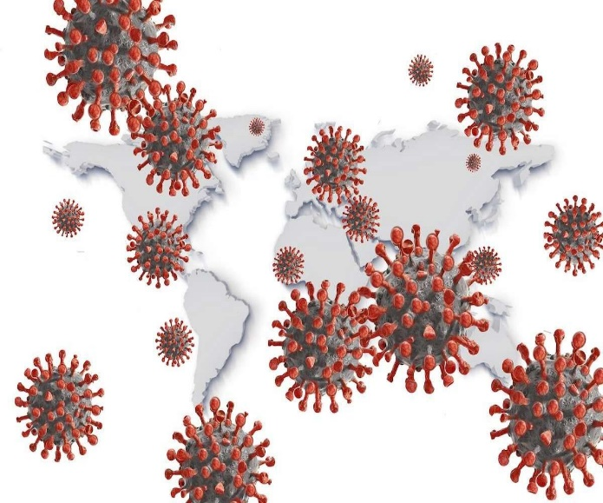
What is COVID-19?
Coronaviruses are a large family of viruses
Some coronaviruses cause respiratory illness in people,
COVID-19 is the disease caused by SARS-CoV-2 coronavirus, a new virus that was first recognized in Dec 2019
It’s referred to as a novel coronavirus strain as it has not been previously identified in humans
Due to it being a novel virus there is no herd immunity and there are no specific treatments
COVID-19 poses a serious risk to public health and the healthcare system

Slide 7
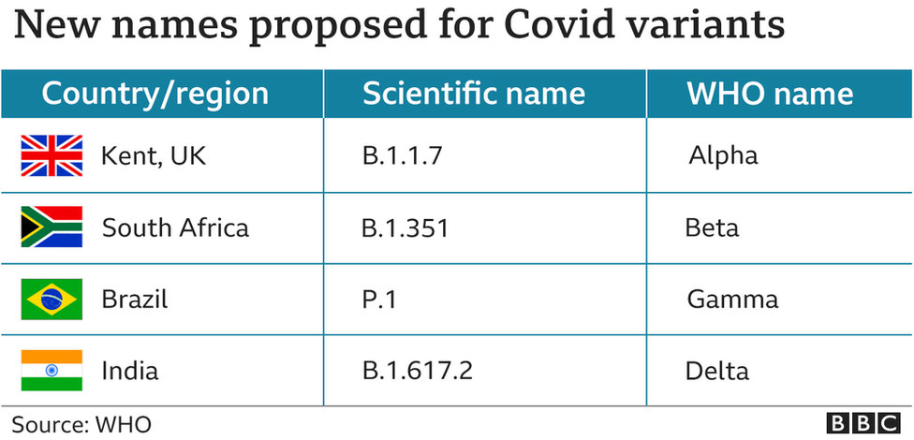
What are COVID-19 Variant Strains?
Mutations in the COVID-19 virus over time are expected, and can cause variant strains of COVID-19 to emerge
Variant strains of COVID-19 have been identified in the United Kingdom, South Africa, Brazil and India,
These strains are known as variants of concern, as they appear to spread more easily than other COVID-19 strains
Studies are ongoing to determine the effectiveness of the currently authorized vaccines against these variants

Slide 8
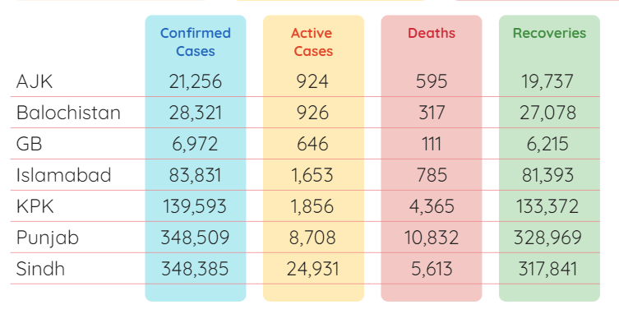
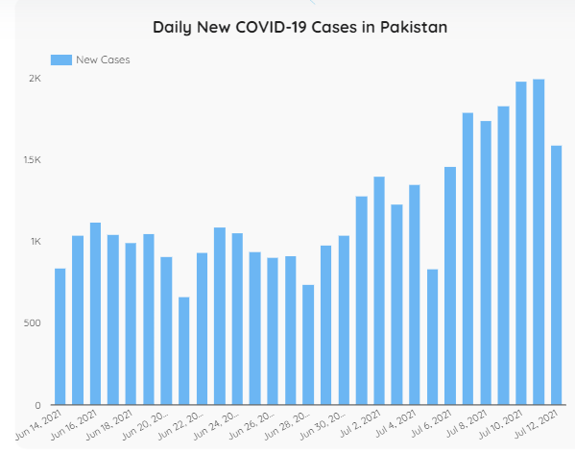
COVID update

Slide 9
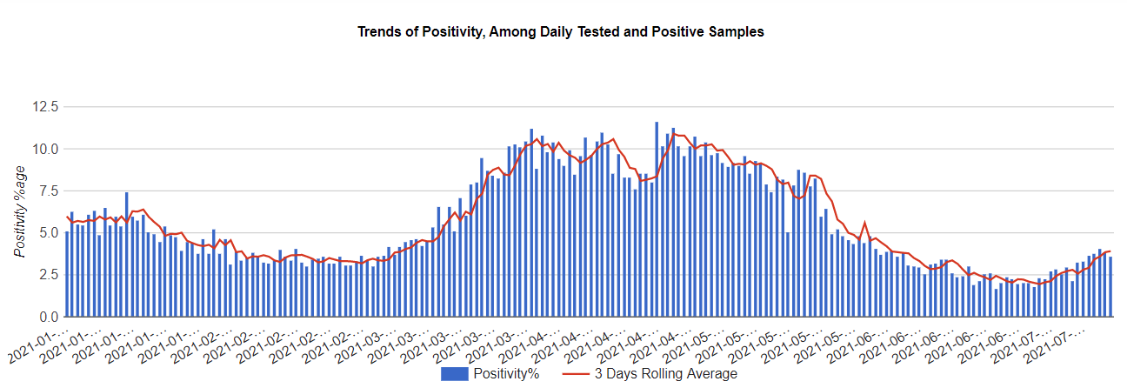

Slide 10
Outlines
COVID update
COVID Vaccine
Vaccine types

Slide 11
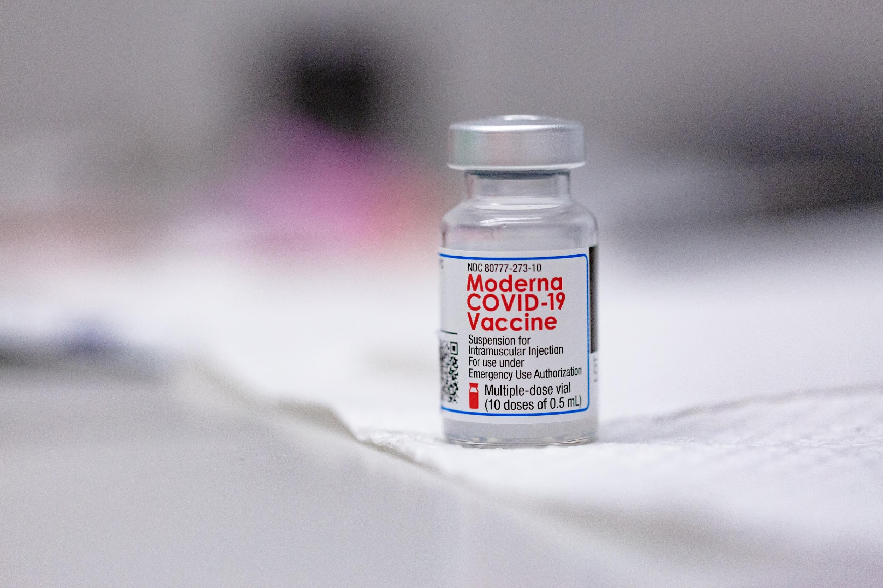
Vaccines
COVID-19 and Vaccine Basics
A vaccine is a product designed to help prevent diseases
Vaccines can help individuals from getting diseases such as:
Chickenpox
Influenza (flu)
COVID-19
Notes:
Script:
What is a vaccine? To put it simply, a vaccine is designed to help prevent us from getting sick from “germs”. The vaccine contains ingredients that give a person's body a sample of a germ so the body can learn to fight the disease. Common germs include bacteria and viruses. When a person’s body gets a vaccine with a sample of the virus or bacteria, their body makes antibodies that will guard them in the future. If a person then catches the actual virus or bacteria invader, their antibodies attack and kill the invader before it can make them sick.
Vaccines have helped eliminate worry about many diseases in the United States such as chickenpox. They also help protect people from diseases that still occur every year like influenza. In the short run the new COVID-19 vaccines can protect indivudal people from getting sick. In the long run, it is hoped that we can eliminate the concern for COVID-19 by making it rare, like chickenpox
In some cases, immunity does not last forever, whether you get a vaccine or get the disease.

Slide 12
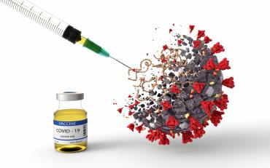
Vaccines
COVID-19 and Vaccine Basics
Vaccines keep communities safe and healthy by:
Supporting herd immunity
Preventing a disease from spreading
Notes:
Script:
One way to help keep people healthy is widespread vaccination. Vaccinating all, or most, of the people in a community can help stop diseases like COVID-19 from spreading from one person to another. This is called herd immunity, when most people in a population or group are immune so that the infection cannot spread from person to person. When most of the people are immune and cannot get the disease, it helps to protect other people who cannot get the vaccine, or who have other conditions that make them vulnerable even if they get the vaccine. So when most the people get the vaccine, it can protect all the people.

Slide 13
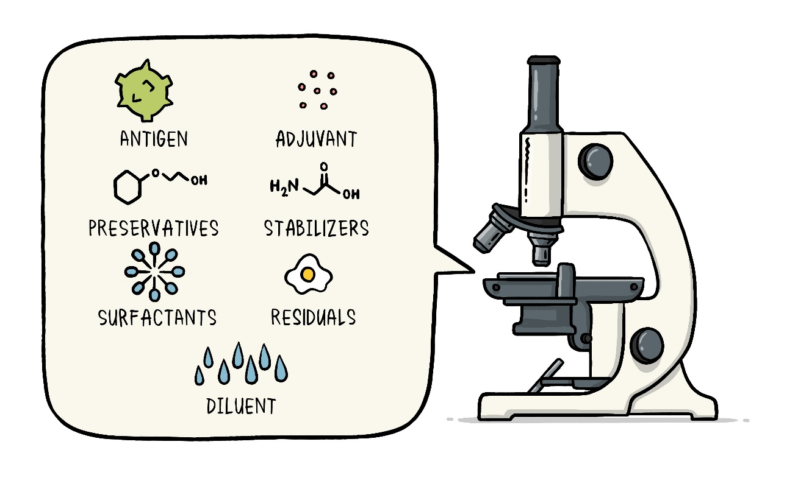
How Vaccines Are Made
A virus can be used to make a vaccine in different ways:
Using a whole virus by using it when it is dead or weakened (like Chickenpox, flu and MMR)
Using a piece of the virus (like tetanus and hepatitis B vaccines are made)
Without using any of the virus itself (how mRNA vaccines are made)
Notes:
Script:
The main three ways to make a vaccine against a virus are.
First, to include a whole virus inside the vaccine. In this case, the virus is weakened or killed, so that it cannot make someone sick with the disease. Many common vaccines are made this way, like chickenpox, influenza and Measles/MMR
A second method is to use just part of the virus. Because it is just a piece of a virus, it does not need to be killed or weakened. A piece of a virus cannot make someone sick. Many vaccines are made this way, probably the best known are tetanus and hepatitis B vaccines.
A third way to make a vaccine is to give the body instructions to make something that looks like a piece of the virus, but not give them any of the real virus. For COVID, this type of vaccine is called an mRNA vaccine. This type of vaccine does not contain any virus at all, and it does not create a virus in your body, so you cannot get the infection from the vaccine
While a person can get side effects from any vaccine since it is triggering your bodies defenses, most vaccines cannot make a person sick with the actual disease.

Slide 14
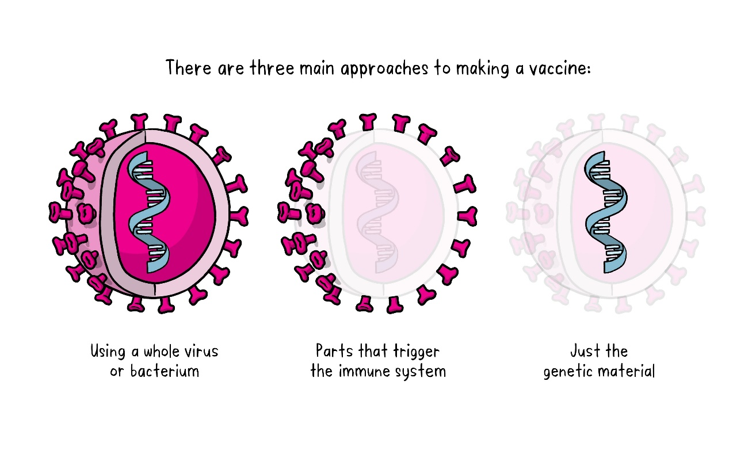
COVID-19 Vaccines
No COVID-19 vaccine is made using the whole killed or weakened viruses
One vaccine is made with a piece of the COVID virus, and two are mRNA vaccines and made with no virus
None of the vaccines can give a person COVID-19
Notes:
Script:
None of the COVID-19 vaccines contain the whole or weakened viruses, like influenza, chickenpox or MMR. They either use a messenger RNA (mRNA) and we call it an mRNA vaccine (Moderna and Pfizer), or they contain a piece of the covid virus (J&J vaccine). There is no possibility of getting the COVID virus with these types of vaccines.
After getting one of these vaccines, your body prepares for the actual infection by making antibodies which guard your body. If you get COVID, these antibodies work like guards –they recognize the virus and attack and kill the COVID virus before it can make you very sick.

Slide 15
SARS-CoV-2 VACCINES
Updates…

Slide 16
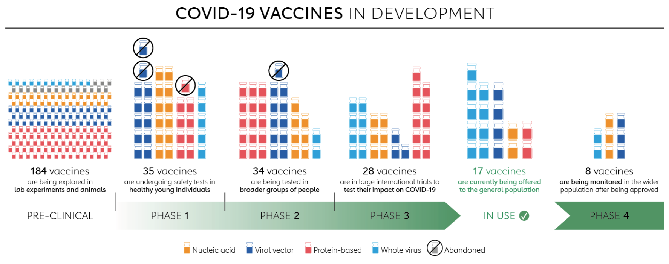

Slide 18
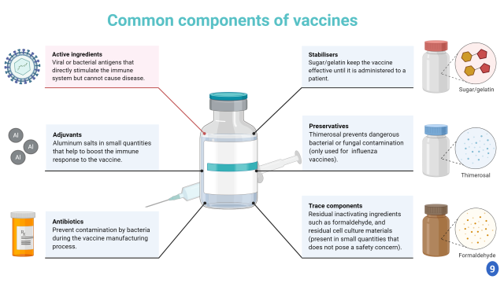
COMMON COMPONENTS
Of a VACCINE
What’s inside a Vaccine?

Slide 20
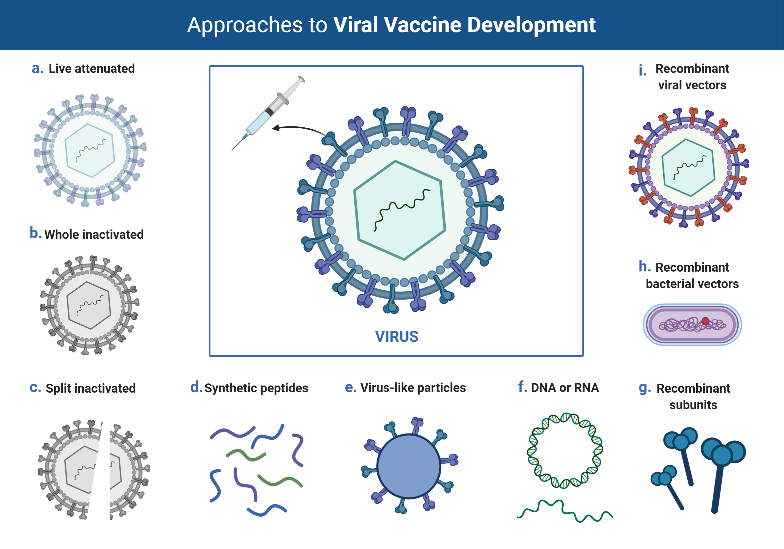

Slide 21
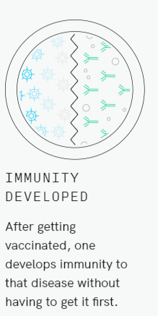
HOW Vaccines Work?

Slide 22
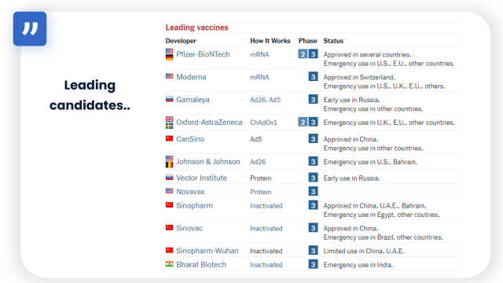
Leading COVID-19 Vaccine candidates

Slide 23
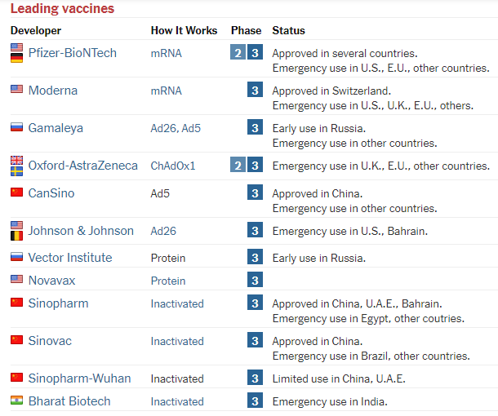
Leading
candidates..

Slide 24
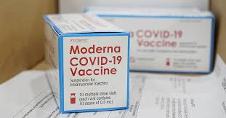
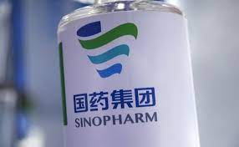
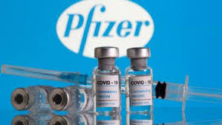
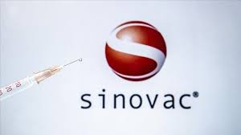
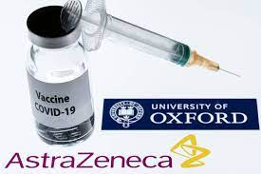
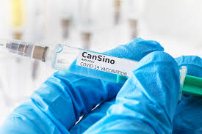
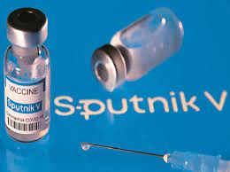
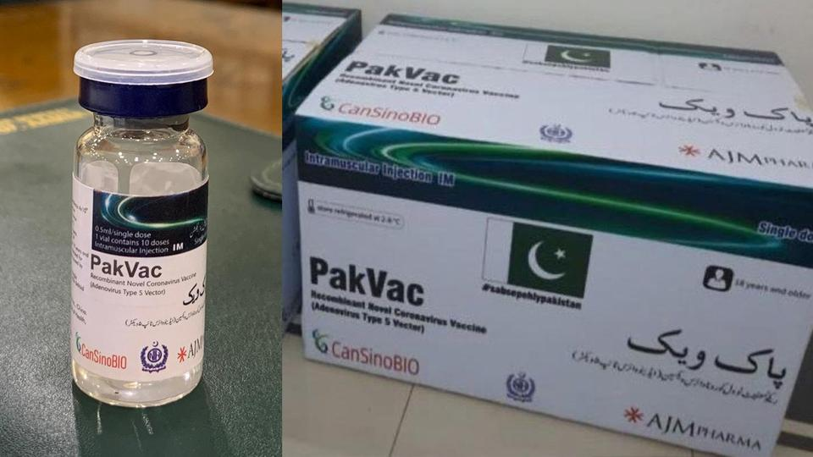
Vaccine available in Pakistan

Slide 25
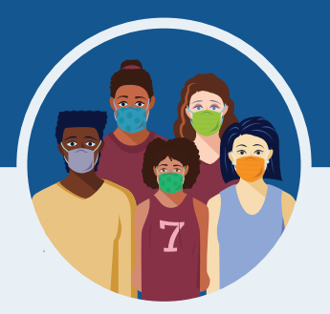
Do the COVID-19 vaccines have any side effects?
Serious side effects from vaccines, including the COVID-19 vaccine, are rare.
It is possible that some people may have side effects, which are normal signs that your body is building protection.
These side effects may affect your ability to do daily activities, but they should go away in a few days.
The most common side effects are minor and include:
Tiredness
Headache
Pain at the injection site
Muscle and/or joint pain
Chills
Nausea and/or vomiting
Fever
Notes:
Serious side effects from vaccines, including the COVID-19 vaccine, are rare. In the Pfizer, Moderna, and Janssen clinical trials, serious side effects happened at the same frequency as they do in the general population (among less than 1.0% of participants who received the vaccine). There were no notable differences in serious adverse events by age, race, ethnicity, or medical conditions. The side effects in adolescents 12-15 years old were consistent with those reported in clinical trial participants 16 years of age and older.
If you got the J&J COVID-19 vaccine and develop any of the symptoms below within 3 weeks after vaccination, get medical care right away:
Severe headache or blurred vision
Shortness of breath
Gut pain that does not go away
Chest pain
Leg swelling
Easy bruising or tiny blood spots under the skin
In the Moderna vaccine trial, examples of serious side effects included two people with facial swelling, one person with difficult-to-control nausea and vomiting, and one report of Bell’s palsy. In the Pfizer vaccine trial, examples included a shoulder injury at the vaccination site and swollen lymph nodes in the armpit opposite the vaccination arm. In the Janssen vaccine trial, examples included four people with seizures and six people with deep vein thrombosis. We don’t know if these serious side effects are related to the vaccine or not.
Some instances of severe allergic reactions have been reported outside of clinical trials. See slide 19 for more information about allergic reactions.
Minor side effects are more common after the second dose of Moderna and Pfizer than the first.
https://www.fda.gov/emergency-preparedness-and-response/mcm-legal-regulatory-and-policy-framework/pfizer-biontech-covid-19-vaccine-frequently-asked-questions
https://www.fda.gov/emergency-preparedness-and-response/mcm-legal-regulatory-and-policy-framework/moderna-covid-19-vaccine-frequently-asked-questions
https://www.fda.gov/emergency-preparedness-and-response/mcm-legal-regulatory-and-policy-framework/janssen-covid-19-vaccine-frequently-asked-questions
https://www.fda.gov/media/146305/download

Slide 26
Global update
25.4% of the world population has received at least one dose of a COVID-19 vaccine. 3.47 billion doses have been administered globally, and 29.22 million are now administered each day. Only 1% of people in low-income countries have received at least one dose.

Slide 27
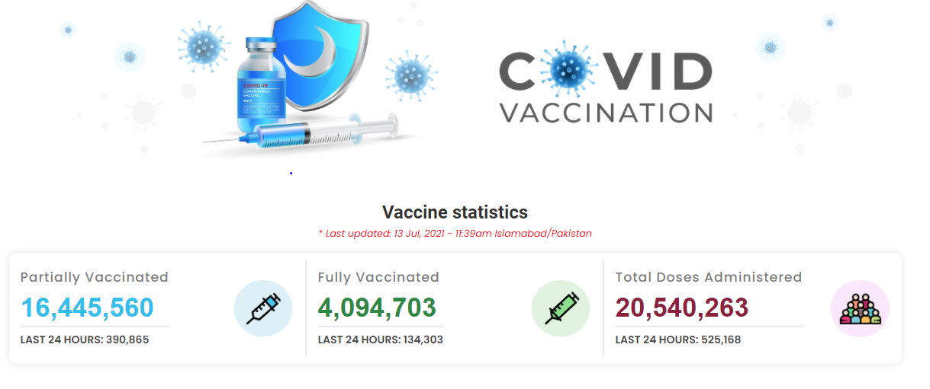
Vaccine update

Slide 28
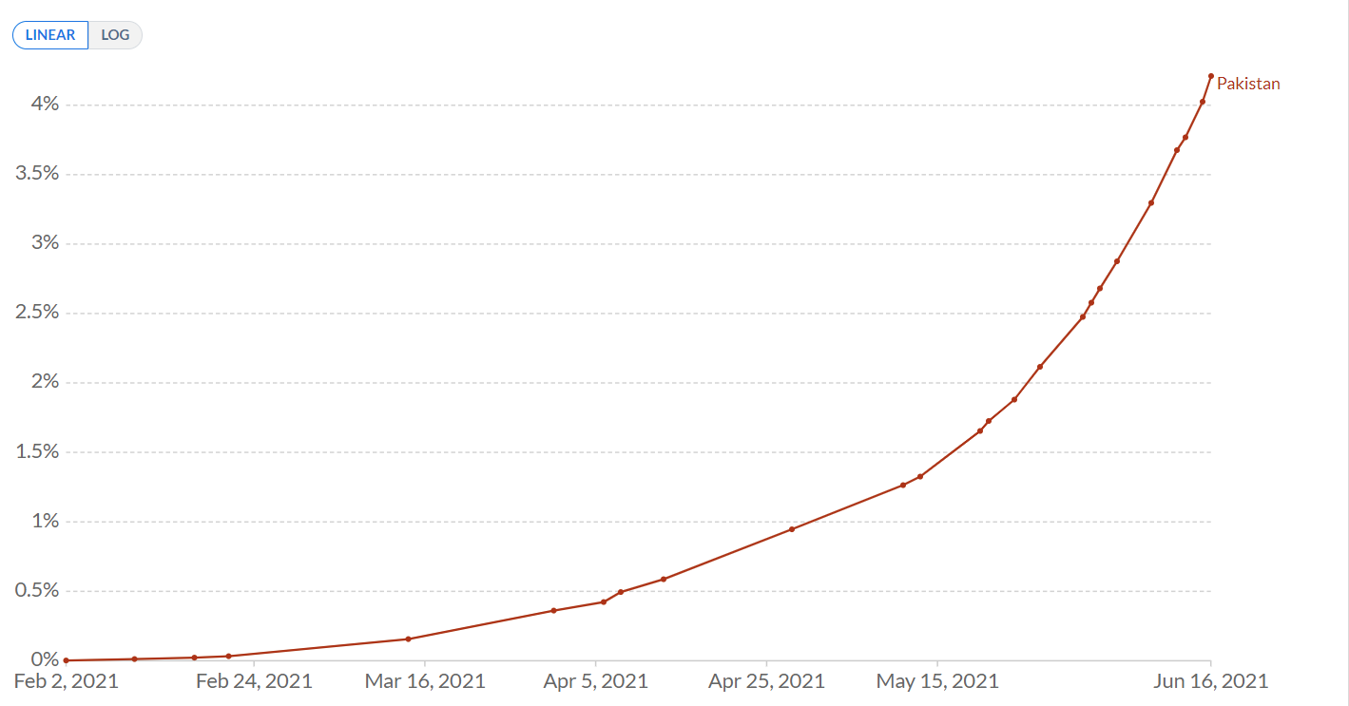

Slide 29
Outlines
COVID update
COVID Vaccine
Vaccine types (available in Pakistan)

Slide 30
Sinopharm
The Sinopharm COVID-19 vaccine, BBIBP-CorV, which the Beijing Bio-Institute of Biological Products (BBIBP) developed, is the first Chinese COVID-19 vaccine that the World Health Organization (WHO) has authorized for emergency use (May 7, 2021)
The two-dose vaccine incorporates inactivated virus to stimulate an immune response
The WHO recommends the Sinopharm vaccine for people aged 18 years and older, with a gap of 3–4 weeks between the two doses

Slide 31
Who should receive Individuals who are 18 years of age and above
Vaccination is recommended for persons with comorbidities that have been identified as increasing the risk of severe COVID-19, including obesity, cardiovascular disease, respiratory disease and diabetes.
Pregnant women and those who are breastfeeding
Who should NOT receive
Individuals having fever at the time of coming for vaccination (Can be rescheduled after the illness is settled)
Patients with active COVID-19
Individuals on short-term immunosuppressive medication should wait for 28 day after the medication ends
Those chronically immunosuppressed may receive the vaccine, though efficacy may be lower
Intra-muscular intramuscular injection
Dose: 0.5ml
Single dose vial Vaccine Dose
Two doses should be administered 6 weeks after the first dose

Slide 32
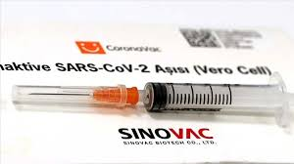
SINOVAC (CHINA); INACTIVATED VACCINE
Sinovac conducted phase 3 trials involving volunteers in Brazil, Indonesia and Turkey
The company began phase 4 trials in February 2021
The WHO Strategic Advisory Group of Experts (SAGE) on Immunization has issued Interim recommendations for the use of the inactivated COVID-19 vaccine, Sinovac (2 June 2021)
WHO recommends the use of the Sinovac-CoronaVac (COVID-19) vaccine in pregnant women when the benefits of vaccination to the pregnant woman outweigh the potential risks

Slide 33
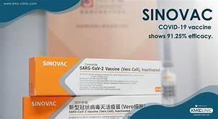
Who should receive
Individuals who are above 18 years of age
Persons with comorbidities including obesity, cardiovascular disease, respiratory disease and diabetes
Pregnant women and those who are breastfeeding
Who should NOT receive
Below 18 years of age
People with history of allergic reaction to CoronaVac
Previous severe allergic reactions to the vaccine
People with severe neurological conditions (e.g. transverse myelitis, Guillain-Barré syndrome, demyelinating diseases, etc.).
Two doses intramuscular injection
The second dose 6 weeks
Each vial (syringe) contains 0.5 mL of single dose

Slide 34
CANSINO BIOLOGICS INC. (CHINA); VIRAL VECTOR VACCINE
The Ad5-nCoV vaccine candidate uses a harmless non-replicating viral vector to carry vaccine antigens into the human body
In May 2021, the company registered a phase 4 trial with 300 adult participants
Vaccine, produced by CanSino Biologics, has submitted clinical trial data, but no WHO review has been scheduled yet

Slide 35
Who should NOT receive
Having fever at the time vaccination
Patients with active COVID-19
People with history of allergic reaction to CoronaVac
Previous severe allergic reactions to the vaccine
People with severe neurological conditions (e.g. transverse myelitis, Guillain-Barré syndrome, demyelinating diseases, etc.).
immunosuppressive drugs
Who should receive
Individuals who are above 18 years of age
Persons with comorbidities including obesity, cardiovascular disease, respiratory disease and diabetes
Pregnant women and those who are breastfeeding
Intra-muscular
Dose: 0.5ml/vial
Single dose vial

Slide 36
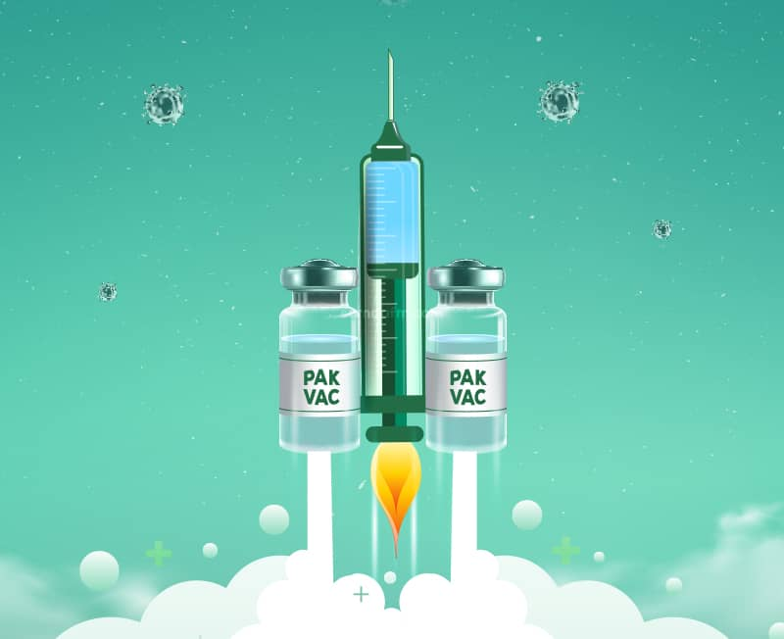
PakVac
To bolster the fight against the pandemic, the government has partnered up with Chinese COVID-19 vaccine producer CanSinoBio to manufacture homegrown vaccine, PakVac
Since the newly branded Pakvac models after the CanSino vaccine it is expected to function in similar ways

Slide 37
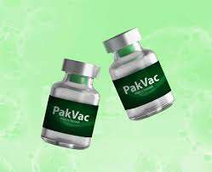
Intra-muscular
Dose: 0.5ml/vial
Single dose vial
Who should NOT receive
Pregnant and lactating women
Individuals having fever at the time of vaccination
Patients with active COVID-19 o
Individuals on short-term immunosuppressive medication should wait for 28 day after the medication ends
Those chronically immunosuppressed may receive the vaccine, though efficacy may be lower
Those post-transplantation may receive the vaccine 3 months after transplantation
Those post-chemotherapy may receive the vaccine 28 days after chemotherapy
Any history of asthma
People with epilepsy, brain disease, and history of convulsions.
Who should receive
Individuals who are above 18 years of age
Persons with comorbidities including obesity, cardiovascular disease, respiratory disease and diabetes

Slide 38
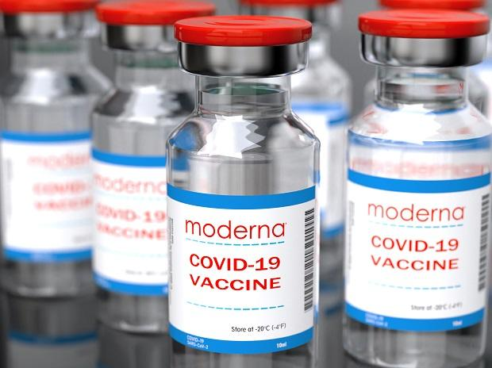
MODERNA (USA)
The final trial results confirm this RNA vaccine has a 94% efficacy
Need to be kept in ultra-cold freezers
The final trial enrolled 30,000 healthy people from across the United States
In February, a phase 4 trial was launched as part of a national cohort study in collaboration with the Danish Ministry of the Interior and Health

Slide 39
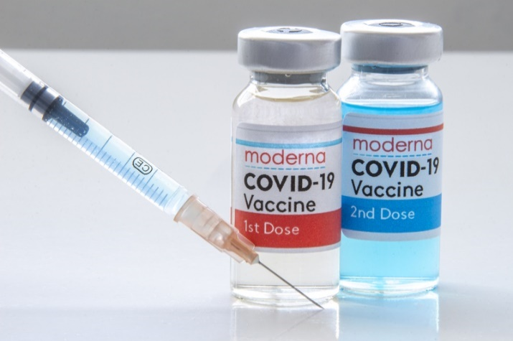
Who should NOT receive
If you have had an allergic reaction (anaphylaxis) or an immediate allergic reaction, to any ingredient in an mRNA COVID-19 vaccine or after getting the first dose of the vaccine,
The vaccine is not recommended for persons younger than 18 years of age
Persons with an immediate non-anaphylactic allergic reaction to the first dose
Those who have experienced a mild episode of COVID-19, can receive the vaccine once the isolation period is completed.
Those with severe COVID-19 can receive the vaccine once they become clinically stable
Who should receive
18 years of age or older and have NOT received any other currently available Covid-19 vaccines
Comorbid conditions, Chronically immunosuppressed
Post organ transplantation, the patient may receive the vaccine 3 months after transplantation
Post chemotherapy, 28 days after chemotherapy
Individuals with a mandatory requirement of vaccination for travel
pregnant and lactating
Intra-muscular intramuscular injection
Dose: 0.5ml
Single dose vial Vaccine Dose
Two doses should be administered 6 weeks after the first dose

Slide 40
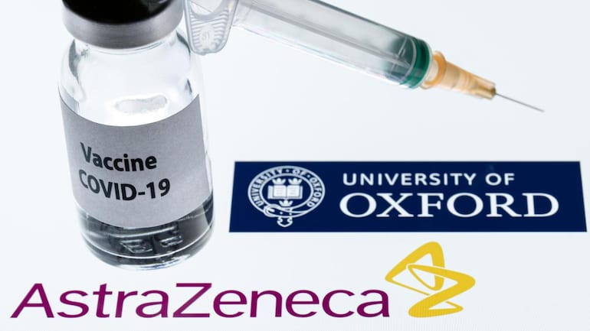
ASTRAZENECA/UNIVERSITY OF OXFORD (UK)
VIRAL VECTOR VACCINE
Developed by the University of Oxford, has a vaccine efficacy of up to 90%
Efficacy is slightly lower than the Moderna and Pfizer vaccines

Slide 41
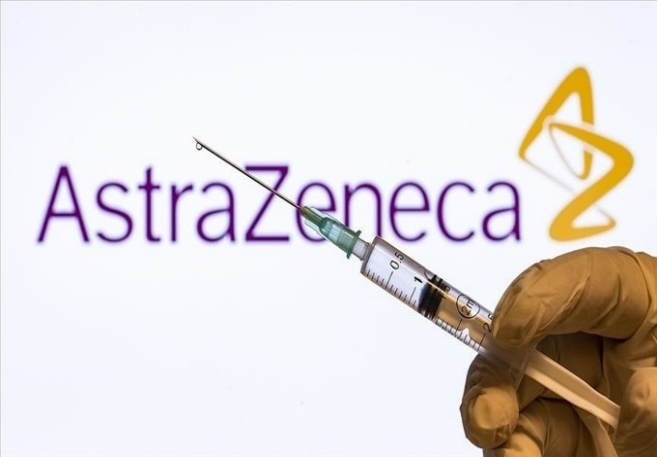
Who should receive
All adults (including pregnant and lactating women) over the age of 40 years
Eligible adults with diabetes, hypertension, heart disease and other stable chronic disorders
Those aged 18 years and above:
Who have already received the 1st dose of AstraZeneca vaccine abroad,
Who require evidence of AstraZeneca vaccine as part of travel
Who should NOT receive
Women below 40 years of age
People with a history of severe allergic reaction to any component
Persons younger than 18 years of age
People who developed clotting disorder with the first dose of AstraZeneca vaccine
Individuals having fever at the time of vaccination
Individuals on short-term immunosuppressive medication should wait for 28 days after the medication ends
Those having active GI bleeding disorder or seizures.
Those with history of heparin-induced thrombocytopenia and thrombosis
Those with history of major blood clot occurring at the same time as having low levels of platelets after receiving any COVID-19 vaccine
Intra-muscular
Lateral Deltoid Muscle (Upper Arm),
Regimen: Two doses
Dose: 0.5ml/vial (5 x 1010 viral particles)
Interval: 12 weeks

Slide 42
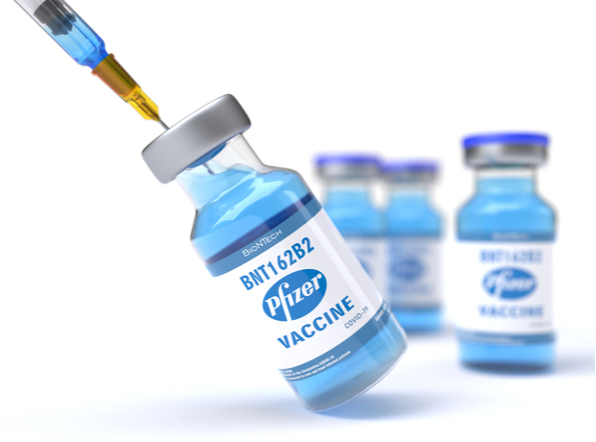
PFIZER/BIONTECH (GERMANY)
RNA VACCINE
In December 2020, the UK became the first country in the world to approve this vaccine
Started testing its BNT162 vaccine in humans in global trials, initially in Germany, and then started trials in the USA
Data showed a vaccine efficacy rate of 95% (even in adults over 65 years efficacy was more than 94%)
In February, a phase 4 trial was launched

Slide 43
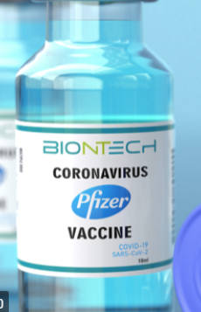
Who should receive
Pfizer Vaccine will be administered to 18 years of age or older and have NOT received any other Covid-19 vaccines
Individuals with a mandatory requirement of vaccination for travel
Immunosuppressed individuals: those who are clinically extremely vulnerable and at a high risk of severe illness from COVID-19
Chronic respiratory disease, Chronic heart disease and vascular disease, Chronic kidney disease, Chronic liver disease, Chronic neurological disease
Solid Organ Transplant (SOT) recipients
pregnant and lactating women
Hematopoietic Stem Cell Transplant (HSCT) recipients
Primary Immune Deficiency Diseases
Immunosuppression
Haematological malignancy
Asplenia or dysfunction of the spleen
Who should NOT receive
Individuals having fever at the time of coming for vaccination
Patients with active COVID-19
Those who have already received any other COVID-19 vaccine
Those with history of severe allergic reaction (anaphylaxis) to any ingredient in an mRNA COVID-19 vaccine or to first dose of an mRNA COVID-19 vaccine
Intra-muscular in Lateral Deltoid Muscle
Dose: 30 mcg (0.3 mL)
Diluent: 0.9% sodium chloride (normal saline, preservative-free) •
Multidose vial (6 doses/vial)
2 shots, 6 weeks apart
Notes:
Pre-transplant patients: complete vaccine course at least 2 weeks prior to transplantation if possible. • Post-transplant patients may receive vaccine 1 month after transplantation. • No adjustment of immunosuppressive medications required prior to vaccination

Slide 44
How to prevent COVID-19
COVID-19 and Vaccine Basics
Wear a mask that covers your mouth and nose.
Avoid close contact with others. Stay at least 6 feet (about 2 arm lengths) from other people.
Avoid crowds and poorly ventilated spaces.
Wash hands often with soap and water.
Use an alcohol-based hand sanitizer with at least 60% alcohol if soap and water are not available.
Avoid touching your eyes, nose, and mouth with unwashed hands.
Clean and disinfect frequently touched surfaces daily.
Get a COVID-19 vaccine.

Slide 45
COVID-19 vaccination is a safer way to build protection
COVID-19 and Vaccine Basics
Getting the virus that causes COVID-19 may offer some natural protection, known as an antibody or immune. But experts don’t know how long this protection lasts.
The risk of severe illness and death from COVID-19 far outweighs any benefits of natural immunity.
COVID-19 vaccination will help protect you by building immunity without the risk of severe illness.
Notes:
COVID-19 vaccination is a safer way to help build protection. Getting the virus that causes COVID-19 may offer some natural protection, known as immunity. But experts don’t know how long this protection lasts, and the risk of severe illness and death from COVID-19 far outweighs any benefits of natural immunity. COVID-19 vaccination will help protect you.

Slide 46
Key facts about COVID-19 vaccination
COVID-19 and Vaccine Basics
Getting vaccinated can help prevent getting sick with COVID-19
People who have already gotten sick with COVID-19 may still benefit from getting vaccinated
COVID-19 vaccines cannot give you COVID-19
COVID-19 vaccines will not cause you to test positive on COVID-19 viral tests*
https://www.cdc.gov/coronavirus/2019-ncov/vaccines/about-vaccines/vaccine-myths.html
*https://www.cdc.gov/coronavirus/2019-ncov/hcp/testing-overview.html
Notes:
It is easy to be confused by all the information that is circulating, some of which may be conflicting. CDC has facts to counteract common myths on this page, such as:
COVID-19 vaccines will not give you COVID-19
People who have gotten sick with COVID-19 may still benefit from getting vaccinated
Getting vaccinated can help prevent getting sick with COVID-19
COVID-19 vaccines will not cause you to test positive on COVID-19 viral tests*
Please visit: https://www.cdc.gov/coronavirus/2019-ncov/vaccines/about-vaccines/vaccine-myths.html to read more about these vaccine myths and the facts about COVID-19 vaccine from CDC.
NOTE: While COVID-19 vaccination will not cause a positive result on viral tests, there is a possibility that it could cause a positive result on a serologic (antibody) test.

Slide 47
Safety of COVID-19 vaccines is a top priority
COVID-19 and Vaccine Basics
COVID-19 vaccines are being held to the same safety standards as all vaccines.
Before Authorization
After Authorization
FDA carefully reviews all safety data from clinical trials.
ACIP reviews all safety data before recommending use.
FDA and CDC closely monitor vaccine safety and side effects. There are systems in place that allow CDC and FDA to watch for safety issues.
V-safe:
https://www.cdc.gov/coronavirus/2019-ncov/vaccines/safety/vsafe.html
Notes:
COVID-19 vaccines are being held to the same safety standards as other routine vaccines. Several expert and independent groups evaluate the safety of vaccines being given to people in the United States.
Before ANY vaccines receive authorization or approval, the Federal Drug Administration (FDA) carefully reviews all the safety data from clinical trials. And the Advisory Committee on Immunization Practices, or ACIP, which is an independent body of experts, reviews all safety data before recommending use. FDA and ACIP have qualified scientific and clinical experts with minimal conflicts of interest reviewing all of the data.
After ANY vaccines are authorized and in use, both FDA and CDC continue to monitor their safety.
Existing systems can rapidly detect possible vaccine safety problems. These systems are being scaled up for COVID-19 vaccine introduction to fully meet the needs of the nation. Additional systems and data sources are also being developed to further enhance safety monitoring capabilities.
There are systems in place that allow CDC and FDA to watch for safety issues:
CDC: V-safe — A new smartphone-based, after-vaccination health checker for people who receive COVID-19 vaccines. V-safe uses text messaging and web surveys from CDC to check in with vaccine recipients following COVID-19 vaccination. V-safe also provides second vaccine dose reminders if needed, and telephone follow up to anyone who reports medically significant (important) adverse events.
CDC and FDA: Vaccine Adverse Event Reporting System (VAERS) — The national system that collects reports from healthcare professionals, vaccine manufacturers, and the public of adverse events that happen after vaccination; reports of adverse events that are unexpected, appear to happen more often than expected, or have unusual patterns are followed up with specific studies.

Slide 48
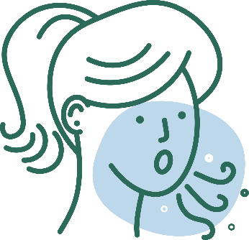
COVID-19 vaccination will help protect you from COVID-19
COVID-19 and Vaccine Basics
Getting a COVID-19 vaccine...
Will help create an immune response in your body against the virus
May help keep you from getting severely ill, even if you do get COVID-19
Notes:
COVID-19 vaccination will help keep you from getting COVID-19. Getting a COVID-19 vaccine will help create an immune response in your body against the virus without your having to experience illness. Based on what is known about vaccines for other diseases, experts believe that getting a COVID-19 vaccine may help keep you from getting seriously ill even if you do get COVID-19.

Slide 49
What to expect before, during, and after COVID-19 vaccination
COVID-19 and Vaccine Basics
Before
During
After
Learn about COVID-19 vaccines.
See if COVID-19 vaccination is recommended for you.
Read the fact sheet that tells you about the specific COVID-19 vaccine you receive.
Receive a vaccination record card.
Expect some side effects.
Enroll in v-safe. V-safe will remind you if you need a second shot.
Continue using all the measures to protect yourself and others.
V-safe: https://www.cdc.gov/coronavirus/2019-ncov/vaccines/safety/vsafe.html
Notes:
Before vaccination, you should learn more about the different types of COVID-19 vaccines and how they work. We’ve provided some of this information in this presentation.
During your vaccination appointment, you should receive a paper or electronic version of a fact sheet specific to the COVID-19 vaccine you are being offered that contains information to help you understand the risks and benefits of receiving that specific vaccine. After you are vaccinated, you should be given a vaccination record card that tells you what COVID-19 vaccine you received, the date you received it, and where you received it.
Your provider may also give you information about how to enroll in v-safe. V-safe is a free, smartphone-based tool that uses text messaging and web surveys to provide personalized health check-ins after you receive a COVID-19 vaccination. This program will help CDC monitor safety of COVID-19 vaccines. Find more information at https://www.cdc.gov/coronavirus/2019-ncov/vaccines/safety/vsafe.html.
Its important to continue using all the tools available to help stop this pandemic. Cover your mouth and nose with a mask when you are around others, stay at least 6 feet away from others, avoid crowds, and wash your hands often.

Slide 50
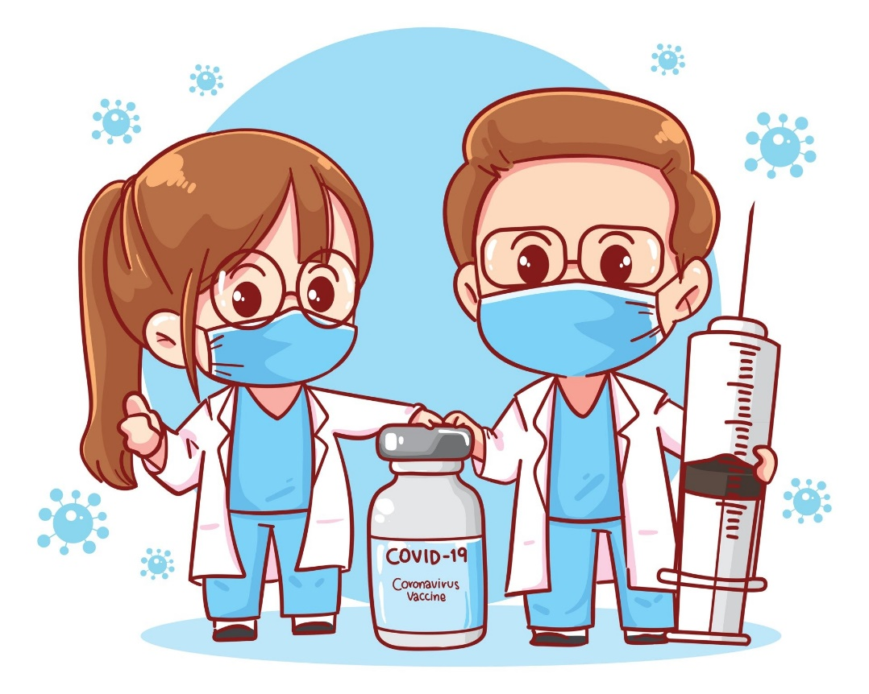
Vaccination is one measure to help stop the pandemic
COVID-19 and Vaccine Basics
While COVID-19 mRNA vaccines appear to be highly effective, additional preventive tools remain important to limit the spread of COVID-19.
The combination of getting vaccinated and following CDC recommendations to protect yourself and others offers the best protection from COVID-19.
Cover your nose and mouth with a mask.
Stay at least 6 feet from people who don’t live with you.
Avoid crowds and poorly ventilated indoor spaces.
Wash your hands.
Notes:
COVID-19 vaccination will be an important tool to help stop the pandemic, but it continues to be one tool in the toolbox. While COVID-19 mRNA vaccines appear to be highly effective, additional preventive tools remain important to limit the spread of COVID-19. The combination of getting vaccinated and following CDC’s recommendations to protect yourself and others will offer the best protection from COVID-19. Wash your hands. Avoid close contact. Cover your nose and mouth with a mask. Clean and disinfect frequently touched surfaces. Stopping a pandemic requires using all the tools we have available.
It will take time to vaccinate all people living in the United States. While the vaccines are being delivered, it's important that everyone continue to take all steps (wear a mask, avoid close contact with others, and wash your hands) to prevent spread of COVID-19.

Slide 51
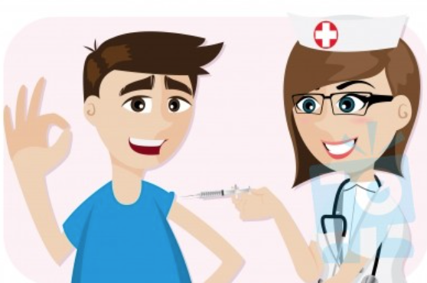
Protect yourself, your family, friends, coworkers, and your community. Get vaccinated.
COVID-19 and Vaccine Basics
Choose to get vaccinated when it is offered.
Share your experience with coworkers, friends, and family.
Know the basics about the COVID-19 vaccine. Help answer questions from your family and friends.
Show you received the vaccine by wearing a sticker or button prominently.
Notes:
COVID-19 vaccination can protect you, your family, your friends, and your community. Choose to get vaccinated. Participate in v-safe and help CDC monitor for any health effects after vaccination. Share your experience with your coworkers, friends, and family. And visibly show that you received a vaccine by wearing a sticker or button. You have a role in increasing confidence in COVID-19 vaccination and sharing your experience may influence those you care about.

Slide 52
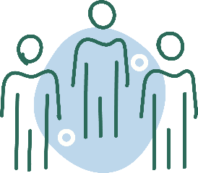
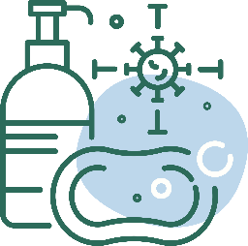
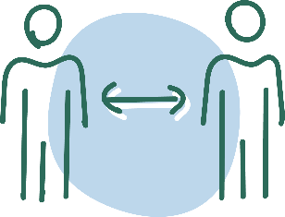
After Vaccination
Getting Vaccinated
Continue COVID-19 prevention measures:
Cover your nose and mouth with a mask.
Stay at least 6 feet from people who don’t live with you.
Avoid crowds and poorly ventilated spaces.
Wash your hands.
Clean and disinfect frequently touched surfaces.
If you have questions about your health and vaccination, call your doctor, nurse, or clinic.
Notes:
If you experience a fever after vaccination, you should stay home from work if you can. Most side effects after vaccination do not last very long. The vaccine does not give you COVID-19. However, you could have been exposed to the virus before you were vaccinated, so if you continue to feel sick, you should consider getting a COVID-19 test. CDC and FDA encourage the public to report possible side effects to the Vaccine Adverse Event Reporting System (VAERS). CDC is also implementing a new smartphone-based tool called v-safe to check in on people’s health after they receive a COVID-19 vaccine. If you enroll in v-safe, you can tell CDC if you have any side effects after getting a COVID-19 vaccine. If you report serious side effects, someone from CDC will call to follow up.

Slide 53
Thank You

Slide 55
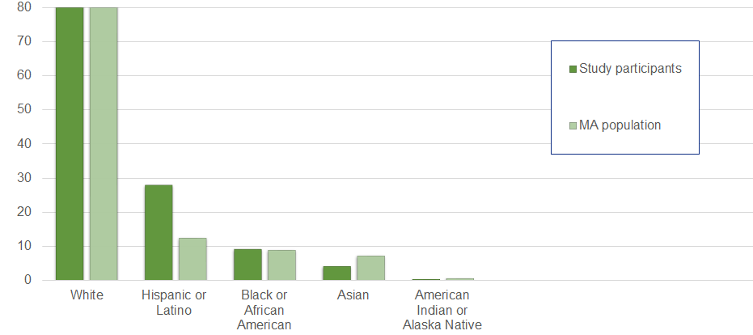
Who was the Pfizer vaccine tested on?
The safety of the Pfizer vaccine was evaluated in 43,448 people 16 years of age and older in two clinical studies conducted in the United States, Europe, Turkey, South Africa, and South America.
Notes:
Overall, 50.6% of participants in the Pfizer safety trials were male and 49.4% were female, 83.1% were White, 9.1% were Black or African American, 28.0% were Hispanic or Latino, 4.3% were Asian, and 0.5% were American Indian or Alaska Native. The safety of the Pfizer vaccine in younger adolescents was studied in 2,260 adolescents ages 12-15 in the U.S.
https://www.fda.gov/media/144413/download

Slide 56
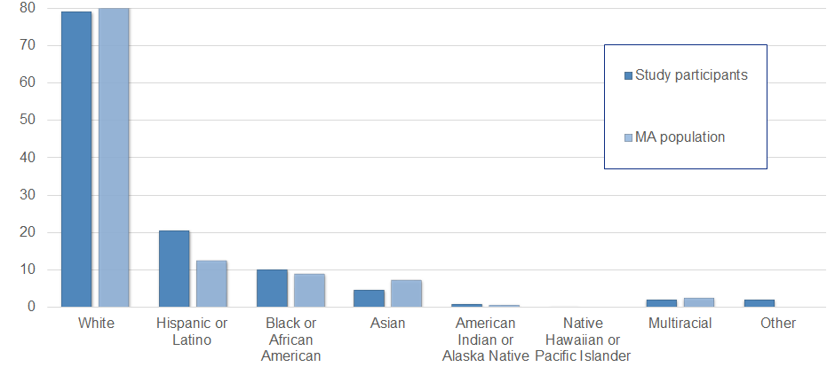
Who was the Moderna vaccine tested on?
The safety of the Moderna vaccine was evaluated in 30,351 people 18 years of age and older in the United States.
Notes:
Overall, 52.7% of participants in Moderna safety trials were male, 47.3% were female, 79.2% were White, 10.2% were Black or African American, 20.5% were Hispanic or Latino, 4.6% were Asian, 0.8% were American Indian or Alaska Native, 0.2% were Native Hawaiian or Pacific Islander, 2.1% were Other, and 2.1% were Multiracial.
The average age of participants was 52; 75.2% were 18 to 64 years of age and 24.8% were 65 years of age and older.
The demographic characteristics were similar among participants who received Moderna COVID-19 Vaccine and those who received placebo.
https://www.fda.gov/media/144637/download

Slide 57
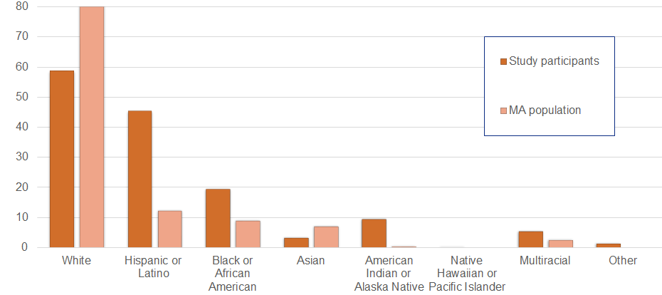
Who was the Johnson & Johnson vaccine tested on?
The safety of the Janssen (Johnson & Johnson) vaccine was evaluated in 43,783 people 18 years and older in the U.S., Brazil, South Africa, Colombia, Argentina, Peru, Chile, and Mexico
Notes:
Overall, 45% of Janssen participants were female, 55% were male, 58.7% were White, 19.4% were Black or African American, 45.3% were Hispanic or Latino, 3.3% were Asian, 9.5% were American Indian/Alaska Native 0.2% were Native Hawaiian or other Pacific Islander, 5.6% were from multiple racial groups and 1.4% were unknown races. The average age of participants was 52.
The demographic characteristics were similar among participants who received Janssen COVID-19 Vaccine and those who received placebo.
https://www.fda.gov/media/146304/download

