Slide 1
Humanitarian and Development Project Designing amid COVID-19
December 15, 2020

Slide 2
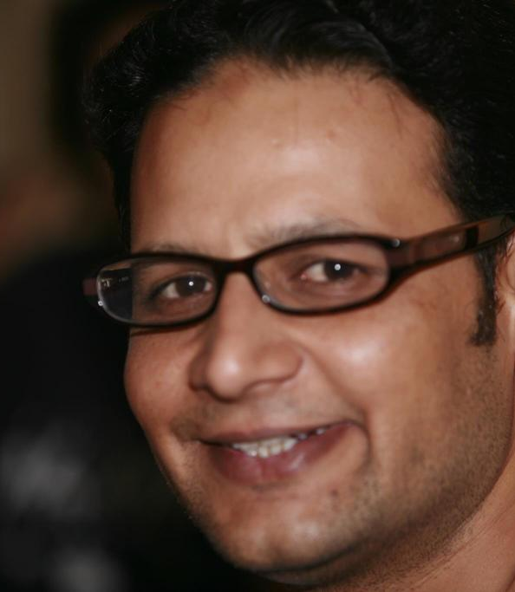
Presenter
Mr. Wajahat Ali’s professional career spreads over 18 years. He has worked (regular and as freelance consultant) with various renowned INGOs such as British Council, Oxfam International, International Rescue Committee, Save the Children, Mercy Corps, Islamic Relief etc. designing and leading a number of projects, programs, strategies & studies in East Africa, Middle East & South Asia. He has been instrumental in developing the humanitarian architecture in Pakistan and globally. He remained part of the pilot rollout of Cluster System in Pakistan in the wake of 2005 earthquake. He also extended his contributions in developing and rolling out the humanitarian coordination systems in Kenya (Kakuma Camp) and Jordan during 2012-14. He actively contributed in the development of Global Minimum Standards for Child Protection during the year 2010-12. He has also been supporting/leading various researches, evaluations and impact assessment studies in country and internationally.

Slide 3
Roadmap
Project Design – overview
Background & Context
Risks & Assumptions
Goals, Objectives, Outputs & Outcomes
Stakeholders, Beneficiaries, Timeline, Workplan & Budget
Sustainability & M&E Strategies
Communications & Advocacy

Slide 4
It identifies key elements by outlining the answers to 4 Ws of the project: What-Where-When-Who.
What: defines the project itself
Where: is the internal and external environment
When: is the timeframe
Who: is you and the beneficiaries
A project develops as an idea or vision-which is feasible.
An idea can only become a reality once it is broken down into organized, actionable elements within a timeline.
NGO project design centres around problems and solutions: it involves identifying a prevailing/future problem that is/may impact a target population.
COVID – Transformative Approach to Project Design
Challenges ➔ Opportunities

Slide 5
What should be included in the project background?
The project background should include information about the reasoning why you want to implement this specific project in this specific location in this specific manner.
It has to explain the current situation and its problems and the way in which you want to solve these problems.
These explanations and assumptions should be backed up by reliable data..
Where can you find data for your project background?
Based on verifiable information
Statistics and data to base your assumptions on
Brief overview of the current situation
Only use data from sources that are reliable
Government, UN, WB and other big organizations as data source
If possible, also use specific data from your community
Draw this data from the former project, the baseline study or surveys and interviews.

Slide 6
S
strength, nature of organization and project that give it an advantage over others
W
weakness, nature of organization and project that is disadvantage relative to others
O
opportunity, elements that could be used for success of the project
T
threat, elements that could cause failure of the project
The project context analyses the problem and the range of impact of the project strategy to bring the desired change. The project context is also useful to develop appropriate strategies for dealing with the SWOT analysis.
COVID-19 Context

Slide 7
ASSUMPTION
A risk is an assumption with a higher level of failure.
It is an event that could happen with a notable probability and could affect the outcome of your project substantially.
An assumption is a statement that you assume to be true.
Without assuming certain things planning would be impossible, as we never know for certain how the future will look like.
Sometimes we look at these things as if they were facts, but in reality they are just assumptions, as we cannot be 100% sure.
RISKS
More, More & More but Rationalized

Slide 8
Change your Box amid COVID 19 before going out of the box
Innovate & Learn
Project goals and objectives are similar in that they are both the reason for why the project needs to take place.
The goal gives direction to the project.
Goals & Objectives
Outcomes
Produced from the project outputs; just completing the project activities does not guarantee that the outcomes were also achieved
Typically more intangible and harder to measure
The reason why the project is necessary
The objectives are the specific targets the project aims to achieve to meet the goal.
In short, the goal can be seen as the high-level, “shoot-for-the-stars” vision while the objectives are the grounded, well-thought-out plan to reach that vision.
Outputs
Directly produced by the project; as long as you completed the project activities, you will create an output
Typically tangible and easy to measure
Not the reason why the project was necessary

Slide 9
Project Beneficiaries
Workplan
The project beneficiaries also called the target group or the target beneficiaries of your project, are those who will benefit from your project.
Timeline
Timeline basically shows the chronological order of events that you plan to do in your project.
A work plan is a description of the sequence of the project activities in time. It is much more detailed than a mere timeline though. It includes information about responsibilities, objectives and sometimes even the budget.
Budget estimates
A budget is an estimate of income and expenditure for a set period of time. Project budget simply refers to a document which specifies how much money needs to be allocated and how will the allocated money be implemented on the activities to achieve the goal of the project.
Who is vulnerable amid COVID 19?
Be more realistic amid COVID 19
More details will be needed
Quality Costs even more amid COVID 19

Slide 10
Sustainability
Sustainability is the ability of an organization to continue its mission or program far into the future.
Monitoring and Evaluation Strategies
Monitoring and Evaluation strategies is an approach that has mainly been developed to measure and assess the success and performance of projects, programs or entire organizations.
Communication & Advocacy
Effective communication – advocacy or otherwise – involves more than just using words to convey a message. Integrated campaigns that include print, multimedia and interactive content are likely to be more appealing, easily shared through different channels and thus, highly effective
Cross-cutting Elements amid COVID 19

Slide 11
Thank You
Any Questions?

