Slide 1
Resource Mobilization during Emergencies
Presenter: Adeel Qaiser
27th January 2021

Slide 2
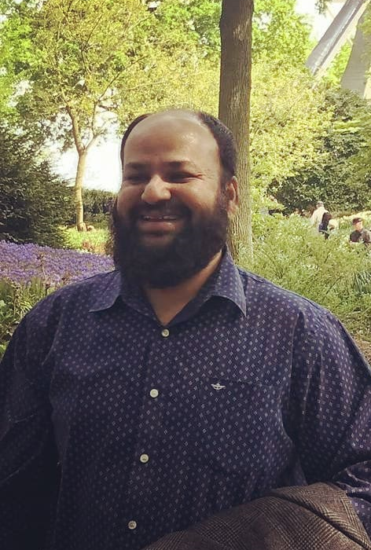
Presenter
Mr. Adeel Qaiser is a renowned development practitioner with 15 years of experience on leading positions with international organizations in programme management, execution and development in complex political and humanitarian settings, in Asia, Middle East and Africa. He has a divers experience of leading teams and offices within fragile humanitarian contexts and setting including natural and the political crisis. Mr. Adeel Qaiser has a successful record of developing and leading multicultural and multidisciplinary teams with high level representation and coordination with the Government, UN, INGOs, donor agencies and media. He is well versed in managing substantial budgets and multiple grants simultaneously

Slide 3
In the name of Allah, the most merciful and most beneficent .
Allah SWT is the source and only source of all what we have and all what we could plan for.

Slide 4
5 questions about NGOs relevance
Are we allowed/ authorized, recognized as the legitimate emergencies' responders?
Are we transparent/ accountable to the beneficiaries/ donors, governments ?
Do we have credible evidence of change that we have brought in the lives of people affected?
Do we have an idea of the geographical priorities/ thematic priorities we will have in case of next big flooding, next big earthquake, an internal conflict, pandemic (Maaz Allah)?
Do we have a plan until 2030 for our organization ? Are we here to stay or fading away?

Slide 5
What are The Resources for An NGO ?
Physical Resource: Vehicles, offices, computers, cameras, furniture, tents, containers, warehouses, rub-halls, equipment, internet appliances, Satellite phones, mobile phones, laptops, portable internet systems, helicopters, speed boats, safety jackets, water pumps, tanks, emergencies first aid kits,
Human Resource: staff, volunteers, consultants, trainers, translators, researchers, marketing professionals
Strategic Resource : funding/ proposal writers, SITREP writers. strategic plan, emergency preparedness plan, procurement plan, human resource plan, policies, operating procedures, guidelines, emergency assessment questionnaires, sphere project handbooks, market assessment toolkits, MoUs with the local governments, ear – marked funds for emergency responses, agreements with the banks for cash disbursements (Easy Paisa, Jazz cash , tameer bank etc)
Tactical Resource : donor relationships, framework agreements with suppliers and service providers, memberships of emergency networks emergency roasters/ registers for experts, partnership agreements with local partners, proposal samples, situation reports samples, emergency assessment tools (online / offline ), lists of emergency stocks/ supplies, online training material , linkages for quick induction,

Slide 6
Traditional Funding Sources for NGOs during emergencies
ECHO , USAID (OFDA, Food for Peace), UKAID , Irish Aid, Aus Aid
UN agencies – multilaterals
World bank , Asian Development Bank , ICRC, IFRC
Saudi Government, Turkish Government, Malaysian Government,
International NGOs (Save the Children, Oxfam, IRC, Care, ACTED, WHH)
Foundations, Charities and Trusts (British Asian Trust, Bill & Melinda Gates Foundation, IKEA Foundation)

Slide 7
new resources for emergencies
Corporates, multinational companies, GSK, UNILIVER,
telecom companies https://www.telenor.com.mm/en/article/telenor-myanmar-extends-support-flood-affected-communities-ayeyarwaddy
service companies https://www.uber.com/en-GB/blog/london/london-giving/
lotteries (post code lottery schemes),
International football clubs/ teams (https://www.chelseafc.com/en/news/2015/11/05/plan-international-thanks-club-for-syria-donations
Celebrities and philanthropists https://gulfnews.com/entertainment/hollywood/syrian-refugee-crisis-celebrities-lending-a-hand-1.2088271
Discounts from hotels, airlines, transport companies, service providers, and suppliers
Local chambers and local corporations https://pakiholic.com/haji-muhammad-naeem-founder-savour-foods
National universities and degree colleges for volunteers and also for researches
Use of community buildings/ infrastructure/ hostels for temporary offices – staff houses

Slide 8
BASICS for better resource mobilization
Attend / participate in compliance training courses of the big donors' requirements better –
https://www.usaid.gov/work-usaid/get-grant-or-contract/trainings-how-work-usaid
https://www.dgecho-partners-helpdesk.eu/learning-and-trainings
https://www.bond.org.uk/learning/dfid-grant-management
avail online courses/ training certificates, register with UN / IFRC – ICRC training resources to save costs
https://usnwc.libguides.com/c.php?g=866733&p=6228670
Go for specialized thematic expertise instead of emphasizing on general areas, because specialized actors are preferred over general skills – SDGs could be a way forward
Pay attention to your policies and procedures upgrade and update these according to the new norms in the industry
You have to be gender balanced in your team , in your BOARD and in your emergency response roles (invest in women leadership)
safeguarding policies are also critically important
Establish resource mobilization / funding units within your organizations – equip these
Join consortium's, partnerships and networks for multiplier effects

Slide 9
Ideas for future – unpredictable world
Think / consult setting up business ventures for the resource mobilization
https://data.unaids.org/publications/irc-pub06/jc579-strategies_ngo_en.pdf
https://www.fundsforngos.org/alternative-fundraising/9-businesses-for-ngos/
Better Assets Management
https://www.fundsforngos.org/ngo-operational-policies/5-fixed-assets-policy-for-ngos/
Attend and continue to hold webinars , and participate in global webinars
https://www.youtube.com/watch?v=HCsmml0aIKE
https://www.youtube.com/watch?v=jhd2QKuRexY
https://www.youtube.com/watch?v=rBg12HZRM_U
https://www.youtube.com/watch?v=jsGBuu88WE0

Slide 10
Go pool it
This is a new social media-based funding solution for NGOs
Mr. Raheel Nazir Chaudhary is the Representative in Pakistan – he can briefly introduce participants about the program
https://www.gopoolit.com/

Slide 11
Questions and Answers
And Thank you very much.

