Slide 1
Tax Filling System in Pakistan

Slide 2
Session Outline
Introduction to Tax Filling System (IRIS).
Purpose and Importance of Tax Filling.
Introduction to Tax Statements.
Registration Procedure of Individuals. (With Detail Example)
Registration Procedure of (AOP & Company Just Introduction)
Tax Filling Process. (Calculations, Assessments, Valuations)
Any Quires/ Questions.

Slide 3
Introduction to Tax Filling System (IRIS).
The portal used in Pakistan for Tax filling named as IRIS.
Iris is an integrated, end-to-end, highly configurable and customizable ERP, covering all business processes of Income Tax and Sales Tax.
Iris is accessible through every latest browser i.e. (Chrome version 37+, Opera, Internet Explorer version 9+, Firefox, Netscape, and Safari) However, recommended browser is Google Chrome.
You can access Iris at the following URL: https://iris.fbr.gov.pk/infosys/public/txplogin.xhtml.

Slide 4
Purpose and Importance of Tax Filling.
Government Requirement
Financial Self Assessment
Calculating Benefits and Credits
Filing ITR avoids penalties
ITR receipt is a very important document
ITR receipt is a useful document for hassle-free processing of bank loans
Visa processing
Compensate losses in the next financial year

Slide 5
Introduction to Tax Statements.
Return of Income filed voluntarily for complete year u/s 114 (1)
Statement of Assets / Liabilities filed voluntarily u/s 116 (2)

Slide 6
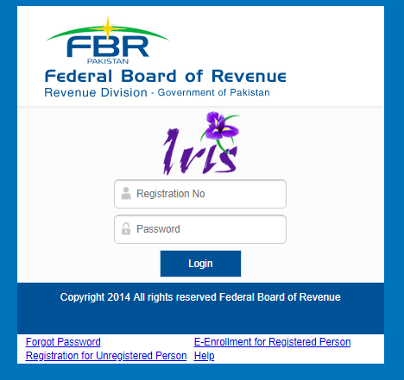
Registration Procedure of Individuals.
Registration for Unregistered Persons.
E-Enrollment for Register Person

Slide 7
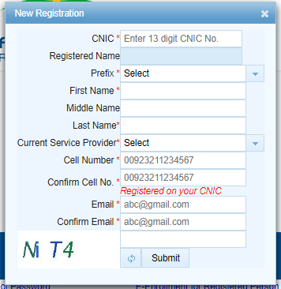
Registration for Unregistered Persons.
CINC
Name Prefix
Mobile Number (Must be Unique)
E-Mail (Must be Unique)
Pin Codes (“Msg” send it to 9966)
Received Passwords via mail and sms

Slide 8
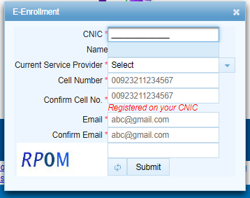
E-Enrollment for Register Person
CINC
Mobile Number (Must be Unique)
E-Mail (Must be Unique)
Pin Codes (“Msg” send it to 9966)
Received Passwords via mail and sms

Slide 9
Registration Procedure of (AOP & Company Just Introduction).
AOP
Company
Firm Registration Documents.
Request on Letter Head.
Details of Partners with Copy of CNIC’s.
Paid Electricity bill.
Company Registration Documents.
Request on Letter Head.
Details of Directors with Copy of CNIC’s.
Paid Electricity bill.

Slide 10
Tax Filling Process. (Calculations, Assessments, Valuations)
Registration Completion (In case of New Registration).
Preparation of Tax Statements.
Calculation of Incomes/Expenses.
Calculation of Withholding Taxes.
Valuation of Assets/ Liabilities.

Slide 11
Question Answer
This Photo by Unknown Author is licensed under CC BY-SA

