Slide 1
Project Monitoring & Evaluation

Slide 2
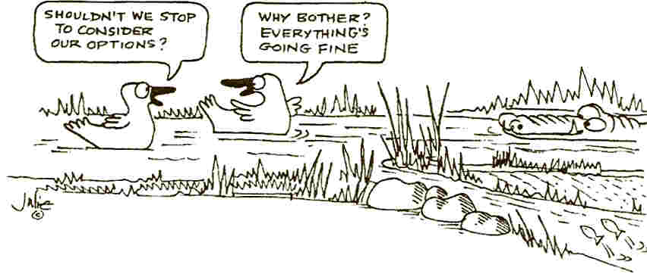
What does this picture tell?????

Slide 3
Definition
A continuing function that uses systematic collection of data on specified indicators to provide management and the main stakeholders of an on-going humanitarian and development intervention with indications of the extent of progress, achievement of objectives and progress in the use of allocated funds.
(Based on OECD-DAC, 2002)

Slide 4
What is not Monitoring
Policing/imposing
Pointing out (but it is highlighting)

Slide 5
Tools for Monitoring

Slide 6
Monitoring Tools
Staff meetings – Weekly, Monthly, Quarterly
Field Visits
Spot Checks
Observations
Participatory Reviews – Stakeholders
Partners meeting/Learning Forums (FGD, Surveys)
Monitoring and Supervision Mission (Self/Donors/Joint)
Community Feedback /Complaints

Slide 7
Develop a flow chart and description showing how the monitoring data will flow from the place where it is collected up to the management team and then to other stakeholders, including the donor.
Project/Field Coordinators
Program Manager
Executive Director
Further reviews and clarifies Report
Manager M & E
Review of Report
Program Manager
Monitoring Report prepared based on field monitoring visit and action plan agreed upon by the Project/Field Coordinator after a de-brief session with him/her.
In case of reports of serious nature or requiring further inputs as per the de-brief session they are shared with Program Managers at this stage along with direct sharing with Executive Director ( M& E head) .
M& E Officer

Slide 8
Evaluation

Slide 9
Evaluation
The systematic and objective examination of humanitarian action to determine the worth or significance of an activity, policy or programme, intended to draw lessons to improve policy and practice and enhance accountability.
(Evaluation of Humanitarian Action Guide by ALNAP , 2016)
Notes:
Systematic – a planned and consistent approach, based on
credible methods.
• Objective – stepping back from the immediacy of the humanitarian action
and getting some perspective, basing findings on credible evidence.
• Examination – exploration or analysis to determine the worth or
signifi cance of the action.
• Drawing lessons to improve policy and practice and enhance
accountability are the reasons for doing an evaluation.

Slide 10
Purpose of Evaluation
Learning
Accountability
Notes:
Learning: The process through which experience and reflection lead to changes in behavior or the acquisition of new abilities.
Accountability: Accountability is the means through which power is used responsibly. It is a process of taking into account the views of, and being held accountable by, different stakeholders, and primarily the people affected by authority or power.

Slide 11
Evaluation Criteria

Slide 12
What?
Impact
Better skilled population
Outcome
Increased access to quality Skill edu services
Outputs
Improved curricula and materials, teaching
skills, and systems for school management
Activities
Materials development, artisans training,
and management capacity building
Inputs
Money, facilities, HR, materials
Notes:
An outcome is only partly attributable to the actor responsible for the
intervention – for example, how the water from water points newly installed by
an NGO is used (e.g. domestic consumption, animal consumption, or other
livelihood activities such as brick-making).
Impacts can be positive and negative at the same time. For example, providing
food aid may prevent households selling their productive assets, such as
livestock, to buy food (a positive, intended impact), but it may also discourage
local food production (an unintended and potentially negative impact).

Slide 13
Relationship of Monitoring and Evaluation
Evaluation
Monitoring
Information from
Monitoring
Information
from other
sources
Recording
Analysis
Information
Analysis
Reporting
Recording
Recommendations
Corrective action at the operational level
Affirmation or modification in objectives, resources, and process

Slide 14
Monitoring | Evaluation
A continuous process | A specific activity or moment
To provide information to day-to-day decision making (adjustments) | To provide recommendations to strategic decision-making processes
It is carried out by the project team and designated staff For the project team (to adapt and improve the impacts) and the donors (to follow the progress) | It is carried out by an evaluation team (internal or external to the project team) For the project team and the donors (lesson learned)
The monitoring system should provide information for evaluations

