Slide 1
Human Resource Management Training Session 4
Agenda: Staff Retention & Motivation

Slide 2
Staff Retention & Motivation:
Conducive Working Environment
Team Management
Conflict Resolution within Teams
Gender Sensitivity
Role Modeling (Lead by Example)

Slide 3
Challenge?
The challenge is not only to attract the best talent but also to retain them

Slide 4
Solution?
Retention can be increased through the Development of Employees

Slide 5
Staff Retention:

Slide 6
Why is Retention so Important?
The Cost of Turnover
Loss of Company Knowledge
Disruption of Customer service
Turnover spirals into more turnover

Slide 7
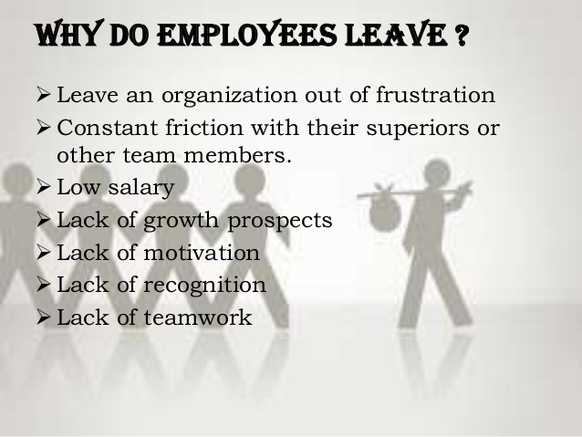
Why do Employees leave?

Slide 8
Why do Employees leave?

Slide 9
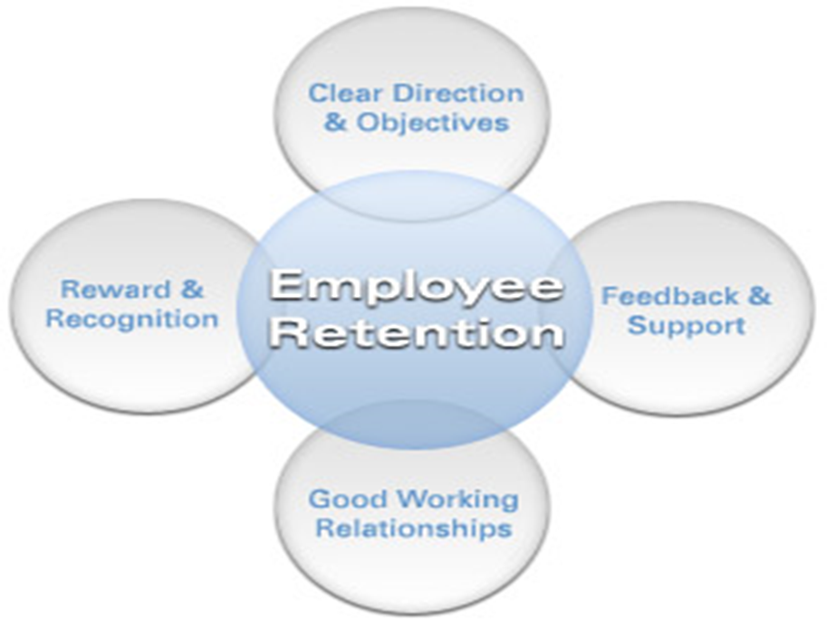
Factors that Affect Retention:

Slide 10
Motivation:
Internal and external factors that stimulate desire and energy in people to be continually interested and committed to a job, role or subject, or to make an effort to attain a goal.

Slide 11
Sources of Motivation:
Extrinsic Motivation:
Created from factors outside oneself (like rewards and pressures)
Intrinsic Motivation:
Created from an inner impulse
Leads to self-motivation

Slide 12
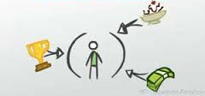
Extrinsic Motivation:
Salaries
Benefits
Having a title, e.g Regional Director
Working with people one likes
Proximity of office to one’s residence
Beauty of the work place
Stature of the organization
Pressure from formal authority

Slide 13
Intrinsic Motivation:
Enjoyment of the work for its own sake
Belief in the importance of one’s work
The excitement of a challenge
Desire to exceed one’s previous level of job performance
Desire to be “part of the action”
Pride in performing excellently
Need to prove some point to oneself
Achievement of a deep-seated value

Slide 14
Conducive Working Environment:
- Is a key success factor for any organization.
There is a direct relationship between high morale and productivity.
For maximum productivity, an organization must address the following issues:
Ambience
Equipment, supplies and facilities
Noise Level
Prejudice and stereotyping
Conflict Resolution Mechanisms

Slide 15
Team Management:
Motivating
Managing the Psychological Contract
Commitment & Morale
Leadership
Team building
Delegating
Communicating
Organizing

Slide 16
Gender Sensitivity:
Gender Sensitivity requires internalizing
Biological Differences
Social Gender
Gender roles
Gender needs

Slide 17
Role Modelling:
A line Manager should
Set clear expectations
Identify individual strengths and development
Areas
Challenge staff to stretch outside their comfort
Zones
Actively coach and develop staff
Have a solutions focus approach to challenges
Deliver regular praise and developmental
feedback

Slide 18
Qualities of a Role Model (Lead by Example):
Awareness
Commitment
Empathy
Foresight
Listening
Persuasion

Slide 19
Inputs/Feedback:

