Slide 1
FAQs Session-4 to Increase Public Understanding on COVID-19 and its Implications in Gender Perspective
By: Miss Mariam Saigol
29 October 2020

Slide 2
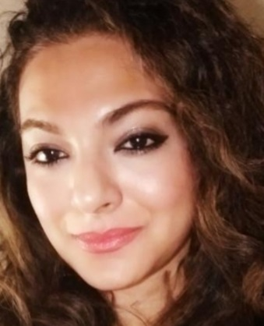
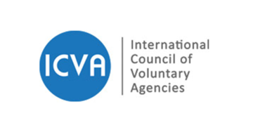
Presenter
Miss Mariam Saigol is currently working as Head of Communications at Strengthening Participatory Organization (SPO) Islamabad. She has completed her B.A. in Government and International Politics at George Mason University in Virginia, USA. She has developed in-depth knowledge of the political context of the country with demonstrated experience in the political and education development sector through her various work with international and local organizations. While working at SPO, she has been specially engaged in the COVID-19 response on behalf of her organization and their donors. She has developed and launched several COVID-19 awareness campaigns which have given her a clear and up to date understanding of the issues being faced in Pakistan with regards to the COVID-19 pandemic.

Slide 3
Questions
How has COVID-19 worsened gender equality ?
How are girls and women affected by COVID-19?
Is the COVID-19 pandemic affecting women disproportionately?
Are the rates of gender based violence rising as a result of COVID-19?
How can the COVID-19 pandemic affect women’s sexual and reproductive rights?

