Slide 1
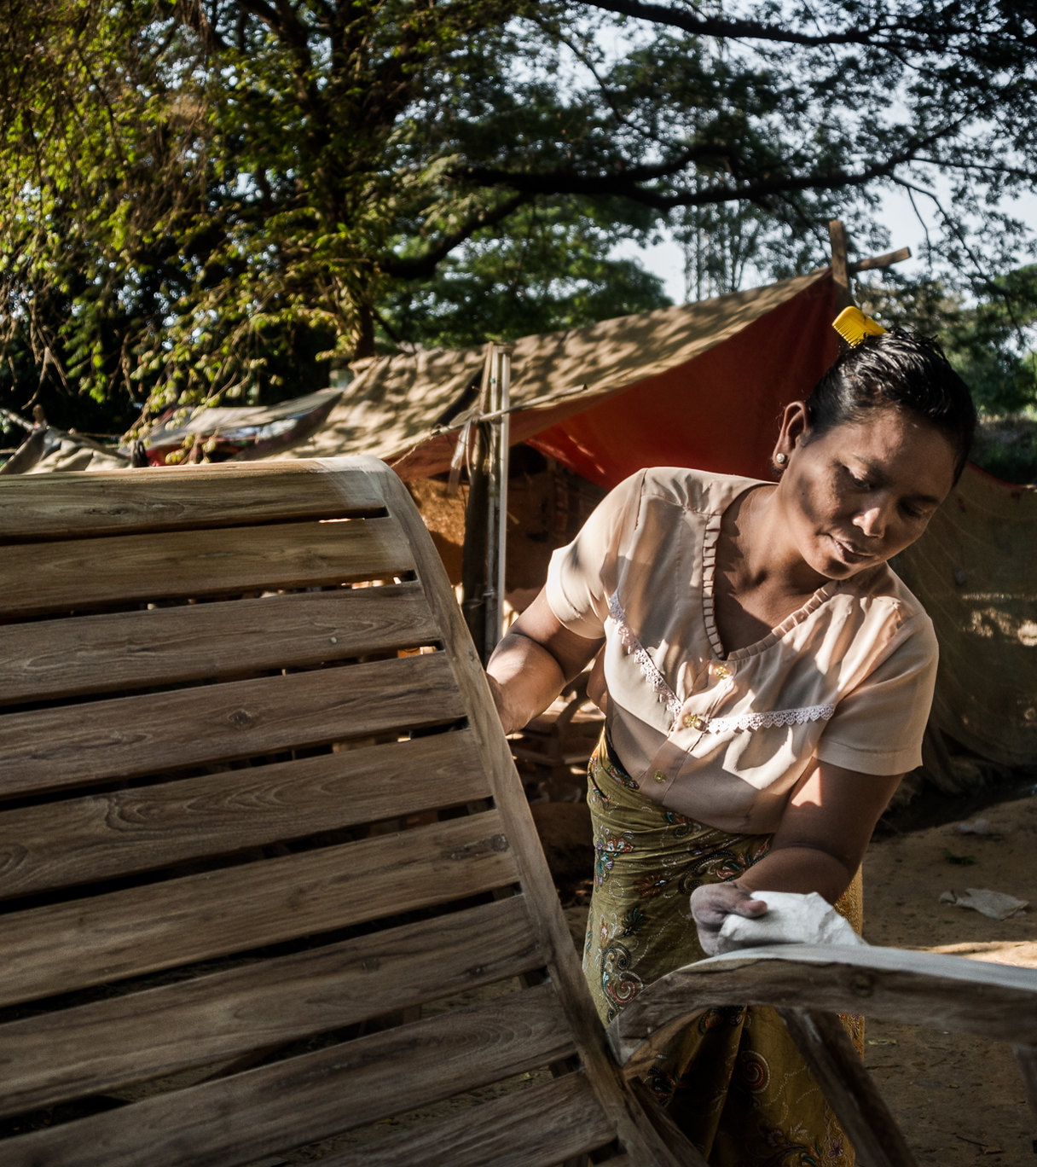
In coordination with the Gender in Humanitarian Action Community of Practice Myanmar
Gender in Humanitarian Action and IASC Gender with Age Marker (GAM) Training
7th November 2022
Adapted from Un Women’s PPT April 2022

Slide 2
The IASC commits to the goals of gender equality and the empowerment of women and girls in humanitarian action. This entails making provision to meet the specific needs of women, girls, men and boys in all their diversity, promote and protect their human rights, and redress gender inequalities.
|IASC Gender Policy Statement

Slide 3
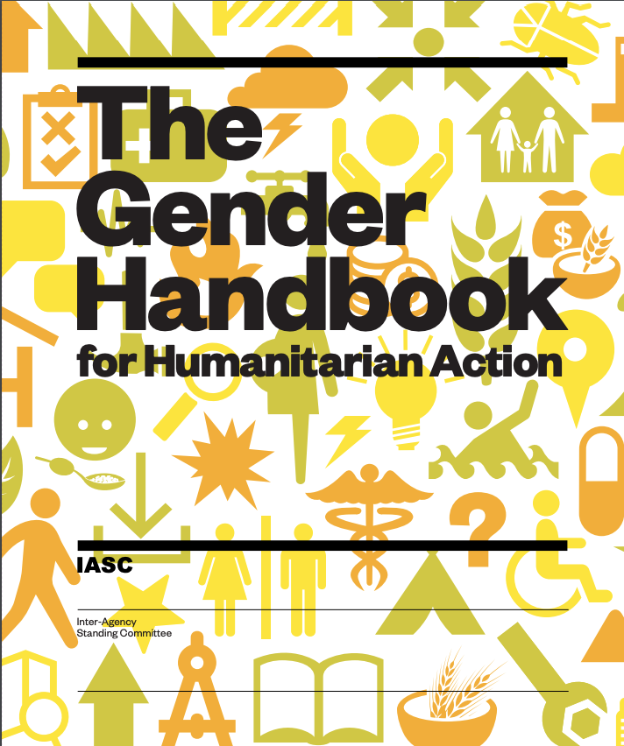
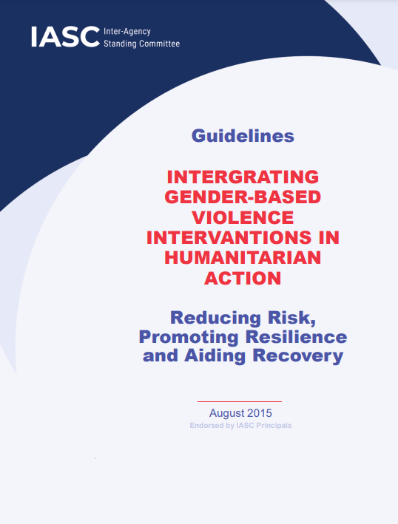
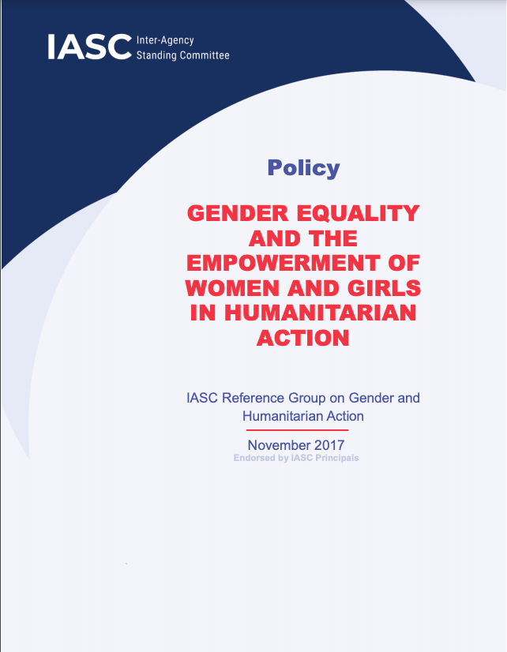
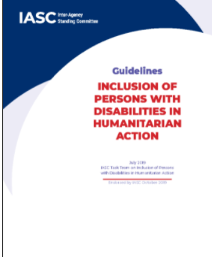
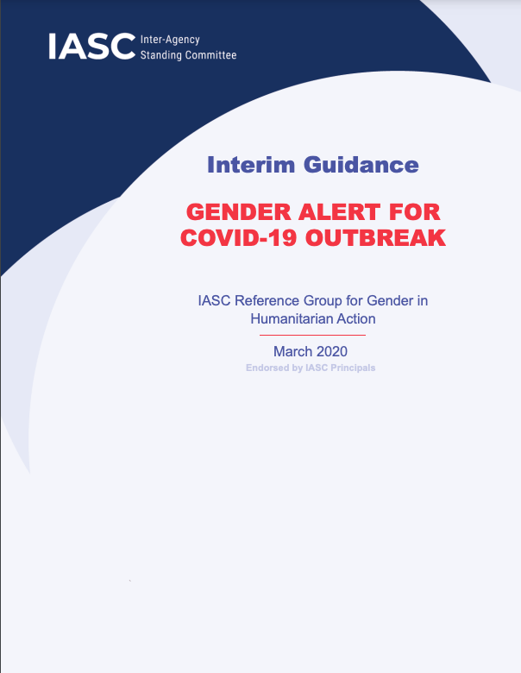
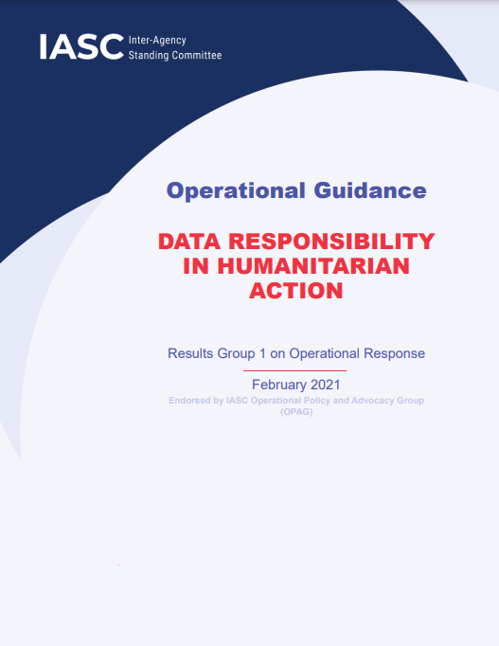
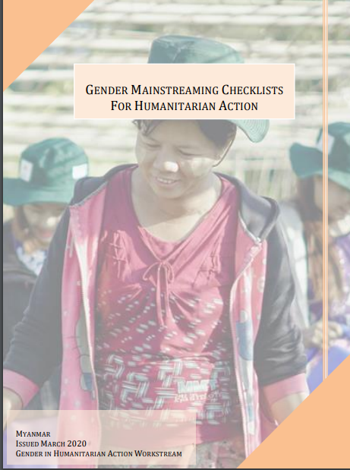
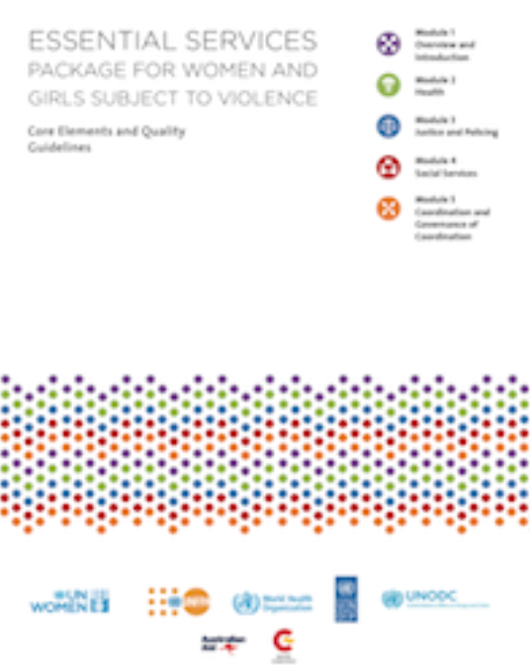
|Guiding Frameworks: IASC Resources for Gender in Humanitarian Action
IASC Intergrating Gender-Based Violence Intervantions in Humanitarian Action, 2015
IASC Policy (and Accountability Framework) on Gender Equality and the Empowerment of Women and Girls in Humanitarian Action, 2017
IASC Guidelines, Inclusion of Persons with Disabilities in Humanitarian Action, 2019
IASC Interim Guidance: Gender Alert for COVID-19 Outbreak, 2020
IASC Operational Guidance: Data Responsibility in Humanitarian Action, 2021
Gender Mainstreaming Checklists For Humanitarian Action, 2020
Essential Services Package for women and girls subject to violence, 2015
IASC Gender in Humanitarian Action Handbook, 2018
Notes:
Gender handbook – bigger
Add more:
IASC guidance GBV in emergencies
IASC guidance on data
Gender mainstreaming checklist for humanitarian action (per clusters)
Essential service packages
If you want, we can create a list of all the essential resources you may need and add it in the dedicated dropbox.

Slide 4
PRINCIPLES
Human rights a prime motivation for promoting Gender Equality and Empowerment of Women and Girls (GEEWG) in humanitarian action.
GEEWG is a critical component of achieving effective and life-saving humanitarian action and is a responsibility to be owned by all actors. It is not optional or additional.
Gender includes LGBTIQ+ persons.
Capacities and agency of women and girls recognized and strengthened in all HA, with equitable participation.
Sustainable change on GEEWG, and strengthening resilience, requires robust action throughout DRR, HA, and development, and conflict resolution and peace-building.
STANDARDS (Highlights)
Programmes
All stages of HPC informed by gender analysis backed by SADDD
Support to women’s economic empowerment
Provisions for SRH
Provisions to mitigate, prevent and respond to GBV
PSEA and AAP implemented in a gender-responsive manner
Organizational Practices
IASC-led funding mechanisms include GEEWG requirements
Presence of dedicated Gender Focal Points in all IASC countries
Gender Parity in HCT
Functioning Gender Working Groups informing the HCT’s work
Notes:
Update of the policy: The Inter-Agency Standing Committee (IASC) Policy on Gender Equality and the Empowerment of Women and Girls (GEEWG) in Humanitarian Action was endorsed on December 2017 by the IASC Working Group (now OPAG) The policy sets out the principles, standards, and actions that IASC Bodies, Members and Standing Invitees should abide by at global and field level to integrate gender equality and the empowerment of women and girls into all aspects of the IASC's work, including preparedness, response and recovery efforts.
A rights-based approach that looks at W&Gs beyond victimhood but as voices and contributors to be heard.
Emphasis on building resilience whilst recovering. Strategy of protection through empowerment.
Set outs standards of programming methodology and organizational practices.

Slide 5
|Roles and Responsibilities as defined by the IASC Gender Policy
Humanitarian Coordinators
Demonstrate leadership on GEEWG in all aspects of HA
Establish targets for gender parity in HCTs and other operational teams, particularly in surge teams
Consistently raise awareness of the Policy, and encourage ownership
Humanitarian Country Teams
Prepare, implement and monitor a country-specific plan on GEEWG.
Include GEEWG considerations in needs assessments, appeals, and response plans
Cluster Coordinators
Integrate gender equality considerations in all cluster strategies, work plans, needs assessments, etc.
Designate a gender advisor and collaborate with women’s organisations on sectoral issues.
Strengthen capacities and accountability of cluster actors to deliver on GEEWG
Make gender a standing item at cluster meetings
Members and Standing Invitees
Mainstream gender in all internal strategies, plans, operational guidance, with financial and other resources allocated
Contribute to and support the work of the Gender Working Group
Raise GEEWG issues, and share information on GEEWG approaches, at cluster meetings
Inter-Cluster Coordination Group
Ensure gender is fully mainstreamed in all inter-cluster strategies, work plans, guidance and activities
Commission and coordinate joint participatory gender analysis
Appoint a senior Gender Focal Point, to support the HCT
Engage with national and local women’s rights organisations, in a consistent manner
Designate a seat on the HCT for a representative of women’s rights organizations
Undertake studies on the capacities of women and girls to prevent and respond to crises, (to counteract the frequent exclusive focus on vulnerabilities)
Establish and support a Gender Working Group

Slide 6
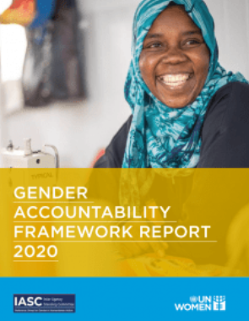
|Key findings from IASC Gender Accountability Framework Report 2022
77% of published decisions from Principals reflected inclusion of gender commitments
68% of crisis contexts reported having consulted at least one local women’s rights organization in the humanitarian planning process
75% of countries had an independent gender analysis feeding into the humanitarian planning process
81% country contexts had a functioning Gender Reference/Gender Working Group in place
55% of HNOs demonstrated use of SADD and gender analysis. Where Gender Working Groups were active, 69% of HNOs did so
Over 90% of HRPs included provisions for sexual and reproductive health and to mitigate and respond to GBV. However, only 63% of HRPs included provisions for women’s livelihoods.
Accessible here
Notes:
The 2020 Gender Accountability Framework report marks the third monitoring cycle of the IASC’s 2017 Gender Equality and Empowerment of Women and Girls in Humanitarian Action Policy.
It is produced by UN Women on behalf of the IASC Gender Reference Group with support from the IASC Secretariat and OCHA.
Key findings shows the scope of the Accountability Framework from the Principals level to country-based clusters and HCTs.
We have observed an overall positive trend from findings at both the global and field levels to mainstream gender into humanitarian responses.
2020 saw humanitarian actors rapidly mobilize themselves to respond to the pandemic that aggravated humanitarian needs in protracted crisis settings. Significant efforts went towards attempts to understand the impact of the pandemic on crisis-affected communities.
This is reflected in the large number of guidance materials on COVID-19 and its impact as well as localized needs assessments and analysis across settings.
For instance, in 2020, the IASC Principals Group released 22 outputs (compared to six in 2019). Notably, close to 80 percent of these outputs in 2020 reflected the standards and commitments of the IASC Gender Policy – a marked improvement from 33 percent in 2019.
For the first time, more than half of the HNOs (55 percent) reviewed demonstrated use of SADD and gender analysis.
Over 90 percent of HRPs included provisions for sexual and reproductive health and to mitigate and respond to GBV.
However, only 63 percent of HRPs included provisions for women’s livelihoods, similar to previous years.
68 percent of crisis contexts reported having consulted at least one local women’s rights organization in the humanitarian planning process reflecting another area of gradual improvement.
Significantly, over 80 percent of settings reported having active gender working groups in place.
A significantly higher proportion of crisis settings – almost 80 percent – reported having conducted joint gender analysis in 2020.
60 percent of all gender analysis was dedicated to understanding the impact of COVID-19 or included such a component in 2020

Slide 7
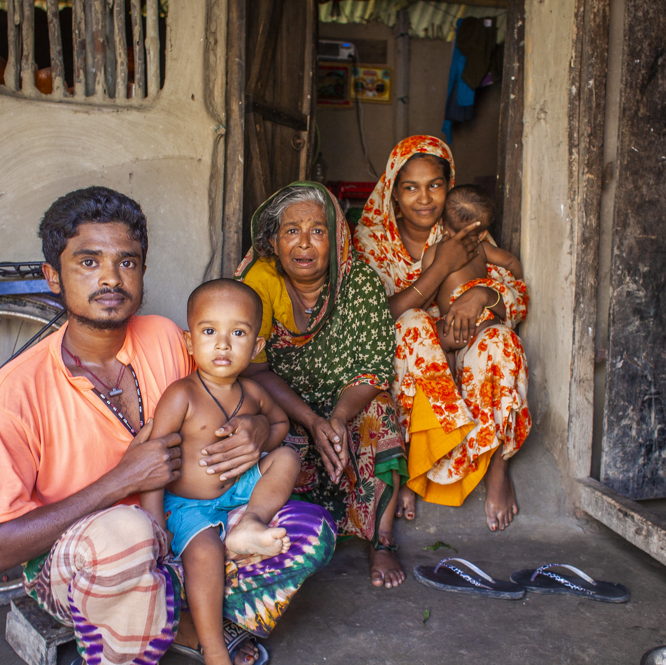
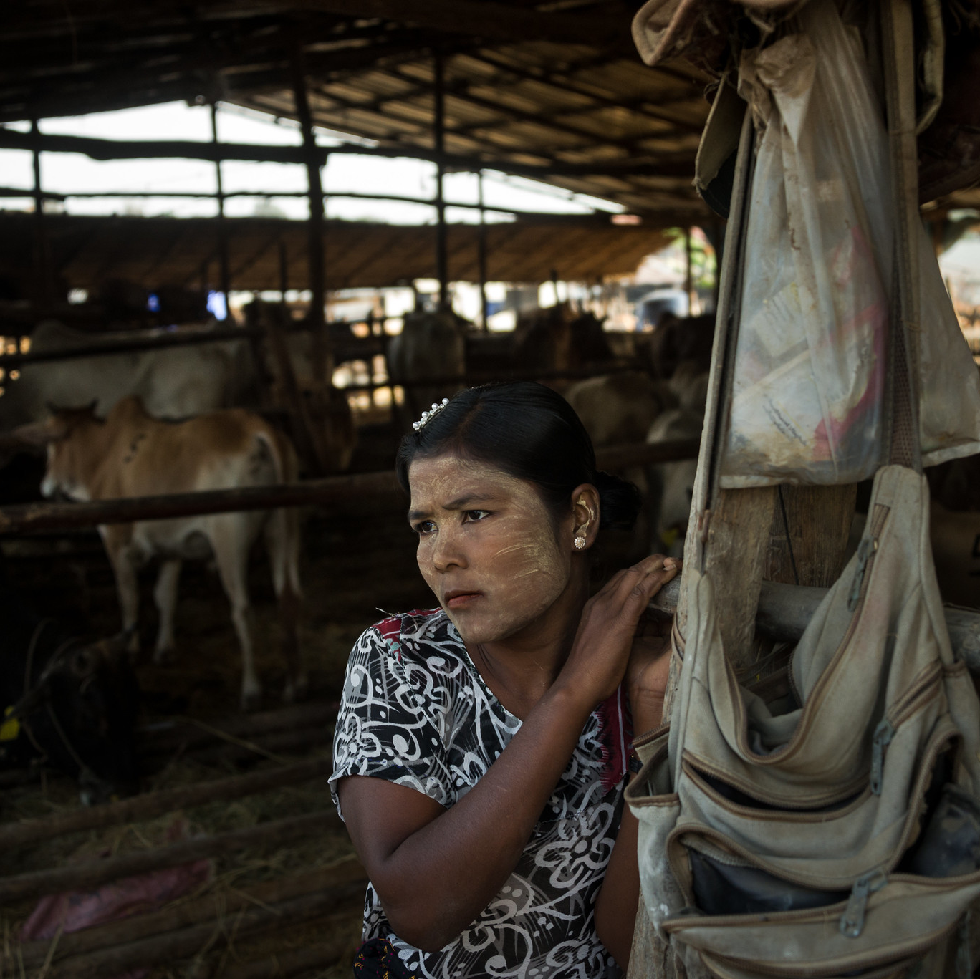
|Why gender equality is essential in humanitarian action
Gender
Identity
Gender equality
Notes:
Gender is:
A social construct built through cultural, political, and social norms and practices of what it means to be masculine or feminine. It often defines the roles, duties and responsibilities expected of people based on the sex they were assigned at birth
A person’s identity is:
Made up of their gender, age, ethnicity, ability (mental, physical), social background, sexual orientation, religious beliefs, type of livelihood, displacement status, health, education, wealth status, and other factors that contribute to their diversity. These factors all come together and interact to give a person their identity. This is called “intersectionality”.
A person’s identity has a profoundly effect on how they are impacted by a crisis and their ability to cope.
Gender equality means:
Persons of all genders and ages, with all the intersecting aspects of their identity –
Enjoy the same rights, opportunities, resources, rewards, and quality of life
Are equally valued and considered in an emergency
Are free to make choices without being limited by gender roles
Are not governed or limited by the sex they were assigned at birth, their sexual orientation, age, ethnicity, or any other diversity factor.

Slide 8
|Exercise
Some male youth, former fighters, who were living in IDP camps, showed signs of malnutrition. World Food Programme increased their rations but malnutrition continued and some of the youth died. World Food Programme conducted an assessment to identify the problem and to find a solution.
Notes:
We will now move into an interactive portion of the presentation where I would like to invite you to participate and think about why integrating gender into humanitarian action is important. Here is the exercise, which I will read to you.
Answer: The former fighters do not know how to cook. So they were actually eating the ration and items provided raw and uncooked. This is because in their culture, men were not taught to cook.
The reason why I am using this as an example is because we as UN Women have the capacity to conduct gender analysis to understand the contexts. It illustrates the importance of conducting proper analysis of the types of humanitarian programming that you do.

Slide 9
|Disaster impacts are not gender neutral
Humanitarian situations can often further reinforce, perpetuate and increase gender inequalities
Year | Disasters and Country | Female Mortality | Male mortality
1991 | Cyclone 0B2 (Bangladesh) | 90% | 10%
2004 | Tsunami (Aceh, Indonesia) | 77% | 23%
2004 | Tsunami (Tamil Nadu, India) | 73% | 27%
2008 | Cyclone Nargis (Myanmar) | 61% | 39%
2009 | Tsunami (Tonga and Samoa) | 70% | 30%
2014 | Solomon Islands Floods | 96% women & children | -
2015 | Nepal Earthquake | 55% | 45%
2015 | Myanmar Floods | 42% | 58%
2016 | Fiji Cyclone Winston | 50% (92% iTaukei) | 50%
Due to traditional gender roles and responsibilities, women and girls are:
More likely to be working in homes when disaster strikes
Less likely to receive early warning information in time
Less likely to learn life-saving skills
More likely to attempt to save children, valuable assets and documentation in disasters
Notes:
As we have already noted vulnerability to hazards is multi-dimensional, and specific to different demographics (including women, children, and persons with disabilities), are often disproportionately affected.
Structural inequalities in society result in distinct risks and varied capacities to prepare, respond and recover in disaster contexts.
The extent of these differentials is dependent upon wealth, disability, ethnicity, age, sexual orientation and gender identity or a combination of those.
Although, disaggregated data by gender and age are scarce and fragmented, available statistics show that women, girls and marginalized groups are more likely to die in disasters.
In particular, it has been noted that disasters persistently kill “more women than men or kill women at a younger age than men”.
[This higher mortality rate is not merely a result of biological and physiological differences between men and women, but rather a product of social norms and gendered roles and relations.]
Gendered disaster impacts derive from imbalances and biases in political, social, economic and cultural structures that increase women’s vulnerability and exposure to disaster.
For example, we see that
Women and girls are more likely to take on the role of caregivers for children, the elderly and for persons living with disabilities, increasing their propensity to remain in unsafe locations during a disaster when unable to transport their dependents safely.
Girls may not be taught potentially life-saving skills, such as swimming and climbing, if considered ‘boy’s activities’ and thus socially unacceptable.
The subordinate domestic role of women also often reduce their access to hazard warnings and resources in post-disaster situations.
For women and girls who survive disasters and crises, we are seeing that the impacts continue to be severe. This is because disasters and crises reinforce, perpetuate, and increase gender inequality. We see that
After disasters, women face increased burdens of care work and poverty.
Disasters (often) exacerbate levels of sexual and gender-based violence.
Women and girls also face higher risks of human trafficking after disasters.
Young women and girls face increased risks of child and early marriage after disasters, because this is one of the key coping mechanisms for families.
Women lose livelihoods, assets, properties, and documentation in disasters, often in ways disproportionate to men.
Disasters often cause the interruption of primary health centres services which cover maternal assistance and sexual and reproductive health needs of women and girls.
At the same time, women should not only be seen as victims since they have shown resilience and strength when confronted with adversity.
Their role in society and in disaster risk reduction should be recognized, valued and strengthened as it is crucial to effective prevention and mitigation, as well as sustainable recovery

Slide 10
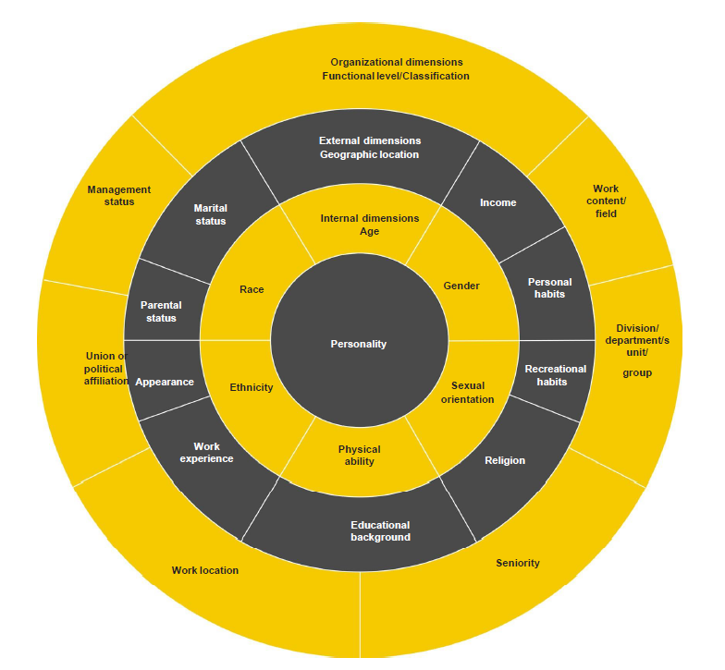
|Intersectionality in humanitarian action
Notes:
A humanitarian emergency has different impacts on individuals according to the factors that define their identity. These factors include but are not limited to: gender, age, ability (mental, physical), social background, race, caste, ethnicity, religious beliefs, nationality, language, economic wealth, level of education, martial status, parental status, health, displacement situation, sexual orientation, type of livelihood, urban/rural setting.
The way these different factors interact is called intersectionality.
Intersectionality Wheel
The factors making up a person’s identity can be organized in concentric layers, beginning with their personality at the centre. This is referred to as the Intersectionality Wheel.
It is an important tool for understanding how different people are affected by a crisis and ensuring that humanitarian action is designed to reach and meet the needs of the most vulnerable people.

Slide 11
|Power walk exercise
Situation:
My little town has experienced bad flooding for the past 3 months. I have been evacuated to an emergency center since then.
Access the whiteboard and pick a character,
Count one point if the statement is true to your characters or stay where you are if it is not,
Share the results and your comments.
Notes:
A humanitarian emergency has different impacts on individuals according to the factors that define their identity. These factors include but are not limited to: gender, age, ability (mental, physical), social background, race, caste, ethnicity, religious beliefs, nationality, language, economic wealth, level of education, martial status, parental status, health, displacement situation, sexual orientation, type of livelihood, urban/rural setting.
The way these different factors interact is called intersectionality.
Intersectionality Wheel
The factors making up a person’s identity can be organized in concentric layers, beginning with their personality at the centre. This is referred to as the Intersectionality Wheel.
It is an important tool for understanding how different people are affected by a crisis and ensuring that humanitarian action is designed to reach and meet the needs of the most vulnerable people.
Characters:
Young girl aged 10
Young boy aged 10
Tribal chief
Religious figure (Imam, Priest, etc.)
Mother and housewife of 3 children
Working woman (liberal profession)
Working woman (labor - non liberal profession)
Working man (liberal profession)
Working man (labor – non liberal profession)
Elderly woman
Elderly man
IDP woman
IDP man
IDP young girl
IDP young boy
Female member of Parliament
NGO community worker
Visually impaired young man
Visually impaired young woman
Supreme Court judge
Policewoman
Policeman
Community nurse
Questions:
Can I influence decisions made at municipal level?
Can I influence decisions at humanitarian response level?
Can I meet government officials?
Can I read newspapers of my interest regularly?
Do I have access to internet/telephone/Television/Radio?
Have I access to credits/micro-credits
Do I have debit/saving bank accounts
Am I still employed or do I still have a revenue?
Can I buy hygiene products (sanitary women products, condoms, etc.) and medication?
Does my opinion have a weight in the municipality where I live?
Have I access to information on HIV, malaria, Covid-19, etc.?
Do I eat at least two meals a day?
Do I have access to clean and drinkable water?
Am I in danger of being sexually harassed or abused?
Can I question expenditure of community funds for the flood response?
Is my accommodation fit for my physical condition?

Slide 12
|Implications of gender and identity for humanitarian action
Gender inequalities exist before the crisis and can be exacerbated in a crisis
Persons of all genders and ages are:
Affected differently by a crisis because of their identities and intersecting factors
Have different needs, viewpoints, capacities, and rights
Have the same human rights for assistance that is appropriate and effective for them
Humanitarian action needs to be designed and implemented in ways that integrate the realities of gender and identity of all persons affected by the emergency.
An emergency context can provide new entry points to promote gender and social equality.
Benefits: right to participation, protection, access to assistance and transformative change
Notes:
Understanding peoples’ gender and identity and providing assistance that fosters gender equality are essential in humanitarian action for the following reasons:
Gender inequalities exist before the crisis
Gender inequalities can be exacerbated in a crisis
Persons of all genders and ages are affected differently by a crisis because of their identities and the various intersecting factors (Intersectionality Wheel).
Persons of different genders and ages therefore have different needs, viewpoints, capacities, and rights in the crisis
Persons of all genders and ages have the same human rights for assistance that is appropriate and effective for them
If this assistance is provided in ways that are inappropriate, then
Individuals become increasingly vulnerable and unable to cope with emergency,
Humanitarian action is ineffective, wasting time and resources.
To be effective in saving lives and livelihoods humanitarian action needs to be designed and implemented in ways that integrate the realities of gender and identity of all persons affected by the emergency.
An emergency context can provide new entry points to promote gender and social equality.
Benefits of promoting gender equality in humanitarian action
Facilitates the right to participation
Affords protection
Increases access to assistance
Enables transformative change
…for all persons of all genders and ages
Q: Who is responsible for integrating gender equality into programming?
A: ALL humanitarian actors. Not just gender specialists or gender focal points
Q: What does transformative change look like?
A: Ensuring that men and women can look at their roles

Slide 13
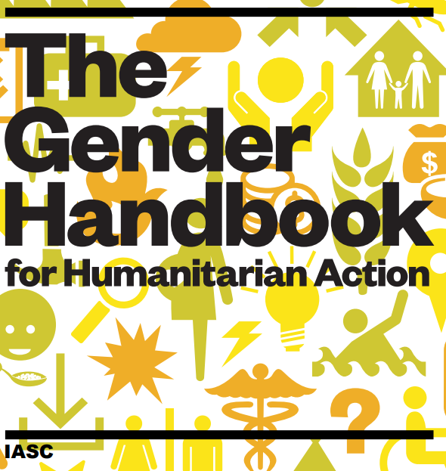
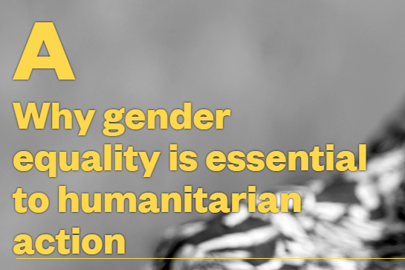
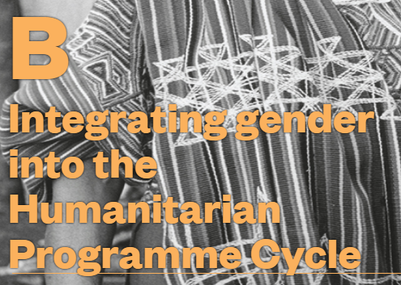
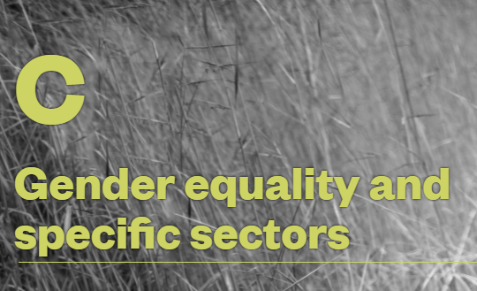
|The Gender Handbook for Humanitarian Action
Section A – Why gender equality is essential to humanitarian action
Sets out the impact that gender inequality has on humanitarian outcomes and how addressing gender inequality is the responsibility of all humanitarian stakeholders.
Section B – Integrating gender into the Humanitarian Programme Cycle
Outlines the entry points of how to integrate gender into the humanitarian programme cycle – assessment and analysis, strategic planning, resource mobilization, implementation and M&E.
Section C – Gender equality and specific sectors
Provides specific guidance on a sector-by-sector basis on how to develop and deliver gender integrated humanitarian programmes.
Download the Handbook here
Notes:
The update of the Handbook was led by UN Women, in partnership with Oxfam and with ECHO funding and with the guidance of a Handbook Steering Committee made up of GRG member agencies, CARE, WFP, UNFPA, UNHCR, Interaction, WRC and OCHA.
The Handbook update was conducted through a highly consultative process, taking in the views and inputs of the IASC’s structures, membership, Global Clusters and subsidiary bodies.
Target audience for the Handbook are frontline humanitarian actors: Who implement and coordinate humanitarian action (government agencies, UN agencies, NGOs); Across all sectors; and Non-gender specialists; as well as gender specialists working in collaboration with frontline actors, and who may also use the Handbook as a resource
The emphasis on the Handbook is to be as pragmatic as possible, providing practical working examples of how to develop programme plans through assessment, gender analysis and participation, citing case-studies and best practice on a sector-by sector basis.
Section C covers:
Cash-based interventions
Camp coordination and camp management
Early recovery
Education
Food security
Health
Livelihoods
Nutrition
Protection
Shelter
Water, sanitation and hygiene
[Note] Additional information on Handbook
Field level consultations were held in Colombia, South Sudan, Jordan and Nepal to garner the inputs of frontline humanitarian workers and other field level stakeholders, who are the intended target users of the resource. These included UN, INGOs, LNGOs and government officials.
These field consultations were later followed by a field testing of a prototype of the handbook in Afghanistan and Ethiopia to assess the practical usefulness of the handbook and its content.
Handbooks are distributed via OCHA’s regional offices to over 45 countries world-wide.

Slide 14
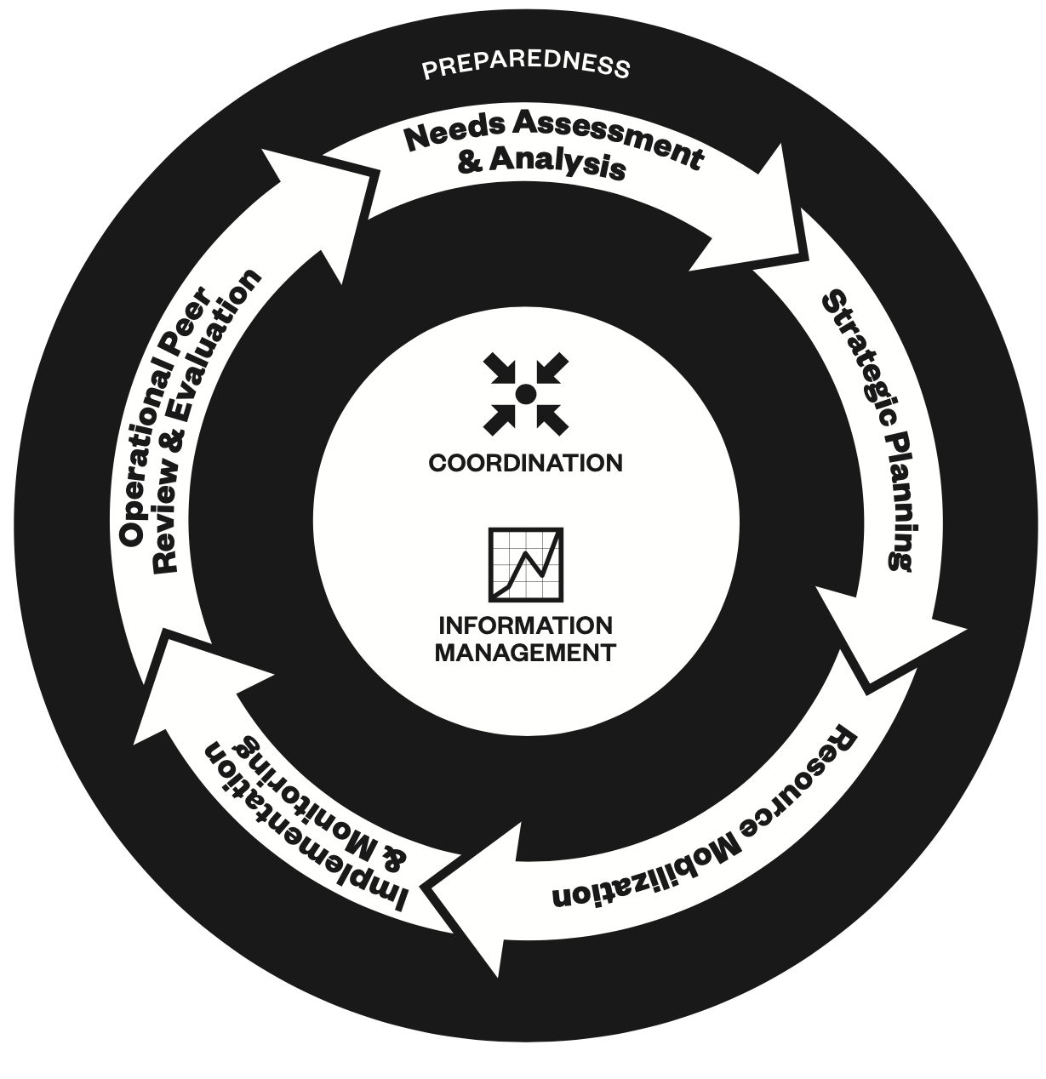
|Integrating gender into the Humanitarian Programme Cycle
Coordination
GBV mitigation and response
Assess the situation and needs together
Develop common strategies
Convene coordinating forums
Set aside adequate funds for coordination
Cross-cutting priority for all sectors
Training for every humanitarian actor
Ensuring access of survivors to care and support
Supporting local and national capacities
Participation
Transformative change
Participatory assessments
Community-based approaches
CSOs, women's organizations
Training and info exchanges
Representative and participatory design process
Accountability: feedback and complaint mechanisms
Structural change that addresses root causes
Enable inclusion and leadership of local women
Develop women and girls' capacities
Women and girls are agents of change in their communities
Checklist for integrating gender into each stage of the Humanitarian Programme Cycle (adapted from OCHA Gender in the HPC Checklist 2016 for Field Users)
Notes:
Whilst individual agencies have a responsibility to ensure that their respective response programmes meet the specific needs of women and girls, in addition there are a number of key approaches that the humanitarian community as a whole must have in place to ensure an effective gender-integrated humanitarian response, including: coordination, participation, gender-based violence mitigation and response and transformative change.
1. Coordination is essential effective programming and response. When it comes to addressing the gender dimension of humanitarian responses, joint planning—the exchange of information and collaboration across the UN system and with international actors, including NGOs and local civil society—is crucial
Key coordination steps for gender in humanitarian action:
Gender expertise deployed
Gender networks established with representation from all clusters/sectors
Disaggregated data are collected, analyzed and used in planning and implementation
Each sector/cluster has a gender action plan with gender indicators
Gender dimensions are integrated into the training provided to field actors in all sectors/clusters and on cross-cutting issues.
2. Participation does not refer to passive inclusion. Participation should include the active and meaningful contribution of all impacted by the emergency from design through to implementation and programme review. Meaningful contribution encompasses the instrumental voices and opinions of all affected women, girls, men and boys, in all their diversity, that help actors to better understand needs and empower affected members of community.
Key participation steps for gender in humanitarian action:
Equal access to information and channels of comment and communication
Gender balance representation in decision making groups
Age- and sex-specific outreach is established for individuals who are marginalized, for example the homebound, persons with disabilities or others who may have problems accessing services.
Programming is designed to maximize the use of local skills and capacities, including the skills and capacities of women and youth.
Gender-sensitive programmes are designed to build on local capacity and do not undermine coping strategies of women, men, boys and girls in all their diversity
Programmes support, build on and/or complement the gender-responsiveness of existing services and local institutional structures.
3. Prevention and mitigation of gender-based violence is a critical component of any programme in humanitarian action. Humanitarian crises heighten protection risks for women, girls, men and boys as crises weaken or collapse the usual informal and official protection mechanisms.
Key GBV prevention and steps for gender in humanitarian action:
Reduced risk of GBV by implementing prevention and mitigation strategies from pre-emergency to recovery stages of humanitarian action;
Promote resilience by strengthening national and community-based systems that prevent and mitigate GBV, and by enabling survivors and those at risk of GBV to access specialized care and support;
Aid recovery of communities and societies by supporting local and national capacities to create lasting solutions to the problem of GBV.
4. Transformative change is fundamental, lasting change. It goes beyond meeting the immediate needs of women, girls, men and boys. In terms of gender equality, it means changes in the structures and cultures of societies, as well as in ways of thinking and believing.
Key steps for transformative change through gender in humanitarian action:
Facilitate the participatory, inclusive and consolidated role of women across all humanitarian, peacebuilding and development strategies, activities and outcomes.
Enable W&Gs to gain financial independence, leadership abilities and literacy and advocacy skills, and promoting their voices and opinions to enable them to emerge as agents of change in their communities.
Engage with men and boys

Slide 15
IASC Gender with Age Marker (GAM)

Slide 16
|Gender Markers
What is a gender marker?
Why use gender markers?
When do we use gender markers?
Benefits of gender markers
Tool to assess the extent to which gender equality has been integrated into humanitarian programmes
Assess how well a programme integrates gender equality
Ensure persons of all genders and ages benefit equally
Help donors identify and fund gender-sensitized programmes
Humanitarian response planning (HRP)
Resource mobilization
Implementation and monitoring
Operational peer review and evaluation
Gender-responsive programmes
Visibility for good work on gender equality and empowerment
Aid effectiveness
Gender accountability
Gender links to development
Notes:
What is a gender marker?
A Gender Marker is a tool to assess the extent to which gender equality has been integrated into humanitarian programmes.
Typically gender markers have the following characteristics:
Codes - applied to a programme to show the extent to which gender equality is integrate across the programme elements,
Scales - vary with between three and five points, e.g., scale of 0 - 4, depending on the marker,
Questionnaire or checklist - that enables assessors to allocate a code to each element of the programme being assessed.
Why use gender markers?
A gender marker is used to assess:
How well a programme integrates gender equality into programme design and implementation (and sometimes end of programme/review stage)
If a humanitarian programme will ensure that persons of all genders and ages benefit equally from it
If a humanitarian programme will advance gender equality in other ways
Help donors identify and fund gender-sensitized programmes - that help ensure that all segments of the affected population have access to equal quality of services.
When do we use gender markers?
A gender marker is particularly useful to assess the extent to which gender equality has been integrated into the Humanitarian Programme Cycle (HPC) at the stages of -
Humanitarian response planning (HRP)
Resource mobilization
Implementation and monitoring
Operational peer review and evaluation.
Benefits of gender markers
The benefits for clusters (sectors) and people affected by a crisis gender markers enable more:
Gender-responsive programmes delivering better outcomes for persons of all genders and ages
Visibility for good work on gender equality and empowerment
Aid effectiveness
Gender accountability to donors
Gender links to development.

Slide 17
|Gender Markers
What is a gender marker?
Why use gender markers?
When do we use gender markers?
Benefits of gender markers
Tool to assess the extent to which gender equality has been integrated into humanitarian programmes
Assess how well a programme integrates gender equality
Ensure persons of all genders and ages benefit equally
Help donors identify and fund gender-sensitized programmes
Humanitarian response planning (HRP)
Resource mobilization
Implementation and monitoring
Operational peer review and evaluation
Gender-responsive programmes
Visibility for good work on gender equality and empowerment
Aid effectiveness
Gender accountability
Gender links to development
Notes:
Number of countries using GAM
https://www.iascgenderwithagemarker.com/wp-content/uploads/2020/12/Dec-2020-GAM-Results.pdf
In summary: GAM has increased in 8 countries in 2020 (while decreasing in 12) – Globally, over 11,000 projects have applied the GAM tool. 32 organizations have applied the GAM more than 50 times in their operation around the world in 2020.
Projects that are not related to gender equality will also benefit from GAM

Slide 18
|IASC Gender with Age Marker (GAM)
Widely used gender marker to ensure gender equality is a priority in humanitarian programming
IASC GAM is a reflective tool
Developed in response to requests from the field for a tool that would help them understand how to do better gender equality programming
Provides topics and questions for project teams to discuss, reflect on, and decide if there are ways they can improve the project
Notes:
The IASC Gender with Age Marker helps to ensure gender equality is a priority in humanitarian programming.
The GAM was developed in response to requests from humanitarians for a tool that would help them to do better gender equality programming. The GAM is a capacity-building tool for teams, but it also gives valuable data on humanitarian program quality. The questionnaire is based on the premise that discussing and deciding how gender, age, and disability differences will be addressed in key program elements leads to more responsive and accountable humanitarian action. Users report that the GAM’s reflective discussion process helps them to do this.
Points:
The GAM is project-specific: a separate questionnaire must be completed for each project.
The questionnaire automatically determines from the answers if the program mainstreams gender or is a targeted action specifically to address discrimination.
The GAM is simply a questionnaire -- people do not need “training” to fill in a questionnaire!

Slide 19
|The new IASC Gender with Age Marker (GAM)
Enhancing and assessing quality of programme – used for planning, monitoring and reporting
Makes age more explicit
Disability specific interventions
Mandatory tool to track gender equality programming in all humanitarian financial mechanisms
Should be considered as a mechanism to identify and address gaps in gender programming than penalization of partners through rejection of proposal
Notes:
The GAM questionnaire asks about 12 key programme areas where gender and age differences need to be considered. It works at project level, but is also applied to Cluster response plans, HNOs, HRPs --- the same issues are relevant. 4 elements are reviewed in the project design phase, and all twelve indicators are reviewed 3-6 months later in project monitoring.

Slide 20
|Why was the IASC Gender with Age Marker (GAM) developed?
Responding to humanitarians & donors who wanted to know
that programming is relevant, responding to an analysis
that affected people are actively engaged in and influencing humanitarian processes--more than just passive recipients of aid
new ways of working to address humanitarian “silos”, both as contexts change (the “nexus”) and across sectors
that programming is at a minimum gender-and age-sensitive (ideally responsive and transformative)

Slide 21
|Gender and age analysis
Mine risk is higher for those who spend more time outside, for example farmers and labourers, who are predominantly men in eastern Ukraine, and 65% of mine casualties are adult men. Women are also at risk, e.g. when walking in forests or picking wild fruits and mushrooms to sell or for sustenance; 111 women have been affected so far. At least 124 children, 90% boys, have been killed or injured in mine accidents since the conflict began, as a result of playing with unexploded ordnance, running in contaminated fields and forests, or travelling with their families. MRE in schools, universities, businesses and community groups will provide at-risk populations with the information they need to be safer.
Notes:
Q: What can we take out from this example? Is this a good example for gender and age analysis?
A:
% of men and women
% of children (disaggregated by sex)
Specific behaviors that cause risks to different gender and age groups – what gender and age groups are most at risk
Interventions could be tailored to address specific needs of different gender and age groups
There is always room for improvement on that data showing.

Slide 22
|Even a simple paragraph can demonstrate that the project understand these differences:
“For women main risks are limited employment opportunities, resulting in food insecurity for their children. Elderly people with chronic diseases are exposed to risks of limited motion due to their help limitations. “
“Internally displaced women are often more financially dependent on other family members than men, more likely to be taking care of children (a 14.5 per cent gender gap), less active on the labour market and in starting their own businesses, and much more frequently faced with insufficient funds and forced to economize than internally displaced men.”

Slide 23
|Common errors
Making promises:
Defining gender analysis:
“We will ensure that 50% of beneficiaries are women”
“Services will be provided to everyone without discrimination”
“Gender analysis is the process of assessing the different impacts of the activities on women and men.”
Reciting policy:
Providing only statistics:
“Our organization is committed to…” or “The AGD policy guarantees that we will…”
Children <18 – 1500; Adults (18-59) – 3000
Male – 30% Female – 70%
These statements do not demonstrate that the project or sector understands important differences between different groups in the affected population.

Slide 24
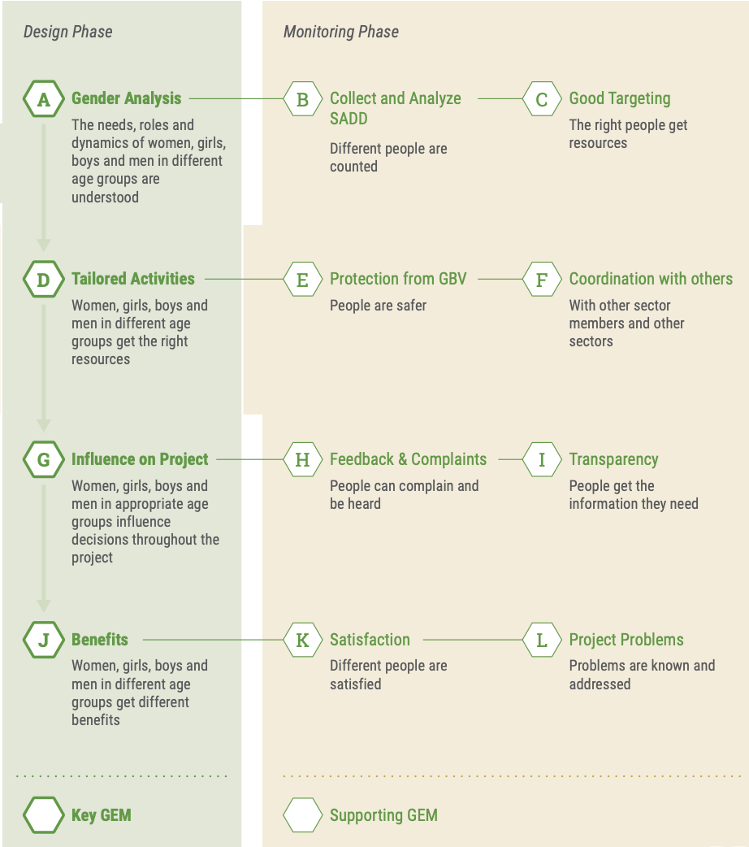
|12 Indicators of Gender Equality Measures (GEMS)
Four key GEMs are considered in the project design phase.
Each of the four key GEMs have two supporting GEMs that are considered during project monitoring. This enables reflection of what is working well in the project and what can be improved.
Good programming requires that affected people participate in and influence all stages of a project.
GEMS Summary
Notes:
The most useful entry point for advisors and focal point to improve attention to gender and inclusion continues to be in reviewing the narratives submitted by projects or clusters, “Briefly describe your gender analysis / your analysis of who is marginalized and why,” in their project/sector GAM Report.
If people cannot describe existing inequalities, they will be unlikely to use this information to tailor their interventions.
Use the dashboard to identify areas for improvement – e.g. more accessible complaints mechanisms, better communication with different groups, or to highlight a potentially underserved age group

Slide 25
|10 Indicators of Good Programming: Gender Equality Measures (GEMs)
Design Phase
Monitoring Phase
A
Gender Analysis
B
Disaggregated Access Data
The issues facing females, males and LGBTI in different age and/or disability groups are understood and described
Different groups of people are able to access assistance
D
Tailored Activities
E
GBV Protection
Females, males, all gender groups of different ages and/or disabilities get the assistance they need
People are safer
G
Influence
H
Feedback & Complaints
I
Communication with Communities
Females and males in appropriate age and/or disability groups influence decisions throughout the project
People can complain and be heard
People get the information they need
J
Benefits
K
Satisfaction
L
Project Problems
Different groups of concern (gender, age, disability) get different benefits; no one will be left behind
Different people are satisfied
Problems are known and addressed
Notes:
The GAM questionnaire asks about 12 key program areas where gender and age differences need to be considered. It works at project level, but is also applied to Cluster response plans, HNOs, HRPs --- the same issues are relevant. 4 elements are reviewed in the project design phase, and all twelve indicators are reviewed 3-6 months later in project monitoring.
The questionnaire still steps users through TEN key elements of good programming, in each case asking about gender, age, and people with disabilities.
Removed GEM C – Good Targeting – this asked about which gender/age groups were getting less than planned, duplicating Monitoring GEM J benefits, “who’s missing out.”
Removed F – Coordination – this asked what kind of information was shared in clusters and how it was disaggregated, and produced unrealistically optimistic responses.
Monitoring GEM B – will now ask about Disaggregated Access Data – what kind of ‘beneficiary’ numbers are being used (actual or population estimates), whether this is analyzed, and how access information is disaggregated (sex, age, persons living with disabilities)

Slide 26
|Can choose and prioritize Gender Equality Measures (GEMs) most relevant
Examples:
Impact on women, girls, boys and men in different age groups:
relative benefits (J), satisfaction (K), consequences/barriers (L)
Accountability & Participation:
Protection:
project influence (G), feedback (H), communication (I)
successful targeting (C) including benefits/satisfaction/ consequences (J,K,L); GBV prevention (E), responsive complaints (H)

Slide 27
|GAM Coding
4 | Addresses GENDER & AGE differences in key programme actions
3 | Addresses only GENDER differences in key programme actions
2 | Addresses only AGE differences in key areas
1 | Key programme actions do not address gender or age differences
0 | Key programme actions are not present

Slide 28
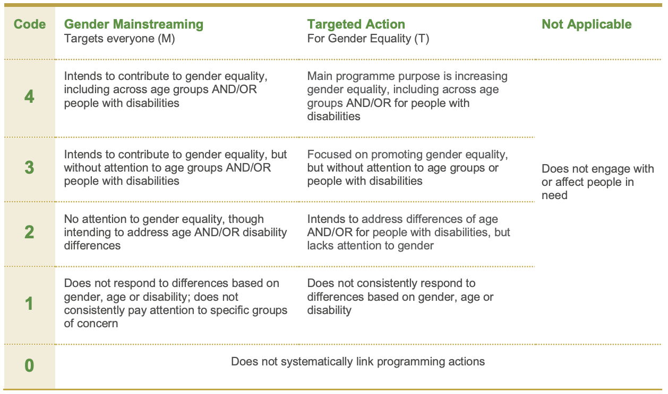
|New GAM coding definitions
New GAM Coding Definitions

Slide 29
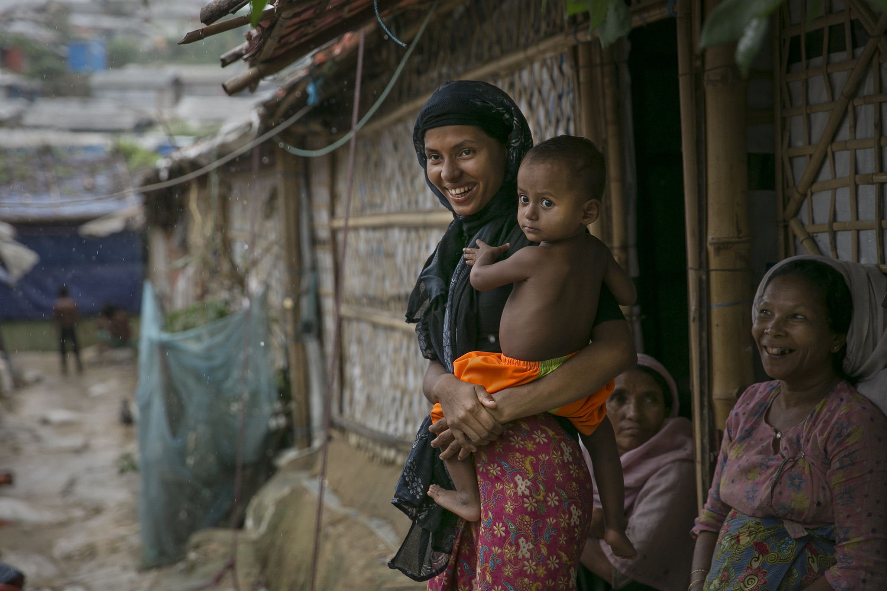
|Available resources to improve GAM application
GAM Sectoral Tipsheets:
CCCM
Child Protection
Coordination
Early Recovery
Education
Food Security
Health
Livelihoods
Nutrition
Protection
Shelter
WASH
Supporting Documents
Guidance Note: Diverse SOGIESC Rapid Assessment Tool to Assess Diverse SOGIESC Inclusion Results in Humanitarian Contexts
GAM Dashboard
Notes:
Guidance Note: Diverse SOGIESC Rapid Assessment Tool to Assess Diverse SOGIESC Inclusion Results in Humanitarian Contexts (developed by Edge Effect)
Provides detailed information on how and when to use the Diverse SOGIESC Rapid Assessment Tool package to facilitate assessment of diverse SOGIESC inclusion of programmes/projects implemented by humanitarian organizations.
The tool requires use of a Survey instrument for collecting data from people with diverse SOGIESC, and spreadsheet-based Questionnaires and Dashboard for deriving a diverse SOGIESC inclusion score.
The tool focuses on five key areas: Pre-emergency marginalization and gender analysis; Inclusion, partnership and leadership; Safety and protection; Shelter and housing; as well as Livelihoods and early recovery.

Slide 30
How to use the IASC Gender with Age Marker (GAM)

Slide 31
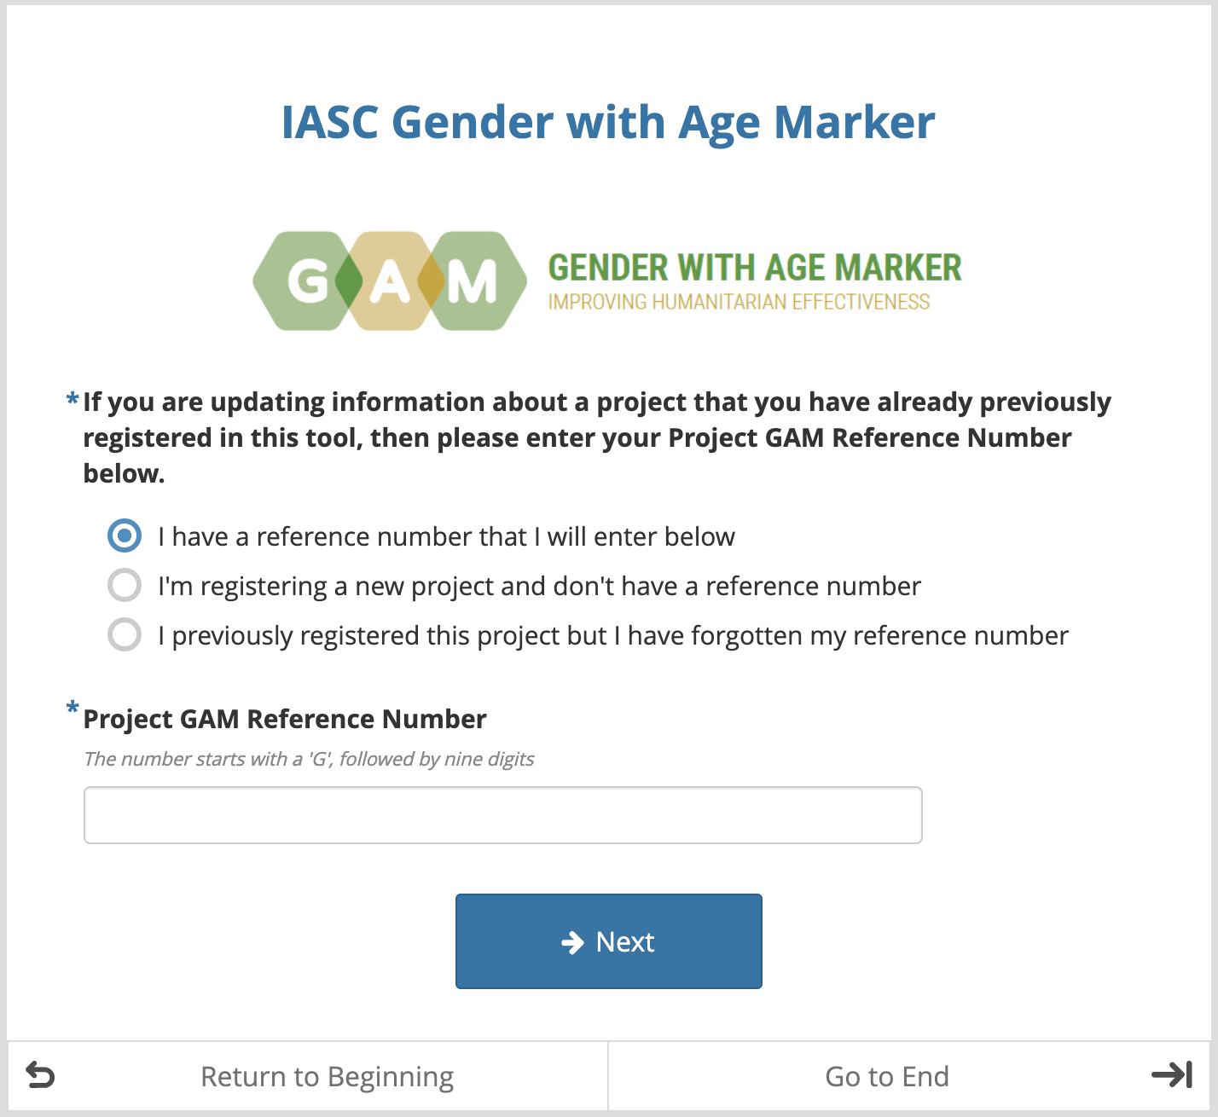
|Accessing the GAM

Slide 32
On 30 January 2020, the World Health Organization (WHO) declared Public Health Emergency of International Concern (PHEIC) for novel coronavirus. As of 1 April 2020, 106,330 cases of COVID-19 have been confirmed in the Myanmar with 2,104 deaths. According to WHO, among the confirmed cases, 59,487 are male (56%) and 46,843 are female (44%). The most affected age group is 20-29 (25.1%) followed by 30-39 (23.9%). More than 53% of the cases continue to be reported from Yangon.
|Case Study

Slide 33
Needs Analysis – done on 1 April 2020 A total of 1,450 individuals participated in the needs analysis in Rakhine state, Myanmar. This includes 920 female (64% of total), 380 male (26%) , and 150 (10%) other non-binary individuals. The breakdown per sector are: 200 individuals are homeless, 190 are urban poor (women and men), 210 solo/young /parents, 150 LGBTQI, 170 youth, 210 persons with disabilities, 140 elderly, 180 community health workers (CHW).
|Case Study

Slide 34
Health: • Women and girls have limited access to health care services in Rakhine. Only 19% of women give birth in professional health facilities compared to 37% nationally, and unsafe abortions are a key cause of maternal mortality, responsible for 15% of all maternal deaths in Rakhine state compared to the national average of 10%. Only 20-25% of the new generation of parents use contraceptives. Women have little decision-making power over sexual matters or the number of spacing children and rely on other women in their household to share knowledge. • A relatively small share of children under 5 have visited a health facility since the start of the crisis. While 71 per cent of children under 1 had visited a health facility since lockdown, only 13 per cent of 4-year olds had visited a health facility.
|Case Study

Slide 35
Health: • 23% of participants were living with HIV and they mentioned losing access to HIV care providers as a result of COVID-19 social isolation measures. People living with HIV, including LGBT people, struggle to access their medication as governments designated their typical points of medication distribution and medical attention as COVID-19 centers, meaning immuno-compromised people would be taking extra risks to go there to retrieve medication, or deprioritised the respective services.
|Case Study

Slide 36
Gender-based violence: • Rakhine state has the highest percentage of ever-pregnant women who have experienced violence during pregnancy (8.6%) among all states and regions of Myanmar. Domestic violence including intimate partner violence (IPV), is the most prevalent form of GBV reported for Rakhine state. The COVID-19 pandemic with its quarantine, isolation and mobility restriction measures can potentially increase the risk of GBV for women and girls as studies from other contexts have shown. Disclosures of GBV cases remains extremely limited in northern Rakhine state due to fear of stigma by survivors within their community, the lack of dedicated and accessible services and a widespread lack of accountability among government agencies. The lack of dedicated female staff in health, security and legal sectors, which is specifically pronounced in northern Rakhine state, pose additional barriers to GBV survivors’ access to services.
|Case Study

Slide 37
Your organization’s project: Establishment of Mobile clinics to support SRH and provide mobile safe spaces for referral and support to GBV survivors in Sittwe, Rakhine state Indicators: Number of pregnant women accessing professional health facilities in mobile clinics Percentage of pregnant women satisfied with antenatal and post-natal care provided in mobile clinics Number of GBV survivors referred to GBV specializing agencies and supported to access other required services
|Case Study

Slide 43
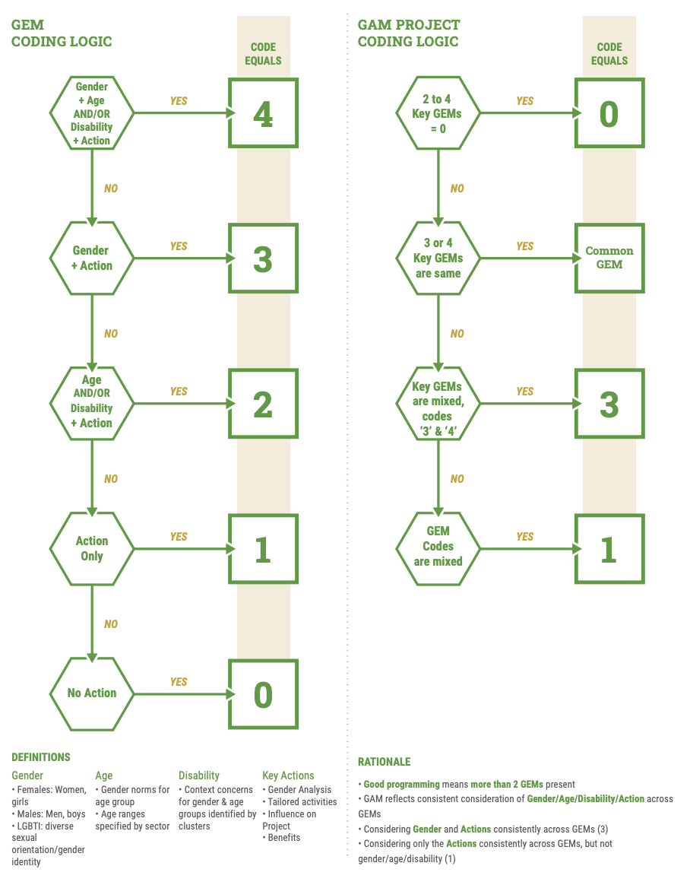

Slide 44
Reflections?

Slide 45
Better programmes do not come from the CODE. . .
They come from REFLECTING on the questions:
It’s about the PROCESS, not the RESULTS!

Slide 46
Q&A

Slide 47
Thank you!

Slide 48
Contact:
Management of the GAM has been handed over to:
OCHA Gender Equality Unit (GEU), iasc-gam@un.org
GenCap Advisor Floods 2022, Pakistan
nusrat@un.org

