Slide 1


Information Gathering & Dissemination Process in Emergency Response
By: Sana Zulfiqar

Slide 2
Content layout
Presenter introduction
Why information management?
What is information management?
Basic principles
Information needs of stakeholders during preparedness phase
Information needs of stakeholders during response phase
Challenges & risks
Recommendations
Key humanitarian information products

Slide 3

Presenter introduction – Sana Zulfiqar
Has significant expertise in humanitarian coordination with efforts mainly focusing on negotiating local civil society space in the humanitarian architecture and advocating localization agenda on national and international platforms. She has done M.Sc. in Communication Sciences and has served in different positions for the last 11 years at Earthquake Reconstruction & Rehabilitation Authority (ERRA), United Nation Volunteer (UNV), National Health Emergency Preparedness Response Network (NHEPRN), National Disaster Management Authority (NDMA), the National Humanitarian Network (NHN). She was awarded volunteer of the year in 2008 by the Government of Pakistan.
For 7 years, she has worked on keys positions in the National Secretariat of NHN Pakistan and played vital role in streamlining the network operational and strategic coordination; facilitated in development of network contingency, preparedness, advocacy and capacity building plans. On her credits, she conceived, designed and facilitated the first digital resource center (DRC) in-country and region as a one knowledge management window to galvanize communication for the humanitarian sector. She facilitated the development of the first national, sector experts roster titled as Surge Emergency Response Team (SERT) in Pakistan, development of Local Charter of Commitment derived from Charter 4 Change for Pakistan under localization agenda and introduced initiatives to capacitate females of local government and civil society as Women Leadership in Emergency Response.
She has also managed and coordinated Pakistan Resilience Partnership (PRP) at the country level and remain communication focal point for Asian Preparedness Partnership (APP) managed by Asian Disaster Preparedness Center (ADPC). Currently, she is working as Project Coordinator at Asian Disaster Preparedness Center (ADPC), Pakistan for Climate Adaptation and Resilience (CARE) for South Asia, initiative.

Slide 4
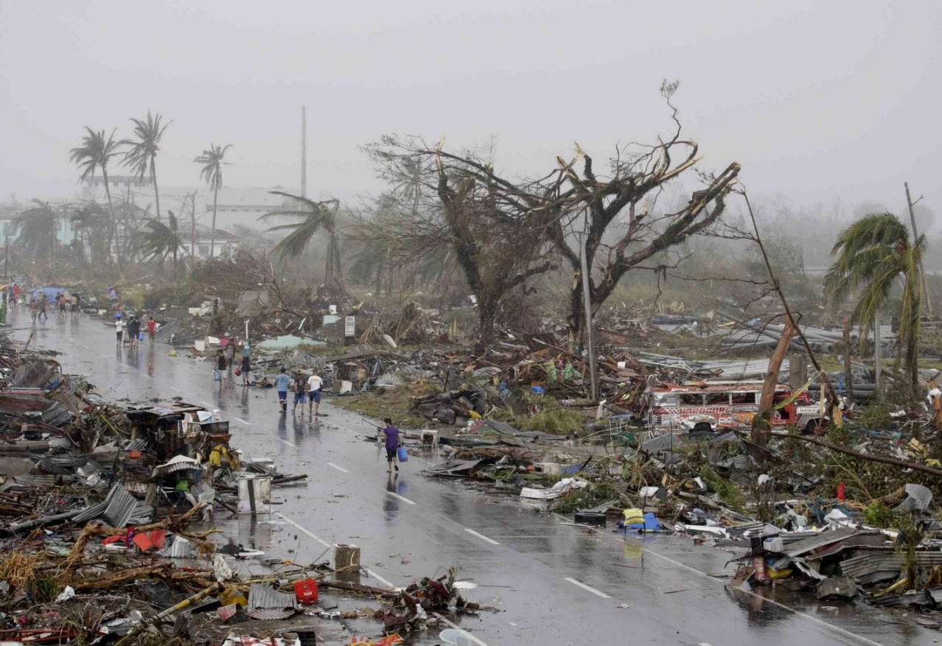
Why
information management?
Typhoon Haiyan Philippines – 8 November 2013

Slide 5
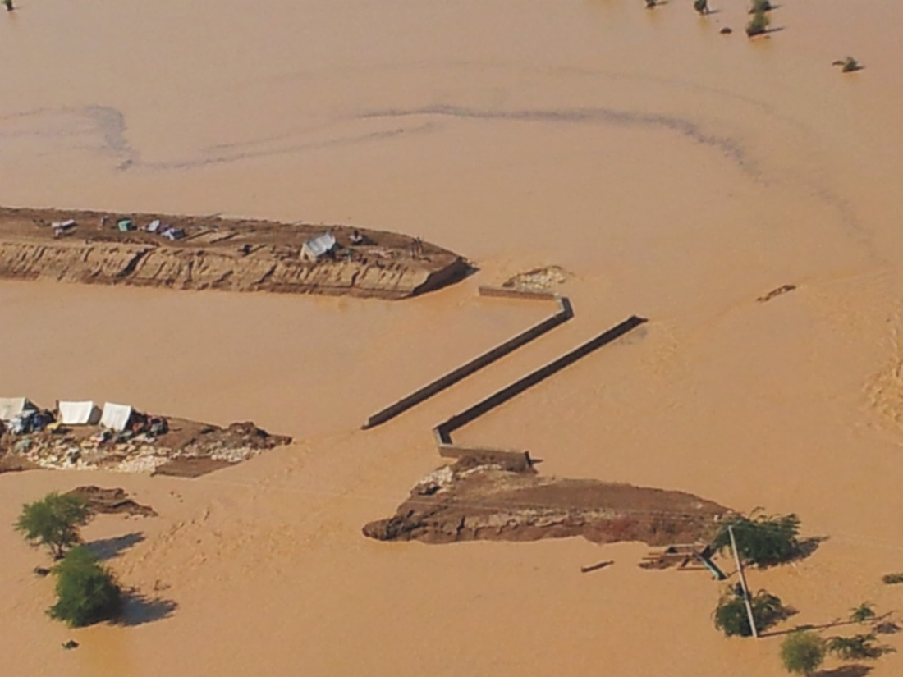
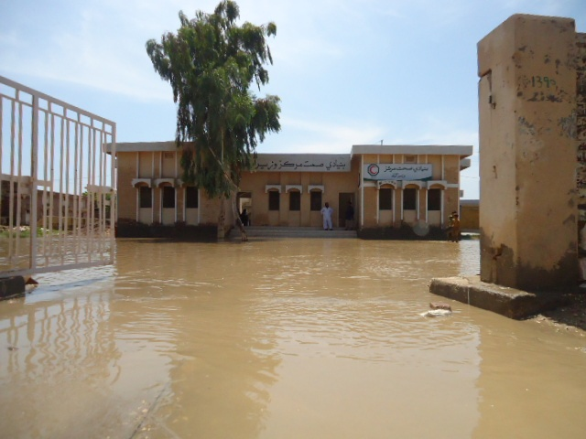
Why information management?
Pakistan - Floods 2012

Slide 6
Why information management?
Case Study: Philippines Floods 2012
Two women were surrounded by flood water.
They called their son for help by mobile phone.
The son turned to Twitter for assistance using the hashtag #rescueph.
Authorities monitored #rescueph messages and saved both the women.

Slide 7
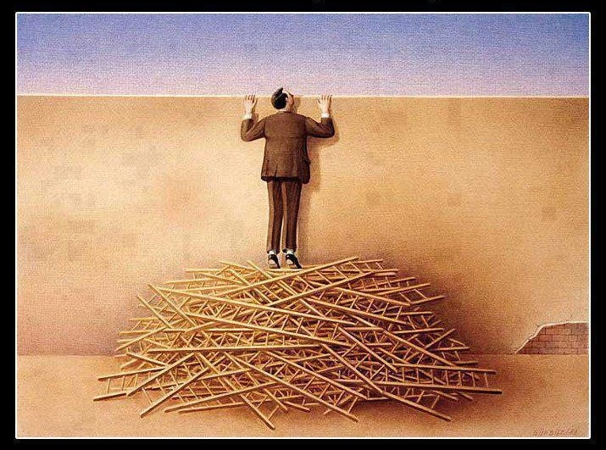
Why information management?
It doesn’t matter how many resources you have
If you don’t know how to use them, it will never be enough.

Slide 8
What
is
information management?
The development and implementation of a systematic approach for
identifying,
collecting,
analyzing
sharing data
for decision support in humanitarian responses.

Slide 9

What is information management?
Primary findings:
  There are more Red and Yellow than any other color
  There is also a large quantity of Blue and White
  Only a smaller quantity of Black, Green, Orange and Lime
Subsequent questions for:
  Why are there more Reds and Yellows?
    Is the color cheaper?
    Is it easier to produce?
    Is it a preference of the customers?

Slide 10
What is information management?
Data
Collection
1
2
Processing
Information
3
Analysis
4
Sharing
Communication
5
Storage

Slide 11

What is information management?
Information Management Cycle
Collection
Compile
Complete and
correct?
Data
NO
YES
Analyse
Complete and
correct?
NO
Information
Common but NOT recommended
YES
Share
No Information is better than Wrong Information

Slide 12
What is information management?
Data
Collect
Process
Activity
Information
Knowledge
Apply
Experience
45,000 L-Water/day is necessary to meet the needs of the population
1,000 people have not enough space because we are over the maximum capacity of the camp
- 3,000 people in Camp A
2 water pumps (10,000L/day) in Camp A
The amount of water available in Camp A is not sufficient
3,000 people exceed the capacity of Camp A, which is 2,000 people
OXFAM install a water pump in 3 days
Org. working in Shelter need to mobilize resources
Org. working in WASH plan new water sources to produce additional 35,000 liters of water/day in camp A

Slide 13
What is information management?
Rules
Priorities
Focus on essential data
KISS (Keep it Simple and Short)
Basic and fast
Perfection is enemy of good
Standards
Use, Review, Improve
There is no magic system
There is no optimized system in the initial version
Review to improve is the only way to create something functional.

Slide 14
What is information management?
Tools
Data
Standardized forms
Communication means
Trained teams
1
Collect
2
Process
Computarized system
Standardized tables
Information
3
Analyse
Graphics
Maps
Reports
4
Share
Communication
Meeting
Media
Websites
5
Store
Information can be generated by anyone, shared with anyone & acted on by anyone

Slide 15
Basic principles
What is information management?
Information
Basic need
Generate Valuable
Shared widely
Shared freely

Slide 16
Information needs of stakeholders during preparedness phase
  Analyze hazards and risks, build scenarios and develop planning assumptions
  Mapping of resources, inventory available stocks, Logistics information (roads, railways, airport/helipads, boats etc.), Emergency relief center, Community Based Committees, Community Based Committees, IM Network
  Training information of Scouts/Razakaar/Civil Defense/Rescue –
  Elevation information/maps
  Socioeconomic characteristics of the population (literacy, economic activity, etc.)
  Security situation of the area
  Contact lists of key stakeholders (rescue services, Pak Army, concern departments, disaster management trained officials, hospitals etc.)
  Early warning system, Preparedness plan/CP at district level
  Assessment tools and methodology and reporting tools

Slide 17
Information needs of stakeholders during response phase
  Mapping/Data collection of Population affected, displaced (with age and sex disaggregation) and infrastructure conditions
  Immediate Needs and gaps analysis
  Logistics situation/roads status and maps
  Security situation of the area
  Information/Communication channels available and functional, V-wireless etc.
  Human resource available including doctors, lady doctors etc.
  Aid arrived and in pipeline
  Reporting mechanism - Information sharing
  Emergency relief center, if not established earlier
  Common web-portal
  IM Network

Slide 18
Stakeholders | Products of their interests
Operational Agencies | Contact list of partners and authorities Generic guidance applied to the context Gaps and needs analysis based on all partners contributions and mapping support Meeting schedule and minutes Policy, Strategic Document Flowcharts/ guidance docs Dashboard, Snapshot Documents available in the country language to allow national partner’s full participation
Government Departments | Contact list of partners, Departments and nominated authorities Policy, Strategic Document Gaps and needs analysis based on all partners contributions and mapping support Meeting schedule and minutes Dashboard, Snapshot Who is doing, What, Where, When (4-W)

Slide 19
Stakeholders | Products of their interests
Operational Agencies | Contact list of partners and authorities Generic guidance applied to the context Gaps and needs analysis based on all partners contributions and mapping support Meeting schedule and minutes Policy, Strategic Document Flowcharts/ guidance docs Dashboard, Snapshot Documents available in the country language to allow national partner’s full participation
Government Departments | Contact list of partners, Departments and nominated authorities Policy, Strategic Document Gaps and needs analysis based on all partners contributions and mapping support Meeting schedule and minutes Dashboard, Snapshot Who is doing, What, Where, When (4-W)

Slide 20
Challenges & Risks
Privacy, ethics and security
Accuracy and utility
Bias
Information overload
Increased expectations

Slide 21
Recommendations
Ethical guidelines
Recognize information
Communicate as basic need
Information availability
Capacity to use information

Slide 22
Key humanitarian information products
Humanitarian Web-portal
http://pakresponse.info (archived)
https://pak.humanitarianresponse.info
Who is doing What, Where and When (4W)
Financial Tracking Service – Expenditure Tracking
http://fts.unocha.org
Online Project System (OPS)
http://ops.unocha.org
Survey of Surveys (SoS)/Assessment Registry https://pak.humanitarianresponse.info/assessment-registry
Humanitarian Dashboard
Snapshot
UC Ranking System
District Profiles
Mapping Products
Mapping Service to Humanitarian Community
Provision of standardized baseline and GIS Data
NHN digital resource center
http://resourcecenter.nhnpakistan.org/
Thank you
Q & As

