Slide 1



Making inclusion a reality in humanitarian response
Age and disability task force-pakistan

Slide 2

The objective of the session
To provide an introduction to humanitarian inclusion standards for older people and people with disabilities

Slide 3
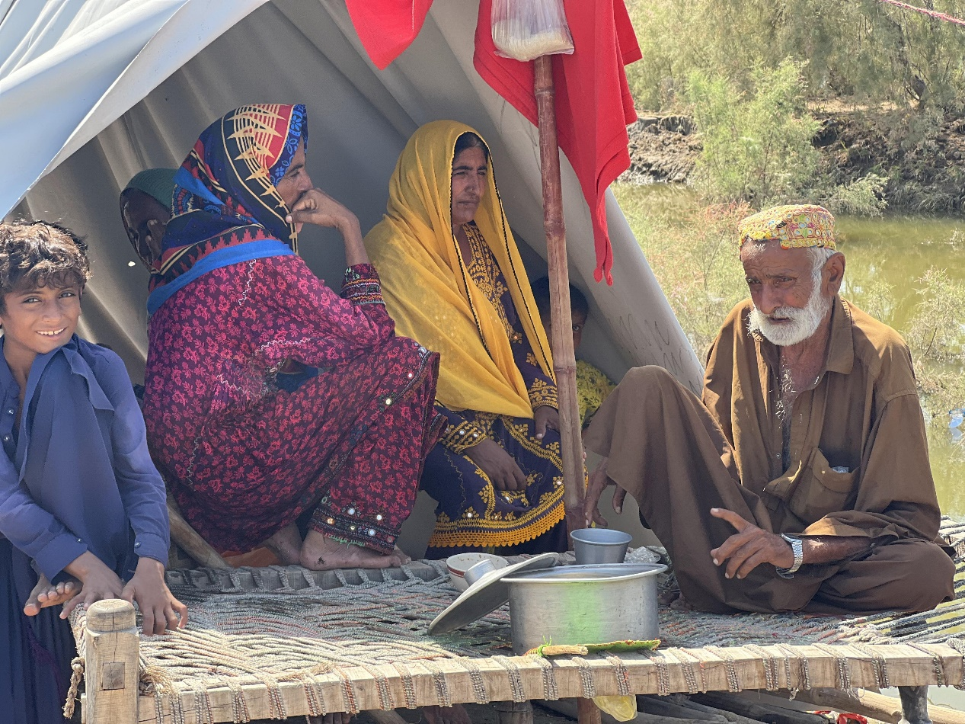
About ADTF
Established in 2010 under the protection cluster
ADTF_Where we are\Position in cluster system

Slide 4
Who is an older person?
The United Nations: Age 60 years.
In many developed countries: The age of 65 is used as a reference point for older persons.
Or the age when older people becomes eligible for older person’s social security benefits.
So, there is no exact definition of "old” as this concept has different meanings in different societies
https://emergency.unhcr.org/entry/43935/older-persons#:~:text=An%20older%20person%20is%20defined,or%20age%2Drelated%20health%20conditions.

Slide 5
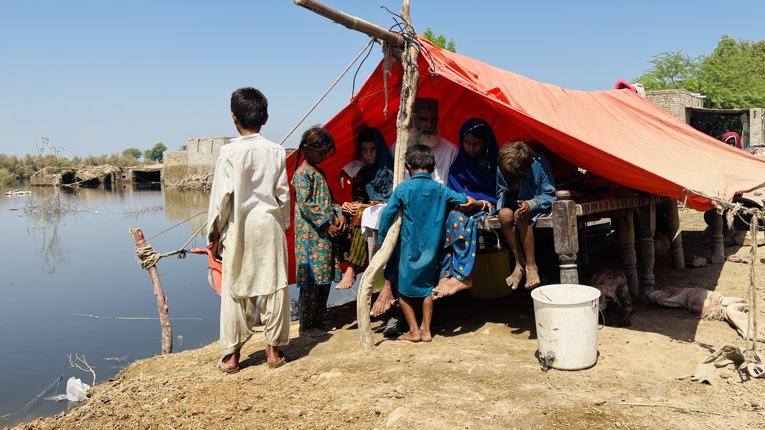
Disability
People with disabilities include women, men, girls and boys with long-term physical, mental, intellectual or sensory impairments which, in interaction with various barriers, may hinder their full and effective participation in society on an equal basis with others
(Article 1 of the UNCRPD).

Slide 6
Intersectionality
Intersectionality is an analytic framework that attempts to identify how interlocking systems of power impact those who are most marginalized in society. Intersectionality considers that the various forms of what it sees as social stratification, such as class, race, sexual orientation, age, disability, and gender, do not exist separately from each other but are complexly interwoven.

Slide 7
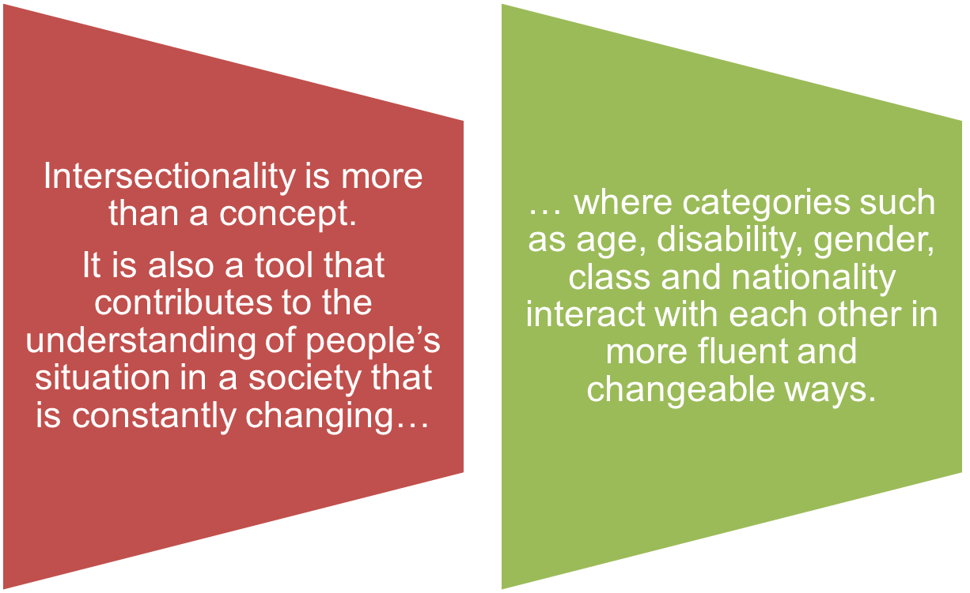
Intersectionality

Slide 8
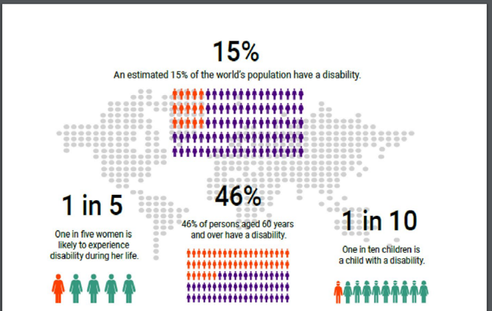

Slide 9

What is Inclusion?

Slide 10
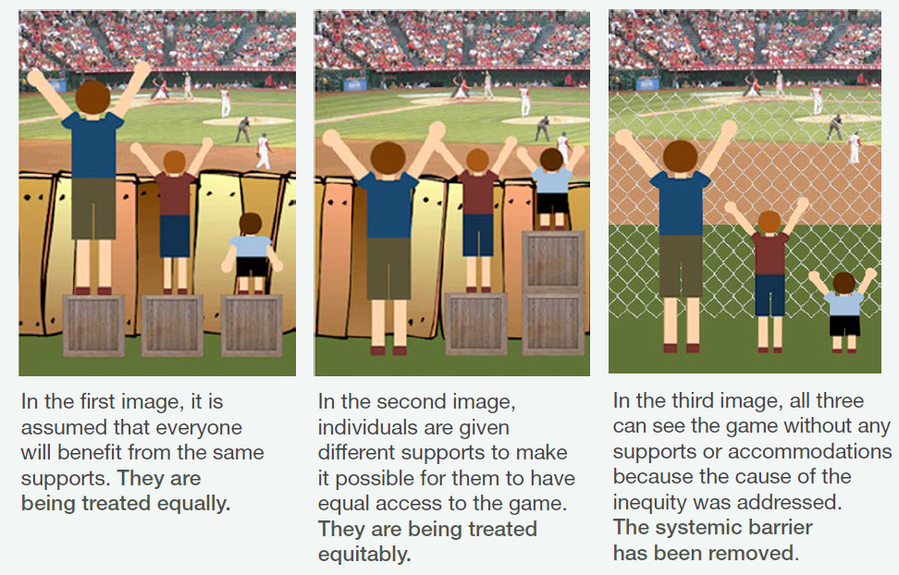

Slide 11
What is inclusion about?
Inclusion means a rights-based approach to community programming, aiming to ensure older people and persons with disabilities have equal access to basic services and a voice in the development and implementation of those services. At the same time, it requires that mainstream organisations make dedicated efforts to address and remove barriers. (IFRC 2015)
International Federation of Red Cross and Red Crescent Societies, All Under One Roof, Disability-inclusive shelter and settlements in emergencies, Geneva, IFRC, 2015, p10 http://bit.ly/2Bt4FCZ

Slide 12
Inclusion Principles
Participation: Ensure older people, persons with disabilities, and or other vulnerable groups are involved in all stages of the programme.
1
Identify and understand the social, economic, environmental and power dynamics contributing to exclusion and who is excluded as a result.
2
Be Aware, question and challenge social norms, attitudes and institutional and remove barriers and create an enabling environment for inclusion.
3
Do No Harm: Consider all the possible effects, positive and negative, of a programmes efforts to be inclusive. We have a responsibility to prevent harm to all people involved.
4
Monitor, review and learn: Collect data, know who does and doesn’t benefit from our work, avoid assumptions; Discrimination and exclusion differs country by country and village by village and can change over time.
5

Slide 13
Inclusion principles to practice
Gender, age and disability inclusion can be achieved to a high standard when organisations commit to putting older men and women and people of all ages with disabilities at the centre of all processes
This means to systematically include older men and women and people of all ages with disability in all organisational policies, procedures and programmes
Identifying and overcoming social, environmental and organisational barriers is the key to inclusion of older men and women and people of all ages with disability
Notes:
Key messages

Slide 14
The Humanitarian Inclusion Standards – where do they fit with other Humanitarian guidance?
.
The Humanitarian inclusion standards for older people and people with disabilities are part of the Humanitarian Standards Partnership (HSP), which includes Sphere and its companion standards.
All HSP standards are based on the Humanitarian Charter and the Core Humanitarian Standard on Quality and Accountability (CHS), and are designed to be used in conjunction with each other.
Complement Protection Mainstreaming, defined by the Global Protection Cluster as the process of incorporating protection principles and promoting meaningful access, safety, and dignity in humanitarian aid

Slide 15
The Humanitarian Inclusion Standards – where do they fit with other Humanitarian guidance?
Humanitarian Charter
Core Humanitarian Standard on Quality and Accountability
Sphere
Humanitarian Standards Partnership (HSP)
Humanitarian inclusion standards
Protection Mainstreaming, under Global Protection Cluster
Notes:
The Humanitarian inclusion standards for older people and people with disabilities are:
Part of the Humanitarian Standards Partnership (HSP), which includes Sphere and its companion standards.
All HSP standards are based on the Humanitarian Charter and the Core Humanitarian Standard on Quality and Accountability (CHS), and designed to be used in conjunction with each other.
Complement Protection Mainstreaming, defined by the Global Protection Cluster as the process of incorporating protection principles and promoting meaningful access, safety and dignity in humanitarian aid

Slide 16
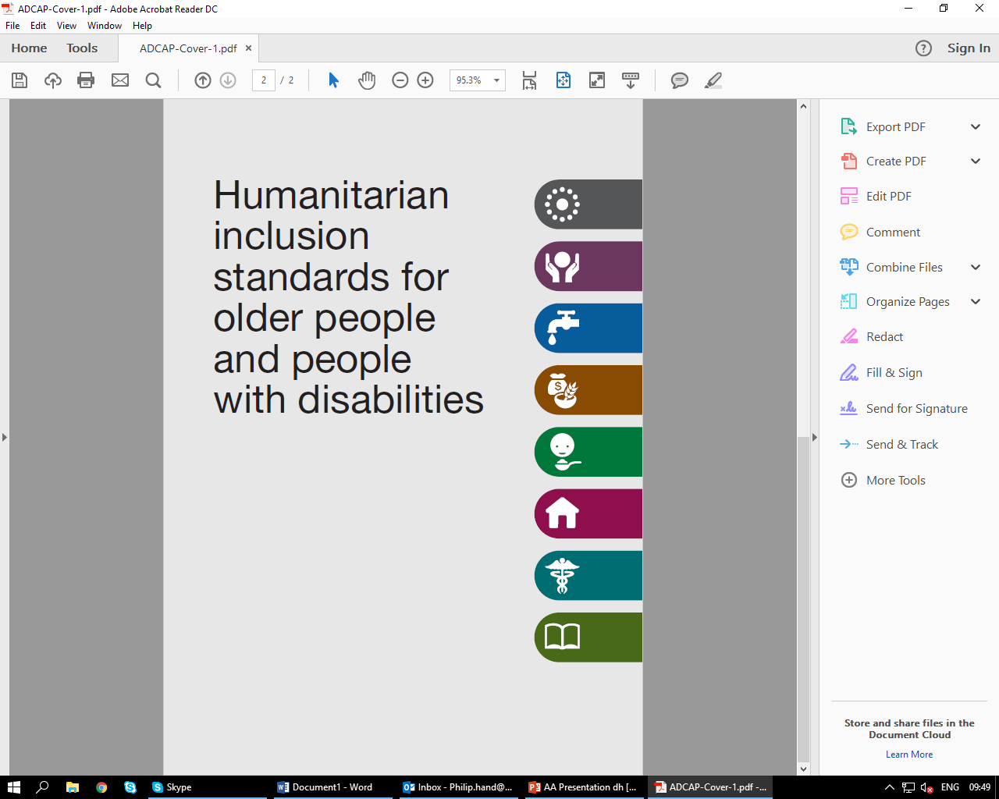
Purpose of the Humanitarian Inclusion Standards
To support the inclusion of older people and people with disabilities in the programmes of all humanitarian organizations.
https://www.youtube.com/watch?v=B3gsp5rbg7k

Slide 17
Humanitarian inclusion standards for older people and people with disabilities
Globally, around 15% of the population live with some kind of disability.
An estimated 13% of people worldwide are over 60 - more than 46% of those have a disability.
Humanitarian principles require that humanitarian assistance and protection are provided based on need, without discrimination.
There is still limited capacity among humanitarian actors to fulfill this commitment and systematically include older people and people with disabilities in humanitarian action.
The Humanitarian inclusion standards for older people and people with disabilities are designed to help address the gap in understanding the needs, capacities, and rights of older people and people with disabilities and promote their inclusion in humanitarian action.

Slide 18
Structure
9 Key inclusion standards, derived from the 9 Commitments of the Core Humanitarian Standard on Quality and Accountability (CHS)
7 sets of sector-specific inclusion standards: protection; water, sanitation, and hygiene; food security and livelihoods; nutrition; shelter, settlement, household items, health, and education.
Chapters contain standards, key actions; guidance notes; tools and resources; case studies.
Sector inclusion standards are structured around three key areas of inclusion:
      1. Data and information management
      2. Addressing barriers
      3. Participation

Slide 19
Principles and complimentary
Standards are underpinned by basic principles:
Humanitarian principles of humanity, impartiality, neutrality, and independence
Non-discrimination
Accessibility
Respect for the inherent dignity of older people and people with disabilities
Active and effective participation and equality of opportunities
Respect for diversity and acceptance of older people and people with disabilities
Equality between people of different genders and age groups.

Slide 20
9 Key inclusion standards
Identification
Safe and equitable access
Resilience
Knowledge and participation
Feedback and complaints
Coordination
Learning
Human resources
Resources development

Slide 21
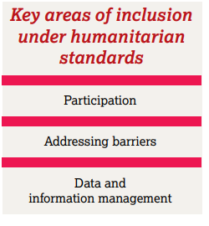
Each key inclusion standard include key actions and guidance notes
Notes:
There are three common components to how it’s understood in humanitarian crises:
Collecting SADD data and using it to inform the design and implementation of the projects
Removing barriers faced by individuals and groups who are marginalised or excluded through patterns of discrimination and denial of rights.
Ensuring people’s equitable involvement and participation in the planning and implementation of humanitarian responses.
See Key Inclusion Standards – HIS https://reliefweb.int/sites/reliefweb.int/files/resources/Humanitarian_inclusion_standards_for_older_people_and_people_with_disabi....pdf

Slide 22
Why Inclusion is important in Humanitarian Action?
Activity 02: Food distribution
Scenario 1

Slide 23
Why is Inclusion important in Humanitarian Action?
Activity 02: Food distribution
Scenario 2

Slide 24
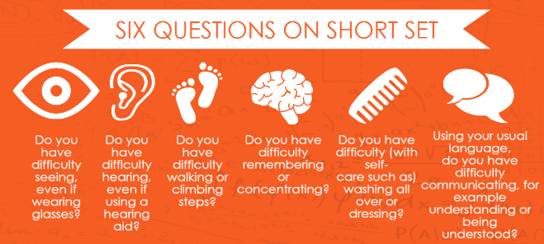
Application of inclusion standards in projects
Collecting Sex, Age and Disability Disaggregated Data-SADDD
4 answer categories for each question:
(1) No difficulties (2)Yes some difficulties (3) Yes a lot of difficulties (4) Cannot do it at all
Age Cohorts: 0-5, 6-12, 13-17, 18-29, 30-39, 40-49, 50-59, 60-69, 70-79, and 80+.

Slide 25
Putting in a format for basic information
Example of a database

Slide 26
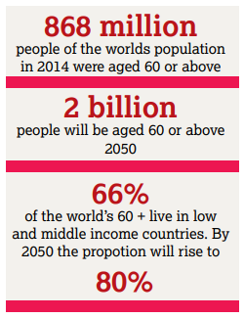
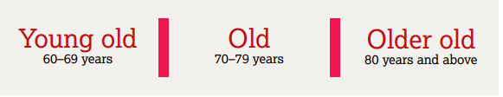
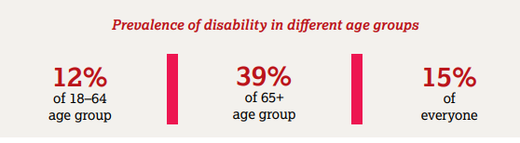
Make the data sex, age and disability disaggregated !
Notes:
With these concerns – how do we start to address some of the challenges to ensure older people are actively participating and included in DRR and humanitarian response ? Some key steps start with data – as shared earlier … and we need to be sure this is standardised across the data collection activities . We also need to use the Washington Group questions in assuring we have sex, age and disability disaggregated data to use and analyse in preparedness, etc – if we know the levels of need and participation in a community then we should know how to be best prepared to protect and save lives .

Slide 27
Meaningful participation
Engaging Older People Associations-OPAs and organizations of Persons with Disabilities-OPDs in needs assessment, planning, implementation and monitoring, and evaluation.
Reduce prejudice and stigma related to older people at the local level (Committee members aged up to 40 only) to address barriers to participation.
Empower OPAs and OPDs at the local level through establishing their networks and supporting legislation. Example senior citizen act in Pakistan

Slide 28
Removing barriers
Ensure that the services are accessible for older persons and older persons with disabilities
Ensure access to your office and service through adopting RECU principles
Ensure access evaluation is conducted for the service points
Follow guidelines https://hhot.cbm.org/en/

Slide 29
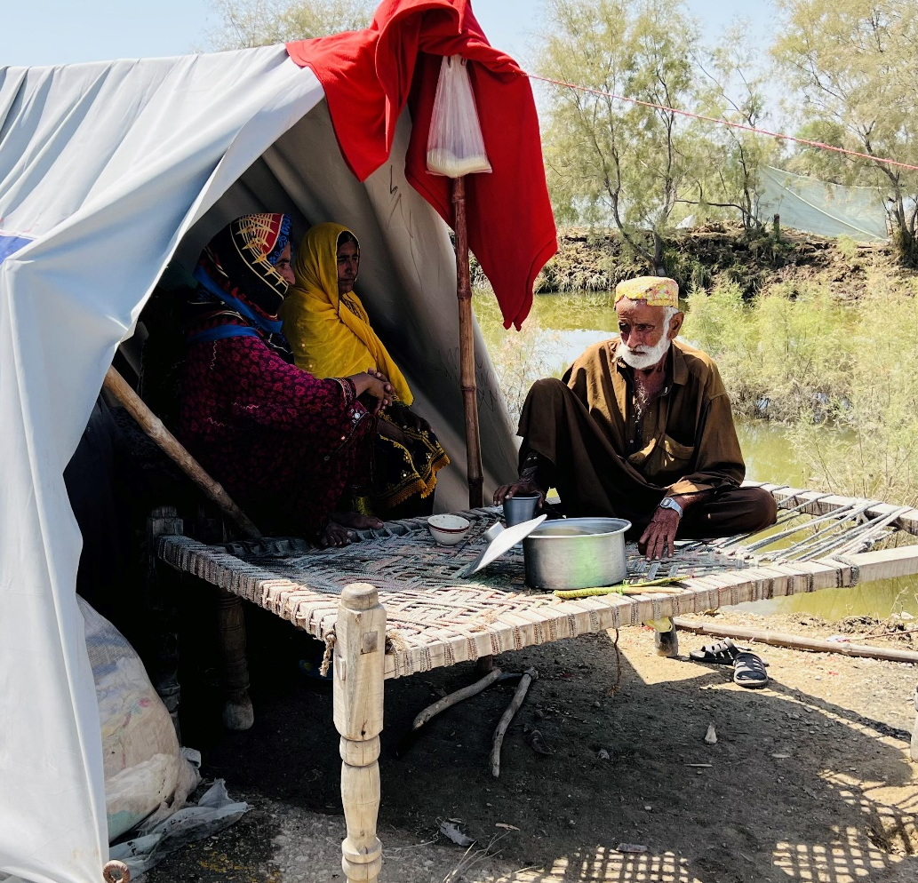
Challenges in flood response
Data is not disaggregated with Age and disability by using internationally recognized standards
Older person and persons with disabilities of all ages have lost their mobility products
Accessibility to humanitarian services
Meaningful participation in the project cycle

Slide 30
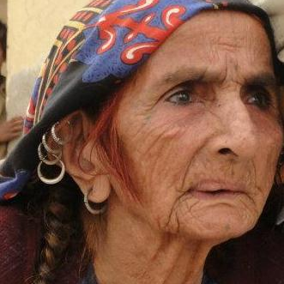
Recommendations/ADTF plan
Include specific questions and consult older men and women during your needs assessment. Inclusion of older people in Emergency Needs Assessment-Short Course, SADDD-Minimum Standards and Guidance
Age and disability-sensitive sample size
Separate FGDs
Collecting Sex, Age, and Disability Disaggregated data (use age cohorts according to the HIS)

Slide 31
Recommendations/ADTF plan
Training of humanitarian actors on Humanitarian Inclusion Standards for older people and persons with disabilities
All humanitarian actors understand and should identify the specific risks and needs of older people in humanitarian response
ADTF will continue collaboration with NHN, PHF, GCC, OPDs, OPAs, and PWG
ADTF is developing a package on identifying and reducing risks related to older persons and persons with disabilities in all different sectors and will plan capacity building and on-the-job coaching

Slide 32
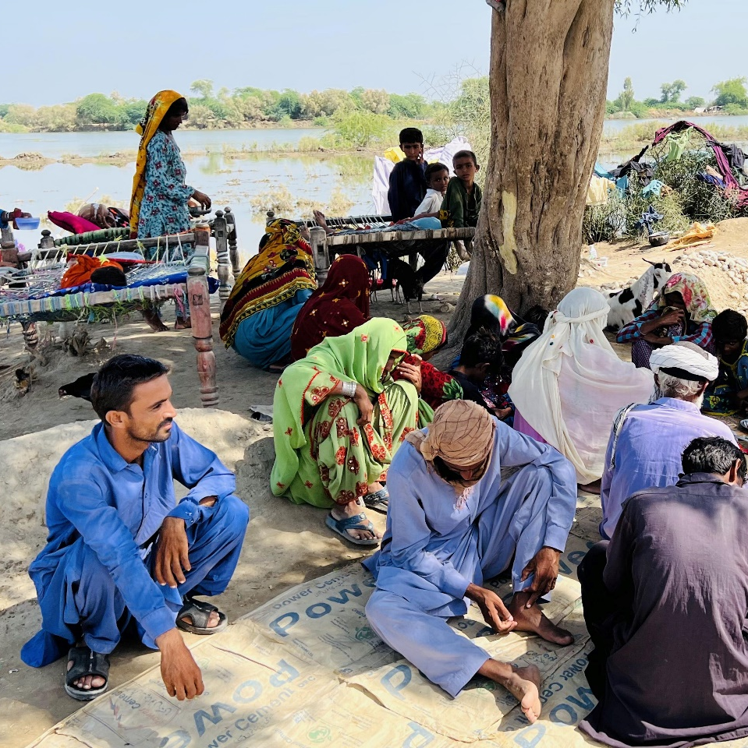
Recommendations/ADTF plan
Capacity sharing with OPAs and OPDs
Online and in-person sessions at the provincial and district level through ADTF member organizations

Slide 33
Please help us in improving inclusion of older people and people with disabilities in flood response in Pakistan by filling the Survey on inclusion of older people and persons with disabilities

Slide 34
Thank you!

