Slide 1
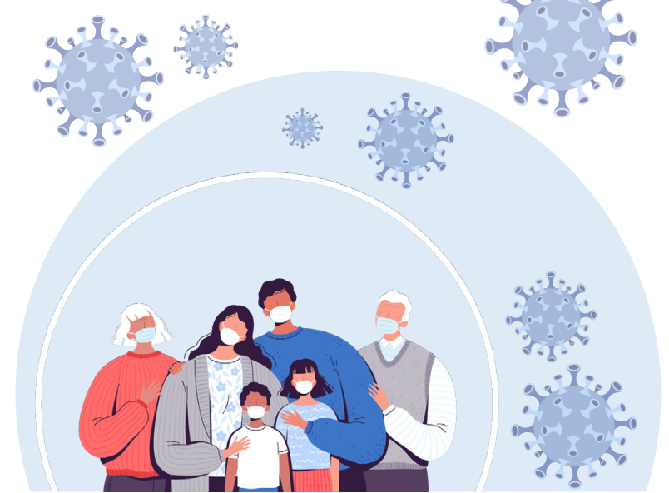
Universal COVID-19 Immunization Program

Slide 2
Presentation Overview
National Vaccinataion update
Review COVID vaccine basics
Who Are We Vaccinating?
Booster dose policy

Slide 3
Vaccination Update

Slide 4
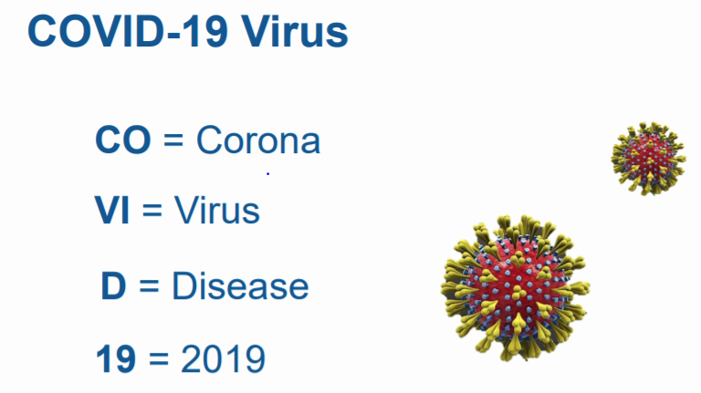

Slide 5
COVID-19 vaccination is a safer way to build protection
COVID-19 and Vaccine Basics
COVID-19 and Vaccine Basics
Getting the virus that causes COVID-19 may offer some natural protection, known as an antibody or immune. But experts don’t know how long this protection lasts.
The risk of severe illness and death from COVID-19 far outweighs any benefits of natural immunity.
COVID-19 vaccination will help protect you by building immunity without the risk of severe illness.
Notes:
COVID-19 vaccination is a safer way to help build protection. Getting the virus that causes COVID-19 may offer some natural protection, known as immunity. But experts don’t know how long this protection lasts, and the risk of severe illness and death from COVID-19 far outweighs any benefits of natural immunity. COVID-19 vaccination will help protect you.

Slide 6
Key facts about COVID-19 vaccination
COVID-19 and Vaccine Basics
COVID-19 and Vaccine Basics
Getting vaccinated can help prevent getting sick with COVID-19
People who have already gotten sick with COVID-19 may still benefit from getting vaccinated
COVID-19 vaccines cannot give you COVID-19
COVID-19 vaccines will not cause you to test positive on COVID-19 viral tests*
https://www.cdc.gov/coronavirus/2019-ncov/vaccines/about-vaccines/vaccine-myths.html
*https://www.cdc.gov/coronavirus/2019-ncov/hcp/testing-overview.html
Notes:
It is easy to be confused by all the information that is circulating, some of which may be conflicting. CDC has facts to counteract common myths on this page, such as:
COVID-19 vaccines will not give you COVID-19
People who have gotten sick with COVID-19 may still benefit from getting vaccinated
Getting vaccinated can help prevent getting sick with COVID-19
COVID-19 vaccines will not cause you to test positive on COVID-19 viral tests*
Please visit: https://www.cdc.gov/coronavirus/2019-ncov/vaccines/about-vaccines/vaccine-myths.html to read more about these vaccine myths and the facts about COVID-19 vaccine from CDC.
NOTE: While COVID-19 vaccination will not cause a positive result on viral tests, there is a possibility that it could cause a positive result on a serologic (antibody) test.

Slide 7
COVID-19 vaccination will help protect you from COVID-19
COVID-19 and Vaccine Basics
COVID-19 and Vaccine Basics
Getting a COVID-19 vaccine...
Will help create an immune response in your body against the virus
May help keep you from getting severely ill, even if you do get COVID-19
Notes:
COVID-19 vaccination will help keep you from getting COVID-19. Getting a COVID-19 vaccine will help create an immune response in your body against the virus without your having to experience illness. Based on what is known about vaccines for other diseases, experts believe that getting a COVID-19 vaccine may help keep you from getting seriously ill even if you do get COVID-19.

Slide 8
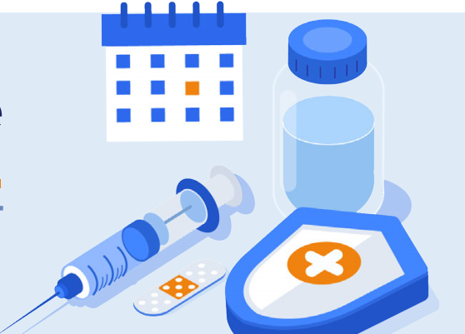
COVID-19 VACCINATION SAVES LIVES
Vaccination reduces the risks of infection, especially severe infection that leads to hospitalization
This will help keep our hospitals and healthcare facilities from being overwhelmed
Notes:
Sources:
https://www.cdc.gov/vaccines/hcp/conversations/understanding-vacc-work.html
https://www.cdc.gov/vaccines/vpd/vpd-vac-basics.html

Slide 9
What is a vaccine and how does it work?
Vaccines prevent diseases that can be dangerous, or even deadly. They work with your body’s natural defenses to safely develop protection from a disease.
A vaccine helps your immune system to produce antibodies, just like it would if you were exposed to the disease. After getting vaccinated, you have protection from that disease, without having to get the disease first.
This is what makes vaccines such powerful medicine. Unlike most medicines, which treat or cure diseases, vaccines prevent them.
Notes:
Sources:
https://www.cdc.gov/vaccines/hcp/conversations/understanding-vacc-work.html
https://www.cdc.gov/vaccines/vpd/vpd-vac-basics.html

Slide 10
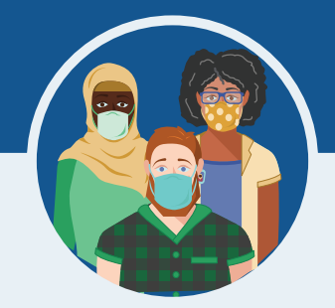
What are the benefits of getting a COVID-19 vaccine?
COVID-19 vaccination will help keep you from getting sick from COVID-19
All COVID-19 vaccines available have been shown to be very effective
The combination of getting vaccinated and following WHO recommendations to protect yourself and others will offer the best protection from COVID-19
The more people who get vaccinated, the faster we can get back to our normal lives
Notes:
We understand that some people may be concerned about getting vaccinated. While more COVID-19 vaccines are being developed as quickly as possible, routine processes and procedures remain in place to ensure the safety of any vaccine that is authorized or approved for use.
Safety is a top priority, and there are many reasons to get vaccinated.

Slide 11
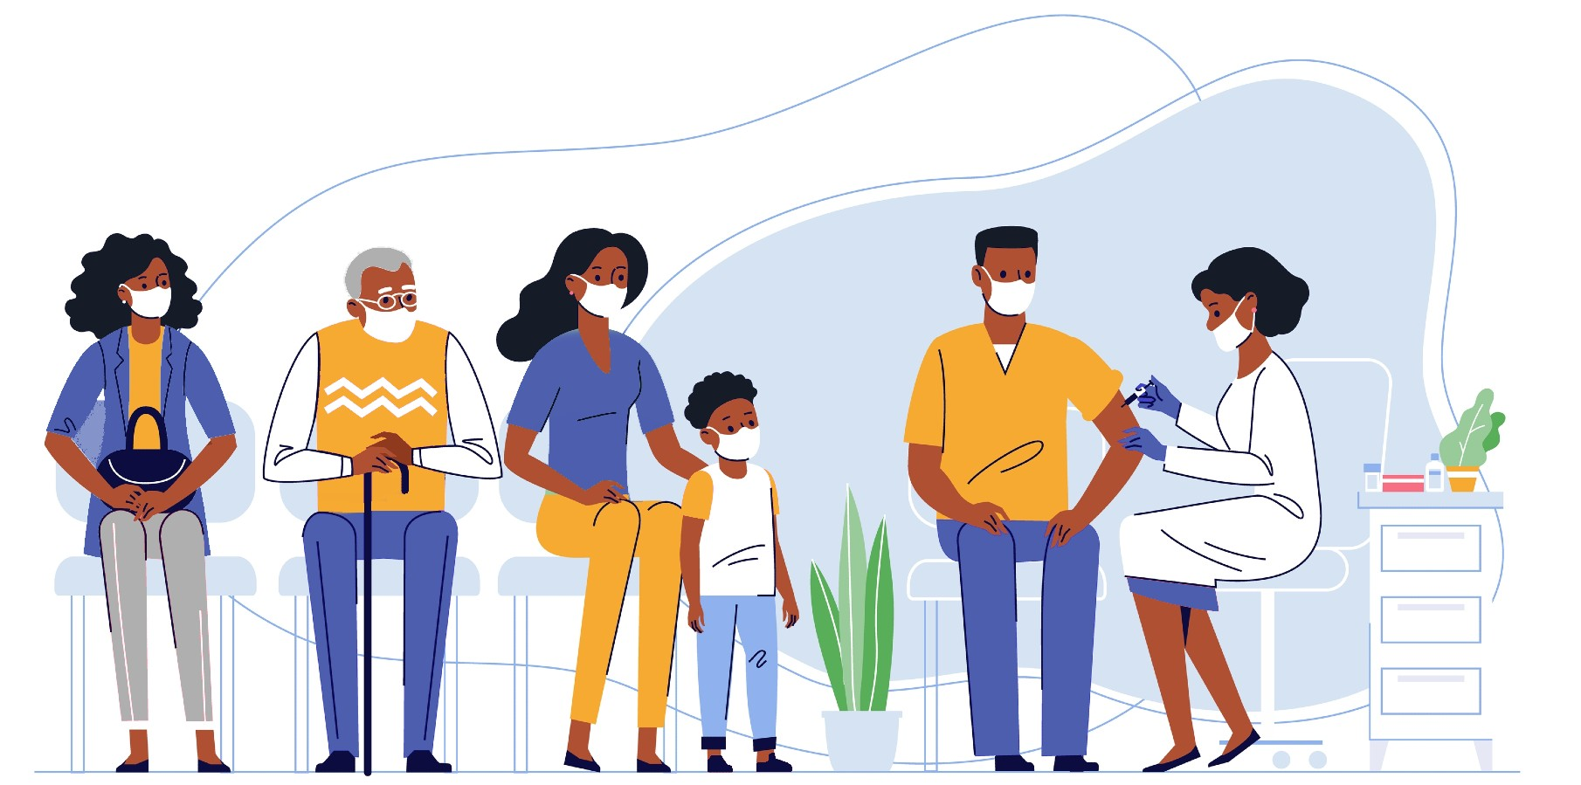
Who may get COVID-19 vaccines?
Everyone 12 years of age and older – including those who are pregnant and recently pregnant/breastfeeding – is recommended to get a COVID-19 vaccination.
Get a COVID-19 vaccine as soon as you can to protect from yourself and your loved ones from COVID.

Slide 12
Who we are vaccinating?
Everyone 5 years of age and older – including those who are pregnant and recently pregnant/breastfeeding – is recommended to get a COVID-19 vaccination
\Get a COVID-19 vaccine as soon as you can to protect from yourself and your loved ones from COVID.

Slide 13
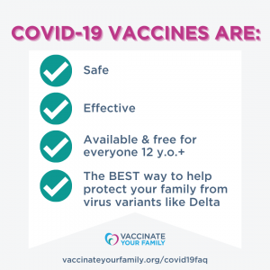
Which Vaccine are available?
There are now Following COVID-19 vaccines that have been authorized and recommended for use in Pakistan
Sinopharm
Sinovac
Cansino
Pakvac
Pfizer
Moderna
Astrazinica
All these COVID-19 vaccines have been shown to be safe and highly effective at preventing serious illness, hospitalization and death due to COVID-19 (including the Delta variant)

Slide 14
The COVID-19 vaccines are safe for most people 18 years and older, including those with pre-existing conditions of any kind, including auto-immune disorders
These conditions include: hypertension, diabetes, asthma, pulmonary, liver and kidney disease, as well as chronic infections that are stable and controlled
If supplies are limited in your area, discuss your situation with your care provider if you:
Have a compromised immune system
Are pregnant or nursing your baby
Have a history of severe allergies, particularly to a vaccine (or any of the ingredients in the vaccine)
Are severely frail

Slide 15
General Public - All 12+ Citizens Register yourself by sending your CNIC no to 1166 (free sms) from any mobile no or visit nims.nadra.gov.pk and just walk-in to nearest centre for vaccination. (Only Pfizer vaccine will be administered to age group 12 to 18 years.
2nd Dose - Message to Citizens will be sent automatically 48/24 hours before the due date from 1166.
Immunocompromised (unvaccinated). Unvaccinated immuno-compromised individuals of 12 years and above will be vaccinated with Pfizer vaccine ONLY (free of cost) as per instructions already issued earlier
12-18 years will be free of cost with Pfizer if individual is unvaccinated. However, additional dose(s) will be charged.
All 18+ yrs. Pfizer or Sinopharm or Sinovac (as per country requirement on payment).
Additional dose(s) of vaccine will be administered at individual’s risk. In case of children below 18 years of age, at parent’s / guardian’s risk.

Slide 16
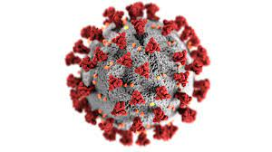
What COVID-19 Vaccines have the risk of getting COVID-19?
No COVID-19 vaccine is made using the whole killed or weakened viruses
One vaccine is made with a piece of the COVID virus, and two are mRNA vaccines and made with no virus
None of the vaccines can give a person COVID-19
All three COVID-19 vaccines protect people by making their body recognize a piece of the outside of the COVID-19 virus called the “spike protein”
The red knobs are the
“spike protein”

Slide 17
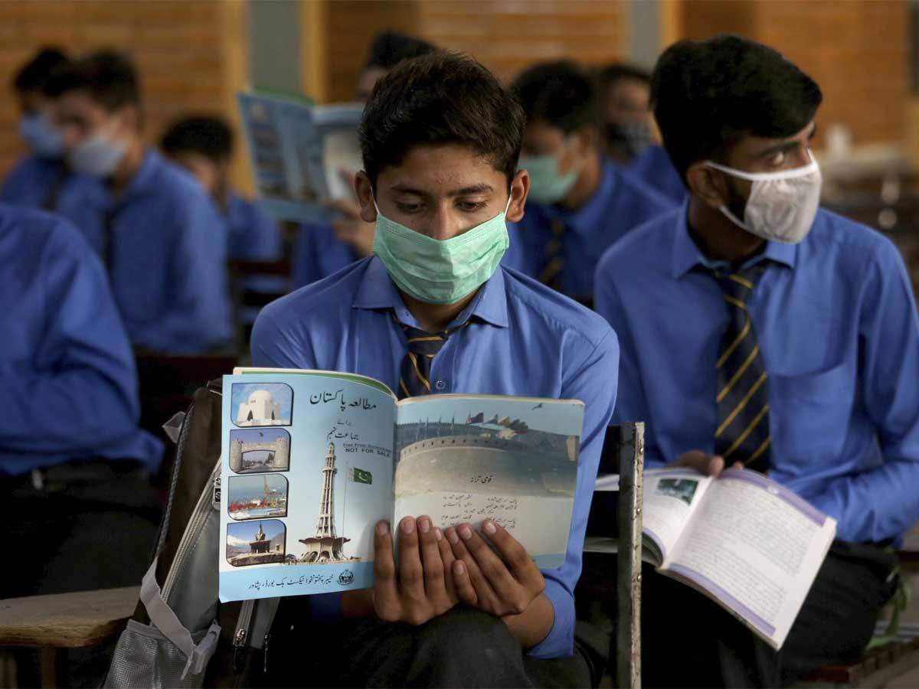
COVID Vaccine for Children 12-17 Years Old

Slide 18
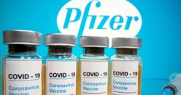
Pfizer and Moderna COVID-19 Vaccines
Use messenger RNA (mRNA)
mRNA is a protein that:
Gives a body instructions to recognize the COVID virus that causes the disease and to kill it before it can make you sick
mRNA is not DNA, and does not interact or change an individual’s DNA in any way

Slide 19
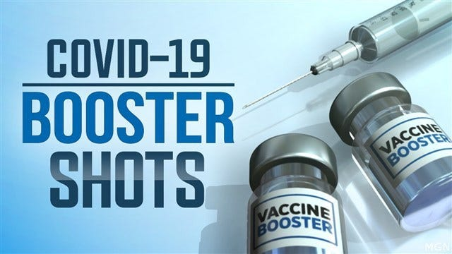
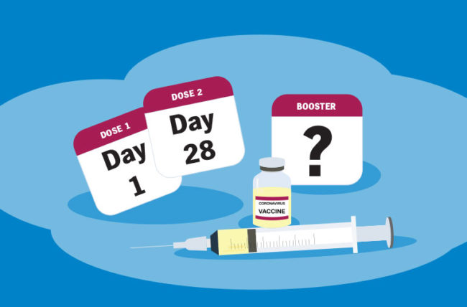

Slide 20
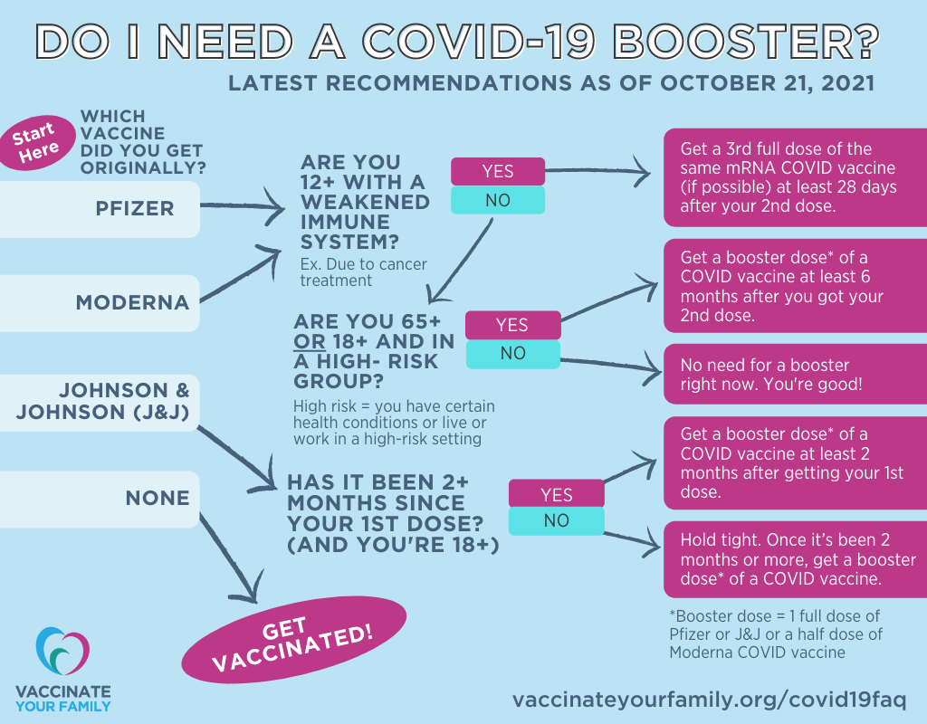

Slide 21
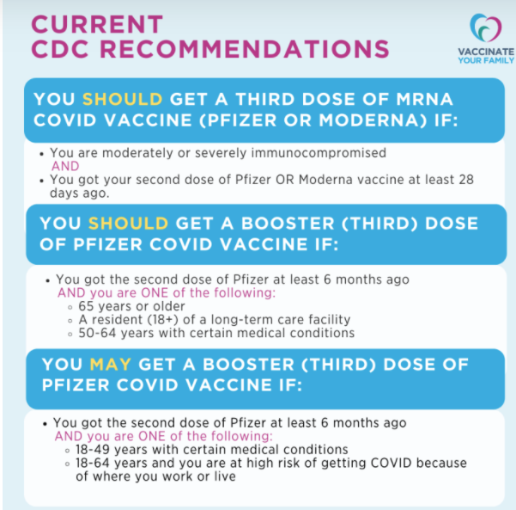
Do I Need a Third Dose of mRNA Vaccine (Pfizer or Moderna) OR a Pfizer Booster Dose?
At this time, there are 2 different recommendations from the CDC:
People who are moderately or severely immunocompromised AND who got vaccinated with a mRNA vaccine (Moderna or Pfizer), should get a third dose of the same COVID vaccine at least 28 days after the second dose.
Certain people who got the Pfizer vaccine (at least 6 months ago) AND are considered to be at high risk of getting a COVID-19 infection or getting serious COVID illness should (or can) get a booster dose of Pfizer vaccine.
At this time, people who got the Moderna or Johnson & Johnson vaccine are NOT recommended to get a booster dose. Stay tuned for more coming soon.
All COVID vaccines (Pfizer, Moderna and Johnson & J0hnson) continue to provide very good protection against severe COVID illness, hospitalization, and death, even during our current surge of the Delta variant.
Notes:
The following individuals are now eligible for a booster dose of Pfizer 6 months after their second shot:
People 65 years and older
Residents of long term care settings
People aged 18–64 years with underlying medical conditions as defined by the CDC: https://www.cdc.gov/coronavirus/2019-ncov/need-extra-precautions/people-with-medical-conditions.html
People aged 18-64 years who are at increased risk for COVID-19 exposure and transmission because of their occupational or institutional setting
You need to get the same brand of vaccine for the booster.
You are still considered fully vaccinated if you do not receive a booster shot.
The side effects following the booster are similar to those after the second dose.
You can get a COVID-19 vaccine and other vaccinations like a flu or shingles vaccine at the same time or close together.
For answers to more commonly asked questions about boosters, visit: https://www.mass.gov/info-details/covid-19-booster-frequently-asked-questions

Slide 23
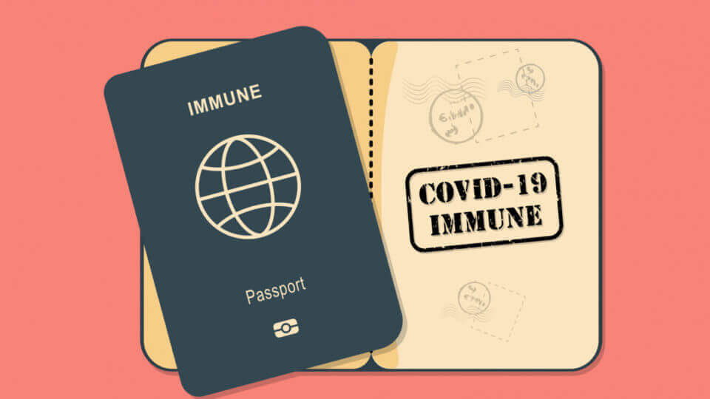
COVID-19 vaccine for travelers

Slide 24
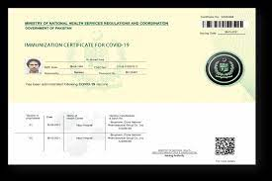
The National Command and Operation Centre (NCOC) announced on Tuesday that all air passengers, including those on incoming and outgoing international flights, would need to be fully vaccinated against Covid-19 by Sep 30
Only fully vaccinated people will be allowed to travel domestically and internationally from Sep 30. The same condition applies to incoming passengers
Full vaccination by Oct 15 is compulsory to use public transport facilities
Additional Dose(s) for Travelers. International travelers, 12 years of age and above with mandatory requirement of specific vaccine can get additional dose (s).

Slide 25
Who Should NOT Get Vaccinated with these Vaccines?
People with a severe allergic reaction (anaphylaxis) to any component of COVID-19 vaccine should NOT receive vaccine
If You Are Allergic to Polyethylene Glycol (PEG) or Polysorbate: PEG is an ingredient in the mRNA vaccines (Pfizer and Moderna), and polysorbate is an ingredient in the Johnson & Johnson (J&J)/Janssen vaccine. If you are allergic to PEG, you should not get an mRNA COVID-19 vaccine
People with a severe allergic reaction (anaphylaxis) to any vaccine or injectable (intramuscular or intravenous) medication should consult with their health provider to assess risk prior to receiving the COVID-19 vaccine

Slide 26
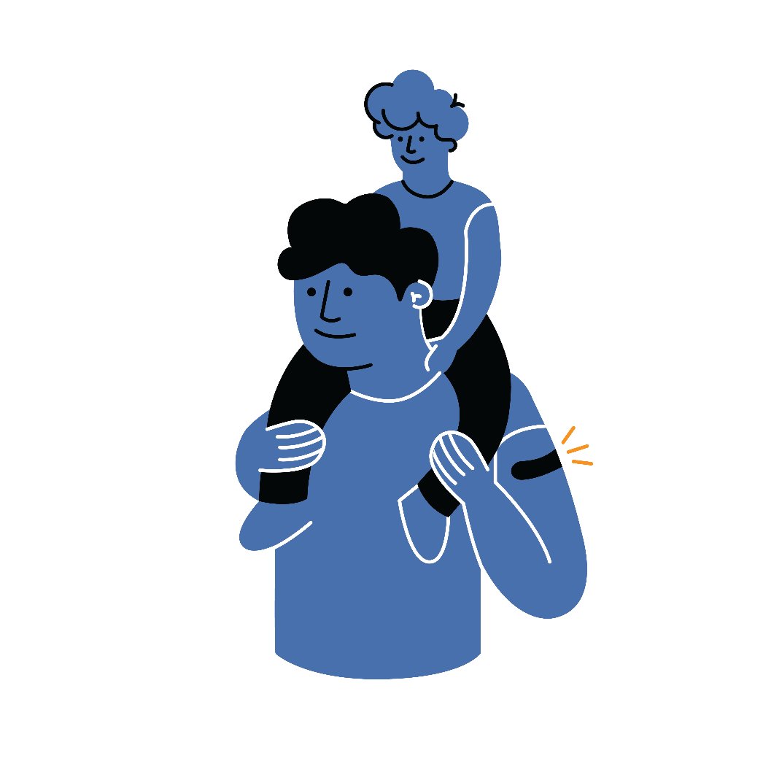
Vaccination is one measure to help stop the pandemic
COVID-19 and Vaccine Basics
COVID-19 and Vaccine Basics
While COVID-19 mRNA vaccines appear to be highly effective, additional preventive tools remain important to limit the spread of COVID-19.
The combination of getting vaccinated and following CDC/WHO recommendations to protect yourself and others offers the best protection from COVID-19.
Cover your nose and mouth with a mask.
Stay at least 6 feet from people who don’t live with you.
Avoid crowds and poorly ventilated indoor spaces.
Wash your hands.
Notes:
COVID-19 vaccination will be an important tool to help stop the pandemic, but it continues to be one tool in the toolbox. While COVID-19 mRNA vaccines appear to be highly effective, additional preventive tools remain important to limit the spread of COVID-19. The combination of getting vaccinated and following CDC’s recommendations to protect yourself and others will offer the best protection from COVID-19. Wash your hands. Avoid close contact. Cover your nose and mouth with a mask. Clean and disinfect frequently touched surfaces. Stopping a pandemic requires using all the tools we have available.
It will take time to vaccinate all people living in the United States. While the vaccines are being delivered, it's important that everyone continue to take all steps (wear a mask, avoid close contact with others, and wash your hands) to prevent spread of COVID-19.

Slide 27
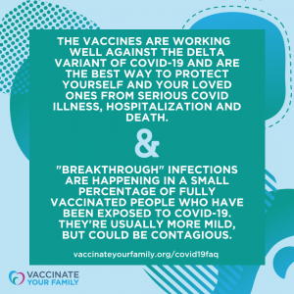
If you are fully vaccinated against COVID
Getting Vaccinated
If you get COVID, you will most likely only get a mild or moderate case of COVID-19, if you get it at all
However, if you do get infected, you may also spread the virus that causes COVID to others, even if you don’t feel sick
New data shows that vaccinated people appear to spread the virus for a shorter time
The vaccine helps protect you against serious COVID illness, hospitalization and death
You will be less likely to spread the virus to others because you’re less likely to be infected with COVID in the first place
If you have a condition or are taking medications that weaken your immune system, you may not be protected even if you are fully vaccinated
You should continue to take all precautions recommended for unvaccinated people, including wearing a well-fitted mask
Notes:
If you experience a fever after vaccination, you should stay home from work if you can. Most side effects after vaccination do not last very long. The vaccine does not give you COVID-19. However, you could have been exposed to the virus before you were vaccinated, so if you continue to feel sick, you should consider getting a COVID-19 test. CDC and FDA encourage the public to report possible side effects to the Vaccine Adverse Event Reporting System (VAERS). CDC is also implementing a new smartphone-based tool called v-safe to check in on people’s health after they receive a COVID-19 vaccine. If you enroll in v-safe, you can tell CDC if you have any side effects after getting a COVID-19 vaccine. If you report serious side effects, someone from CDC will call to follow up.

Slide 28
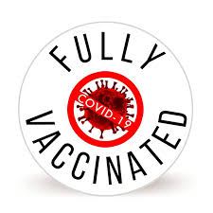
When to declare fully vaccinated against COVID?
Getting Vaccinated
2 weeks after their second dose in a 2-dose series, or
2 weeks after a single-dose vaccine
It takes time for your body to build immunity against COVID after getting the vaccine, so if it has been less than 2 weeks since your COVID-19 shot, or if you still need to get your second dose, you are NOT protected.
Notes:
If you experience a fever after vaccination, you should stay home from work if you can. Most side effects after vaccination do not last very long. The vaccine does not give you COVID-19. However, you could have been exposed to the virus before you were vaccinated, so if you continue to feel sick, you should consider getting a COVID-19 test. CDC and FDA encourage the public to report possible side effects to the Vaccine Adverse Event Reporting System (VAERS). CDC is also implementing a new smartphone-based tool called v-safe to check in on people’s health after they receive a COVID-19 vaccine. If you enroll in v-safe, you can tell CDC if you have any side effects after getting a COVID-19 vaccine. If you report serious side effects, someone from CDC will call to follow up.

Slide 29
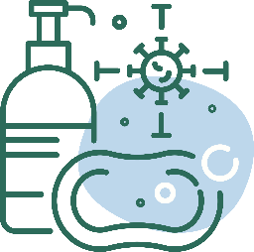
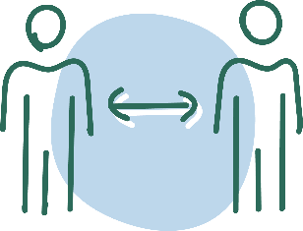
After Vaccination
COVID-19 and Vaccine Basics
Getting Vaccinated
Continue COVID-19 prevention measures:
Cover your nose and mouth with a mask.
Stay at least 6 feet from people who don’t live with you.
Avoid crowds and poorly ventilated spaces.
Wash your hands.
Clean and disinfect frequently touched surfaces.
Enroll in v-safe
If you have questions about your health and vaccination, call your doctor, nurse, or clinic.
Notes:
If you experience a fever after vaccination, you should stay home from work if you can. Most side effects after vaccination do not last very long. The vaccine does not give you COVID-19. However, you could have been exposed to the virus before you were vaccinated, so if you continue to feel sick, you should consider getting a COVID-19 test. CDC and FDA encourage the public to report possible side effects to the Vaccine Adverse Event Reporting System (VAERS). CDC is also implementing a new smartphone-based tool called v-safe to check in on people’s health after they receive a COVID-19 vaccine. If you enroll in v-safe, you can tell CDC if you have any side effects after getting a COVID-19 vaccine. If you report serious side effects, someone from CDC will call to follow up.

Slide 30
